Slide 1
BASIC BIOCHEMISTRY
Lession 1: Introduction to Biochemistry
Professor Dr. Md. Rezaul Karim-2
Department of Biochemistry and Molecular Biology
University of Rajshahi
Phone: 01755391731
Email: drmrkarim@yahoo.com

Slide 4
BIOCHEMISTRY & MEDICINE
Biochemistry and medicine enjoy a mutually cooperative relationship.
Biochemical studies have illuminated many aspects of health and disease, and the study of various aspects of health and disease has opened up new areas of biochemistry.
The medical relevance of biochemistry both in normal and abnormal situations is emphasized.
Biochemistry makes significant contributions to the fields of cell biology, physiology, immunology, microbiology, pharmacology, and toxicology, as well as the fields of inflammation, cell injury, and cancer.
These close relationships emphasize that life, as we know it, depends on biochemical reactions and processes.

Slide 5
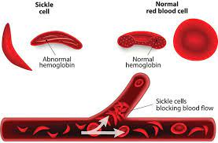
Contd.
A two-way street connects biochemistry and medicine. Knowledge of the biochemical topics listed above the green line of the diagram (Shown below) has clarified our understanding of the diseases shown below the green line.
Conversely, analyses of the diseases have casted light on many areas of biochemistry. Note that sickle cell anemia is a genetic disease, and that both atherosclerosis and diabetes mellitus have genetic components.

Slide 6
Contd.
In pathology, the study of how aberrant biochemistry relates to disease conditions in the human body, physicians can use biochemical analysis.
All diseases have a molecular basis, so biochemistry enables us to analyze the chemical processes involved in diseased conditions to confirm predictions based on patient testimony.
Diabetes, hyperammonemia, hypo- and hyperthyroidism, jaundice, kidney dysfunction, hypercholesterolemia, phenylketonuria, sickle cell anaemia, dental fluorosis, rickets, acidosis and alkalosis, lysosomal storage diseases, atherosclerosis etc.
With information gleaned from the chemical nature of pathologies, biochemists working in medicine are able to investigate potential treatments for diseases.
The action of a drug almost always involves some change in the biochemical processes taking place in the body. As such, pharmacologists must also be acquainted with the biochemical aspects of the human body. In pharmacy, biochemical testing provides indispensable insights into a drug’s mode of action, half-life, storage conditions, metabolism, potential toxic or adverse effects

Slide 7
BIOCHEMISTRY AND AGRICULTURE
To evaluate nutritive value of cereals, pulses, poultry and cattle feed.
Development and exploitation of better genotypes.
Removal and inactivation of toxic or anti nutritional factors present in food grains in general and grain legumes in particular by breeding and chemical treatments. e.g. BOAA in Lakh dal, Trypsin inhibitors of soybean, Aflatoxins of groundnut.
Food preservation and processing technology and post-harvest physiology of fruit crops and vegetables and their nutritional quality.
Biochemistry of disease and pest resistance.
Biochemistry of drought resistance, proline and hydroxyproline imparts drought resistance to Jowar.
Formulation of balanced diet
Use of nonconventional sources of protein foods viz., single cell proteins, fish protein concentrates, mushrooms and leaf proteins.
9) Developments in the field of inter mediatory metabolism i.e. synthesis and degradation of constituents of living tissues.

Slide 8
Biochemistry and Agriculture
Agriculture
Knowledge of biochemistry is very important for understanding the biochemistry of crops and medicinal plants. Plant biochemistry studies can help students to become agricultural scientists in the future. Agricultural scientists work on developing high yielding crops, disease-resistant crops, isolating medicinal compounds from plants.
On gaining knowledge in plant tissue culture techniques students can set up their own farms and nurseries.
Food Industry
Biochemists can help nutritionists, as they can describe different aspects of health related to food consumption; the nutrients value of food material can also be determined by biochemical tests. Proper measurement of carbohydrates, proteins, and fats can be done.
Food Analyst jobs are now available in different private sectors. They can find out adulterants mixed in diverse types of food items.
A food security officer is a very important job prospect for present biochemistry students. The responsibility of a food security officer is to perform the processes towards the elimination of hunger and ensuring food security and nutrition for all human beings.

Slide 9
Biochemistry and Industry
In Industrial Biochemistry is a degree programme in biotechnology. It focuses upon the study of living cells (or components of living cells) and the medical/industrial applications of such substances.
In Industrial Biochemistry is a degree programme in biotechnology. It focuses upon the study of living cells (or components of living cells) and the medical/industrial applications of such substances.
Plant molecular Biotechnology can aid in agroindustry by increasing food production
Food and drug industry mostly depends on Biochemical analysis and evaluation of quality of foods and drugs.

Slide 10
Biochemistry and the Environment
Our environment consists of air, water, soil and many other things around us associated with our day-to-day life.
With an increasing use of technology life becomes easier, while technology in turn adds some harmful components to our daily life.
As a result, air, water, soil and food get poluted and affect our life adversely.
Biochemistry is the branch of Science that can be applied to detect all sorts of pollution, measure their harmful effect on life and take precautionary measure to save life.
Examples of air pollution include increasing CO2, CFC, volatile insecticide, pesticide, electromagnetic field, sound, UV radiation, resulting in complicated diseases.
In this way, water and soil are being polluted by industrial waste, insecticide, pesticide and are being consumed through water and food chain leading to the development of cancer and vital organ damage.

Slide 11
Principal areas of Biochemistry

Slide 23
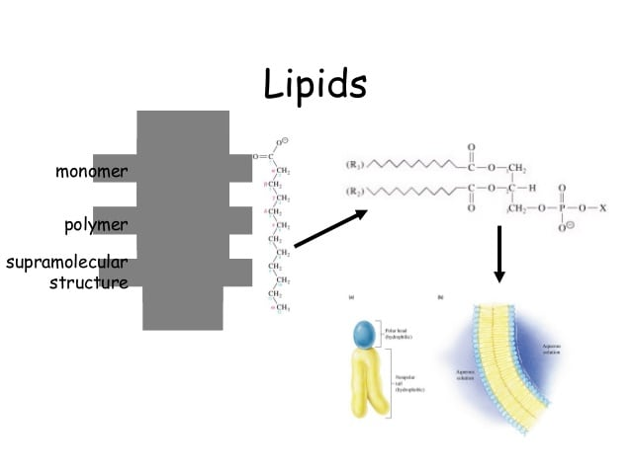

Slide 25
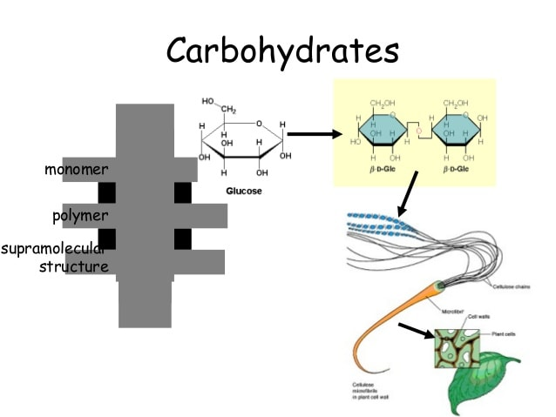

Slide 28
