Slide 1
Central Dogma of Molecular Biology
REPLICATION
Md. Abdur Rakib, PhD
Professor
Department of Biochemistry and Molecular Biology
University of Rajshahi

Slide 2
Molecular Biology
Molecular biology is the branch of biology that studies the molecular basis of biological activity. Living things are made of chemicals just as non-living things are, so a molecular biologist studies how molecules interact with one another in living organisms to perform the functions of life.

Slide 3
Central Dogma of Molecular Biology
In molecular biology, central dogma explain the flow of genetic information from DNA to RNA to protein.
It is defined as a process in which the information in DNA is converted into a functional product
“Central dogma is the process in which the genetic information flows from DNA to RNA, to make a functional product protein.“

Slide 4
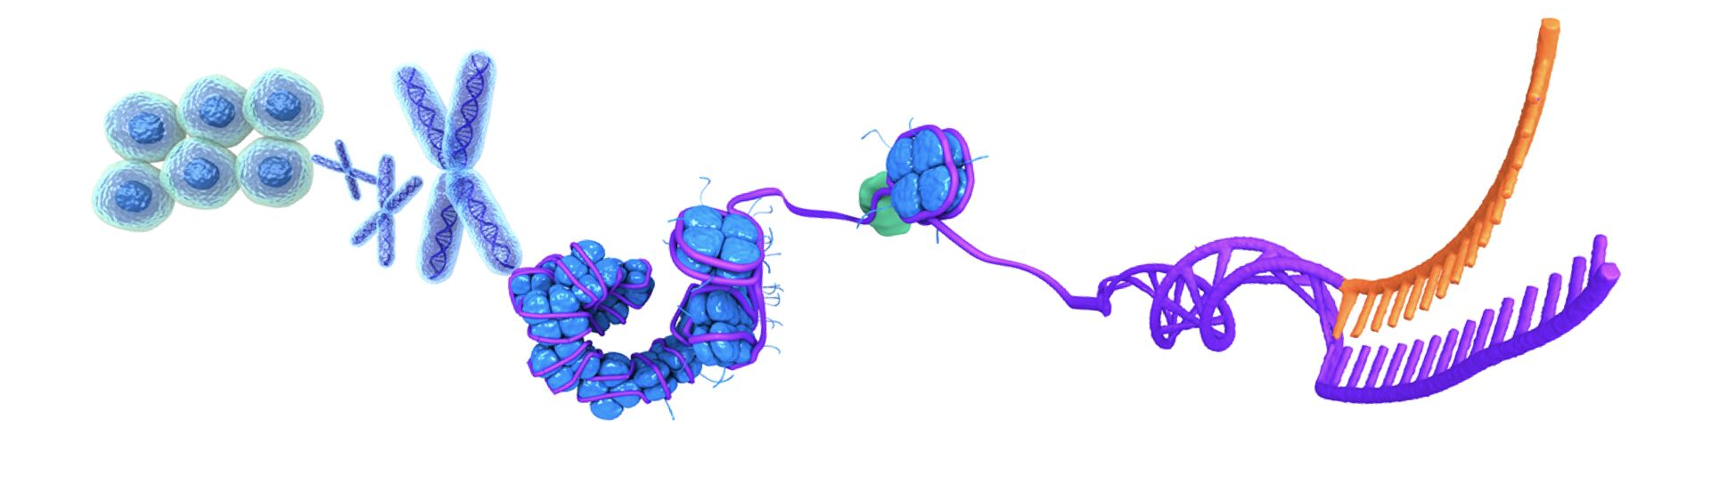
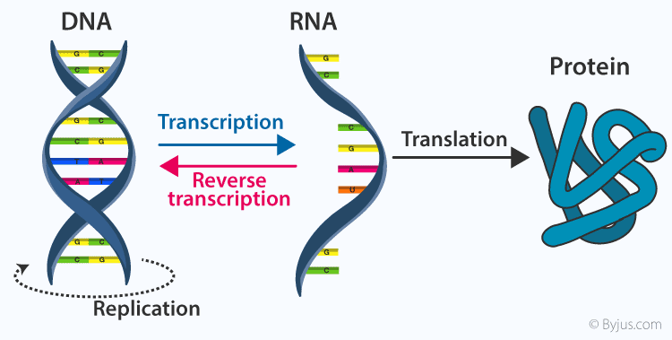
Central Dogma of Molecular Biology
The central dogma of molecular biology, comprising the three major processes in the cellular utilization of genetic information.
The first is replication, the copying of parental DNA to form daughter DNA molecules with identical nucleotide sequences.
The second is transcription, the process by which parts of the genetic message encoded in DNA are copied precisely into RNA.
The third is translation, whereby the genetic message encoded in messenger RNA is translated on the ribosomes into a polypeptide with a particular sequence of amino acids

Slide 5
Replication
Genetic Information must be accurately copied every time a cell divides.
A huge amount of genetic information and an enormous number of cell divisions are required to produce a multicellular adult organism; even a low rate of error during copying would be catastrophic.
A single-celled human zygote contains 6.4 billion base pairs of DNA.
If a copying error were made only once per million base pairs, 6400 mistakes would be made every time a cell divided—errors that would be compounded at each of the millions of cell divisions that take place in human development.
Not only must the copying of DNA be astoundingly accurate, it must also take place at breakneck speed. The single, circular chromosome of E. coli contains about 4.6 million base pairs. At a rate of more than 1000 nucleotides per minute, replication of the entire chromosome would require almost 3 days. Yet, as already stated, these bacteria are capable of dividing every 20 minutes. E. coli actually replicates its DNA at a rate of 1000 nucleotides per second, with less than one error in a billion nucleotides. How is this extraordinarily accurate and rapid process accomplished?

Slide 6
Replication
DNA is the genetic material. When the cell divides, the daughter cells receive an identical copy of genetic information from the parent cell.
Replication is a process in which DNA copies itself to produce identical daughter molecules of DNA.
Replication is carried out with high fidelity which is essential for the survival of the species.
Synthesis of a new DNA molecule is a complex process involving a series of steps.

Slide 7
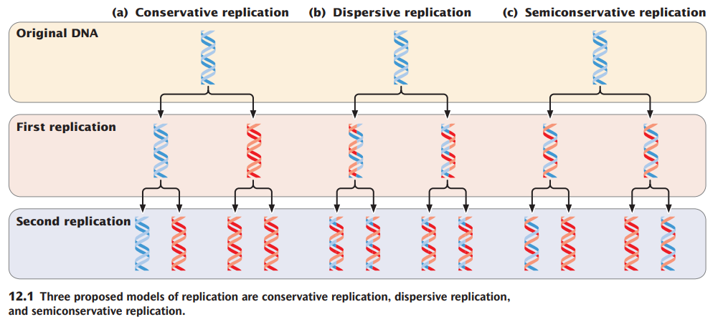
All DNA replication takes place in a semiconservative manner
In dispersive replication (Figure 12.1b), both nucleotide strands break down (disperse) into fragments, which serve as templates for the synthesis of new DNA fragments, and then somehow reassemble into two complete DNA molecules. In this model, each resulting DNA molecule is interspersed with fragments of old and new DNA; none of the original molecule is conserved.
Initially, three models were proposed for DNA replication.
In conservative replication (Figure 12.1a), the entire double-stranded DNA molecule serves as a template for a whole new molecule of DNA, and the original DNA molecule is fully conserved during replication.
Semiconservative replication (Figure 12.1c) is intermediate between these two models; the two nucleotide strands unwind and each serves as a template for a new DNA molecule.

Slide 8
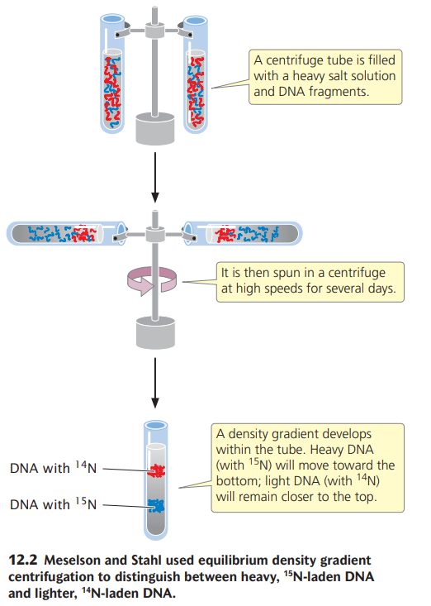
Meselson and Stahl demonstrated that DNA replication is semiconservative.

Slide 9
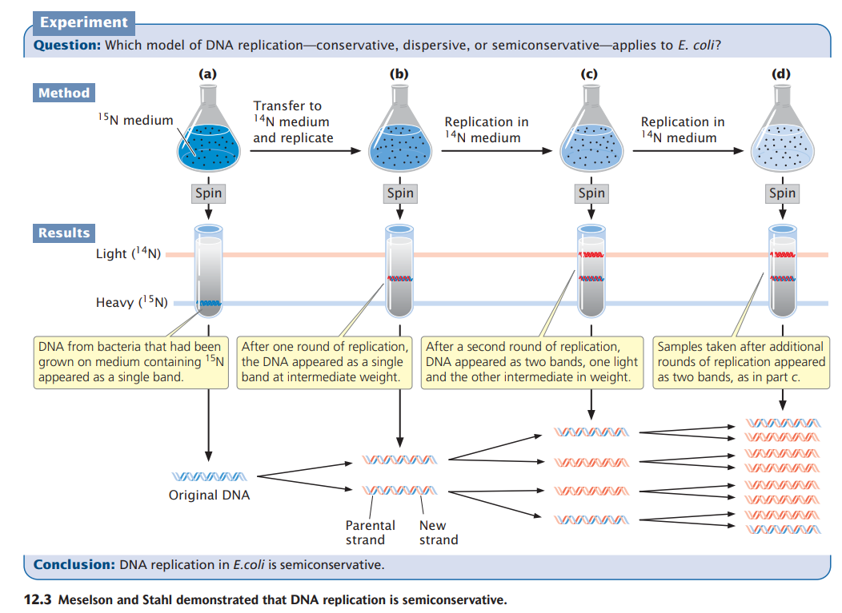
Meselson and Stahl demonstrated that DNA replication is semiconservative.

Slide 10
Modes of Replication
Individual units of replication are called replicons, each of which contains a replication origin.
Replication starts at the origin and continues until the entire replicon has been replicated.
Bacterial chromosomes have a single replication origin, whereas eukaryotic chromosomes contain many.

Slide 11
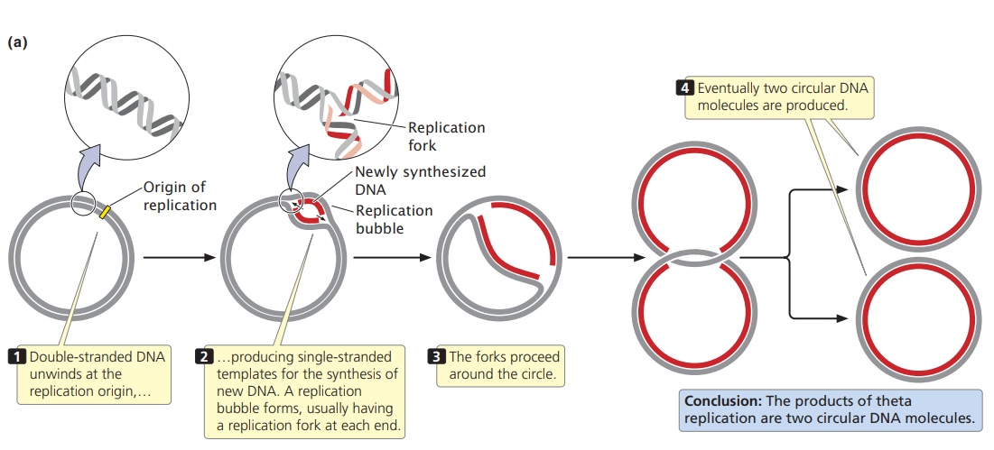
Modes of Replication
12.4 Theta replication is a type of replication common in E. coli and other organisms possessing circular DNA.

Slide 12
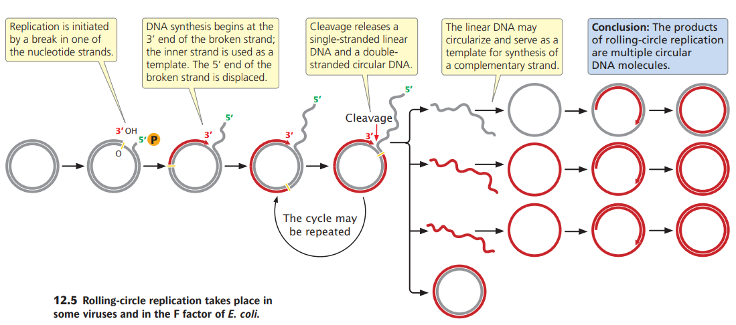
Modes of Replication

Slide 13
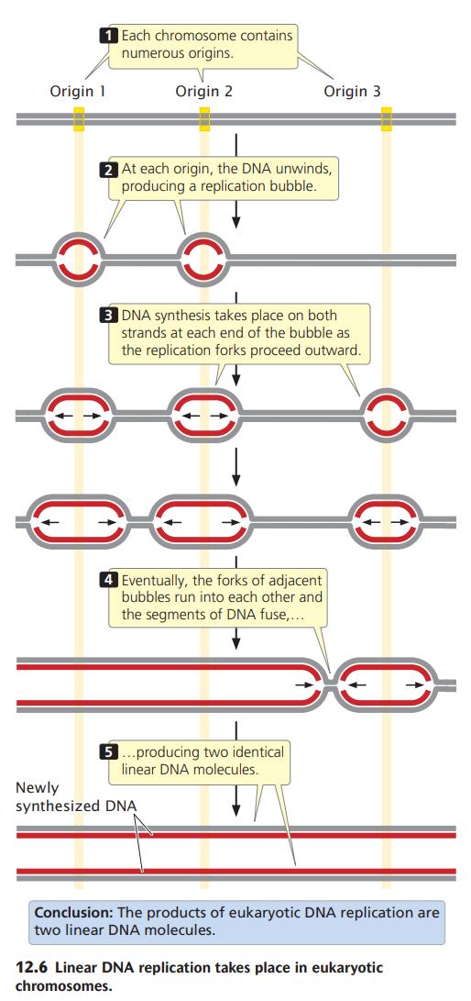
Modes of Replication

Slide 14
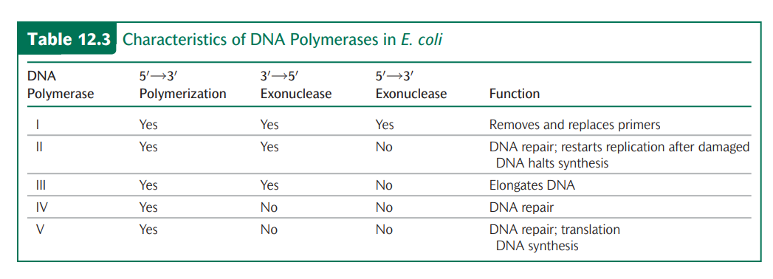
Modes of Replication

Slide 15
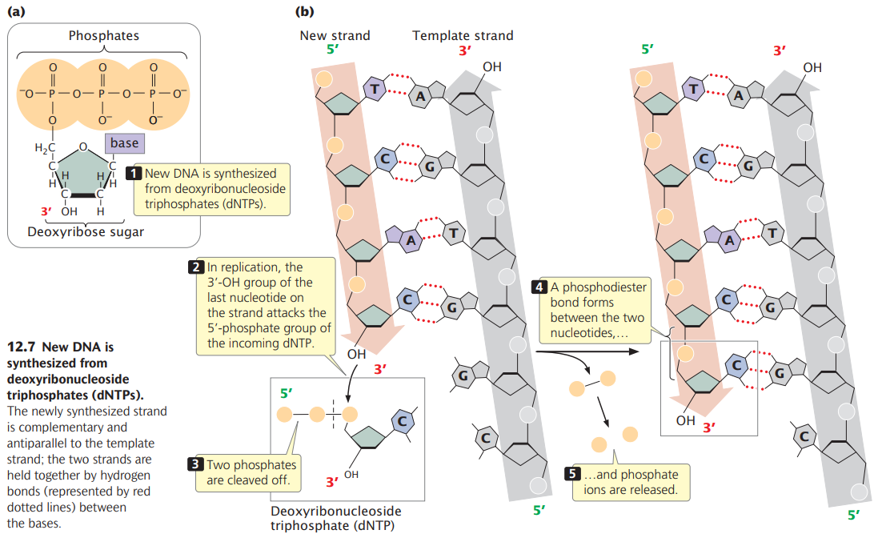
DNA Synthesis
New DNA is synthesized from deoxyribonucleoside triphosphates (dNTPs).

Slide 16
DNA is synthesized by DNA Polymerases
(dNTP)n + dNTP ------------> (dNTP)n+1 + PPi
DNA Polymerases
Elongated DNA chain

Slide 17
Requirements of Replication
a template consisting of single-stranded DNA,
2. raw materials (substrates) to be assembled into a new nucleotide strand, and
3. enzymes and other proteins that “read” the template and assemble the substrates into a DNA molecule

Slide 18
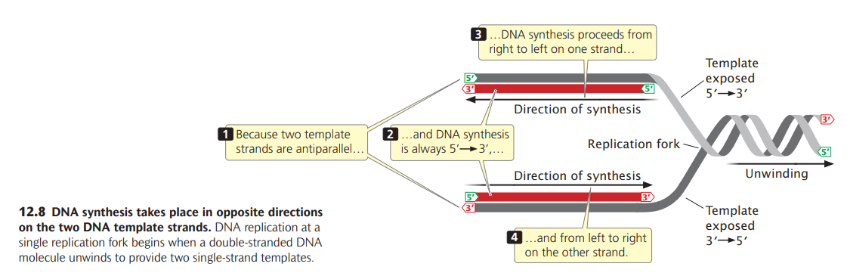
Direction of replication in DNA synthesis
DNA synthesis takes place in opposite directions on the two DNA template strands.

Slide 19
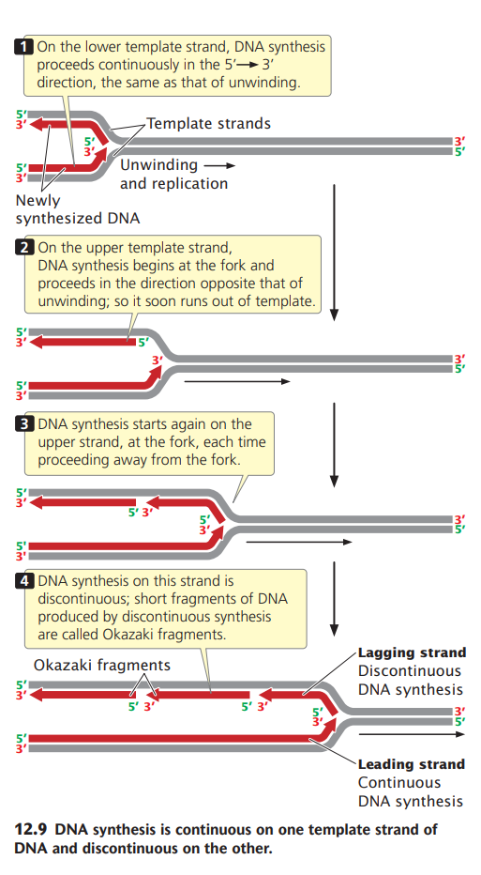
DNA synthesis is continuous on one template strand of DNA and discontinuous on the other

Slide 20
Bacterial Replication
Replication takes place in four stages:
Initiation
Unwinding
Elongation
Termination

Slide 21
Bacterial Replication Requires a Large Number of Enzymes and Proteins
Components required for replication in Bacterial cells

Slide 22
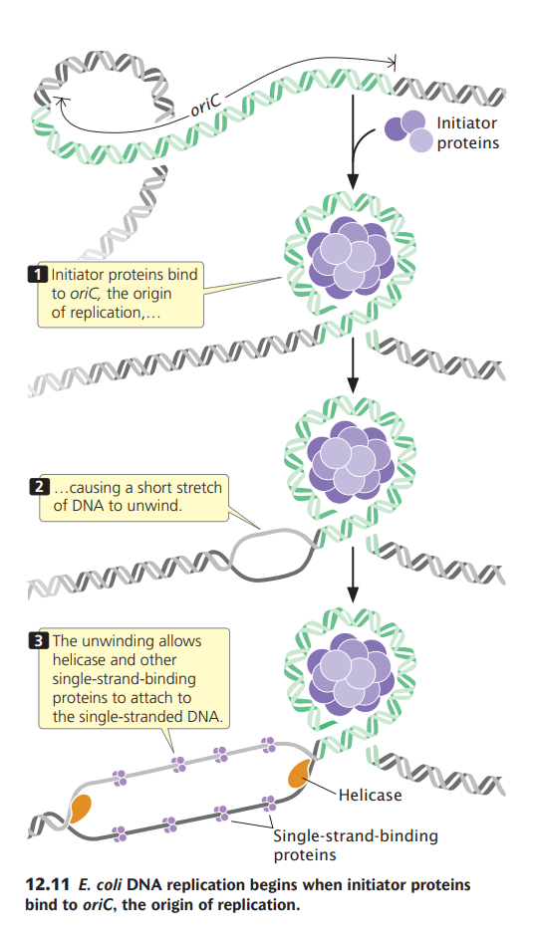
Replication: Initiation
The circular chromosome of E. coli has a single replication origin (oriC).
The minimal sequence required for oriC to function consists of 245 bp that contain several critical sites.
An initiator protein (known as DnaA in E. coli) binds to oriC and causes a short section of DNA to unwind.
This unwinding allows helicase and other single-strand-binding proteins
to attach to the polynucleotide strand (Figure 12.11).

Slide 23
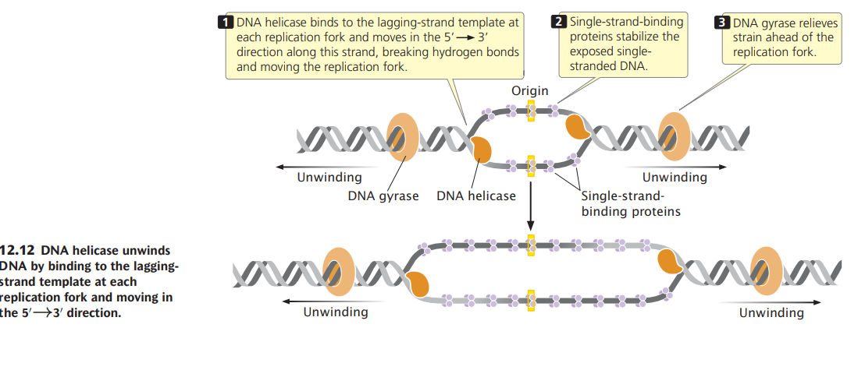
Replication: Unwinding

Slide 24
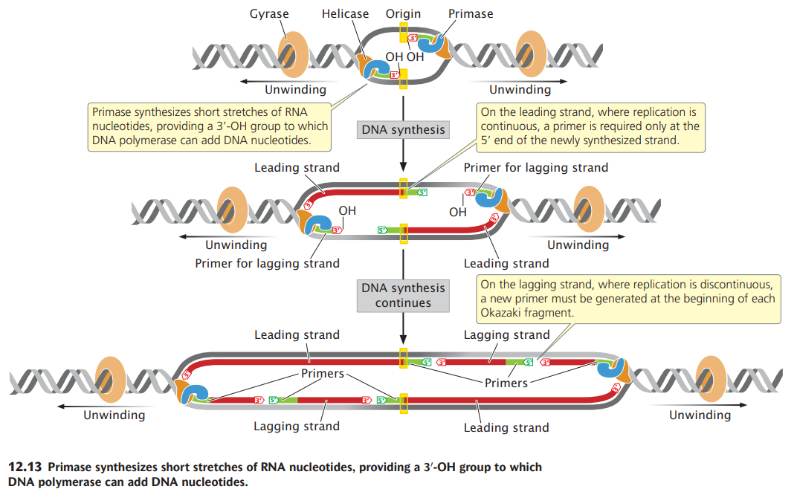
Replication: Elongation

Slide 25
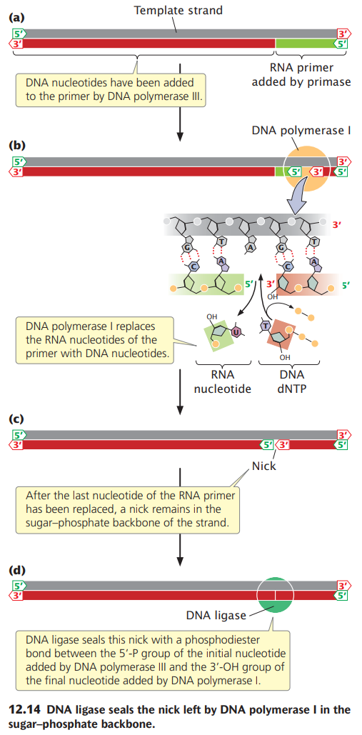
Replication: Elongation

Slide 26
Replication: Elongation
In summary, each active replication fork requires five basic components
helicase to unwind the DNA,
2. single-strand-binding proteins to protect the single nucleotide strands and prevent secondary structures,
3. the topoisomerase gyrase to remove strain ahead of the replication fork,
4. primase to synthesize primers with a 3′-OH group at the beginning of each DNA fragment, and
5. DNA polymerase to synthesize the leading and lagging nucleotide strands.

Slide 27
Replication: Termination
Termination In some DNA molecules, replication is terminated whenever two replication forks meet.
In others, specific termination sequences block further replication. A termination protein, called Tus in E. coli, binds to these sequences. Tus blocks the movement of helicase, thus stalling the replication fork and preventing further DNA replication.

Slide 28
Replication: Basic Rules
Bacterial replication requires a number of enzymes (see Table 12.4), proteins, and DNA sequences that function together to synthesize a new DNA molecule. These components are important, but we must not become so immersed in the details of the process that we lose sight of the general principles of replication.
Replication is always semiconservative.
Replication begins at sequences called origins.
DNA synthesis is initiated by short segments of RNA called primers.
The elongation of DNA strands is always in the 5′→3′ direction.
New DNA is synthesized from dNTPs; in the polymerization of DNA, two phosphate groups are cleaved from a dNTP and the resulting nucleotide is added to the 3′-OH group of the growing nucleotide strand.
Replication is continuous on the leading strand and discontinuous on the lagging strand.
New nucleotide strands are complementary and antiparallel to their template strands.
Replication takes place at very high rates and is astonishingly accurate, thanks to precise nucleotide selection, proofreading, and repair mechanisms.

Slide 29
The Fidelity of DNA Replication
The Fidelity of DNA Replication Overall, the error rate in replication is less than one mistake per billion nucleotides. How is this incredible accuracy achieved?
DNA polymerases are very particular in pairing nucleotides with their complements on the template strand. Errors in nucleotide selection by DNA polymerase arise only about once per 100,000 nucleotides.
Most of the errors that do arise in nucleotide selection are corrected in a second process called proofreading.
When a DNA polymerase inserts an incorrect nucleotide into the growing strand, the 3′-OH group of the mispaired nucleotide is not correctly positioned in the active site of the DNA polymerase for accepting the next nucleotide. The incorrect positioning stalls the polymerization reaction, and the 3′→5′ exonuclease activity of DNA polymerase removes the incorrectly paired nucleotide. DNA polymerase then inserts the correct nucleotide. Together, proofreading and nucleotide selection result in an error rate of only one in 10 million nucleotides.

Slide 30
Replication: Inhibition of Replication
Replication of DNA is vital for life; inhibition of replication prevents cell division.
Topoisomerase II (DNA Gyrase) Inhibitor
- Fluoroquinolones are the group of antibiotics that are used in treating infections caused by both Gram-positive and Gram-negative organisms. Nalidixic acid which was introduced in 1962 was the first quinolone for clinical use.

