Slide 1
Good Afternoon Everyone
Welcome to the class

Slide 2
Today’s Content
1.Necessity of two way communication
2.Communication Models
3. Aristotle’s Persuasive Model
4. The Shannon and Weaver Information Theory
Importance of communication model

Slide 3
Necessity of two way communication

Slide 4
Necessity of two way communication
Two-way communication is the complete communication process. In this communication, information flows form sender to receiver and response of the receiver goes back to the sender. In achieving the organizational goals and facing the personal problems, we need to rely on two-way communication.
In Two Way Communication system both the parties exchange information that acts as an acknowledgement of message to each other. It means that the sender sends the message to receiver and the receiver sends back his response or reaction to the sender. Here the feedback acknowledges that the receiver has received the message sent by the sender.

Slide 5
Aristotle’s Persuasive Model

Slide 6
Aristotle’s Persuasive Model
Aristotle(384-322 B.C) was a Greek philosopher and writer born in Stagira, Northern Greece. He was also the teacher of Alexander the Great. He studied physics, logic, mathematics, etc.
While exploring the human nature scientifically, Aristotle developed a linear model of communication for oral communication known as Aristotle’s Model of Communication. This is considered as the first model of communication and was proposed before 300 B.C. It is also the is most widely accepted among all communication models.
Aristotle Model is mainly focused on speaker and speech. It can be broadly divided into 5 primary elements which are Speaker, Speech, Occasion, Audience and Effect.
The Aristotle’s communication model is a speaker centered model as the speaker has the most important role in it and is the only one active. It is the speaker’s role to deliver a speech to the audience. The role of the audience is passive, influenced by the speech. This makes the communication process one way, from speaker to receiver.
The speaker must organize the speech beforehand, according to the target audience and situation (occasion). The speech must be prepared so that the audience be persuaded or influenced from the speech

Slide 7
The Shannon And Weaver Information Theory

Slide 8
The Shannon And Weaver Information Theory
Shannon Weaver model of communication was created in 1948 when Claude Elwood Shannon wrote an article “A Mathematical Theory of Communication” in Bell System Technical Journal with Warren Weaver.
Shannon was an American mathematician whereas Weaver was a scientist. The Mathematical theory later came to be known as Shannon Weaver model of communication or “mother of all models.” This model is more technological than other linear models.
The sender encodes the message and sends it to the receiver through a technological channel like telephone and telegraph. The sender converts the message into codes understandable to the machine. The message is sent in codes through a medium.
The receiver has to decode the message before understanding it and interpreting it. The receptor machine can also act as a decoder in some cases. The channel can have noise and the receiver might not have the capacity to decode which might cause problems in communication process.
Here, for instance, brain might be the sender, mouth might be the encoder which encodes to a particular language, air might be the channel, another person’s ear might be the receptor and his brain might be the decoder and receiver.

Slide 9
The Shannon And Weaver Information Theory
Similarly, air is the channel here, the noise present in his environment that disturbs them is the noise whereas his response is the feedback. There were only 5 components when the model was made. Noise was added later.
As Shannon was an engineer, this model was first made to improve technical communication, mainly for telephonic communication. It was made to to maximize telephone capacity with minimum noise.
Later, Weaver applied it for all kind of communications to develop effective communication and the model became famous as Shannon Weaver model. In engineering, Shannon’s model is also called information theory and is used academically to calculate transmission through machines and also has a formula.

Slide 10
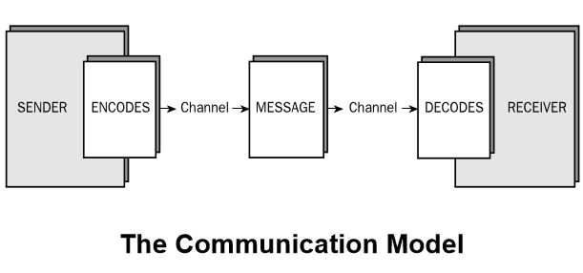
Importance of Communication Model
model of communication is a medium through which information is enclosed in a package and passed or imparted by a sender to a receiver. Aristotle was the first theorists to take an initiative, in developing a communication model. He proposed the model before 300 B.C. Aristotle found the importance the participation of the audience, in a communication chain, in his communication model. Aristotle model of communication focuses more on public speaking rather than interpersonal speaking.

Slide 11
End Of The Session
ARRIVEDERLA

