Slide 1
Transcription
Md. Abdur Rakib
Professor
Dept. of Biochemistry and Molecular Biology
University of Rajshahi

Slide 2
Structure of RNA
RNA, like DNA, is a polymer consisting of nucleotides joined together by phosphodiester bonds. However, there are several important differences in the structures of DNA and RNA.

Slide 3
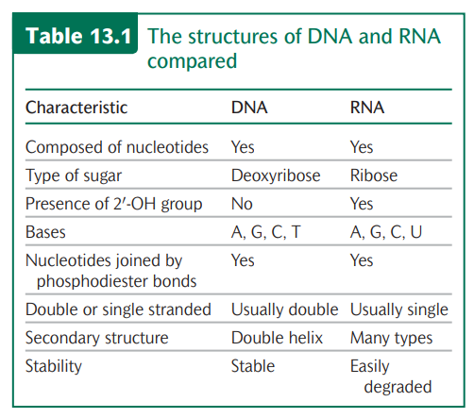
Structure of RNA

Slide 4
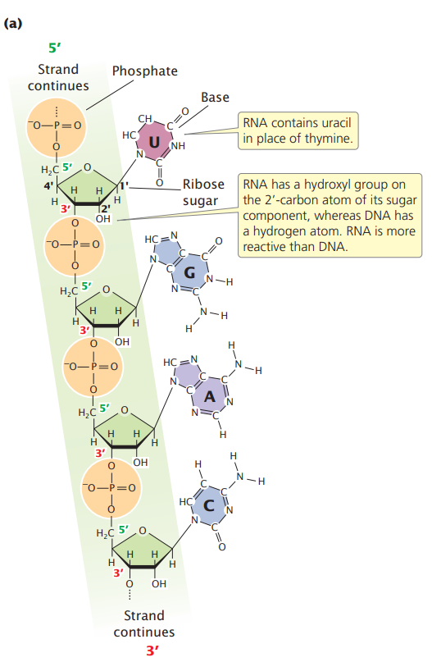
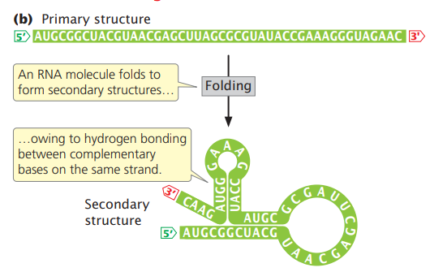
RNA has a primary and a secondary structure.

Slide 5
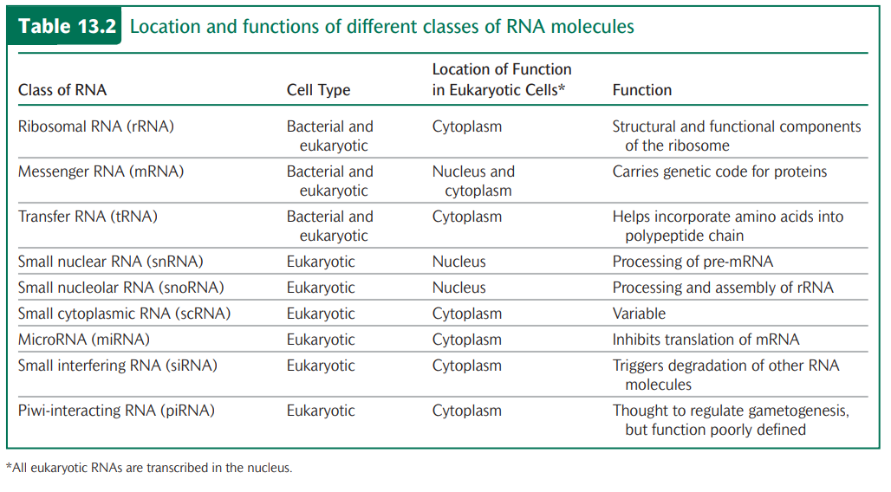
Classes of RNA

Slide 6
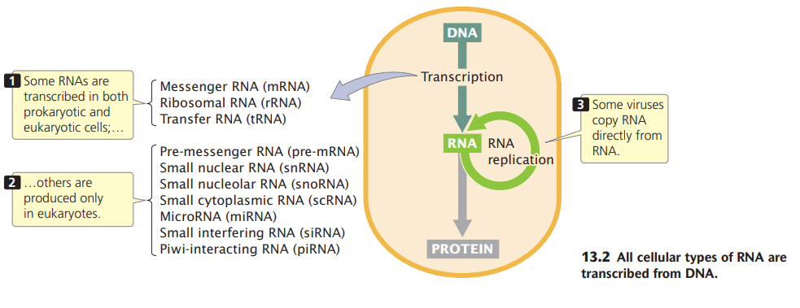
Classes of RNA

Slide 7
Transcription is the synthesis of an RNA molecule from a DNA template.
All cellular RNAs are synthesized from DNA templates through the process of transcription.
Transcription is the synthesis of an RNA molecule from a DNA template.

Slide 8
Comparison of Transcription and Replication
Transcription is in many ways similar to the process of replication.
In replication, all the nucleotides in the DNA template are copied, but, in transcription, only small parts of the DNA molecule—usually a single gene or, at most, a few genes—are transcribed into RNA.
Because not all gene products are needed at the same time or in the same cell, the constant transcription of all of a cell’s genes would be highly inefficient.
Furthermore, much of the DNA does not encode a functional product, and transcription of such sequences would be pointless.
Transcription is, in fact, a highly selective process: individual genes are transcribed only as their products are needed.

Slide 9
Requirements of transcription
Transcription requires three major components:
1. A DNA template;
2. The raw materials (substrates) needed to build a new RNA molecule; and
3. The transcription apparatus, consisting of the proteins necessary to catalyze the synthesis of RNA.

Slide 10
The transcribed strand
The template for RNA synthesis, as for DNA synthesis, is a single strand of the DNA double helix.
Unlike replication, the transcription of a gene takes place on only one of the two nucleotide strands of DNA (Figure 13.4). The nucleotide strand used for transcription is termed the template strand. The other strand, called the nontemplate strand, is not ordinarily transcribed. Thus, within a gene, only one of the nucleotide strands is normally transcribed into RNA (there are some exceptions to this rule).

Slide 11
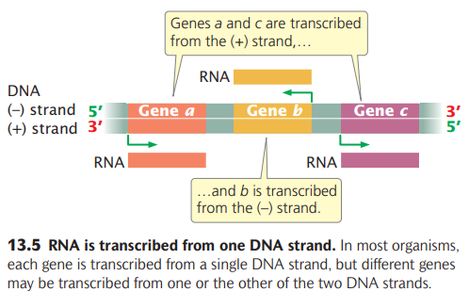

Slide 12
The transcription unit
A transcription unit is a stretch of DNA that encodes an RNA molecule and the sequences necessary for its transcription.
A transcription unit includes three critical regions:
a promoter
an RNA-coding sequence, and
a terminator.
The promoter is a DNA sequence that the transcription apparatus recognizes and binds. It indicates which of the two DNA strands is to be read as the template and the direction of transcription. The promoter also determines the transcription start site, the first nucleotide that will be transcribed into RNA. In most transcription units, the promoter is located next to the transcription start site but is not, itself, transcribed.
RNA-coding region, a sequence of DNA nucleotides that is copied into an RNA molecule.
The third component of the transcription unit is the terminator, a sequence of nucleotides that signals where transcription is to end. Terminators are usually part of the RNA-coding sequence; that is, transcription stops only after the terminator has been copied into RNA.

Slide 13
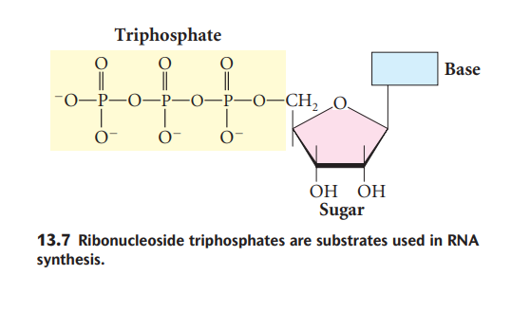
The Substrate for Transcription

Slide 14
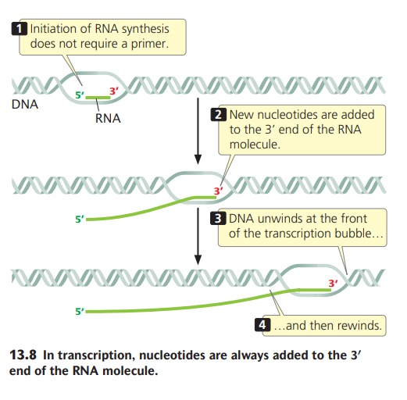
RNA is synthesized from ribonucleoside triphosphates (rNTPs; Figure 13.7). In synthesis, nucleotides are added one at a time to the 3′-OH group of the growing RNA molecule. Two phosphate groups are cleaved from the incoming ribonucleoside triphosphate; the remaining phosphate group participates in a phosphodiester bond that connects the nucleotide to the growing RNA molecule. The overall chemical reaction for the addition of each nucleotide is:
RNAn + rNTP → RNAn+1 + PPi
where PPi represents pyrophosphate. Nucleotides are always added to the 3′ end of the RNA molecule, and the direction of transcription is therefore 5′→3′.

Slide 15
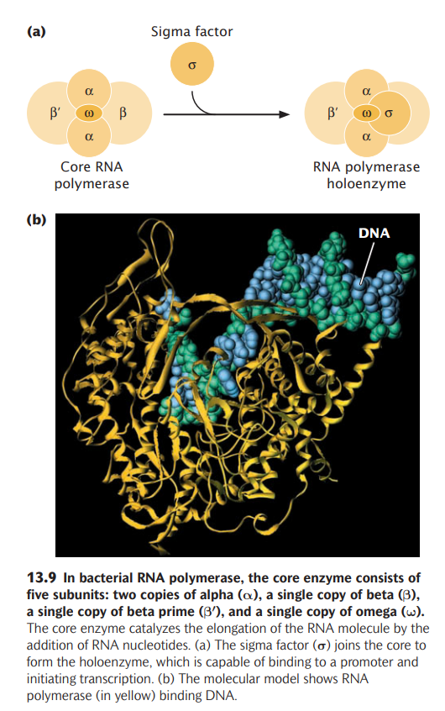
Bacterial RNA polymerases are five subunits (individual polypeptide chains) that make up the core enzyme: two copies of a subunit called alpha (α) and single copies of subunits beta (β), beta prime (β′), and omega (ω) (Figure 13.9).
The ω subunit is not essential for transcription, but it helps stabilize the enzyme. The core enzyme catalyzes the elongation of the RNA molecule by the addition of RNA nucleotides. Other functional subunits join and leave the core enzyme at particular stages of the transcription process.
The sigma (σ) factor controls the binding of RNA polymerase to the promoter. Without sigma, RNA polymerase will initiate transcription at a random point along the DNA. After sigma has associated with the core enzyme (forming a holoenzyme), RNA polymerase binds stably only to the promoter region and initiates transcription at the proper start site.

Slide 16
Bacterial promoters
Essential information for the transcription unit—where it will start transcribing, which strand is to be read, and in what direction the RNA polymerase will move—is imbedded in the nucleotide sequence of the promoter.
Promoters are DNA sequences that are recognized by the transcription apparatus and are required for transcription to take place. In bacterial cells, promoters are usually adjacent to an RNA-coding sequence.
Most of the nucleotides within the promoters vary in sequence, short stretches of nucleotides are common to many. Furthermore, the spacing and location of these nucleotides relative to the transcription start site are similar in most promoters. These short stretches of common nucleotides are called consensus sequences; “consensus sequence” refers to sequences that possess considerable similarity, or consensus (Figure 13.10). The presence of consensus in a set of nucleotides usually implies that the sequence is associated with an important function.
The most commonly encountered consensus sequence, found in almost all bacterial promoters, is centered about 10 bp upsteam of the start site. Called the –10 consensus sequence or, sometimes, the Pribnow box, its consensus sequence is TATAAT.

Slide 17
Another consensus sequence common to most bacterial promoters is TTGACA, which lies approximately 35 nucleotides upstream of the start site and is termed the −35 consensus sequence (see Figure 13.11)
A promoter is a DNA sequence that is adjacent to a gene and required for transcription. Promoters contain short consensus sequences that are important in the initiation of transcription.

Slide 18
Rifamycins are a group of antibiotics that kill bacterial cells by inhibiting RNA polymerase. These antibiotics are widely used to treat tuberculosis, a disease that kills almost 2 million people worldwide each year. The structures of bacterial and eukaryotic RNA polymerases are sufficiently different that rifamycins inhibit bacterial RNA polymerases without interferring with eukaryotic RNA polymerases. Recent research has demonstrated that several rifamycins inibit RNA polymerase by binding to the part of the RNA polymerase that clamps on to DNA and jamming it, thus preventing the RNA polymerase from interacting with the promoter on the DNA.

Slide 19
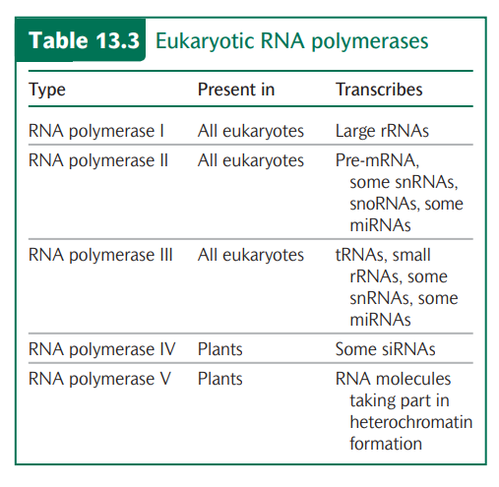

Slide 20
The Process of Bacterial Transcription consists of Initiation, Elongation, and Termination
Transcription can be conveniently divided into three stages:
Initiation, in which the transcription apparatus assembles on the promoter and begins the synthesis of RNA;
2. Elongation, in which DNA is threaded through RNA polymerase, the polymerase unwinding the DNA and adding new nucleotides, one at a time, to the 3′ end of the growing RNA strand; and
3. Termination, the recognition of the end of the transcription unit and the separation of the RNA molecule from the DNA template.

Slide 21
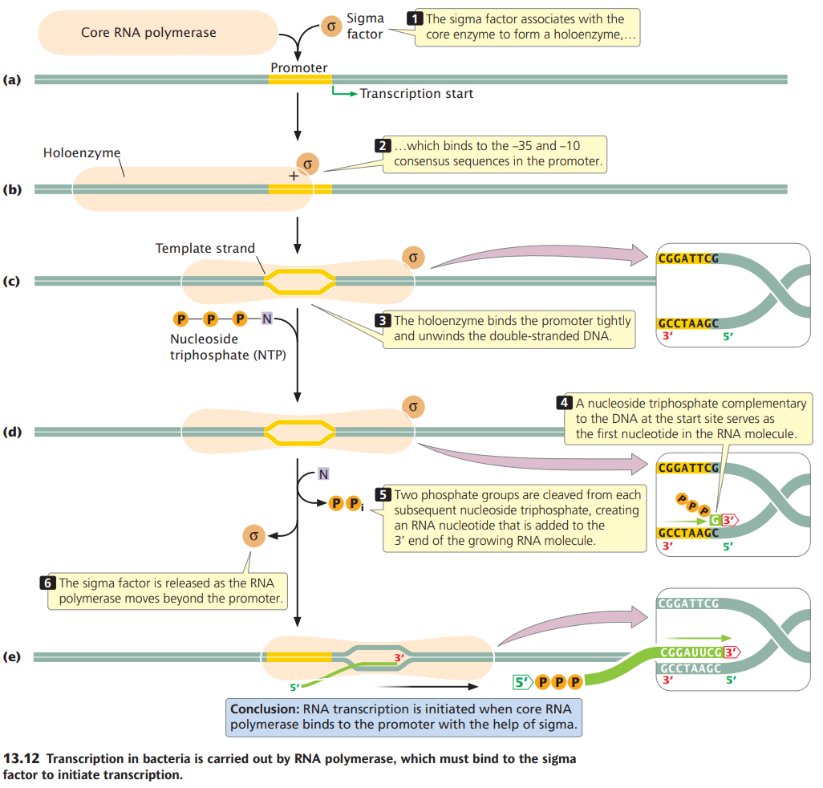

Slide 22
Bacterial cells possess two major types of terminators.
Rho-dependent terminators are able to cause the termination of transcription only in the presence of an ancillary protein called the rho factor.
Rho-independent terminators (also known as intrinsic terminators) are able to cause the end of transcription in the absence of rho.

Slide 23
Rho-independent terminators Rho-independent terminators, which make up about 50 percent of all terminators in prokaryotes, have two common features.
First, they contain inverted repeats (sequences of nucleotides on one strand that are inverted and complementary). When inverted repeats have been transcribed into RNA, a hairpin secondary structure forms (Figure 13.13).
Second, in rho independent terminators, a string of seven to nine adenine nucleotides follows the second inverted repeat in the template DNA. Their transcription produces a string of uracil nucleotides after the hairpin in the transcribed RNA.
The string of uracils in the RNA molecule causes the RNA polymerase to pause, allowing time for the hairpin structure to form. The hairpin destablizes the DNA–RNA pairing, causing the RNA molecule to separate from its DNA template.
Separation may be facilitated by the adenine–uracil base pairings, which are relatively weak compared with other types of base pairings. When the RNA transcript has separated from the template, RNA synthesis can no longer continue (see Figure 13.13).

Slide 24
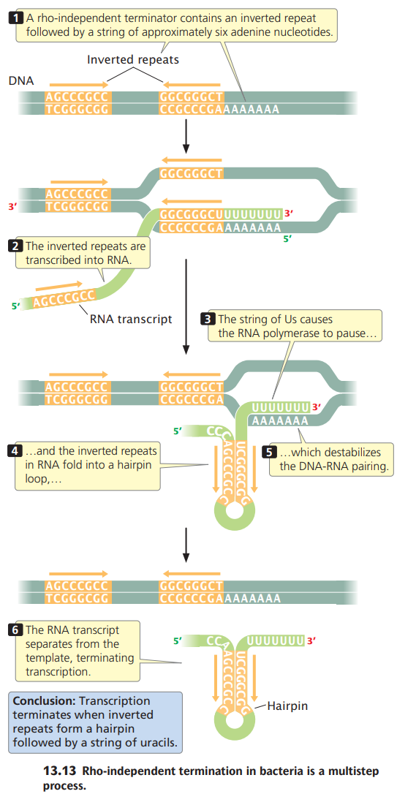
Rho-independent termination

Slide 25
Rho-dependent terminators
Rho-dependent terminators have two features:
DNA sequences that produce a pause in transcription and
(2) a DNA sequence that encodes a stretch of RNA upstream of the terminator that is devoid of any secondary structures. This unstructured RNA serves as a binding site for the rho protein, which binds the RNA and moves toward its 3′ end, following the RNA polymerase (Figure 13.14). When RNA polymerase encounters the terminator, it pauses, allowing rho to catch up. The rho protein has helicase activity, which it uses to unwind the RNA–DNA hybrid in the transcription bubble, bringing transcription to an end.

Slide 26
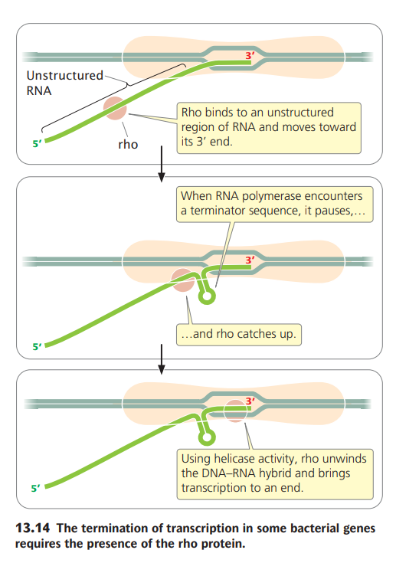

Slide 28
30. The following diagram represents a transcription unit in a hypothetical DNA molecule.
5′...TTGACA...TATAAT...3′
3′...AACTGT...ATATTA...5

Slide 29
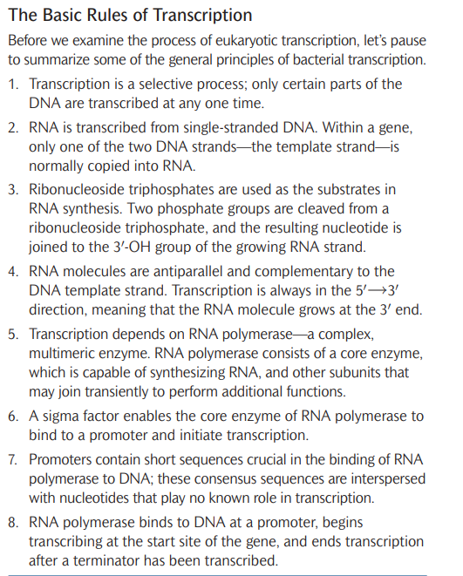

Slide 30
Inverted repeat
Beginning with this initial sequence: 5'-TTACG-3'
The complement created by base pairing is: 3'-AATGC-5'
The reverse complement is: 5'-CGTAA-3'
And, the inverted repeat sequence is: 5'---TTACGnnnnnnCGTAA---3'
"nnnnnn" represents any number of intervening nucleotides.

Slide 31
RNA Splicing
The other major type of modification of eukaryotic pre-mRNA is the removal of introns by RNA splicing.
This modification takes place in the nucleus, before the RNA moves to the cytoplasm.

Slide 32
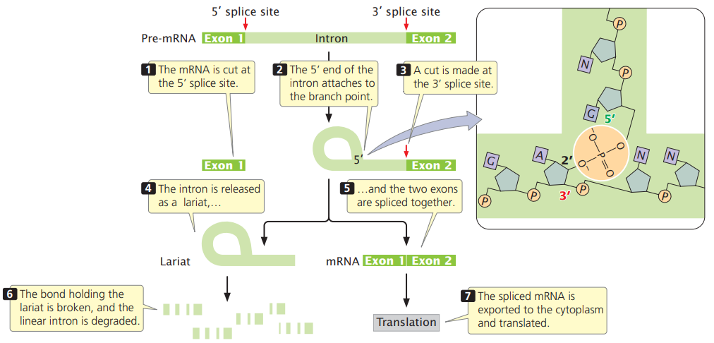
Splicing of pre-mRNA requires consensus sequences.
Splicing requires the presence of three sequences in the intron. One end of the intron is referred to as the 5′ splice site, and the other end is the 3′ splice site; these splice sites possess short consensus sequences. Most introns in pre-mRNAs begin with GU and end with AG, indicating that these sequences play a crucial role in splicing. Indeed, changing a single nucleotide at either of these sites prevents splicing.
The third sequence important for splicing is at the branch point, which is an adenine nucleotide that lies from 18 to 40 nucleotides upstream of the 3′ splice site
The sequence surrounding the branch point does not have a strong consensus. The deletion or mutation of the adenine nucleotide at the branch point prevents splicing.

Slide 33
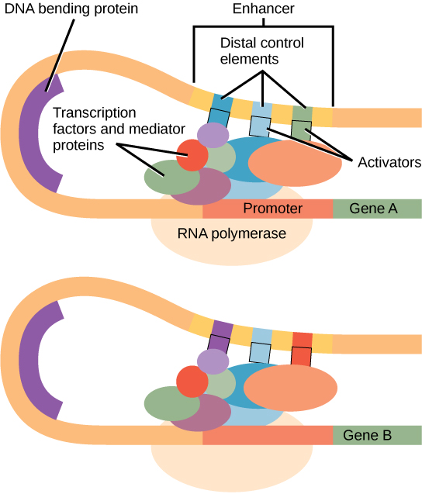
Transcriptional enhancers have traditionally been described as regulatory regions of DNA that elevate basal levels of transcription by increasing activity of the proximal promoter.
Each enhancer is made up of short DNA sequences called distal control elements. Activators bound to the distal control elements interact with mediator proteins and transcription factors.
enhancer: a short region of DNA that can increase transcription of genes
repressor: any protein that binds to DNA and thus regulates the expression of genes by decreasing the rate of transcription
activator: any chemical or agent which regulates one or more genes by increasing the rate of transcription

Slide 34
Inhibitors of transcription
Rifampicin- binds with Beta subunit of prokaryotic RNA polymerase. It is an inhibitor of prokaryotic transcription initiation. It binds only to bacterial RNA polymerase but not to eukaryotic RNA polymerases. Therefore, Rifampicin is a powerful drug for treatment of bacterial infections. Used for the treatment of tuberculosis and leprosy
Mitomycin- Intercalates with DNA strands, blocks transcription, used as anticancer drug.
Alpha amanitin is a molecule made from the “death cap” mushroom and is a known potent inhibitor RNA polymerase. The mechanism of action is that alpha amanitin inhibits RNA polymerase –II at both the initiation and elongation states of transcription.

