Slide 1
Genetic code
Md. Abdur Rakib, PhD
Professor
Dept. of Biochemistry and Molecular Biology
University of Rajshahi

Slide 2
Genetic code
The genetic code is a set of three-letter combinations of nucleotides called codons, each of which corresponds to a specific amino acid or stop signal.
The concept of codons was first described by Francis Crick and his colleagues in 1961.

Slide 3
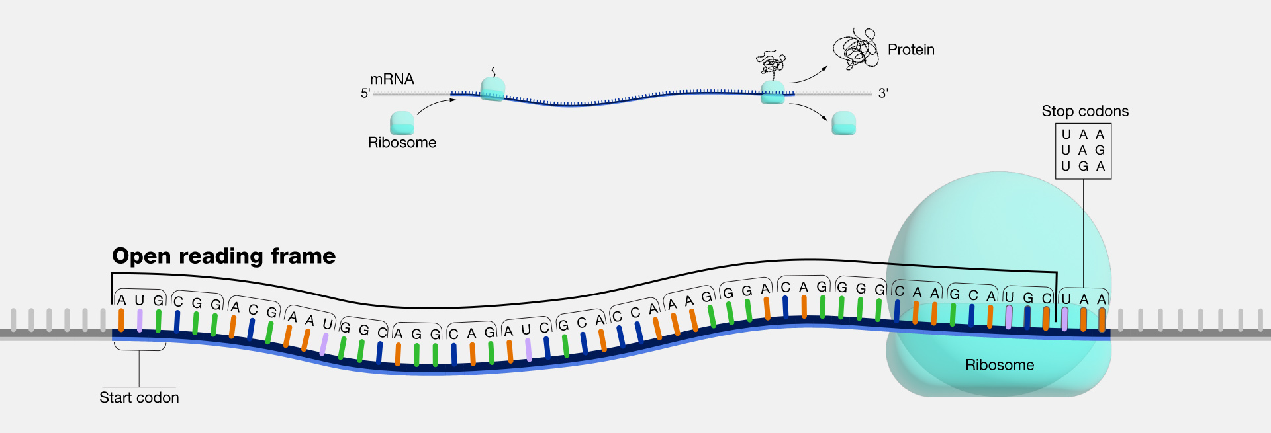
Codon
A codon is a DNA or RNA sequence of three nucleotides (a trinucleotide) that forms a unit of genomic information encoding a particular amino acid or signaling the termination of protein synthesis (stop codon).
There are 64 different codons: 61 specify amino acids and 3 are used as stop codons.
A long open reading frame is often part of a gene (that is, a sequence directly coding for a protein).

Slide 4
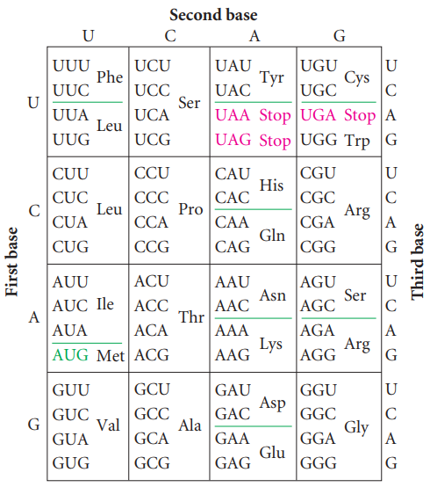
Genetic code table
The genetic code consists of 64 codons. The amino acids specified by each codon are given in their three-letter abbreviation. The codons are written 5′→3′, as they appear in the mRNA. AUG is an initiation codon; UAA, UAG, and UGA are termination (stop) codons

Slide 5
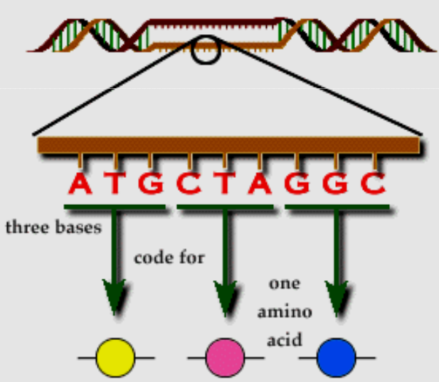
Major characteristics of genetic code
1. Triplet:
Three nucleotides encode an amino acid
Genetic code
Template mRNA is read by the ribosome in groups of three nucleotides, called a codon. A minimum of 3 bases would be needed to code for 20 amino acids.

Slide 6
The Degeneracy of the Code/ Redundant
One amino acid is encoded by three consecutive nucleotides in mRNA, and each nucleotide can have one of four possible bases (A, G, C, and U) at each nucleotide position, thus permitting 4³ = 64 possible codons.
Three of these codons are stop codons, specifying the end of translation. Thus, 61 codons, called sense codons, encode amino acids. Because there are 61 sense codons and only 20 different amino acids commonly found in proteins, the code contains more information than is needed to specify the amino acids and is said to be a degenerate code.

Slide 7
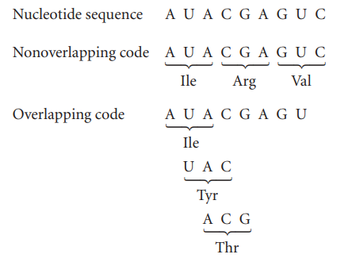
2. Non-overlapping
An overlapping code is one in which a single nucleotide may be included in more than one codon, as follows:
For any sequence of nucleotides, there are three potential sets of codons—three ways in which the sequence can be read in groups of three. Each different way of reading the sequence is called a reading frame, and any sequence of nucleotides has three potential reading frames. The three reading frames have completely different sets of codons and will therefore specify proteins with entirely different amino acid sequences. Thus, it is essential for the translational machinery to use the correct reading frame.
How is the correct reading frame established? The reading frame is set by the initiation codon, which is the first codon of the mRNA to specify an amino acid. After the initiation codon, the other codons are read as successive groups of three nucleotides. No bases are skipped between the codons; so there are no punctuation marks to separate the codons.

Slide 8
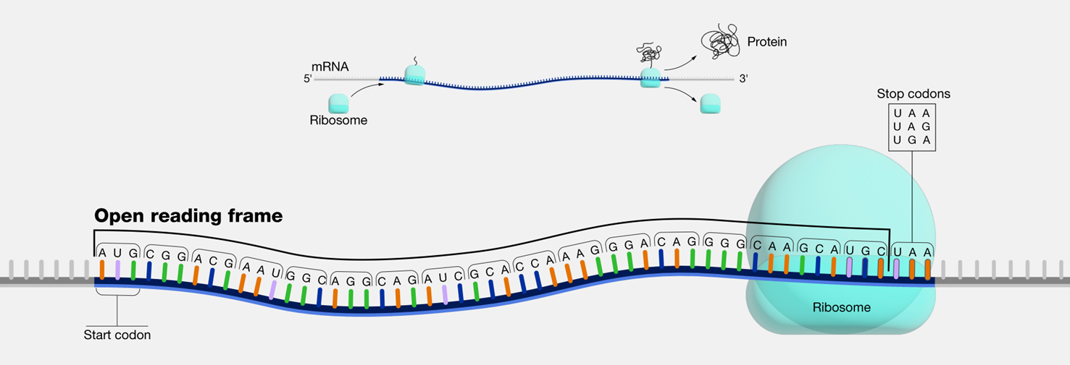

Slide 9
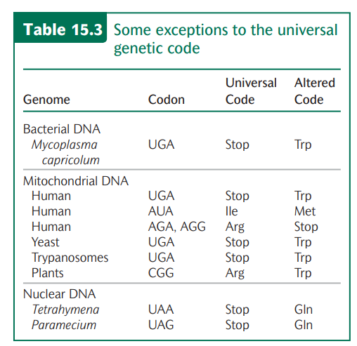
For many years the genetic code was assumed to be universal, meaning that each codon specifies the same amino acid in all organisms. We now know that the genetic code is almost, but not completely, universal; a few exceptions have been found. Most of these exceptions are termination codons, but there are a few cases in which one sense codon substitutes for another. Most exceptions are found in mitochondrial genes; a few nonuniversal codons have also been detected in the nuclear genes of protozoans and in bacterial DNA (Table 15.3).
The Universality of the Code

