Slide 1
Translation

Slide 2
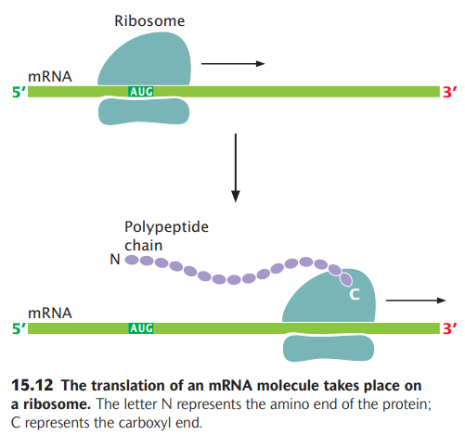
Amino acids are assembled into a Protein through the mechanism of Translation
Translation takes place on ribosomes; indeed, ribosomes can be thought of as moving protein-synthesizing machines.
A ribosome attaches near the 5′ end of an mRNA strand and moves toward the 3′ end, translating the codons as it goes (Figure 15.12).
Synthesis begins at the amino end of the protein, and the protein is elongated by the addition of new amino acids to the carboxyl end.
Protein synthesis includes a series of RNA–RNA interactions:
- interactions between the mRNA and the rRNA that hold the mRNA in the ribosome,
- interactions between the codon on the mRNA and the anticodon on the tRNA, and
- interactions between the tRNA and the rRNAs of the ribosome.

Slide 3
Stages/steps of Translation/protein synthesis
Protein synthesis can be conveniently divided into four stages:
(1) tRNA charging, in which tRNAs bind to amino acids;
(2) initiation, in which the components necessary for translation are assembled at the ribosome;
(3) elongation, in which amino acids are joined, one at a time, to the growing polypeptide chain; and
(4) termination, in which protein synthesis halts at the termination codon and the translation components are released from the ribosome.

Slide 4
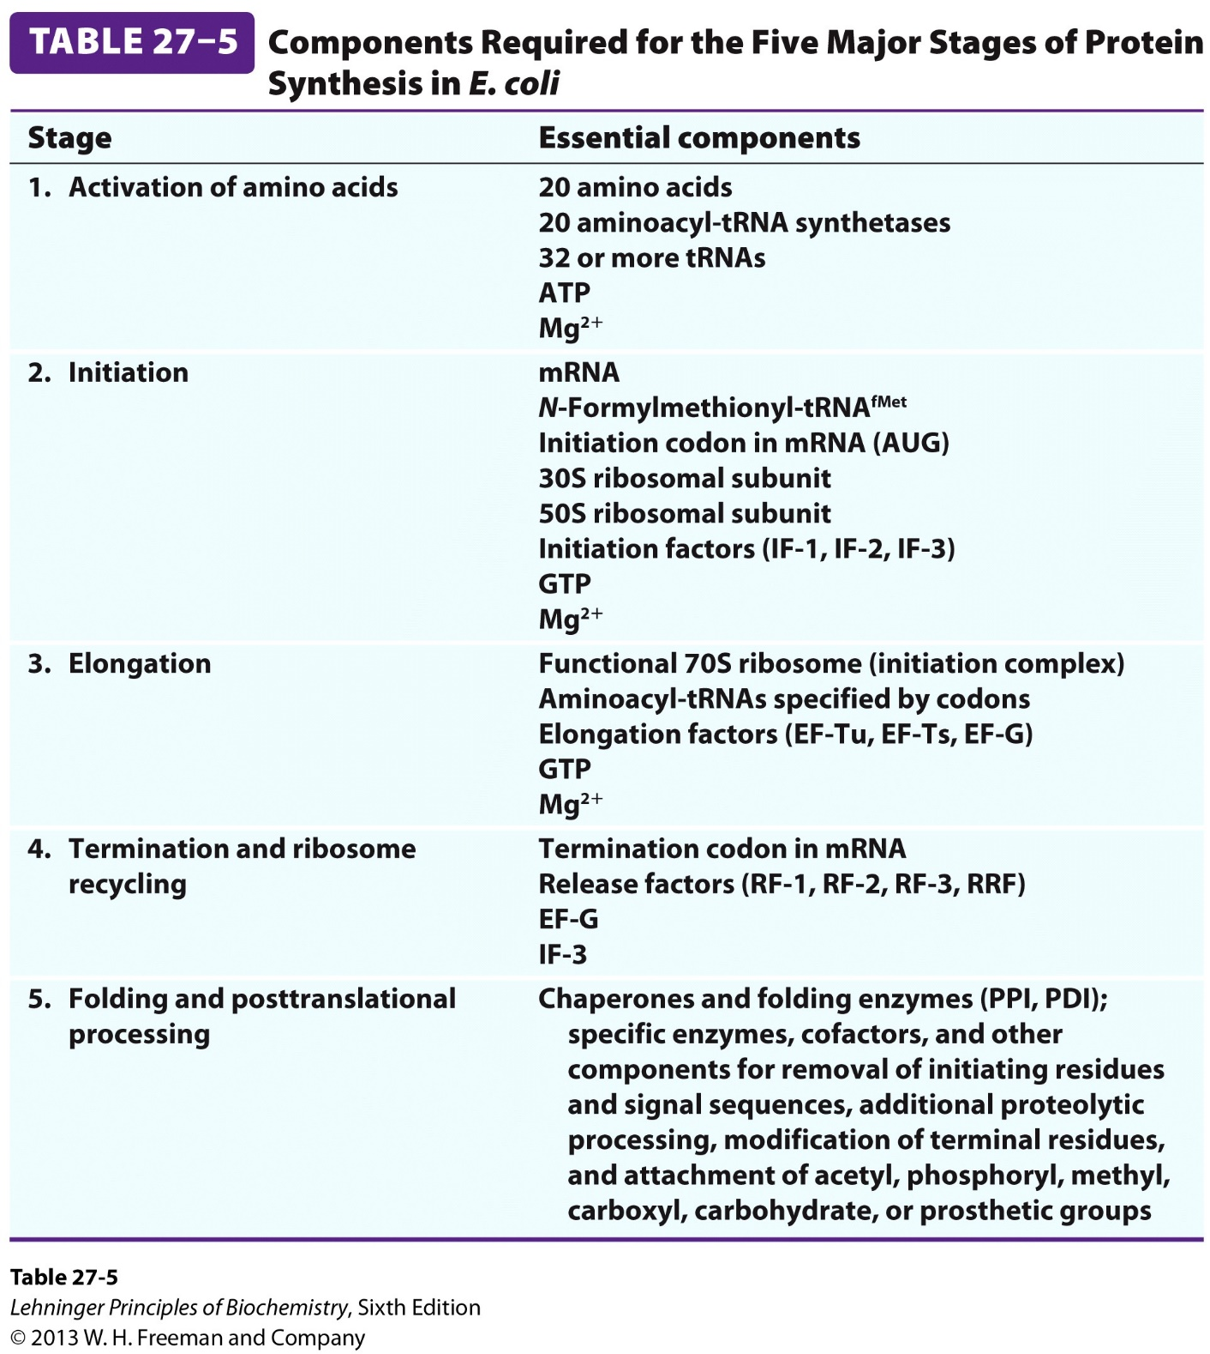

Slide 5
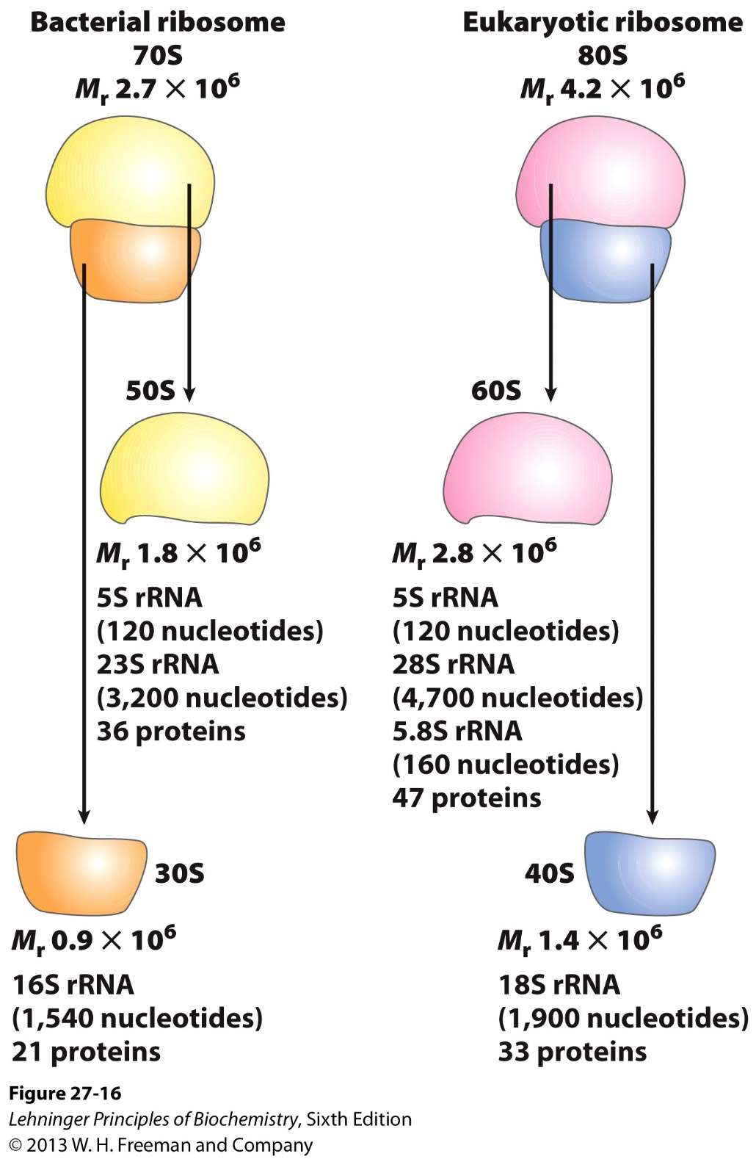

Slide 6
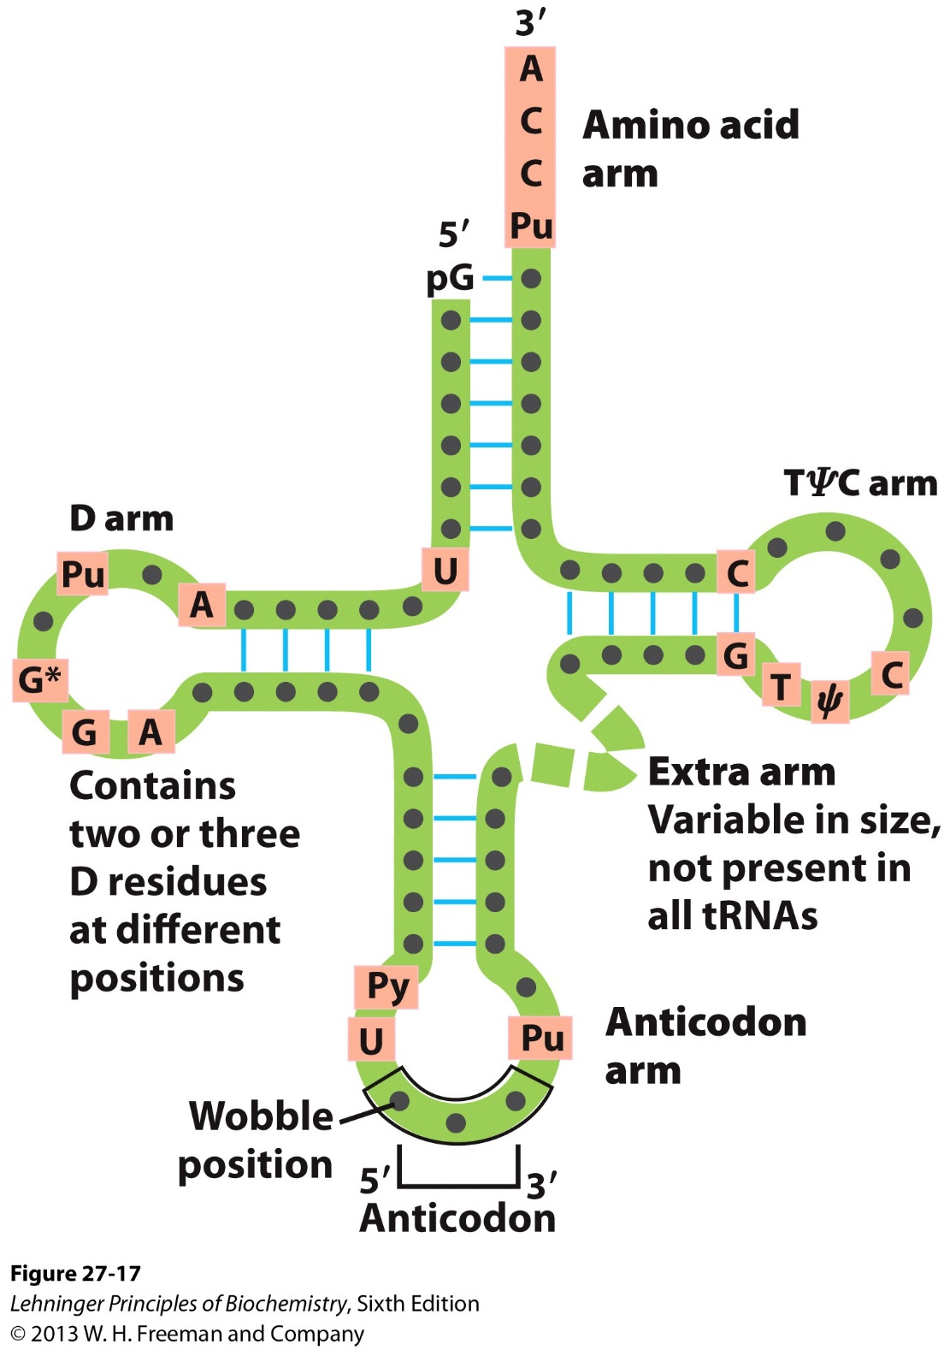

Slide 7
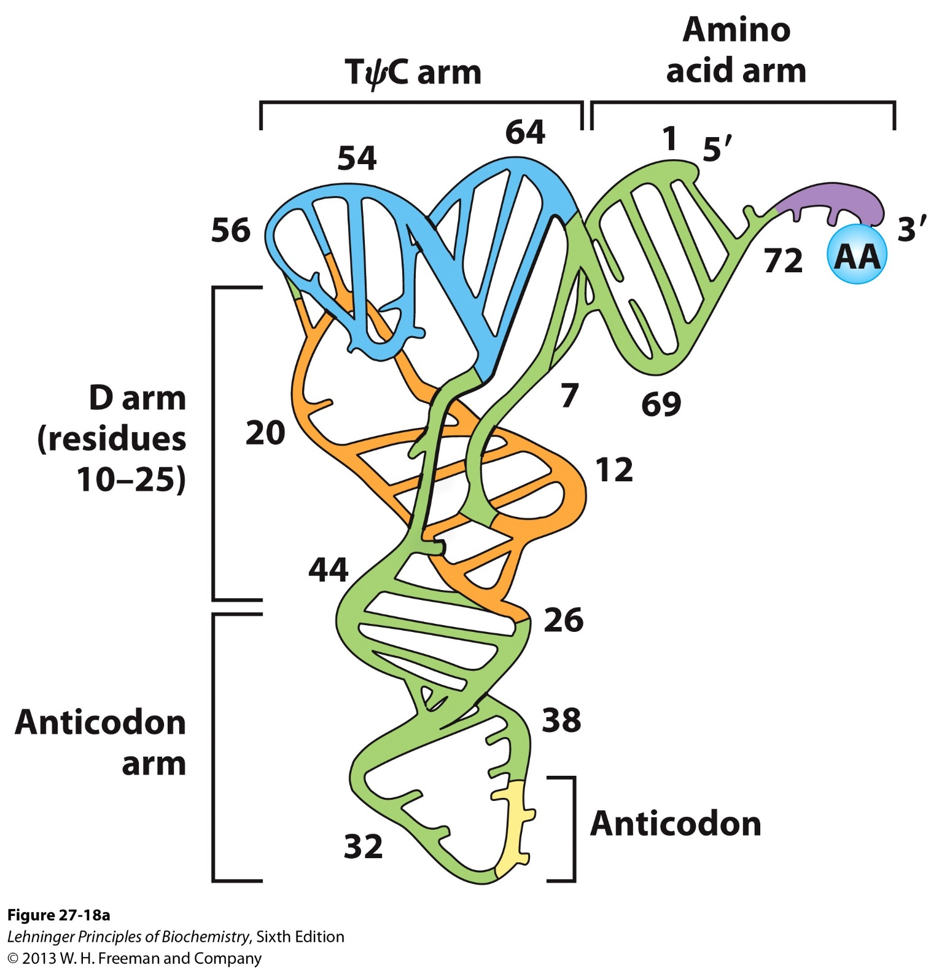

Slide 8
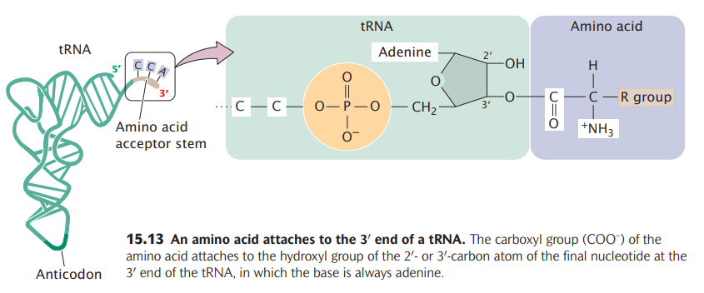

Slide 9
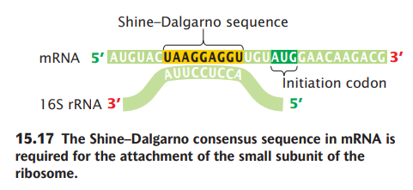
The Shine-Dalgarno sequence is typically found around position -7 to -4 of the translational Start codon and has the sequence AGGAGG. This sequence is complementary to part of the 3′ end of 16S rRNA: GAUCACCUCCUUA-3′ (the portion that is complementary to Shine-Dalgarno is underlined).

Slide 10
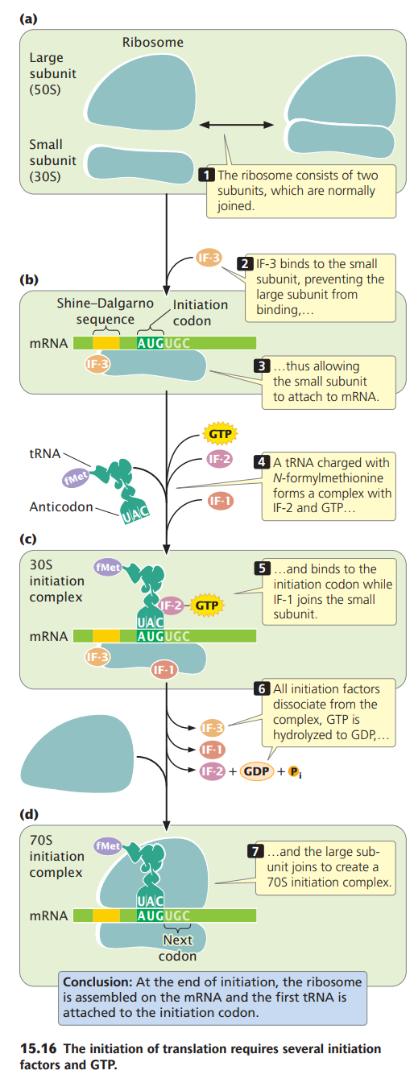

Slide 11
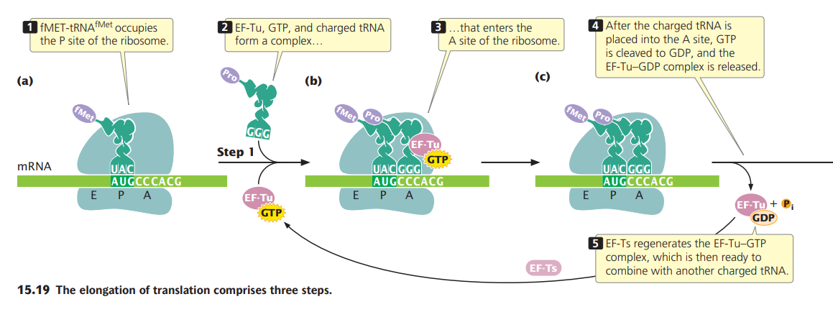

Slide 12
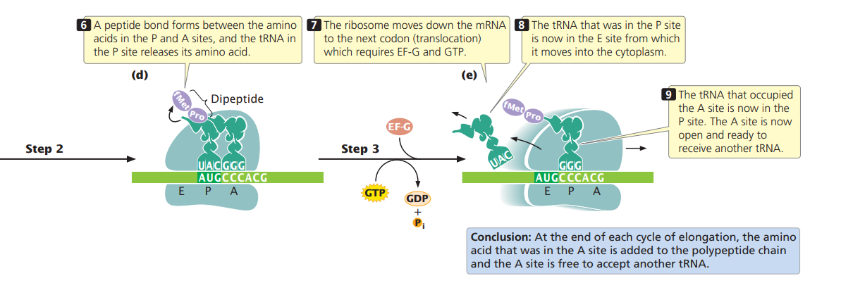

Slide 13
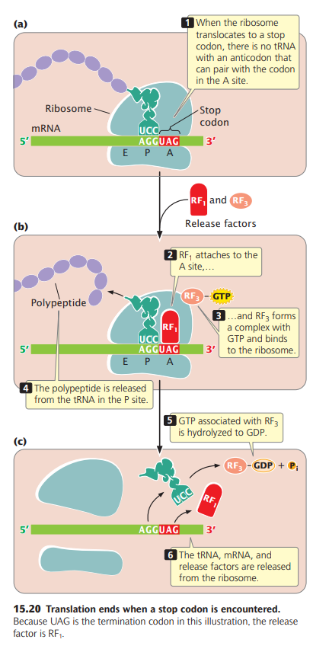

Slide 14
Post-translational modifications
Post-translational modifications not only change the mass of the protein, they are also often responsible for changes in charge, structure and conformation. This leads to changes in the biological activity of proteins like enzymes, the binding affinity of proteins to receptors and other protein-protein interactions.

