Slide 1
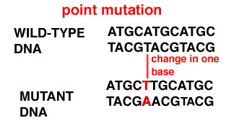
Mutation
Mutation is the change in DNA base pair sequence due to various environmental factors such as UV light, or mistakes during DNA replication.
Any mistake or change in the DNA sequence
Point mutation
Change in one nitrogen base in DNA

Slide 2
Classification & Types of Mutations
Substitution
During replication, one base is inserted incorrectly, replacing the pair at the appropriate location on the complementary strand.
Insertion
In replicating DNA, one or more additional nucleotides are added, frequently causing a frameshift.
Deletion
During replication, one or more nucleotides may be “skipped” or removed, which usually causes a frameshift.

Slide 3
Importance of mutation (beneficial and harmful effects of mutation)
Mutation is the only source of variation
New alleles of gene arise
Most mutations are harmful or lethal but rarely, can be advantageous.
Mutations are raw material of evolution.
Mutagen
A mutagen is a chemical or physical agent capable of inducing changes in DNA called mutations.

Slide 4
Physical mutagens
radioactive substances, x-rays, ultraviolet radiation
Chemical mutagens
- Ethyl methyl sulfate, nitrogen mustards, mitomycin, methyl methane sulfonate (MMS), diethyl sulfate, and nitrosoguanidine (NTG, NG, MNNG) are few examples of alkylating agents as well as DNA-intercalating agents, which include acridine orange, ethidium bromide (EtBr), proflavin, daunorubicin, among others.

