Slide 1
Protein Metabolism

Slide 2
Protein metabolism includes the various biochemical processes
responsible for the synthesis of proteins and amino acids, and the breakdown of proteins by catabolism.
The steps of protein synthesis include transcription, translation,
and post translational modifications.

Slide 3
Unlike fats and carbohydrates, amino acids are not stored by the body,
that is, no protein exists whose sole function is to maintain a supply of
amino acids for future use.
Therefore, amino acids must be obtained from the diet, synthesized
de novo, or produced from normal protein degradation. Any amino acids
in excess of the biosynthetic needs of the cell are rapidly degraded.

Slide 4
Nitrogen enters the body in a variety of compounds present in
food, the most important being amino acids contained in dietary protein. Nitrogen leaves the body as urea, ammonia, and other products derived from amino acid metabolism.
The role of body proteins in these transformations involves two
important concepts: the amino acid pool and protein turnover.

Slide 5
Amino acid pool:
Free amino acids are present throughout the body, for example,
in cells, blood, and the extracellular fluids.
This pool is supplied by three sources:
amino acids provided by the degradation of body proteins,
2) amino acids derived from dietary protein, and
3) synthesis of nonessential amino acids from simple intermediates of metabolism.
Conversely, the amino pool is depleted by three routes:
synthesis of body protein,
amino acids consumed as precursors of essential nitrogen-containing small molecules, and
3) conversion of amino acids to glucose, glycogen, fatty acids, ketone bodies, or CO₂ + H₂O.

Slide 6
Protein turnover
Most proteins in the body are constantly being synthesized and then degraded, permitting the removal of abnormal or unneeded proteins. For many
proteins, regulation of synthesis determines the concentration of protein in
the cell, with protein degradation assuming a minor role. For other proteins,
the rate of synthesis is constitutive, that is, relatively constant, and
cellular levels of the protein are controlled by selective degradation.

Slide 7
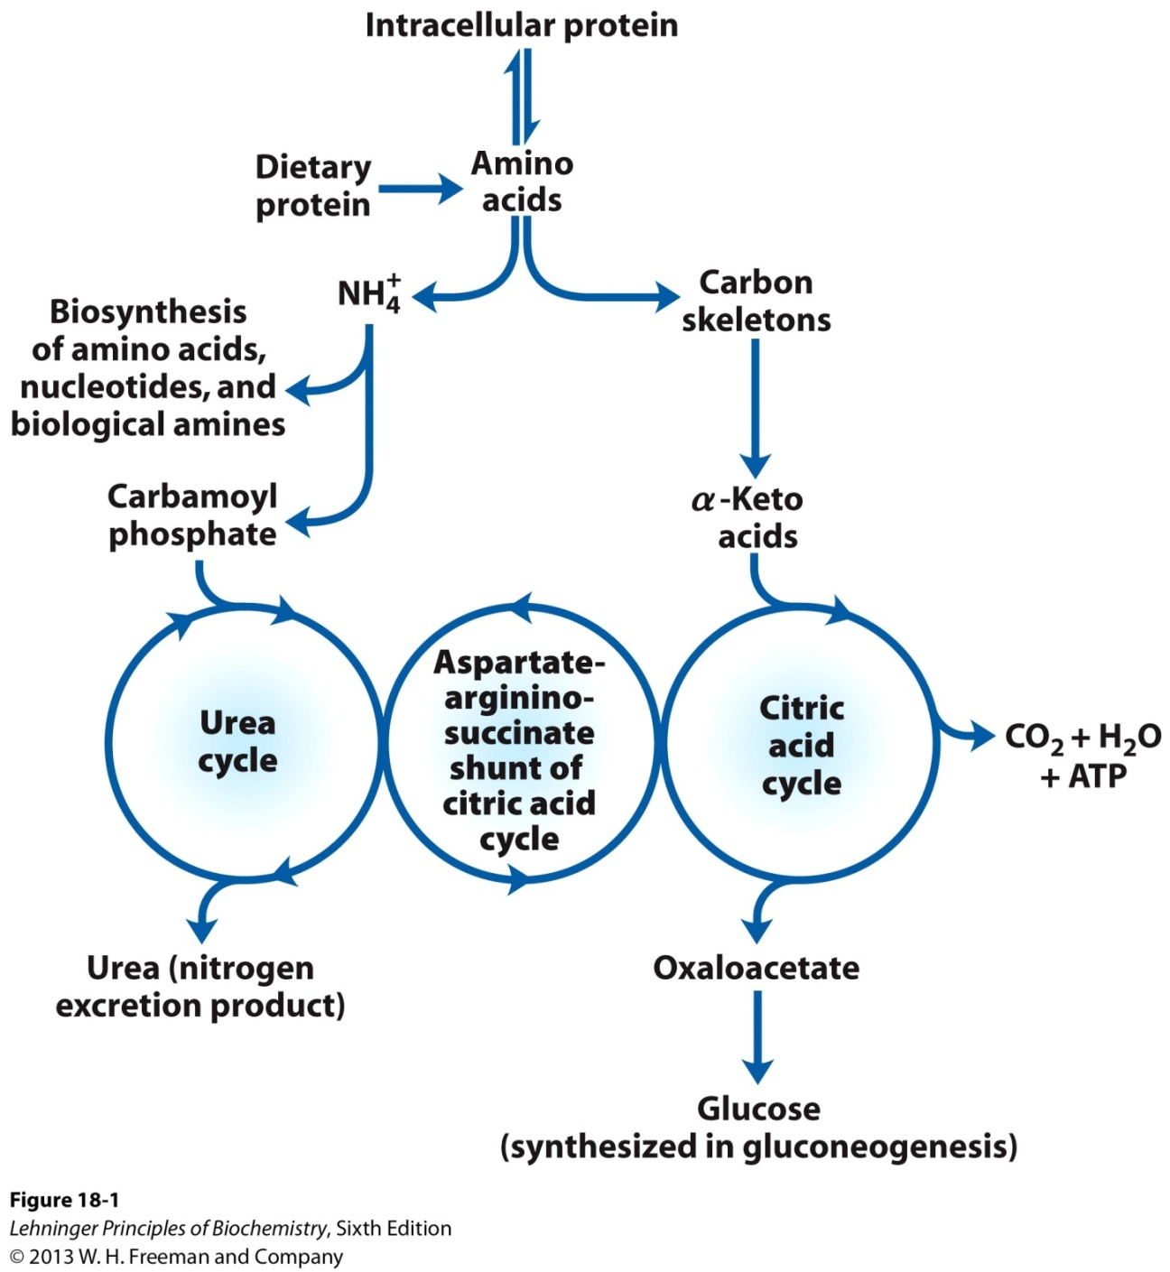
Overview of amino acid catabolism in mammals
Overview of amino acid catabolism in mammals. The amino groups and the carbon skeleton take separate but interconnected pathways.

Slide 8
Metabolic Fates of Amino Groups
Nitrogen, N₂, is abundant in the atmosphere but is too
inert for use in most biochemical processes. Because only a few microorganisms can convert N₂ to biologically useful forms such as NH₃, amino groups are carefully husbanded in biological systems.

Slide 9
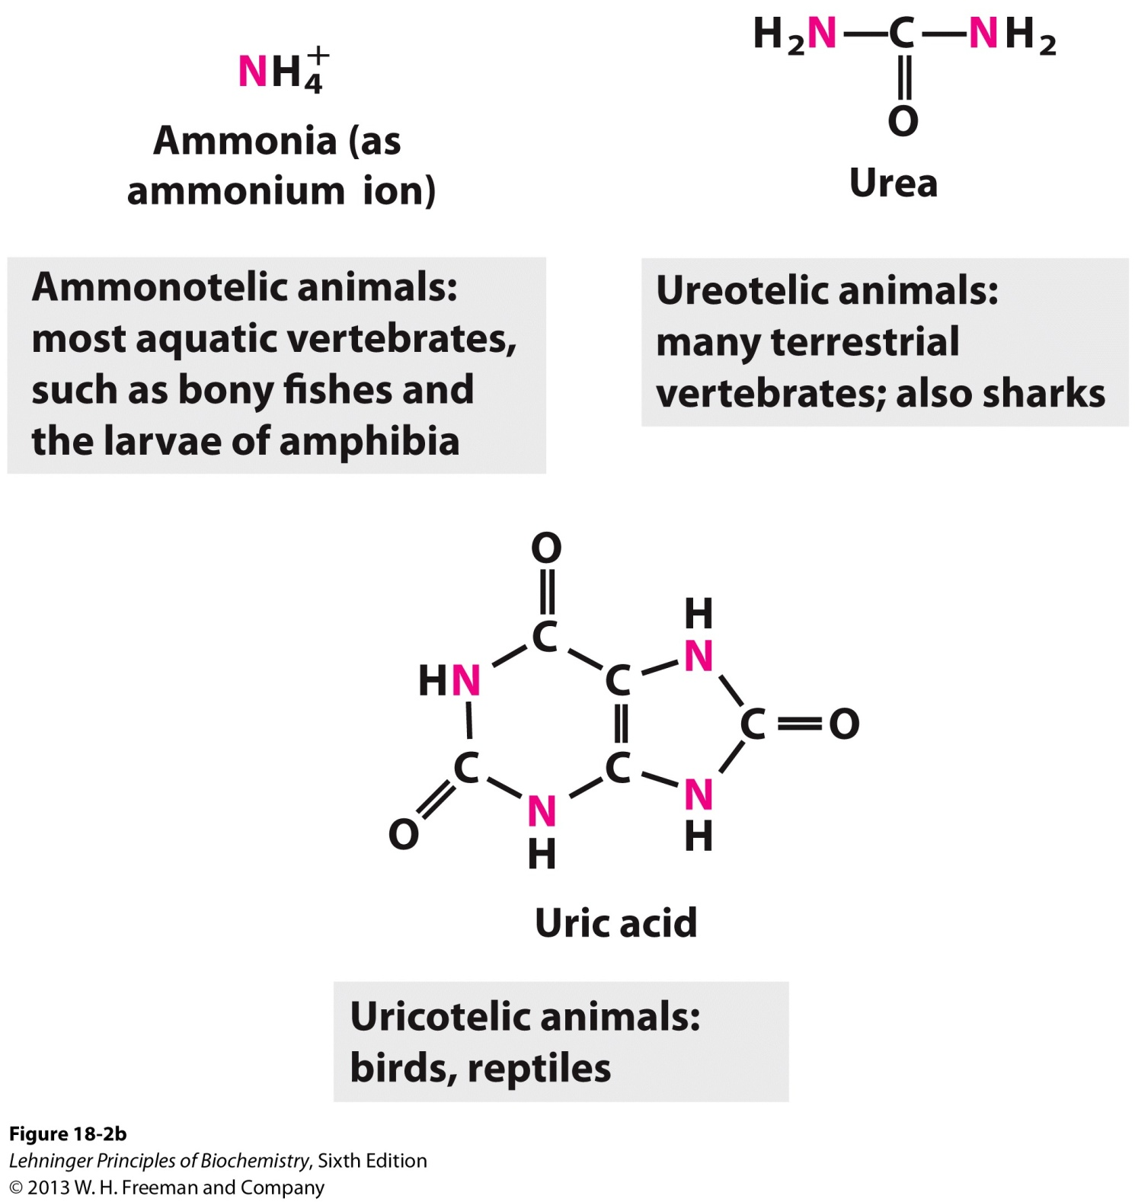
Metabolic Fates of Amino Groups
Excretory forms of nitrogen
(b) Excretory forms of nitrogen.
Excess NH⁺₄ is excreted as ammonia (microbes, bony fishes), urea (most terrestrial vertebrates), or uric acid (birds and terrestrial reptiles)

Slide 10
Amino acid Metabolism
Catabolic Pathway
- Transamination
- Oxidative deamination

Slide 11
Transamination reaction
Transamination
The transfer of an α-amino group from one amino acid to an α-ketoacid with simultaneous conversion another ketoacid to an amino acid catalysed by the enzyme aminotransferase is called transamination.

Slide 12
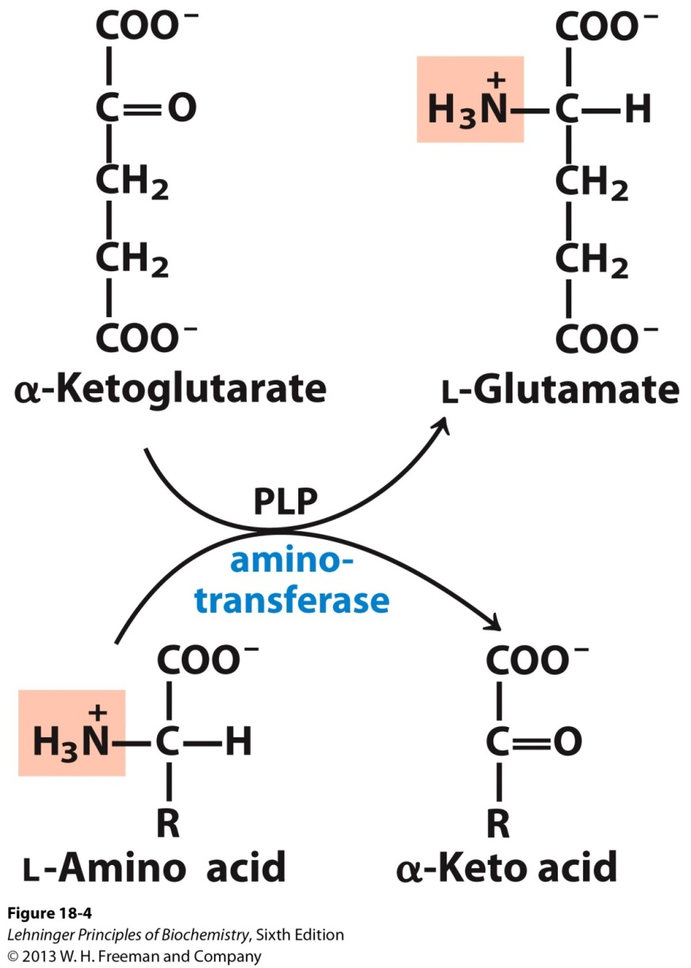
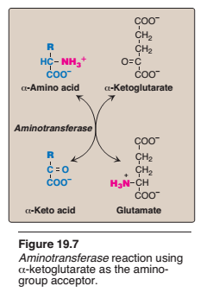
Transamination reaction

Slide 13
This transfer of amino groups from one carbon skeleton to another is catalyzed by a family of enzymes called aminotransferases(formerly called trans -aminases).
These enzymes are found in the cytosol and mitochondria of cells through out the body—especially those of the liver, kidney, intestine, and muscle.
All amino acids, with the exception of lysine and threonine, participate in transamination at some point in their catabolism.

Slide 14
Oxidative deamination
Oxidative deamination is the liberation of free ammonia from the amino group of aminoacids coupled with oxidation.
The amino groups from many of the α-amino acids are collected in the liver in the form of the amino group of L-glutamate molecules coupled with oxidation. These amino groups must next be removed from glutamate to prepare them for excretion.
In hepatocytes, glutamate is transported from the cytosol into mitochondria, where it undergoes oxidative deamination catalyzed by L-glutamate dehydrogenase.
It is the only enzyme that can use either NAD+ or NADP+ as the acceptor of reducing equivalent.
Purpose oxidative deamination is to provide NH3 for urea synthesis and α-Keto acids for a variety of reactions including energy generations

Slide 15
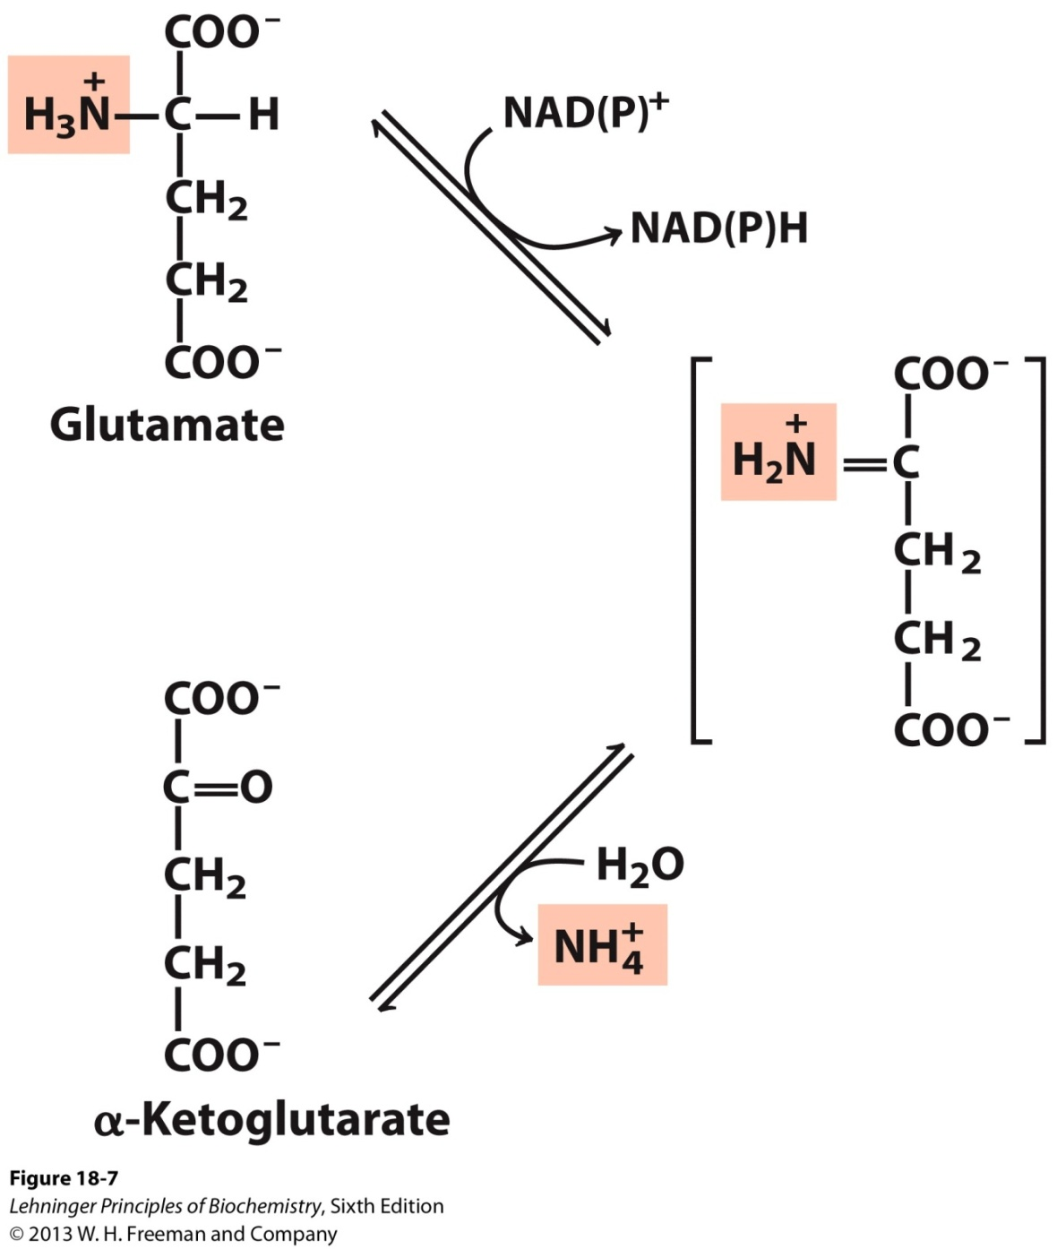
Oxidative deamination
L-glutamate dehydrogenase.
The glutamate dehydrogenase of mammalian liver has the unusual capacity to use either NAD* or NADP+ as cofactor.
The glutamate dehydrogenases of plants and microorganisms are generally specific for one or the other.
The mammalian enzyme is allosterically regulated by GTP and ADP.

Slide 16
Regulation of Glutamate Dehydrogenase (GD)
Glutamate dehydrogenase (GD)
-Present only in the mitochondrial matrix.
-Complex allosteric enzyme
-The enzyme molecule consists of 6 identical subunits.
- Activity is influenced by the positive modulator ADP and by the negative modulator GTP.
Whenever a hepatocyte needs fuel for the citric acid cycle, GD activity increases, making α-ketoglutarate available for the citric acid cycle and releasing NH4+for excretion.
On the contrary, whenever GTP accumulates in the mitochondria due to high activity of the citric acid cycle, oxidative deamination of glutamate is inhibited.

Slide 17
Regulation of Glutamate Dehydrogenase (GD)

Slide 18
Toxicity of ammnonia
Even a marginal elevation in the blood ammonia concentration is harmful to the brain.
Ammonia, when it accumulates in the body, results in slurring of speech and blurring of the vision and causes tremors. lt may lead to coma and, finally, death, if not corrected.
Hyperammonemia
Elevation in blood NH3 level may be genetic or acquired. lmpairment in urea synthesis due to a defect in any one of the
five enzymes is described in urea synthesis.
All these disorders lead to hyperammonemia and cause mental retardation. The acquired hyperammonemia may be due to hepatitis, alcoholism etc. where the urea synthesis becomes defective, hence NH3 accumulates.

Slide 19
Urea cycle
Urea is the end product of protein metabolism (amino acid metabolism). The nitrogen of amino acids, converted to ammonia, is toxic to the body. lt is converted to urea and detoxified.
Urea is synthesized in liver and transported to kidneys for excretion in urine. Urea cycle is the first metabolic cycle that was elucidated by
Hans Krebs and Kurt Henseleit (1932), hence it is known as Krebs-Henseleit cycle.
Urea has two amino (-NH) groups, one derived from NH₃ and the other from aspartate.
Carbon atom is supplied by CO2. Urea synthesis is a five-step cyclic process, with five distinct enzymes. The first two enzymes are present in mitochondria while the rest are localized in cytosol.

Slide 20
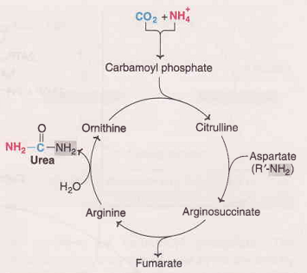
Urea cycle

Slide 21
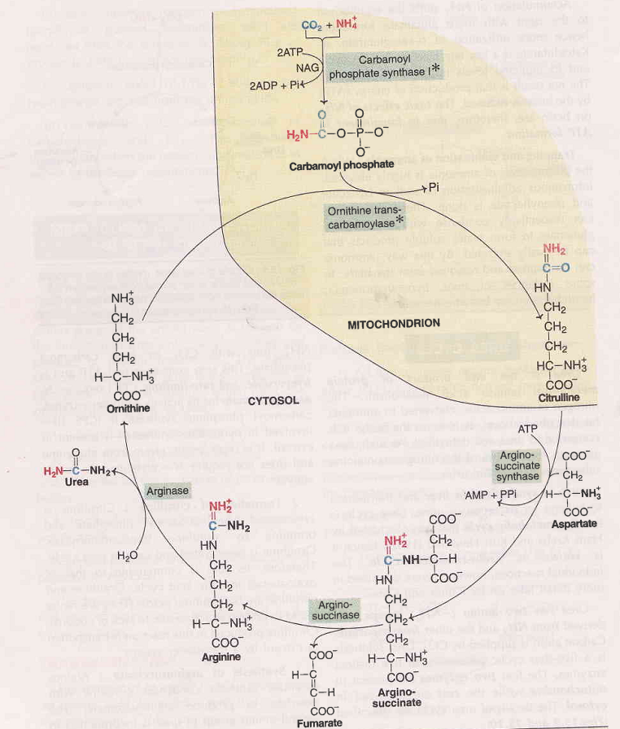
Urea cycle

Slide 22
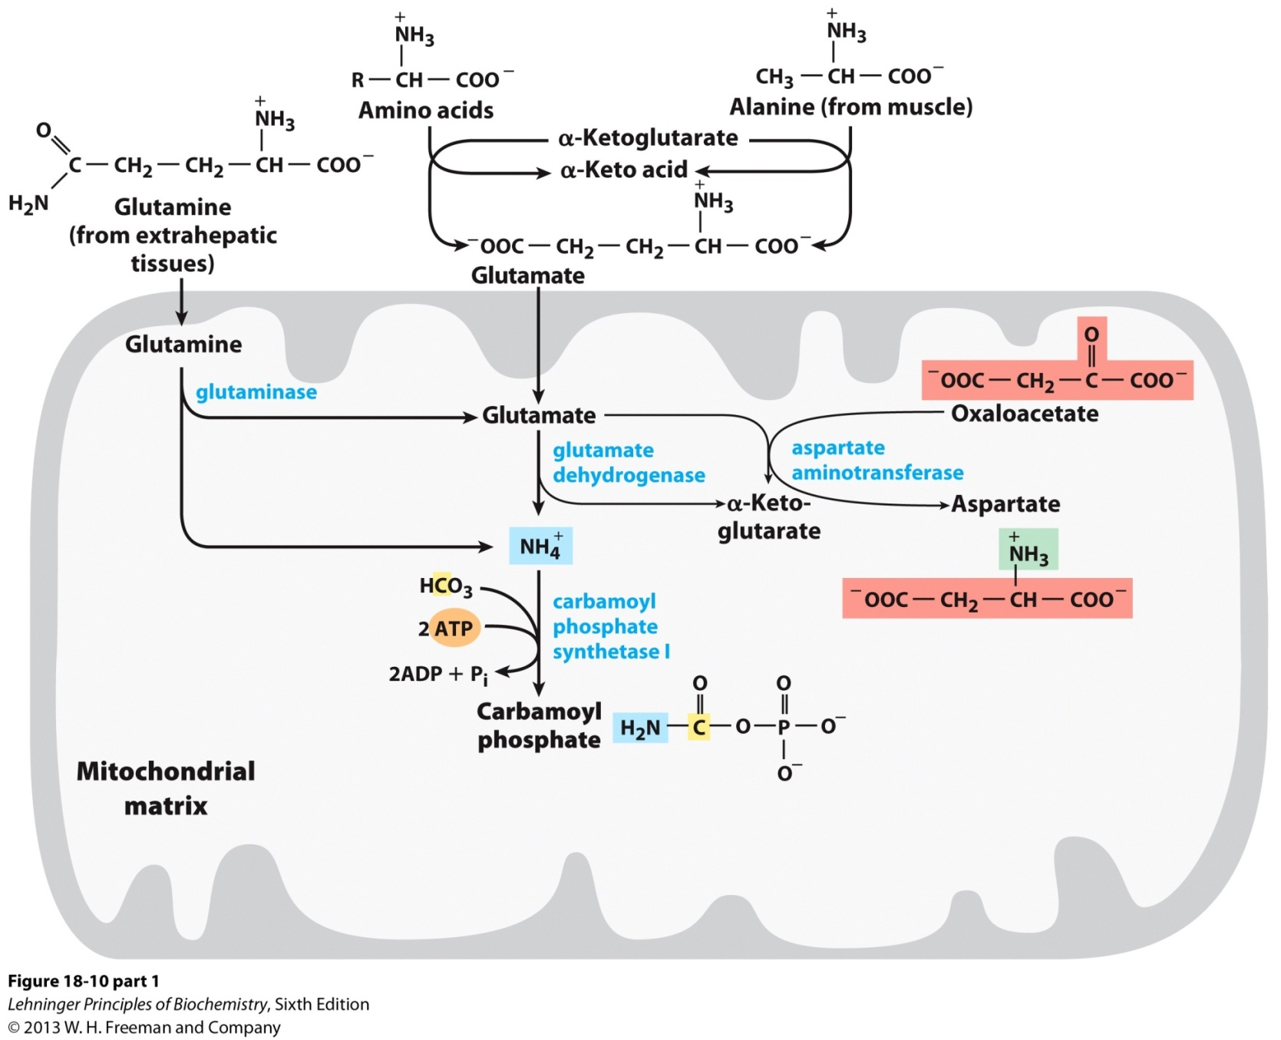
Urea cycle

Slide 23
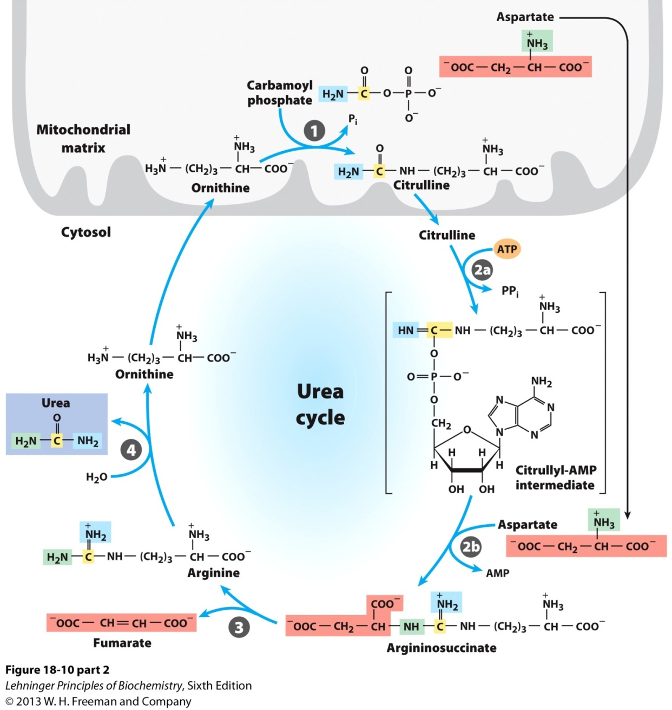
Urea cycle

Slide 24
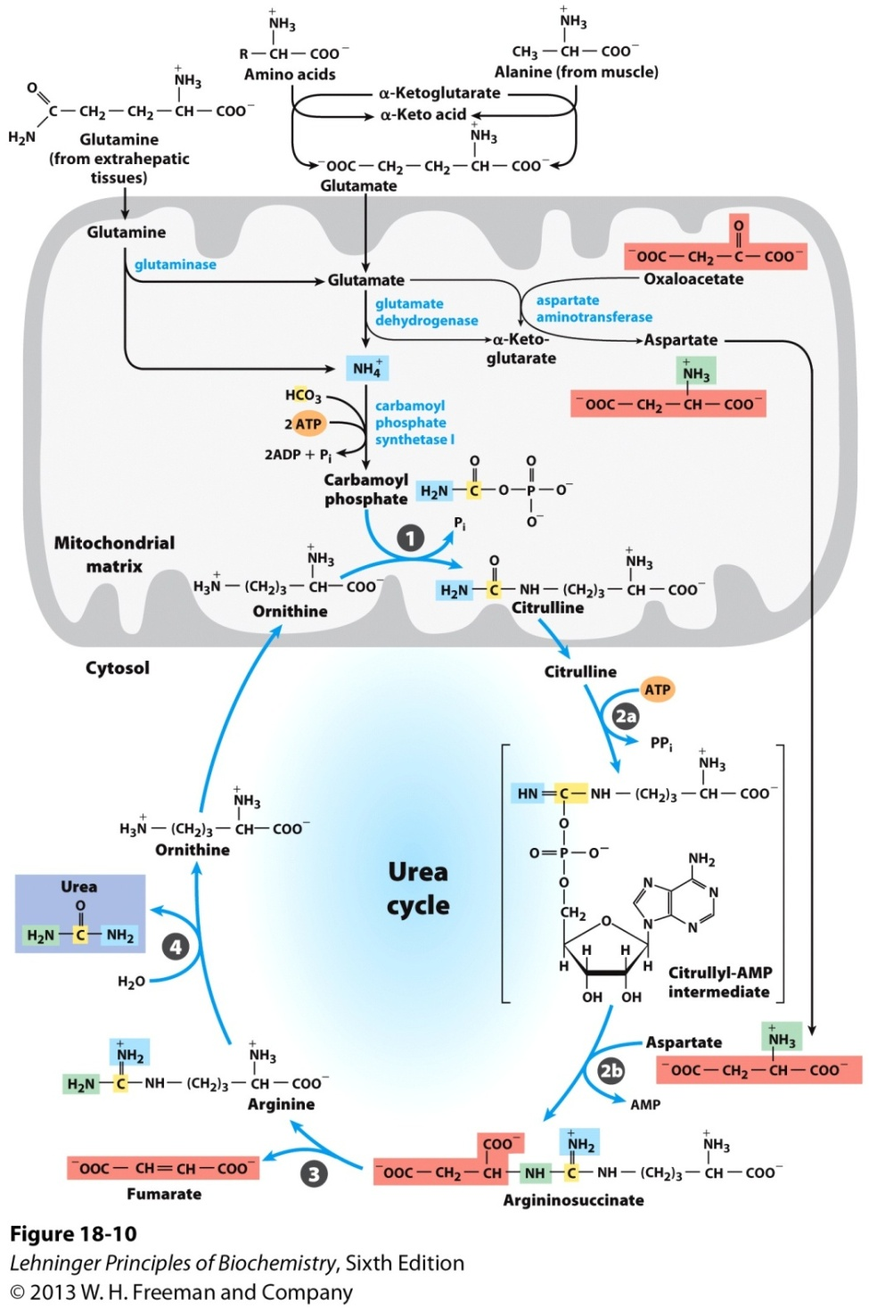
Urea cycle

Slide 25
Urea cycle
1. Synthesis of carbamoyl phosphate : Carbamoyl phosphate synthase | (CPS l) ofmitochondria catalvses the condensation of
NH4 ions with CO2 to form carbamoyl phosphate. This step consumes two ATP and is irreversible, and rate-limiting. CPS I requires Nacetylglutamafe for its activity.
2. Formation of citrulline: Citrulline is synthesized from carbamoyl phosphate and ornithine by ornithine transcarbamoylase.
Ornithine is regenerated and used in urea cycle.
Synthesis of arginosuccinate: Arginosuccinate synthase condenses
citrulline with aspartate to produce arginosuccinate. The second
amino group of urea is incorporated in this reaction. This step requires ATP which is cleaved to AMP and pyrophosphate (PPi).
The latter is immediately broken down to inorganic phosphate (Pi)
Cleavage of arginosuccinate: Arginosuccinase cleaves arginosuccinate
to give arginine and fumarate. Arginine is the immediate
precursor for urea. Fumarate liberated here provides a connecting link
with TCA cycle, gluconeogenesis etc.
Formation of urea: Arginase is the fifth and final enzyme that cleaves arginine to yield urea and ornithine. Ornithine, so regenerated, enters mitochondria for its reuse in the urea cycle

Slide 26
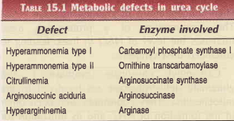
Urea cycle
Deficiencies of Urea cycle enzymes
Metabolic defects associated with each of the five enzymes of urea cycle have been reported (Table l5.l). All the disorders invariably lead to a build-up in blood ammonia (hyperammonemia), leading to toxicity.
Other metabolites of urea cycle also accumulate which, however, depends on the specific enzyme defect. The clinical symptoms
associated with defect in urea cycle enzymes include vomiting, lethargy, irritability, ataxia and mental retardation.

