Slide 1
Neoclassical Organization Theory
Time Line: Approximately 1945 (end of WW II) through the 1950s.
There are mainly three elements of neoclassical theory of management. They are Hawthorne Experiment, Human Relation Movement, and Organizational Behavior.
George Elton Mayo (1890-1949) is considered to be the founder to the neoclassical theory.

Slide 2
Hawthorne experiments:
The Hawthorne studies were a series of experiments conducted at the Western Electric Company (USA) between 1927 and 1932 that provided new insights into individual and group behavior.
The studies focused on behavior in the workplace. In one experiment involving this group of workers, for example, researchers monitored how productivity changed as a result of changes in working conditions.
The Hawthorne experiments is classified into four stages:
Illumination experiments
Relay assembly test room experiments
Mass interviewing programme
Bank wiring observation room study

Slide 3
The crux of the Hawthorne experiment was based on the alteration of the ―intensity of light available to a group of randomly selected workers and, ―on the idea that when the light became brighter, production would increase and when the light became dimmer, production would decrease. In this experiment the workers were told that they would be observed as an experimental group. The conditions were fulfilled by the researchers and, production followed the trend anticipated. Even, when the lights were dimmed to near darkness, production still kept climbing.

Slide 4
Human relation movement:
Taking a clue from the Hawthorne Experiments several theorists conducted research in the field of interpersonal and social relations among the members of the organization. These relations are known as human relations. A series of studies by Abraham H. Maslow, Douglas Mc Gregor, Frederick Herzberg, Keth Davis, Rensis Likert and others lead to what is human relation movement (Singh, 1983). Human relation movement argued that workers respond primarily to the social context of the workplace, including social conditioning, group norms and interpersonal dynamics.

Slide 5
Much of the emphases of human relations have been on the informal work group, what makes them work or not. And, researchers in the school had equally investigated the managerial echelons as well, in addition to conducting research works on motivation and job satisfaction all of which had immensely contributed to the study of Public Administration. In most cases, human needs in organizations as well as the humanistic aspects of the organizations themselves, in the society have been given the pride of place. Notable among these are Maslow‘s hierarchy of human needs, McGregor‘s human side of enterprise which are later highlighted.

Slide 6
Organizational behavior:
Several psychologists and sociologists began the study of group dynamics, Chris Argyris, Homans Kurt Lewin, R.L. Katz, kahn and others developed the field of organizational behavior. It involves the study of attitudes, behavior and performance of individuals and groups in organizational settings. This approach came to be known as behavioral approach. It is extended and improved version of human relations movement. It is multidimensional and interdisciplinary the application of knowledge drawn from behavioral sciences (Psychology, sociology, anthropology, etc) to the management problems (Cole G A, 1984). Therefore, it is also called behavioral science approach.

Slide 7
New-classical approach is contained in two points:
Organisational situation should be viewed in social, economic and technical terms, and
The social process of group behaviour can be understood in terms of clinical method analogous to the doctor’s diagnosis of human organism.

Slide 8
The main propositions of neo-classical theory:
1. The organisation, in general, is a social system composed of numerous interacting parts.
2. Informal organisations exist within the formal organisation. Both are affected by and affect each other.
3. Human being is independent and his behaviour can be predicted in terms of social factors at work.
4. Motivation is a complex process. Many socio- psychological factors operate to motivate human beings at work.
5. A conflict between organisational and individual goals often exists. There is a need to reconcile the goals of the individual with those of the organisation.
6. Team-work is essential for higher productivity.
7. Man’s approach is not always rational. Often, he behaves non-logically in terms of rewards which he seeks from his work.
8. Communication is necessary as it carries information for the functioning of the organisation and the feelings of the people at work.

Slide 9
Improvements over Classical Theory:
Neo-classical theory offers modifications and improvements over classical theory in some aspects such as:
Flat structure
Decentralisation
Informal organisations

Slide 10
Flat Structure:
The classical theory suggested tall structure whereas neo-classical theory suggested flat structure. In tall structure there is a problem of communication because of differentiation between decision makers and implementers, the levels of management are too many and motivation of people is difficult. In case of flat structure the wide span of control helps in motivation, chain of communication is shorter and it is free from hierarchical control.

Slide 11
Decentralisation:
Neo-classical theory advocates decentralised organisation which is close to flat structure because of wider span of control. It allows autonomy and initiative at the lower level. It also develops people to occupy higher positions in future.

Slide 12
Informal Organisation:
The neo-classical theorists advocated the need for both formal and informal organisations. Formal organisation represents the intentions of top management for the purpose of interactions among the people. Informal organisation is necessary to plug the loop holes of formal organisation and to satisfy the social and psychological needs of people. Managements use informal organisation for overcoming resistance to change on the part of workers and also for fast communication process. Both formal and informal organisations are interdependent upon each other.

Slide 13
Dominant Model, Metaphor, Underlying Assumptions:
• “The general connotation is that of a theoretical perspective that revises and/or is critical of classical organization theory – particularly for minimizing issues related to the humanness of organizational members, the coordination needs among administrative units, the operation of internal-external organizational relations, and the processes used in decision making”.
• It “initiated the theoretical movement away from the overly simplistic mechanistic views of classical organization theory”.
• “One of the major themes of the neoclassical organization theorists was that organizations did not and could not exist as self-contained islands isolated from their environments”.
• Incorporated the profession of sociology into organization theory.
• “Provided the intellectual and empirical impetus to break the classicalists’ simplistic mechanically oriented, monopolistic dominance of the field”.
• “paved the way-opened the door-for the soon-to-follow explosions of thinking from the human relations, “modern” structural, systems, power and politics, and organizational culture perspectives of organizations” .

Slide 14
Major Theorists and Contributions:
Chester Bernard
According to Barnard initial existence of organisation depends upon three elements: (i) The willingness of persons to contribute efforts to the co-operative system. (ii) There should be an objective of co-operation (iii) Proper communication system is necessary.
Chester Barnard is regarded as spiritual father of social system school. He conceived organization as a Cooperative system. An organization comes into existence when people are able to communicate with each other, willing to cooperate with each other and have a common purpose.
“Sought to create a comprehensive theory of behavior in organizations that was centered on the need for people in organizations to cooperate – to enlist others to help accomplish tasks that individuals could not accomplish alone”.

Slide 15
“The responsibility of an executive is (1) to create and maintain a sense of purpose and a moral code for the organization – a set of ethical visions that established “right or wrong” in a moral sense, a deep feeling or innate conviction, not arguable; emotional, not intellectual in character”; (2) to establish systems of formal and informal communication; and (3) to ensure the willingness of people to cooperate”.
“Individuals must be induced to cooperate”, “the executive needs to employ different strategies for inducing cooperation, including ways not only to find and use objective positive incentives and reduce negative incentives but also to change the state of mind, or attitudes, or motives so that the available objective incentives can become effective”.
“from the viewpoint of the organization requiring or seeking contributions from individuals, the problem of effective incentives may be either one of finding positive incentives or of reducing or eliminating negative incentives or burdens”
A great list of classes of incentives.
Methods of persuasion.

Slide 16
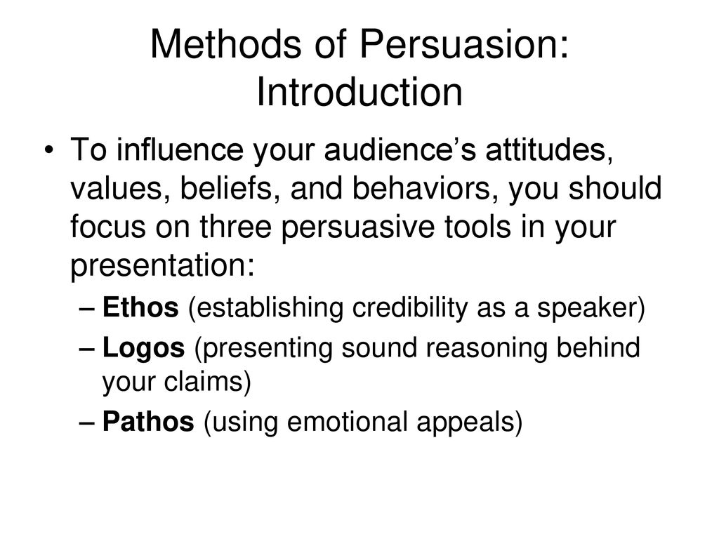

Slide 17
Robert Merton (an article on Bureaucratic Structure and Personality)
“proclaimed that the ‘ideal type” bureaucracy as described by Max Weber had inhibiting dysfunctions – characteristics that prevented it from being optimally efficient – and negative effects on the people who worked in it”.
“Bureaucracy is administration which almost completely voids public discussion of its techniques, although there may be public discussions of its policies”.
Discusses dysfunctions of bureaucracy and problems this creates for research.

Slide 18
Herbert A Simon– The proverbs of Administration
One of the first to attack classical organization theory.
“For almost every principle one can find an equally plausible and acceptable contradictory principle”.
Points out, with a topic of centralization vs. decentralization, that each has their benefits/advantages.
Stated that classical organization theory was “inconsistent, conflicting, and inapplicable to many of the administrative situations facing managers”.
Stated that the “so-called principles of administration are instead proverbs of administration”.
Asserted that “organizational theory is, in fact, the theory of the bounded rationality of human beings who ‘satisfice’ because they do not have the intellectual capacity to maximize”.
He developed the “science” of improving decision making through quantitative measures.
He “was the leader in studying the processes by which administrative organizations make decisions.

Slide 19
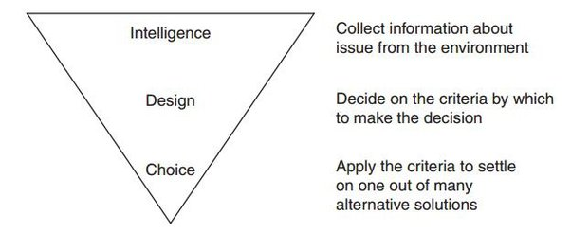
Herbert Decision Making Model

Slide 20
Philip Selznick – Foundations of the Theory of Organization
“But as we inspect these formal structures we begin to see that they never succeeded in conquering the non-rational dimensions of organizational behavior”.
“On one hand, any concrete organizational system is an economy; at the same time, it is an adaptive social structure”.
Sociologist, asserted that “while it is possible to describe and design organizations in a purely rational manner, such efforts can never hope to cope with the non-rational aspects of organizational behavior”.
Stated that “organizations consist not simply of a number of positions for management to control, but of individuals, whose goals and aspirations might not necessarily coincide with the formal goals of the organization”.
Known for his concept of “Cooptation” which “describes the process of an organization bringing and subsuming new elements into its policy-making process in order to prevent such elements from becoming a threat to the organization or its mission”.

Slide 21
Richard M. Cyert and James G. March – A Behavioral Theory of Organizational Objectives
“Our interest is in understanding how complex organizations make decisions, not how they ought to do so”.
“Discussed the formation and activation of coalitions as well as negotiations to impose coalitions’ demands on the organization”.
“Postulated that corporations tended to ‘satisfice’ rather than engage in economically rational profit-maximizing behavior”.

Slide 22
Melvin Dalton
“focused on structural frictions between line and staff units and between the central office of an organization and geographically dispersed facilities”.

Slide 23
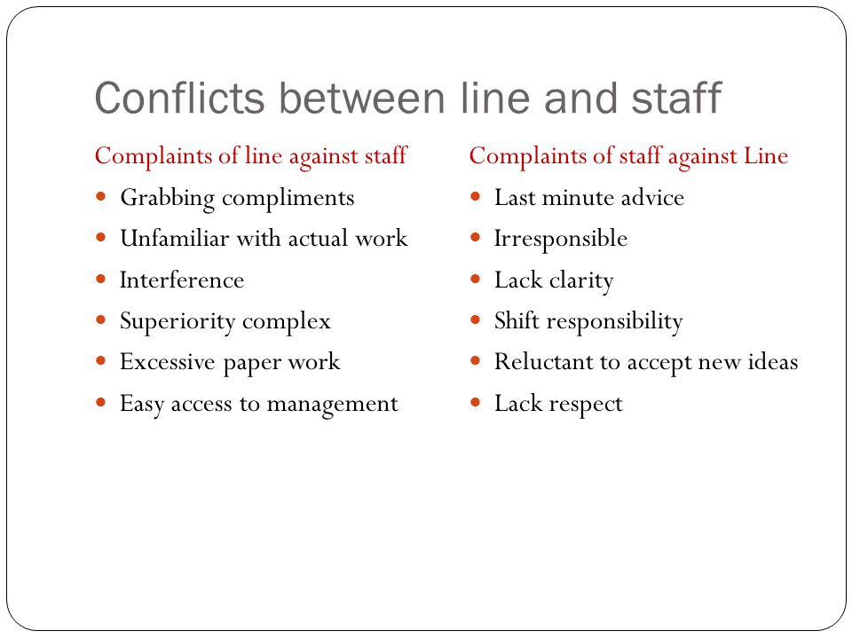

Slide 24
Talcott Parsons
“defined an organization as a social system that focuses on the attainment of specific goals and contributes, in turn, to the accomplishment of goals of a more comprehensive system, such as the larger organization or even society itself.

Slide 25
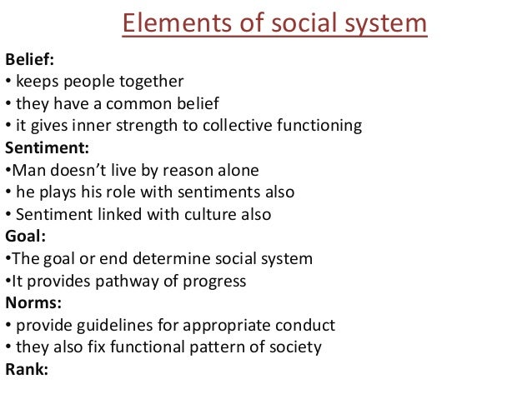

Slide 26
William F. Whyte
studied “stresses that result from interrelations and status differences in the workplace”.

Slide 27
Criticism of this theory
The assumptions on which this theory is based are sometimes not true. A thinking that there is always a possibility of finding a solution acceptable to all is not true. There are conflicting interests among various groups that are structural in character and not merely psychological. This aspect has not been discussed in the theory.
No particular organisational structure can be suitable for all the organisations. Various organisational formats given by neo- classists are not applicable in all situations.
Neo-classical theory is only a modification of classical organisation theory. It suffers from nearly same drawbacks from which classical theory suffered. It lacks unified approach of organisation. This theory has also been criticised on the ground that it is nothing more than “a trifling body of empirical and descriptive information as it was mainly based on Hawthorne Studies.”

Slide 28
Classical Vs Neoclassical theory:
Points of distinction | Classical approach | Neoclassical approach
Focus | Functions and economic demand of workers | Emotion and human qualities of workers
Structure | Impersonal and mechanistic | Social system
Application | Autocratic management and strict rules | Democratic process
Emphasize | Discipline and rationality | Personal security and social demand
Work goal of worker | Maximum remuneration and reward | Attainment of organizational goal
Concept about men | Economic being | Social being
Content | Scientific management, administrative management, and bureaucratic management | Hawthorne experiment , human relation movement and organizational behavior
Relation | Formal | Informal
Nature | Mechanistic | Organistic

Slide 29
Question Hour

