Slide 1
Continued…….

Slide 2
A Shift Away from Classical Management Theory
In the early 1920s, classical management theorists, such as Frederick Taylor, Henry Gantt, and Frank and Lillian Gilbreth, spent their time researching how a specific job was done, what steps were taken by an employee to complete the work, and the amount of time it took a worker to complete a task using different methods. They then used this information to determine the most effective way of completing a task. While these individuals focused on the science of creating specialized work processes and workforce skills to complete production tasks efficiently, critics began to scrutinize classical management theory for its potentially harmful effects on workers.

Slide 3
Neoclassical approaches recognize early classical frameworks but the school takes the assumption of the classical doctrine about the ‘pillars of organization’.
It integrates the behavioral sciences into management thought in order to solve problems caused by classical theory of practice.
Instead of concentrating on production, structures, or technology, the neoclassical theory was mainly associated with the employee.
It focuses on work - and the neoclassical approach - which focuses on workers.

Slide 4
Neoclassical theorists focused on replying questions related to the best way to motivate, structure, and support employees within the organization.
It was believed that any manager who failed to account for the social needs of his or her employees could expect to deal with resistance and lower performance.
It is designated that effective co-ordination of activities is not possible without the collaboration of people.
Neo classical approach emphasised the role of informal organisations as agencies of social change (Informal Leadership). Neo classical theory developed motivational theory and theory of co-ordination and leadership.

Slide 5
The behavioral method/neo-classical theory deliver the basis for contemporary theories of leadership, motivation, and group development and behavior. Managers visualize an organization as a form with many inter-reliant parts, all of which is significant to the welfare of the organization, for instance, a whole employing the systems method.

Slide 6
Concretely put, this school of thought laid emphasis on, and, introduced the values of behavioral sciences into the theory of organization in ways conducive to the demonstration and measurement of the impact of human actions on the pillars of the classical doctrine.

Slide 7
Working with the informal organization involves not threatening its existence unnecessarily, listening to opinions expressed for the group by the leader, allowing group participation in decision making situation”.
The semi-secret nature of the informal organizations notwithstanding, they have some characteristics which include:
● Informal organizations act as agents of social control,
● Informal organizations have status and communication system peculiar to themselves not necessarily derived from the formal system,
● Survival of the informal organizations requires stable continuing relationships among the people in them etc.,

Slide 8
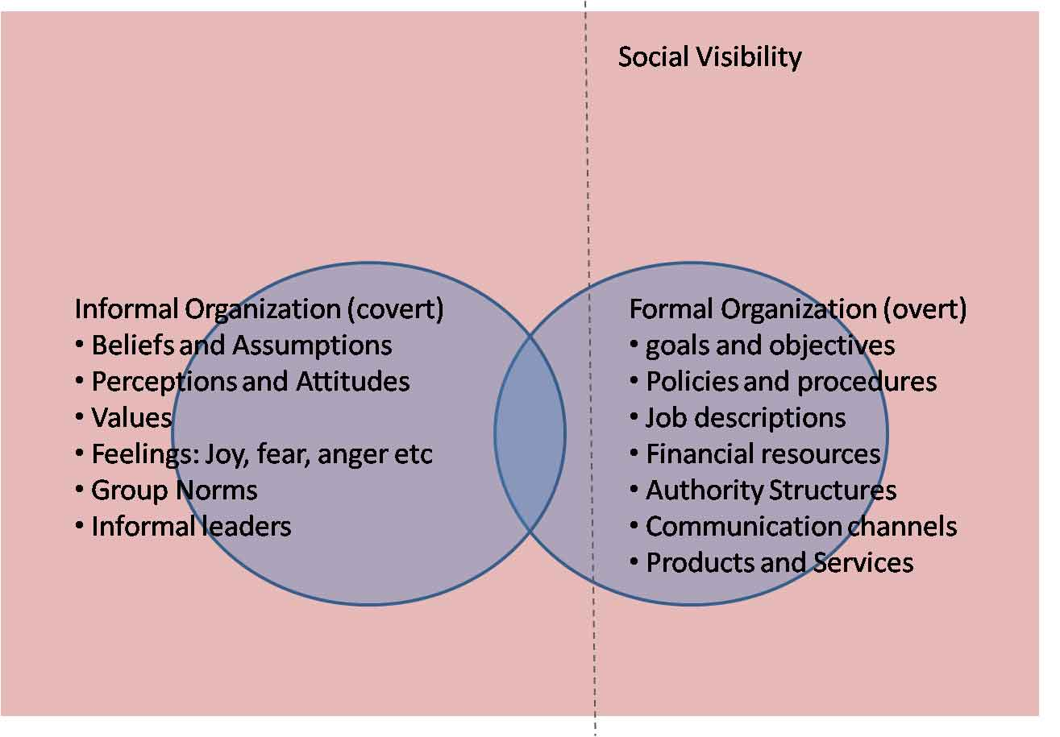

Slide 9
Strengths and Weaknesses
Strengths:
Neoclassical theory has made significant contribution to an understanding of human behavior at work and in organization. It has generated awareness of the overwhelming role of human factor in industry.
It found “holes” in classical organization theory, attempted to revise it, and spurred almost all other schools of thought that followed.
It led to further research and study relating to the humanness of organizational members, coordination needs among administrative units, the operation of internal-external relations, and the processes used in decision making.
De-emphasized simplistic mechanistic organizational theories.
Helped the future incorporation of professions into organization theory, such as sociology.

Slide 10
Weaknesses:
First, it lacks the precision of classical theory because human behavior is unpredictable.
Neo-classical theory is only a modification of classical organisation theory. It suffers from nearly same drawbacks from which classical theory suffered. It lacks unified approach of organisation. This theory has also been criticised on the ground that it is nothing more than “a trifling body of empirical and descriptive information as it was mainly based on Hawthorne Studies.”
No particular organisational structure can be suitable for all the organisations. Various organisational formats given by neo-classists are not applicable in all situations.
Lastly its application in practice is very difficult because it requires fundamental changes in the thinking and attitude of both management and workers.
“The neoclassicalists did not develop a body of theory that could adequately replace the classical school”.
“It attempted to blend assumptions of classical theory with concepts that were subsequently used by later organization theorists from all perspectives”: It was an “anti-school” – it couldn’t stand on its own.

Slide 11
Question Hour

