Slide 1
School: Modern Structural Organization Theory
Time Line: Post WW II, second half of 20th century (differentiated from classical structure theories pre-WW II).

Slide 2
• “Modern” structuralists are concerned with many of the same issues as the classical structuralists”.
• Tenets are similar:
o Organizational efficiency
o Organizational rationality
o Increase the production of wealth in terms of real goods and services

Slide 3
Dominant Model, Metaphor, Underlying Assumptions:
1. “Organizations are rational institutions whose primary purpose is to accomplish established objectives; rational organizational behavior is achieved best through systems of defined rules and formal authority. Organizational control and coordination are key for maintaining organizational rationality”.
2. “There is a ‘best’ structure for any organization, or at least a most appropriate structure in light of its given objectives, the environmental conditions surrounding, the nature of its products and/or services, and the technology of the production process”.
3. “Specialization and the division of labor increase the quality and quantity of production, particularly in highly skilled operations and professions”.
` 4. “Most problems in an organization result from structural flaws and can be solved by changing the structure”.

Slide 4
• “Structural organization theory is concerned with vertical differentiations – hierarchical levels of organizational authority and coordination, and horizontal differentiations between organizational units – such as those between product or service lines, geographical areas, or skills”.
• Org charts are key tools.

Slide 5
Major Theorists and Contributions:
Tom Burns and G. M. Stalker (Mechanistic and Organic Systems)
o Characteristics of the “Mechanistic Management System” and “Organic Management System”.

Slide 6
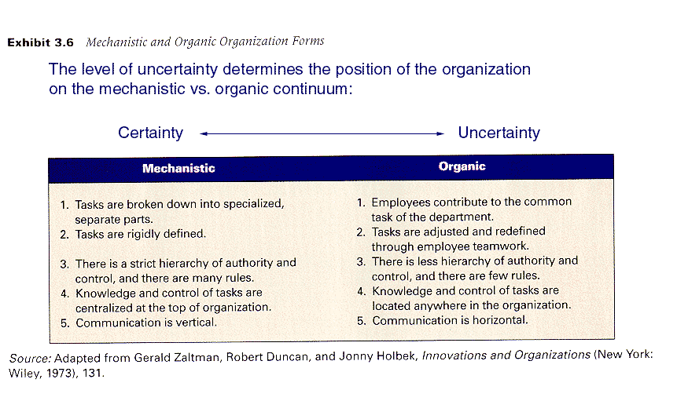

Slide 7
o “The beginning of administrative wisdom is the awareness that there is no one optimum type of management system”.
• “Developed their widely cited theory of ‘mechanistic and organic systems of organization”.
• Contributed to the creation of the “sociotechnical approach”.

Slide 8
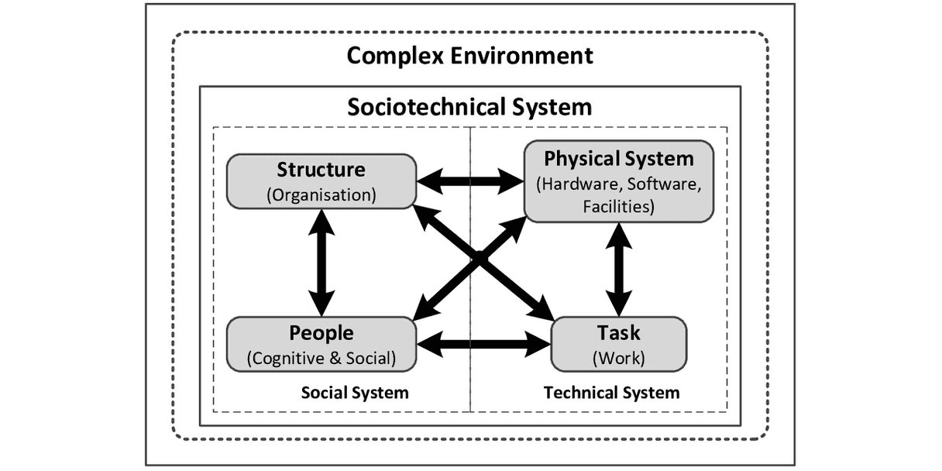

Slide 9
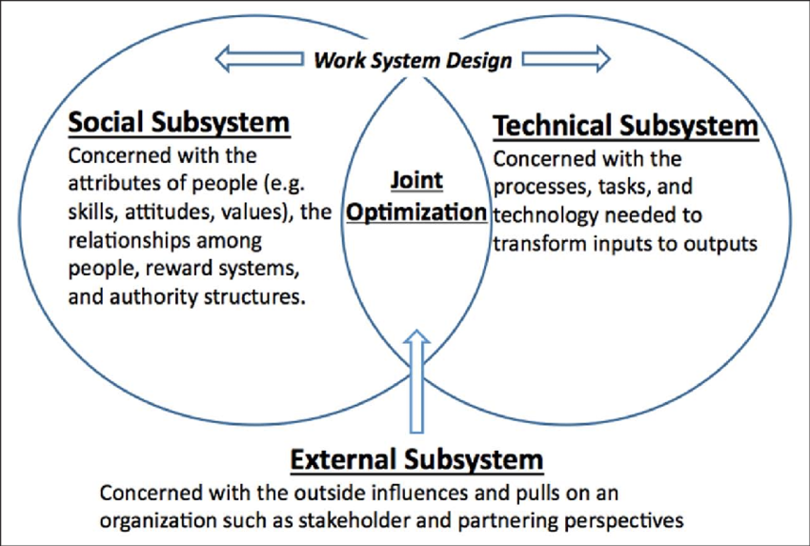

Slide 10
• “found that stable conditions may suggest the use of a mechanistic form of organization where a traditional pattern of hierarchy, reliance on formal rules and regulations, vertical communications, and structured decision making is possible”.
• “However, more dynamic conditions – situations in which the environment changes rapidly – require the use of an organic form of organization where there is less rigidity, more participation, and more reliance on workers to define and redefine their positions and relationships.
• “Either form of organization may be appropriate in particular situations”.

Slide 11
Peter N. Blau and W. Richard Scott (The Concept of Formal Organization)
o “Social organization refers to the ways in which human conduct becomes socially organized, that is, to the observed regularities in the behavior of people that are due to the social conditions in which they find themselves rather than to their physiological or psychological characteristics as individuals”.
o “Since the distinctive characteristics of these organizations is that they have been formally established for the explicit purpose of achieving certain goals, the term ‘formal organization’ is used to designate them”.
• “Assert that all organizations include both a formal and informal element. The informal organization by its nature is rooted in the formal structure and supports its formal organization by establishing norms for the operation of the organization that cannot always be spelled out by rules and policies”.
• “It is impossible to know and understand the true structure of a formal organization without a similar understanding of its parallel informal organization”.

Slide 12
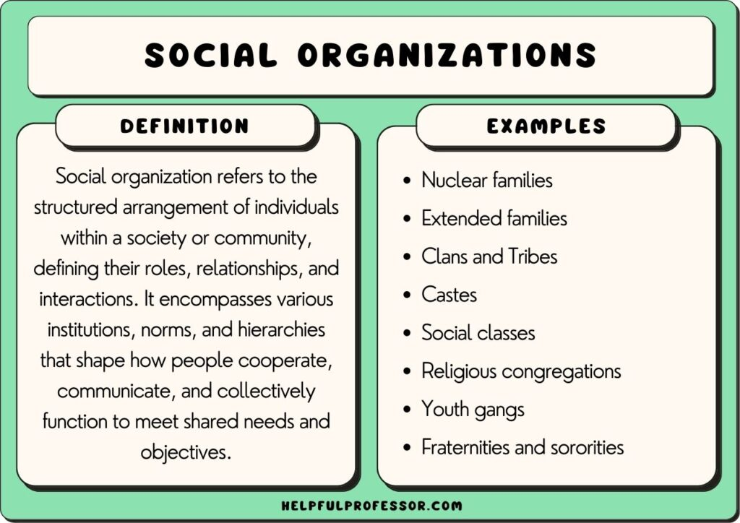

Slide 13
Arthur H. Walker and Jay W. Lorsch (Organizational Choice: Product versus Function)
o Very detailed piece outlining when (a) organization based on product line or (b) based on function, should be used.
• “Should an organization be structured according to product or function?”.
• “Should all specialists in a given function be grouped under a common boss, regardless of differences in products they are involved in, or should the various functional specialists working on a single product be grouped together under the same superior?”.
• “They concluded that either structural arrangement can be appropriate, depending upon the organization’s environment and the nature of the organization itself”.

Slide 14
Types of Organizational Structures
Functional Organizational Structure
Product-Based Divisional Structure
Market-Based Divisional Structure
Geographical Divisional Structure
Process-Based Structure
Matrix Structure
Circular Structure
Flat Structure
Network Structure

Slide 15
Henry Mintzberg (The Five Basic Parts of the Organization)
• “Synthesized many schools of organizational management theory”.
• Created “a model of organizations with five interdependent parts: the strategic apex, the middle line, the operating core, the technostructure, and the support staff”.
o Operating Core – “the operators carry out the basic work of the organization”.
o Strategic Apex – “Those at the very top of the hierarchy, together with their own staff”.
o Middle Line – Managers that join the apex to the core.
o Technostructure – “the analysts carry out their work of standardizing the work of others, in addition to applying their analytical techniques to help the organization adapt to its environment”.
o Support Staff – “supports the functioning of the operating core indirectly, that is, outside the basic flow of operating work”.
o Scalar chain, hierarchy, and feedback.

Slide 16
Coupling
o Pooled coupling – “where members share common resources but are otherwise independent”.
o Sequential coupling – “members work in series as in a relay race”.
o Reciprocal coupling – “the members feed their work back and forth among themselves’ in effect each receives inputs from and provides outputs to the others”.

Slide 17
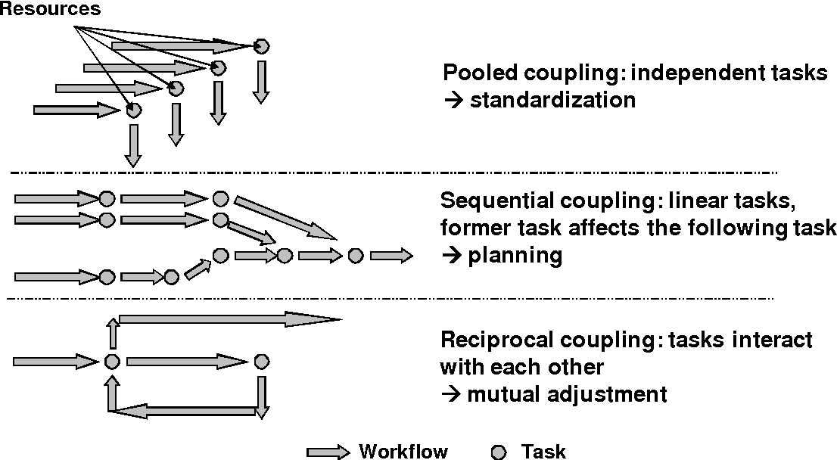

Slide 18
Richard M. Burton and Borge Obel (Technology as a contingency Factor)
o Covers “technology’s effect on formalization, centralization, complexity, configuration, coordination and control, and incentives”.
• Studied “the effects that various dimensions of technology have on organizational design”.
• The effects of technology “assessed on six dimensions of organization: formalizations, centralizations, complexity, configuration, coordination and control, and incentives”.
• Also, interdependency between organizational structure and information technology, organizations as information processing entities, the effects of media richness on design, and design criteria for fitting information technology to decentralized organizations.

Slide 19
Strengths and Weaknesses
Strengths:
Still very focused (in comparison to classical theory) on goals and achievement.
Expanded the perspective of bureaucracy (mechanistic vs. organic).
Acknowledges the existence of both formal and informal elements.
Still a very rational model, but not as closed of a system as classical.
Stressed formal authority and responsibility.
Expanded the understanding of specialization and the division of labor.
More flexible than classical theory (such as organizational structure options: product vs. function).
Synthesized much of the various schools of thought.
Acknowledged, to some extent, the existence of external environments, especially technology.

Slide 20
Weaknesses:
Still a very rational theory.
Does not completely address the potential of external influences.
Relies on control rather than empowerment.
Still considers structure the main tool for making improvements.

Slide 21
Question Hour

