Slide 1
School: Organizational Economics Theory
Time Line: Mostly the second half of 20th century.

Slide 2
Dominant Model, Metaphor, Underlying Assumptions:
• Uses “concepts and tools from the field of economics to study the internal processes and structures of the firm.
• Includes the fields of agency theory, behavioral theory, contract theory, transaction cost economics, game theory, price theory, and theory of property rights.

Slide 3
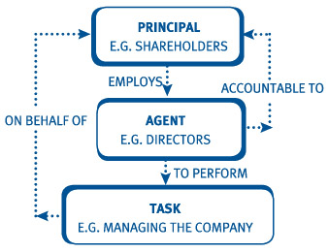
Agency Theory
o “Agency theory defines managers and other employees as ‘agents’ of owners who must delegate some authority to agents out of necessity”.

Slide 4
Behavioral theory
Behavioral economics combines elements of economics and psychology to understand how and why people behave the way they do in the real world.

Slide 5
Contract Theory
Contract theory is the study of how people and organizations construct and develop legal agreements. It analyzes how parties with conflicting interests build formal and informal contracts. Contract theory draws upon principles of financial and economic behavior as different parties have different incentives to perform or not perform particular actions.

Slide 6
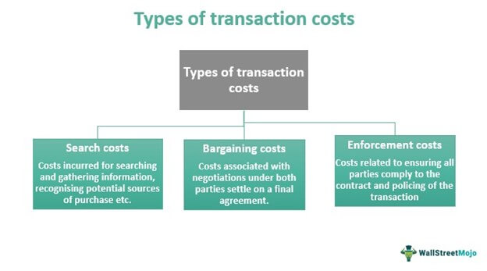
Transaction cost economics
A person trying to buy a house incurs search costs when looking for a real estate agent, bargaining costs when looking through various houses to close a deal, and enforcement costs when hiring a lawyer to draw up the paperwork.
The transaction cost theory states that organizations always try to minimize transaction costs, either by managing resources internally or by outsourcing the service.
o "Transactional cost theory provides a general framework for understanding the origin of organizations as mechanisms to reduce transaction costs and to support management decisions under conditions of high uncertainty and opportunism”.
o According to this model, organizations are superior to markets in managing complex and uncertain exchanges because they reduce the cost of transactions.

Slide 7
Game theory
Game theory is the study of how people behave in strategic situations.
Strategic decisions are those in which each person, in deciding what actions to take, must consider how others might respond to that action.
If the market is composed by a small number of firms, each firm must act strategically.
Each firm affects the market price changing the quantity produced.
Suppose 2 firms are producing 100 units. If one of the firms decides to increase the production by 10 units. The market supply will increase from 200 to 210 and the price has to drop to reach an equilibrium.
Therefore, it also affects the profits of other firms. Each firm knows that its profit depends not only on how much it produced but also on how much the other firms produce.

Slide 8
Price Theory
o “Price theory is concerned with how to structure organizations for the free interplay of markets among agents and principals”.
o “However, price theory falls short ‘since the interests of the principal and agent are inclined to diverge, the delegation of authority from the principal to the agent allows a degree of under-fulfillment of the wishes of the principal by the agent”.
o “Agents are utility maximizers who tent to act in their own best interests. Agency theory thus examines the use of price theory mechanisms and hierarchy mechanisms (for example, monitoring) by principals ‘to limit the aberrant activities of the agent’”.

Slide 9
Theory of Property Rights
“addresses the allocation of costs and rewards among the participants in an organization and, for example, how ‘claims on the assets and cash flows of the organizations……can generally be sold without permission of the other contracting individuals”.

Slide 10
Ronald H. Coase – The Nature of the Firm (1937) article thought to be the origin of organizational economics. Market forces plus hierarchy was its focus.
Ronald Coase's writings were sparse, yet his impact on economics was profound. He did pioneering work on the ways in which transaction costs and property rights affect business and society.

Slide 11
Central Themes
Organizational economics theory has addressed:
The contractual nature of firms
Bounded rationality
The significance of investment in specific assets
The distinction between specific rights and residual rights
The effects of imperfect information
“These different approaches to organizational economies share a common attention to explaining the emergence and expansion of organizations – hierarchies – given the existence of costs associated with uncertainties, information asymmetries, bounded rationality, and cognitive barriers”.

Slide 12
“In sum, organizational economics deals with a fundamental and universal problem of organizations: How to induce managers and other employees to act in the best interests of those who control ownership or, in the case of government agencies and nonprofit organizations, those who have the authority to control policy and resource allocation decisions”.
“The current wave of management theorists who advocate devolution, outsourcing, and employee and group empowerment approaches must address the types of issues that the organizational economists have been wrestling with since 1937”.

Slide 13
Major Theorists and Contributions:
John Locke – Two Treatises of Government (1967).
Jean-Jacques Rousseau – The Social Contract (1947).
Richard Cyert and James March – A Behavioral Theory of the Firm (1947).

Slide 14
Michael C. Jensen & William H. Meckling – Theory of the Firm: Managerial Behavior, Agency Costs and Ownership Structure
o “Agency costs are as real as any other costs. The level of agency costs depends among other things on statutory and common law and human ingenuity in devising contracts. Both the law and the sophistication of contracts relevant to the modern corporation are products of a historical process in which there were strong incentives for individuals to minimize agency costs. Moreover, there were alternative organizations forms available, and opportunities to invent new ones. Whatever its shortcomings, the corporation has thus far survived the market test against potential alternatives”.

Slide 15
Oliver E. Williamson-The Economics of Organization: The Transaction Cost Approach
Explains “a transactional cost occurs when a good or service is transferred across a technologically separable interface”.
“By converting exchange relations into hierarchical sub-elements (for example, by ‘making’ instead of ‘buying’ components of the final products), behaviors of transaction partners can be better monitored through direct supervision, auditing, and other organizational control mechanisms”.
“Transaction costs are thereby reduced or at least controlled by the presence of hierarchy”.
“Transaction cost analysis is an interdisciplinary approach to the study of organizations that joins economics, organization theory, and aspects of contract law”.

Slide 16
Jay B. Barney & William G. Ouchi – Learning from Organizational Economics
“Perhaps organizational theorists balk at generalizing the definition of the concept of organization to include market and quasi-market phenomena out of fear of academic incursions by economists into the protected domain. Without this broader definition, organization theory becomes just part of a general framework for analyzing economic transactions, a specialty that focuses on the more behavioral aspects of exchange”.
“Is this a bad thing? If, after all, the nature of the phenomena being studied requires this integration, is it not appropriate to attempt to accomplish it?”.

Slide 17
Paul H. Rubin – Managing Business Transactions
“focuses on the cost of maintaining the principal-agent relationship, how to minimize costs, and the effects of transaction costs on management decisions”.
“First people are self-interested and opportunistic. Second, it is impossible to write complete contracts with take account of any and all possible events and which eliminate all forms of opportunism or cheating”.
“Thus, other mechanisms must be used to minimize agency costs” such as “pre-contractual and post-contractual mechanisms, including adverse selection, the market, the ‘use of hostages and credible commitments to support exchange,’ strategically selected payment schemes, reputation, and ethics”.
“Because there is a limit to our willingness to reduce our own incomes in order to benefit others (another possible meaning of ethics), there are advantages of structuring transactions in ways which lead us to provide such benefits without harming ourselves”.

Slide 18
Strengths and Weaknesses
Strengths:
• Incorporated fields within economics.
• Helped explain that price theory alone does not control behavior.
• Helped spur production by providing additional tools and lenses (such as reducing transaction costs).
• Incorporated behavior into agency theory.
• Assisted in the legal foundation of “who” owns “what” information within an organization (property rights).

Slide 19
Weaknesses:
• Complex and often technical.
• Organizational structure and change through the economic lens is very limiting, and is based deeply within reduction of costs.
• Raises ethical/equity issues.

Slide 20
Question Hour

