Slide 1
School: Theories of Organizational Culture and Change
Time Line: Some early writings in the 1950s-1960s, but gained notoriety in the 1980s.

Slide 2
Dominant Model, Metaphor, Underlying Assumptions:
• “Organizational culture, like societal culture, is “comprised of many intangible phenomena, such as values, beliefs, assumptions, perceptions, behavioral norms, artifacts, and patterns of behavior”.
• “Lasting organizational reform requires changes in organizational culture”.
• “Organizational cultures that reflect unwanted values, such as hierarchy, rigidity, homogeneity, power based on authority and associations in closed networks, and reliance on rules, restrict flexibility and can be formidable barriers to effecting lasting change”.
• “Organizational members often hang onto familiar ‘tried and true’ beliefs, values, policies and practices of the organizational culture even when these ‘old ways’ have ceased to serve the organization well”.
• “The task is to replace these cultures with cultures where horizontal relations, open and accessible networks, flexibility, responsiveness, individual and group empowerment, diversity, and customer service are valued”.
• “Therefore, understanding and appreciating the theory of organizational culture – the organizational culture perspective – as well as the existing culture of a particular organization, is necessary for effecting lasting organizational change”.

Slide 3
The Organizational Culture Perspective
“is a set of organization theories with its own assumptions about organizational realities and relationships”.
“challenges the basic views of these more rational perspectives (Modern structural, organizational economics, and systems/environment theories) about, for example, how organizations make decisions and how and why organizations – and people in organizations – act as they do”.
“The organizational culture perspective thus assumes that many organizational behaviors and decisions are not determined by rational analysis. Instead, they are, in effect, predetermined by the patterns of basic assumptions held by members of an organization. These patterns of assumptions continue to exist and influence behaviors in an organization because they have repeatedly led people to make decisions that ‘worked best in the past’”.
“In sum, the organizational culture perspective believes that the ‘modern’ structural, organizational economic, and systems/environment schools of organization theory are using the wrong tools (or the wrong ‘lenses’) to look at the wrong organizational elements in their attempts to understand and predict organizational behavior”.

Slide 4
The Context in the 1970s, 1980s, and 1990s: The Need for Organizational Reform
“The approaches to major organizational change-reforming organizations – that had dominated the literature in the 1970s, 1980s, and through most of the 1990s shared their origins in the realization that U.S. companies and government agencies had lost their competitiveness and agility during the last three decades of the 20th century, as well as the understanding that organizational change required more than structural or functional ‘tweaking’ – that organizational cultures had to be reformed”.
“The turning point for the ‘total quality movement’ in the United States” was due to the “NBC television documentary, If Japan Can, Why Can’t We?” which “documented Edwards Deming’s experience and successes in Japan”.

Slide 5
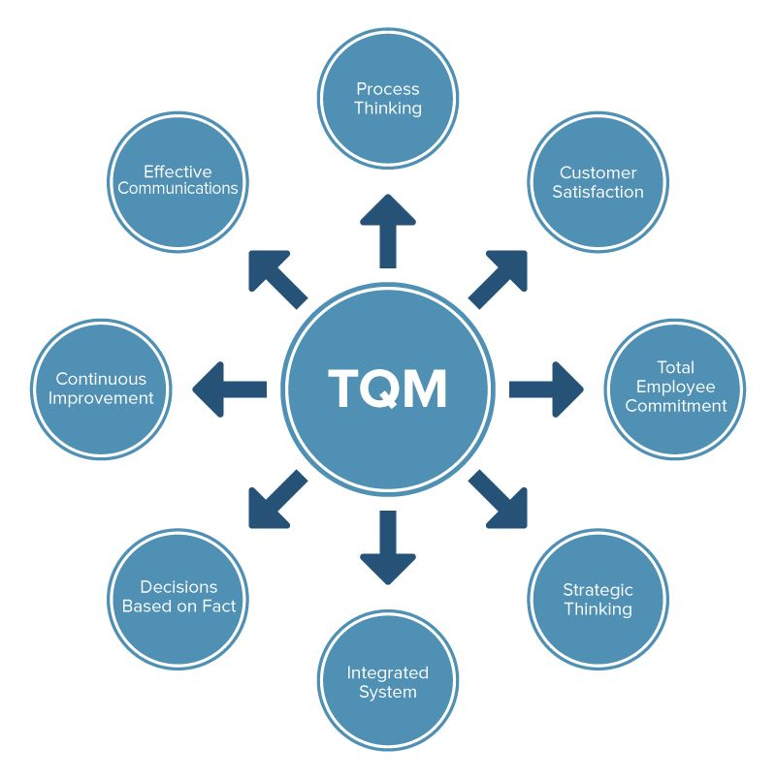

Slide 6
Organizational Culture and Symbolic Management in the 1980s and 1990s
“the symbolic frame, symbolic management, or organizational symbolism:
The meaning or interpretation of what is happening in organizations is more important that what is actually happening;
Ambiguity and uncertainty, which are prevalent in most organizations, preclude rational problem-solving and decision-making; and,
People use symbols to reduce ambiguity and to gain a sense of direction when they are faced with uncertainty”.
Peter Berger and Thomas Luckmann had defined meanings as “socially constructed realities” and “thus paved the way for the symbolic frame. Things are not real in and of themselves; the perceptions of them are, in fact, reality”.
A.I. Thomas wrote “If people believe things are real, they are real in their consequence”.
“According to the organizational culture perspective, meaning (reality) is established by and among the people in organizations – by the organizational culture”.

Slide 7
Major Theorists and Contributions:
Early organization contributors:
Dr. W. Edward Deming
• 1950 trip to Japan, “succeeded in convincing a number of Japanese executives to adopt his approach to statistical quality control”.
• Deming’s 14 points of management.
Create constancy of purpose for improving products and services.
Adopt the new philosophy.
Cease dependence on inspection to achieve quality.
End the practice of awarding business on price alone; instead, minimize total cost by working with a single supplier.
Improve constantly and forever every process for planning, production and service.
Institute training on the job.
Adopt and institute leadership.
Drive out fear.
Break down barriers between staff areas.
Eliminate slogans, exhortations and targets for the workforce.
Eliminate numerical quotas for the workforce and numerical goals for management.
Remove barriers that rob people of pride of workmanship, and eliminate the annual rating or merit system.
Institute a vigorous program of education and self-improvement for everyone.
Put everybody in the company to work accomplishing the transformation.

Slide 8
Joseph Juran
• Also went to Japan and “emphasized the management part of quality”.

Slide 9
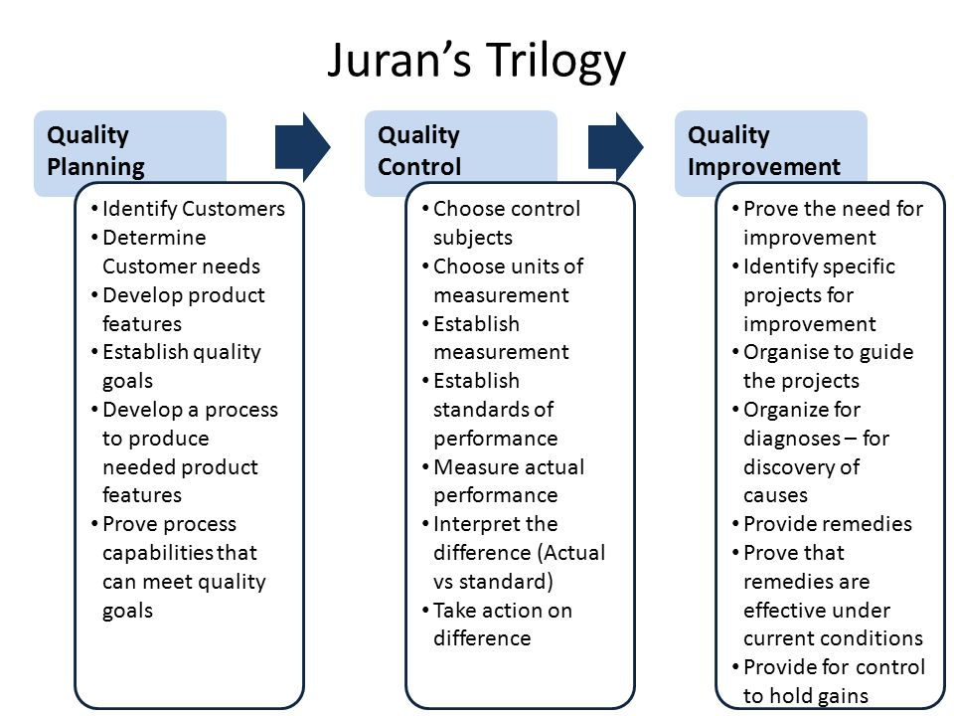

Slide 10
Val Feigenbaum
• Introduced “total quality control (TQC), a management approach that allowed employees across organizations to participate in quality improvement activities – from the chair of the board to hourly workers, from suppliers to customers, and the community”.

Slide 11
Elliott Jacques – The Changing Culture of a Factory (1951).
William H. Whyte Jr. – The Organization Man (1956).
Herbert Kaufman – The Forest Ranger (1960) – U.S. Forest Service’s “will and capacity to conform”.
Becker, Geer, Hughes, and Strauss – The Boys in White (1961).
Edgar Schein – Organizational Socialization and the Profession of Management (1968).
John Van Maanen – Police Socialization (1975)
Thomas Peters and Robert Waterman – In search of Excellence (1980)
Terrence Deal and Allan Kennedy – Corporate Cultures (1982).

Slide 12
The first comprehensive, theoretically based, integrative writings on organizational culture were published in 1984-1986, including:
Thomas Sergiovanni and John Corbally – Leadership and Organizational Culture (1984).
Edgar Schein – Organizational Culture and Leadership (1985).
Vijay Sathe – Culture and Related Corporate realities (1985).
Ralph Kilmann – Gaining Control of the Corporate Culture (1985). “Culture is to the organization what personality is to the individual – a hidden, yet unifying theme that provides meaning, direction, and mobilization”.
Gareth Morgan – Images of Organization (1986).

Slide 13
Examples of Reform Movements that Require Changes in Organizational Culture:
o Total Quality Management
o Japanese Movement
o The Search for Excellence
o Socio-technical Systems of Quality of Work Life
o Learning Organizations
o Productivity Measurement/Balanced Scorecard
o Reinventing Government
o Reengineering, Process Reengineering, or Business Reengineering

Slide 14
Techniques associated with these reform movements:
• Sought to increase productivity, flexibility, responsiveness, and customer service by reshaping organizational cultures.
• Empowered employees and work teams are granted autonomy and discretion to make decisions.
• Work teams coordinate tasks and discipline their own members.
• Policies, procedures, and layers of hierarchy are eliminated.
• Accountability to the bosses is replaced by accountability to customers or clients. Data-based information systems provide the information needed to coordinate and correct actions in real time.
• Levels of middle managers and supervisors are eliminated because they are not needed, do not add value, cost too much, and get in the way of empowered employees.

Slide 15
Edgar H. Schein – The Concept of Organizational Culture: Why Bother
o Schein’s definition of Organizational Culture has gained wide, but not universal acceptance.
o “His definition consists of a model with three levels of culture; Artifacts, Epoused Values and Basic assumptions and values.

Slide 16
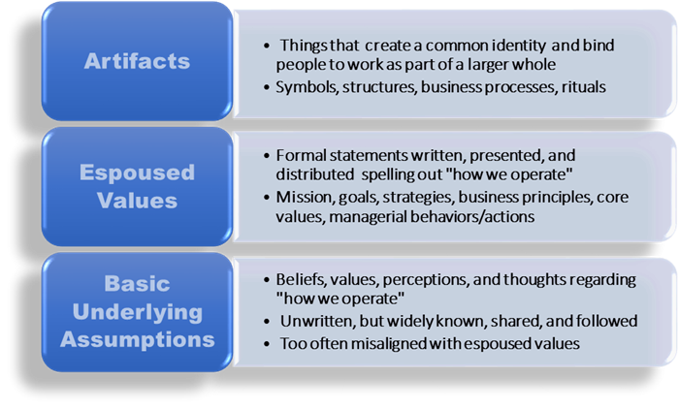

Slide 17
o “The culture of a group can now be defined as a pattern of shared basic assumptions that was learned by a group as it solved its problems of external adaption and internal integration, that has worked well enough to be considered valid and, therefore, to be taught to new members as the correct way to perceive, think, and feel in relation to those problems.
o Mentions the difficulty of “outsiders” assessing true organizational culture.
o “The bottom line for leaders is that if they do not become conscious of the cultures in which they are embedded, those cultures will manage them”.
o “Cultural understanding is desirable for all of us, but it is essential to leaders if they are to lead….”.

Slide 18
Joanne Martin – Organizational Culture: Pieces of the Puzzle
o “Attempts to answer the questions ‘what is culture’ and ‘what is not culture?’ using the intellectual traditions of functionalism, critical theory, and postmodernism”.
o “What distinguishes a cultural study from an inventory……is a willingness to look beneath the surface, to gain an in-depth understanding of how people interpret the meanings of ……manifestations and how……interpretations form patterns of clarity, inconsistency, and ambiguity that can be used to characterize understandings of working lives”.
o “She concludes ‘Because cultural researchers do not agree what we should study when we claim to be studying culture, and because our definitions of culture do not always agree with how we operationalize the concept, it is no wonder that we also disagree about what we have learned, so far, about culture’”.
o “Common types of rituals”.
o “Cultural manifestations are consistent or not, cultural members appear to agree or not, and interpretations are singular and clear or multiple and ambiguous”.

Slide 19
William G. Ouchi – The Z Organization
o Focuses on “Could Japanese management methods be utilized in the United States?”
o His “objective became to separate the culturally specific principles from those universally applicable to economic organizations”.
o The Z Organization “describes the style and substance of companies that achieved a high state of consistency in their organizational cultures. In the sense that Z organizations are more like clans than markets or bureaucracies, they foster close interchange between work and social life”.
o “Ouchi contends that ‘social organizations are incompatible with formality, distance, and contractualism. They proceed smoothly only with intimacy, subtlety, and trust”.
o “Organizational life is a life of interdependence, or relying upon others”.
o “All too often a federal bureau will fail to do that which makes sense because common sense does not fit the rules. All too often bureaucrats, trained not to allow personal values to intrude on decisions, will treat us, their customers, in an unfeeling manner. All too often the machinery of government will respond slowly and inefficiently with poor coordination between agencies, because they have learned not to trust one another, not to rely on subtlety, not to develop intimacy”.

Slide 20
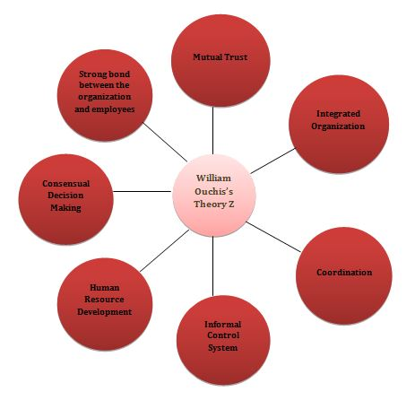

Slide 21
David L. Cooperrider and Diana Whitney – Appreciative Inquiry
o Appreciative Inquiry (AI) “proposes, quite bluntly, that organizations are not, at their core, problems to be solved……Organizations are centers of vital connections and life-giving potentials: relationships, partnerships, alliances, and ever-expanding webs of knowledge and action that are capable of harnessing the power of combinations of strengths”.
o Based on a “socio-rationalist” view “that engages organizational members in a process for appreciating and valuing what might be rather than analyzing existing problems or their causes”.
o “The principles of Appreciative Inquiry suggest the idea that collective strengths do more than perform – they transform.
o The Positive Core of Organizational Life.

Slide 22
Strengths and Weaknesses
Strengths:
• It is an open system that seeks to better understand external environments.
• Offers many tools to understand organizational culture.
• Diverse collection of subjects.
• Helped address the U.S. economic slowdown from the 1970s-1990s.
• Explains symbolism within organizations.
• Offers viewpoints of “how” to initiate changes in organizational culture.
• Blends human relations aspects with other schools of thought.
• Incorporated, and resulted in, a huge body of organizational change tools (for instance, TQM).

Slide 23
Weaknesses:
• Focuses mainly on external environments.
• Explains organizational culture is difficult to identify and measure (such as the predetermined patterns).
• Less rational.
• Since culture and symbolism are hard to identify, changes based on such need rational approaches.

Slide 24
Question Hour

