Slide 1
School: Theories of Organizations and Environments
Time Line: Began to dominate organizational theory in 1966-1967.

Slide 2
Dominant Model, Metaphor, Underlying Assumptions:
Open Systems Theory vs. Closed
• “The primary focus of research and theory building shifted from the internal characteristics of organizations to the external dynamics of organizational competition, interaction, and interdependency”.
• “The organization as open systems perspective views organizations as systems of interdependent activities embedded in and dependent on wider environments”.
• “System theories of organization have two major conceptual themes or components:
Applications of Ludwig Von Bertalanffy’s general systems theory to organizations, and
The use of quantitative tools and techniques to understand complex relationships among organizational and environmental variables and thereby to optimize decisions”.

Slide 3
• “A system is an organized collection of parts united by prescribed interactions and designed for the accomplishment of specific goals or general purposes”.
• “System theory views and organization as a complex set of dynamically intertwined and interconnected elements, including its inputs, processes, outputs, and feedback loops, and the environment in which it operates and with which it continually interacts” and “a change in any element of the system causes changes in other elements”.

Slide 4
“The interconnections tend to be complex, dynamic, and often unknown; thus, when management makes decisions involving one organizational element, unanticipated impacts usually occur throughout the organizational system”.
“Whereas classical organization theory tends to be single-dimensional and somewhat simplistic, open systems theories tend to be multidimensional and complex in their assumptions about organizational cause-and-effect relationships. The classicalists viewed organizations as static structures; systems theorists see organizations as always-changing processes of interaction among organizational and environmental elements”.
“Classical organization theorists saw organizations as rational but closed systems that pursued the goal of economic efficiency”.

Slide 5
• “Organizations are not static, but are rather in constantly shifting states of dynamic equilibrium. They are adaptive systems that are integral parts of their environments. Organizations must adjust to changes in their environment if they are to survive; in turn, virtually all of their decisions and actions affect their environment”.
• “The systems approach is strongly cause-and-effect oriented (‘positivist’) in its philosophy and methods. In these respects, system theories have close ties to the scientific management approach of Frederick Winslow Taylor. Whereas Taylor used quantitative scientific methods to find ‘the one best way,” the systems theorist uses quantitative scientific methods to identify cause-and-effect relationships to find optimal solutions….systems theories are often called management sciences”.
• “Computers, models, and interdisciplinary teams of analysts are the tools of the systems perspective”.
• “defense and aerospace programs provided the development and testing settings for many of the tools and techniques of operations research, including PERT (Performance Evaluation and Review Technique), CPM (Critical Path Method), statistical inference, linear programming, gaming, Monte Carol methods, and simulation”.

Slide 6
Institutional Theory
• “asserts that the world is a product of our ideas and conceptions; our socially created and validated meanings define reality. The rise of the modern world as we know it was not caused solely by new production technologies and administrative structures for coordinating complex activities. The growth of certain beliefs and cognitions about the nature of the world and the way things happen – and should happen – also shaped the modern world”.
• “Beliefs about organizations and institutions are created and reinforced by a wide range of actors and forces, including universities, professional groups, public opinion, the mass media, the state, and laws.
• “According to institutional theory, an organization’s life chances are significantly improved by an organization’s demonstrated conformity to the norms and social expectations of the institutional environments. Thus, environments are sources of legitimacy and support”.

Slide 7
• “Many of the environmental forces that affect organizations are not based on the values of efficiency or effectiveness but instead on social and cultural pressures to conform to a prescribed structural form”.
• “The early intraorganizational-level theories focused on primarily on the internal structure, processes, and dynamics of organizations, while depicting organizations as separate from their environments – as closed entities with clear boundaries”.
• “Theories of Organizations and Society”, builds “on and extend the open systems perspective”.

Slide 8
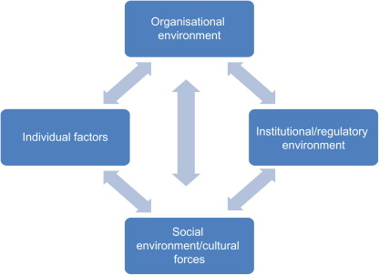

Slide 9
Resource Dependence Theory
“Stresses that all organizations exchange resources with their environment as a condition for survival”.

Slide 10
Major Theorists and Contributions:
Daniel Katz and Robert Kahn (Organizations and the System Concept)
o Conclude “that the traditional closed-system view of organizations has led to a failure to fully appreciate the interdependencies and interactions between organizations and their environments”.
o Common characteristics of open systems”: Importation of Energy; The Through-Put; The Output; Systems as Cycles of Events; Negative Entropy; Information Input, Negative Feedback, and the Coding process; The Steady State and Dynamic Homeostasis; Differentiation; Equifinality
o The open-system approach to organizations is contrasted with common-sense approaches, which tend to accept popular names and stereotypes as basic organizational properties and to identify the purpose of an organization in terms of the goals of its founders and leaders.
o The open system approach, on the other hand, begins by identify and mapping the repeated cycles of input, transformation, output, and renewed input which comprise the organizational pattern.
o Traditional organizational theories have tended to view the human organization as a closed system. This tendency has led to a disregard of differing organizational environments and the nature of organizational dependency on environment. It has led also to an overconcentration on principles of internal organizational functioning, with consequent failure to develop and understand the processes of feedback which are essential to survival”.

Slide 11
• “Articulated the concept of organizations as open systems”.
• “Provided the intellectual basis for merging classical, neoclassical, human relations/behavioral, “modern” structural, and systems perspectives of organizations. They balanced these perspectives through their concept of organizations as open systems- systems that include organizations and their environments”.

Slide 12
James D. Thompson (Organizations in Action)
o Thompson “seeks to bridge the gap between open and closed systems by postulating that organizations ‘abhor uncertainty’ and deal with it in the environment by creating specific elements designed to cope with the outside world, while other elements are able to focus on the rational nature of technical operations”.
o “Core technologies rest on closed systems of logic, but are invariably embedded in a larger organizational rationality which pins the technology to a time and place, and links it with the larger environment through input and output activities. Organizational rationality thus calls for an open-system of logic, for when the organization is opened to environmental influences”.
• Suggested that “the closed system approach may be realistic only at the technical level or organizational operations”.

Slide 13
Norbert Weiner – Cybernetics
• “The basic concept behind cybernetics is self-regulation – through biological, social, or technological systems that can identify problems, do something about them, and receive feedback to adjust themselves automatically”.

Slide 14
John W. Meyer and Brian Rowan – Institutionalized Organizations: Formal Structure as Myth and Ceremony
o “Emphasize cultural and institutional environmental influences while arguing that the modern world contains socially constructed practices and norms that provide the framework for the creation and elaboration of formal organizations.
o “Organizational structures are created and made more elaborate with the rise of institutionalized myths, and, in highly institutionalized contexts, organizational action must support these myths. But an organization must also tend to practical activity. The two requirements are at odds. A stable solution is to maintain the organization in a loosely coupled nature”.

Slide 15
Jeffrey Pfeffer and Gerald R. Salancik – External Control of Organizations: A Resource Dependence Perspective
o Explain that “one cannot understand the structure and behavior of an organization without understanding the context within which it operates”.
o “No organizations are self-sufficient, and thus they must engage in exchanges with their environment in order to survive. Organizations need to acquire resources from their environment, and the importance and scarcity of these resources determine the extent of organizational dependency in and on their environment. For example, information is a resource organizations need to reduce uncertainty and dependency, and thus organizations seek information to survive”.

Slide 16
o “The key to organizational survival is the ability to acquire and maintain resources”.
o “When the administrator really does make a difference and really does affect organizational performance, his effect will be obvious to all and there will be little need to make a show of power and control. It is only when the administrator makes little or no difference that some symbol of control and effectiveness is needed”.
o “Many organizational troubles stem from inaccurate perceptions of external demands or from patterns of dependence on the environment.
o “After all, anyone can make decisions or take actions – it requires more skill to be correct”.

Slide 17
Glenn R. Carroll and Michael T. Hannan – Demography of Corporations and Industries
o Draw “on the theories of organizational ecology to explore theories, models, methods, and data used in demographic approaches to organizational studies. Organizational ecologists assess the applicability of bio-ecological models to the study or organization–environment relations.
o “From this perspective, organizational environments are the loci of competition, selection, and the survival of the fittest. Organizations do not adapt to their changing environments by making decisions, instead, the environment selects the fittest among different organizational forms”.
o “Explain how ‘populations of organizations’ change over time through the processes of founding, growth, decline, transformation, and mortality”.

Slide 18
o The organizational ecology approach differs from other open system theory approaches in that it focuses on populations of organizations rather than individual organizational units” and “organizational ecology attempts to explain why certain types or species of organizations survive and multiply whereas others languish and die”.
o “Environments differentially select organizations for survival on the basis of the fit between organization forms and environmental characteristics” and “the stronger the pressures are from within or outside an organization, the less flexibly adaptive it can be and the higher likelihood that environmental selection will prevail”.

Slide 19
Contingency theory
Contingency theory states “that a leader's effectiveness is contingent on how well the leader's style matches a specific setting or situation” (Wolinksi, 2010).
According to this theory, someone can be an effective leader in one circumstance and an ineffective leader in another.

Slide 20
1. Fiedler’s contingency theory
Fred Fielder developed one of the first contingency theories called Fiedler’s contingency theory of leadership. In the Fiedler contingency model, leadership styles are fixed and unchangeable. According to the Fiedler model, you cannot mold the leader. It is better to put leaders in a situation that matches their styles.

Slide 21
2. Situational Leadership theories
Individual or group performance readiness level – According to situational-contingency theory, the group or person being led decides the right leadership style. The situation theory identified four maturity levels ranging from M1 to M4.

Slide 22
Path-Goal Theory
Robert House developed the Path-Goal Theory in 1971. The theory identified processes that will allow the team members to meet their objectives. The leader will adjust their behavior and expectation to improve team productivity.

Slide 23
Decision-Making Theory
The decision-making theory or the Vroom Yetton Contingency Model believes that decisions are crucial elements of leadership. As per the model, decisions influence the relationship between leader and their team. The leader must maintain and build the relationship and directly affects their success.

Slide 24
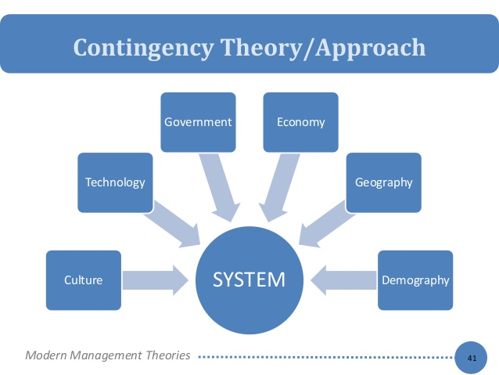
Contingency Theory

Slide 25
Strengths and Weaknesses
Strengths:
• Open systems approach that attempts to account for internal and external environments.
• Attempts to address interwoven variables.
• Multi-dimension approaches.
• Led to institutional, resource dependence, and other theories.
• Is considered an intellectual merger of most prior schools of thought.

Slide 26
Weaknesses:
• Locus of control is mostly external.
• Deemphasizes rational and closed systems.
• States that the use of closed systems is useful only to core technologies.

Slide 27
Question Hour

