Slide 1
Perception in Organizations

Slide 2
What is Perception?
Perception is the process by which individuals select, organize, and interpret their sensory impressions in order to give meaning to their environment.
Perception VS Objective reality

Slide 3
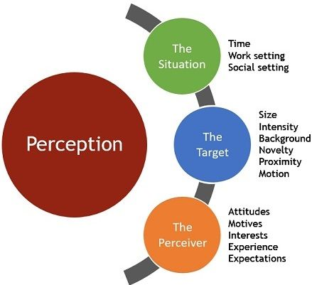
Why Differences of Perception?

Slide 4
Factors Influencing Perception
The Perceiver
When an individual (“the perceiver”) looks at something (“the target”) and tries to interpret what he or she sees, that interpretation is heavily influenced by the perceiver’s personal characteristics.
Attitudes
Motives
Interests
Experience
Expectations

Slide 5
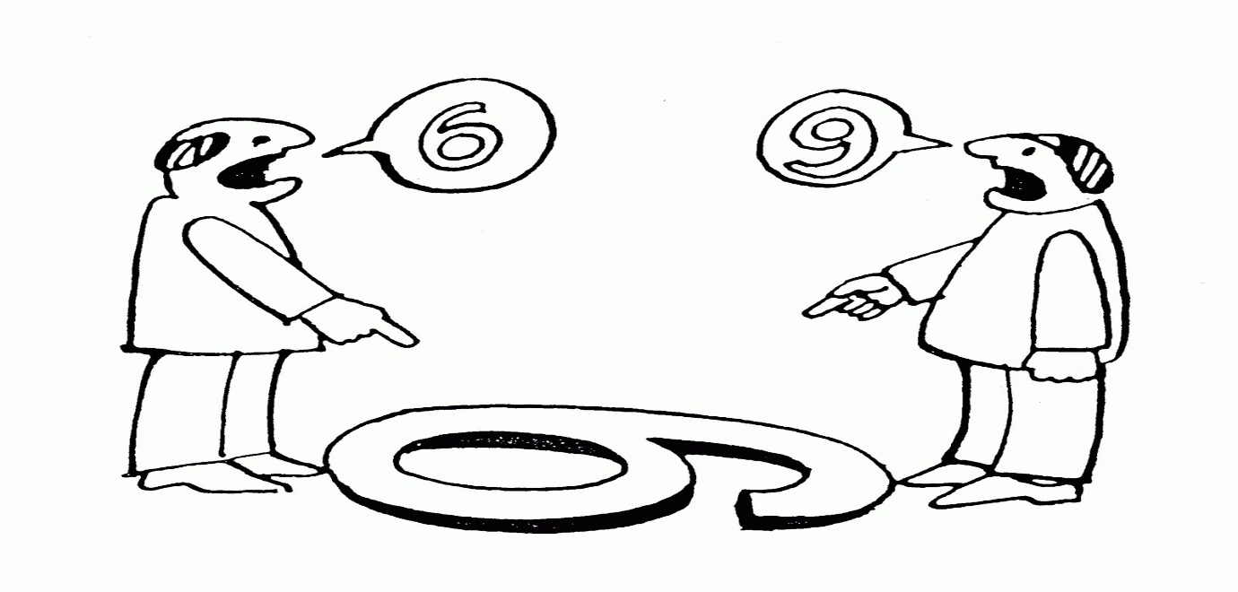

Slide 7
Target
A target’s characteristics can affect what is perceived. Loud people are more likely to be noticed in a group than are quiet ones. So, too, are extremely attractive or unattractive individuals. Novelty, motion, sound, size, and other attributes of a target shape the way we see it.
Novelty
Motion
Sounds
Size
Background
Proximity

Slide 8
Situation
Elements in the surrounding environment influence our perceptions.
Time
Work setting
Social setting

Slide 9
Perceptual Errors
Attribution Theory
It explains how we judge people differently, depending on the cause we attribute to a given behaviour.
Attribution theory that when we observe what seems to be atypical behaviour by an individual, we attempt to determine whether it is internally or externally caused.
Basically, the theory suggests that when we observe an individual’s behaviour, we try to determine whether the individual is responsible for the behaviour (the cause is internal), or whether something outside the individual caused the behaviour (the cause is external).

Slide 10
Rules for Determining Attribution
In trying to determine whether behaviour is internally or externally caused, we rely on three rules about the behaviour:
Distinctiveness (A behavioural rule that asks whether an individual acts similarly across a variety of situations). e.g., not answering urgent emails.
Consensus (A behavioural rule that asks if everyone faced with a similar situation responds in the same way). E.g. When consensus is high, an external attribution is given to an individual’s behaviour. But if an individual’s behaviour is different from everyone else’s, you would conclude the cause for that individual’s behaviour was internal.
Consistency (A behavioural rule that asks whether the individual has been acting in the same way over time). e.g. on time for class.

Slide 11
How Attributes get Distorted
Fundamental Attribution Error
The tendency to underestimate the influence of external factors and overestimate the influence of internal factors when making judgments about the behaviour of others.
Self-serving bias
The tendency for individuals to attribute their own successes to internal factors while putting the blame for failures on external factors.

Slide 12
Selective Perception
Selective perception People’s selective interpretation of what they see based on their interests, background, experience, and attitudes.

Slide 13
Halo Effect
Drawing a general impression of an individual on the basis of a single characteristic.

Slide 14
Contrast Effects
The concept that our reaction to one person is often influenced by other people we have recently encountered.

Slide 15
Projection
Attributing one’s own characteristics to other people.

Slide 16
Stereotyping
Judging someone on the basis of one’s perception of the group to which that person belongs.

Slide 17
Prejudice
An unfounded dislike of a person or group based on their belonging to a particular stereotyped group.

Slide 18
Does perception really affect outcomes?

Slide 19
Self-Fulfilling Prophecy
A concept that proposes a person will behave in ways consistent with how he or she is perceived by others.

Slide 20
Question Hour?????????

