Slide 1
Personality IN organizations
The stable patterns of behaviour and consistent internal states that determine how an individual reacts to and interacts with others.
“the dynamic organization within the individual of those psychophysical systems that determine his unique adjustments to his environment.” Gordon Allport

Slide 2
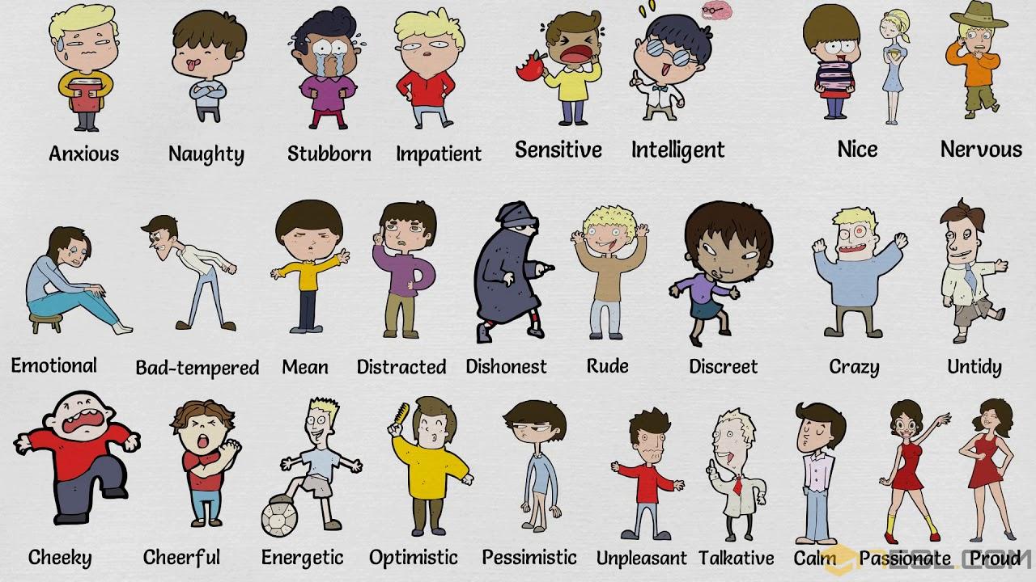
Personality Traits

Slide 3
Personality Determinants
Birth
Environment
Situation

Slide 4
Factors Influences Personality
Heredity
Physical stature, facial attractiveness, gender, temperament, muscle composition and reflexes, energy level, and biological rhythms are characteristics that are generally considered to be either completely or largely influenced by your parents’ biological, physiological, and inherent psychological makeup.

Slide 5
Environmental Factors
Among the factors that exert pressures on our personality formation are the culture in which we are raised; our early conditioning; norms among our family, friends, and social groups; and other influences that we experience.

Slide 6
Situational Conditions
A third factor, the situation, influences the effects of heredity and environment on personality. An individual’s personality, although generally stable and consistent, does change in different situations.

Slide 7
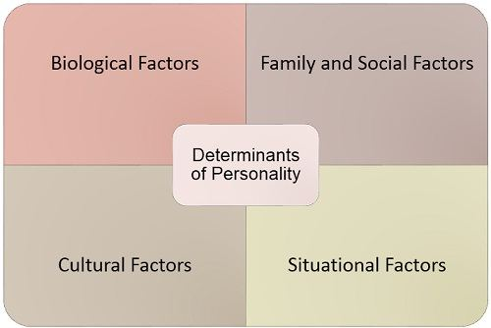

Slide 8
Personality Traits
Enduring characteristics that describe an individual’s behaviour.
Popular characteristics include shy, aggressive, submissive, lazy, ambitious, loyal, and timid.

Slide 9
Extraversion/Introversion (E or I). This dimension refers to how people focus themselves: inside (introversion) or outside (extraversion).
Sensing/Intuiting (S or N). This dimension refers to how people gather information: very systematically (sensing) or relying on intuition (intuiting).
Thinking/Feeling (T or F). This dimension refers to how people prefer to make decisions: objectively and impersonally (thinking) or subjectively and interpersonally (feeling).
Judging/Perceiving (J or P). This dimension refers to how people order their daily lives: being decisive and planned (judging) or spontaneous and flexible (perceiving).

Slide 10
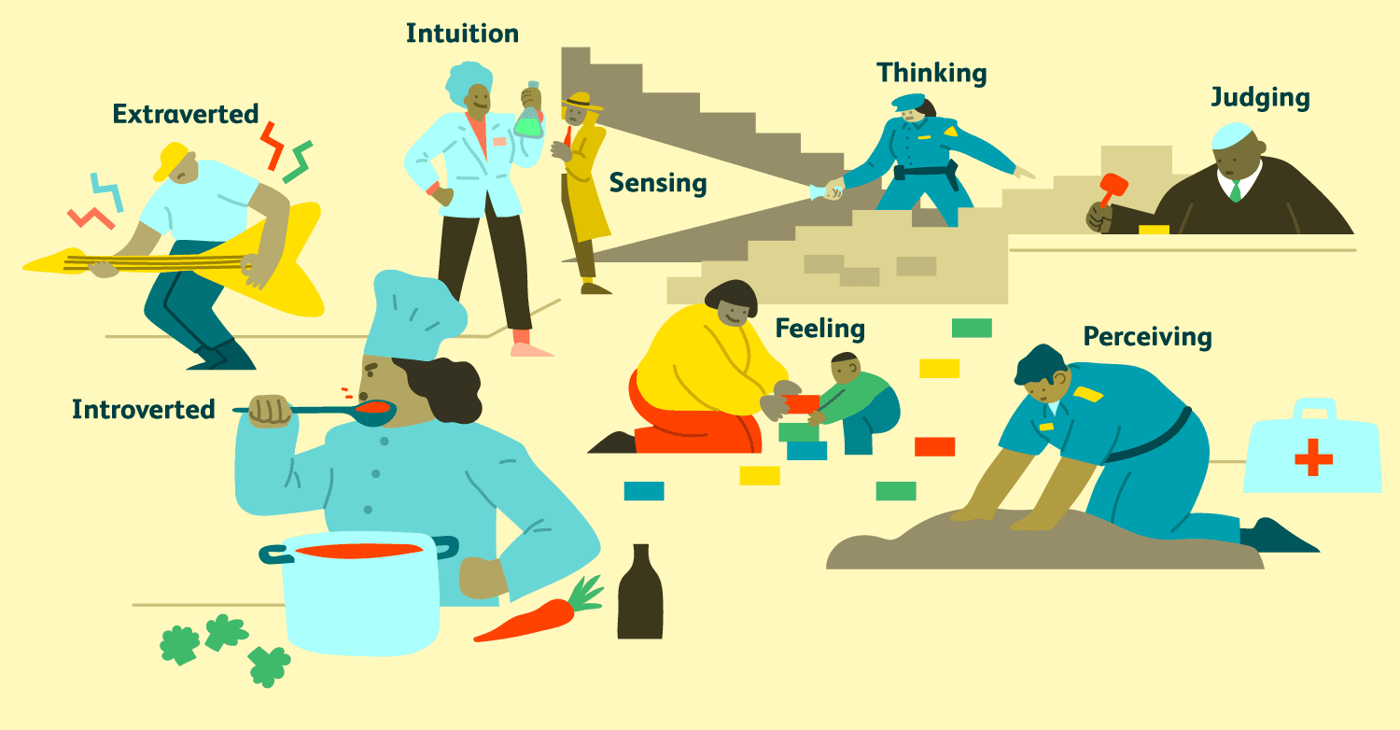
The Myers-Briggs Type Indicator

Slide 11
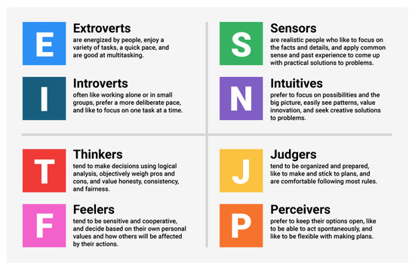

Slide 12
INTJs are visionaries. They usually have original minds and great drive for their own ideas and purposes. They are characterized as skeptical, critical, independent, determined, and often stubborn.
ESTJs are organizers. They are realistic, logical, analytical, decisive, and have a natural head for business or mechanics. They like to organize and run activities.
ENTPs are conceptualizers. They are innovative, individualistic, versatile, and attracted to entrepreneurial ideas. They tend to be resourceful in solving challenging problems but may neglect routine assignments.

Slide 13
The Big Five Model
Extraversion. This dimension captures a person’s comfort level with relationships. Extraverted individuals are sociable, talkative, and assertive.
Agreeableness. This dimension refers to how readily a person will go along with others. Highly agreeable people are good-natured, cooperative, warm, and trusting.
Conscientiousness. This dimension is a measure of a person’s reliability. People who score high on conscientiousness are responsible, dependable, persistent, and achievement-oriented.
Emotional stability. This dimension taps a person’s ability to withstand stress. People high on emotional stability are calm, self-confident, and secure.
Openness to experience. The final dimension addresses a person’s range of interests and fascination with novelty. People high on openness to experience are imaginative, artistically sensitive, and intellectual.

Slide 14
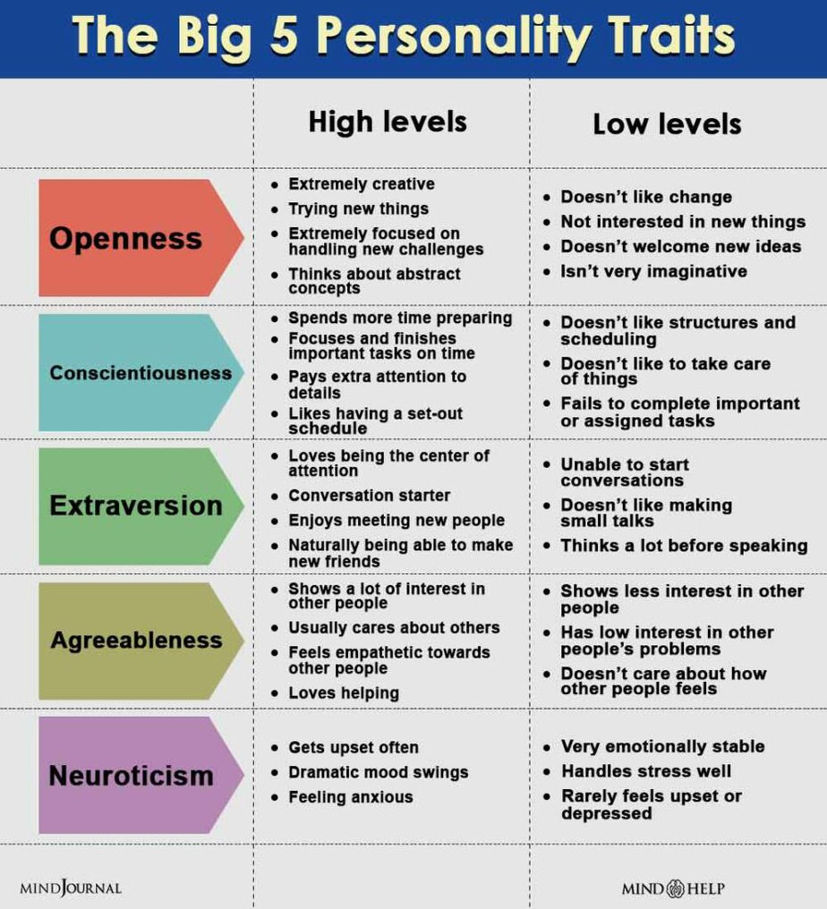

Slide 15
Major Personality Attributes Influencing OB
Locus of Control
A person’s perception of the source of his or her fate is termed locus of control.
External
Who see their lives as being controlled by outside forces, have been called externals
Internal
The degree to which people believe they are in control of their own fates.

Slide 16
Machiavellianism
The degree to which an individual is pragmatic, maintains emotional distance, and believes that ends can justify means.

Slide 17
Self-Esteem
The degree to which individuals like or dislike themselves.

Slide 18
Branden’s Six Pillars of Self-Esteem
Living consciously: Be aware of everything that affects your values and goals, and act with awareness.
Self-acceptance: Accept who you are without criticism and judgment.
Personal responsibility: Take responsibility for the decisions you make and the things you do.
Self-assertiveness: Honour your wants, needs, and values, and don't be afraid to speak up for things that are important to you.
Living purposefully: Develop short- and long-term goals, and make realistic plans to achieve your goals.
Personal integrity: Live up to your word and your values.

Slide 19
Self-Monitoring
A personality trait that measures an individual’s ability to adjust behaviour to external, situational factors.

Slide 20
Risk Taking
People differ in their willingness to take chances.

Slide 21
Proactive Personality
A person who identifies opportunities, shows initiative, takes action, and perseveres until meaningful change occurs.

Slide 22
Personality and National Culture

Slide 23
Type A and Type B Personalities
Type A
Are always moving, walking, and eating rapidly
Strive to think or do two or more things at once
Cannot cope with leisure time
Are obsessed with numbers, measuring their success in terms of how many or how much of everything they acquire
Type B
Never suffer from a sense of time urgency with its accompanying impatience
Feel no need to display or discuss either their achievements or accomplishments unless such exposure is demanded by the situation
Play for fun and relaxation, rather than to exhibit their superiority at any cost
Can relax without guilt

Slide 24
Question Hour

