Slide 1
Organization Culture

Slide 2
Background
When David Dingwall was appointed president and CEO of the Ottawa-based Royal Canadian Mint in March 2003, the mint was a for-profit Crown corporation that had a $7-million deficit. He described the culture that led to this deficit: “There was no discipline. There was no focus. There was no accountability and there was no transparency.” He also noted that there was no urgency in wanting to help customers.

Slide 3
WHAT IS ORGANIZATIONAL CULTURE?
Culture is the soul of the organization-the beliefs and values, and how they are manifested. I think of the structure as the skeleton, and as the flesh and blood. And culture is the soul that holds the thing together and gives it life force.

Slide 4
Culture is shared by the members of the organization.
Culture helps members of the organization solve and understand the things that the organization encounters, both internally and externally.
Because the assumptions, beliefs, and expectations that make up culture have worked over time, members of the organization believe they are valid. Therefore, they are taught to people who join the organization.
These assumptions, beliefs, and expectations strongly influence how people perceive, think, feel, and behave within the organization.

Slide 5
Culture sets the tone for how organizations operate and how individuals within the organization interact. As we discuss organizational culture, you may want to remember that organizations differ considerably in the cultures they adopt.
Culture provides stability to an organization and gives employees a clear understanding of “the way things are done around here.”
An organization that expects employees to work 15 hours a day may not be one in which you would like to work.

Slide 6
Definition of Organizational Culture
Organizational culture is the pattern of shared values, beliefs, and assumptions considered to be the appropriate way to think and act within an organization.

Slide 7
Levels of Culture
Artifacts Aspects of an organization’s culture that you see, hear, and feel.
Beliefs The understandings of how objects and ideas relate to each other.
Values The stable, long-lasting beliefs about what is important.
Assumptions are the taken-for-granted notions of how something should be.

Slide 8
Dimensions of Organizational Culture
Innovation and risk-taking.
Attention to detail
Outcome orientation
People orientation
Team orientation
Aggressiveness
Stability

Slide 10
Culture’s Functions
It has a boundary-defining role because it creates distinction between one organization and others.
It conveys a sense of identity to organization members.
It helps create commitment to something larger than an individual’s self-interest.
It enhances stability; it is the social glue that helps hold the organization together by providing appropriate standards for what employees should say and do.
It serves as a control mechanism that guides and shapes the attitudes and behaviour of employees, and helps them make sense of the organization.

Slide 11
Contrasting Organizational Cultures
Organization A | Organization B
• Managers must fully document all decisions. • Creative decisions, change, and risks are not encouraged. • Extensive rules and regulations exist for all employees. • Productivity is valued over employee morale. • Employees are encouraged to stay within their own departments. • Individual effort is encouraged. | • Management encourages and rewards risk-taking and change. • Employees are encouraged to run with ” ideas, and failures are treated as “learning experiences.” • Employees have few rules and regulations to follow. • Productivity is balanced with treating its people right. • Team members are encouraged to interact with people at all levels and functions. • Many rewards are team-based.

Slide 12
The role of culture in influencing employee behaviour appears to be increasingly important in today’s workplace.
Geoffrey Relph, IBM Canada’s marketing director of professional services, compared the culture of his previous company (GE Appliances in Louisville, Kentucky) with that of IBM: “The priorities in GE are: ‘Make the financial commitments. Make the financial commitments. Make the financial commitments.’ At IBM, the company’s attention is divided among customer satisfaction, employee morale, and positive financial results.”

Slide 13
Culture can also influence people’s ethical behaviour. When lower-level employees see their managers padding expense reports, this sends a signal that the firm tolerates such dishonest behaviour.

Slide 14
Do Organizations Have Uniform Cultures?
Dominant culture A system of shared meaning that expresses the core values shared by a majority of the organization’s members.
Subcultures Minicultures within an organization, typically defined by department designations and geographical separation.
Core values The primary, or dominant, values that are accepted throughout the organization.

Slide 15
Strong Culture VS Weak Culture

Slide 16
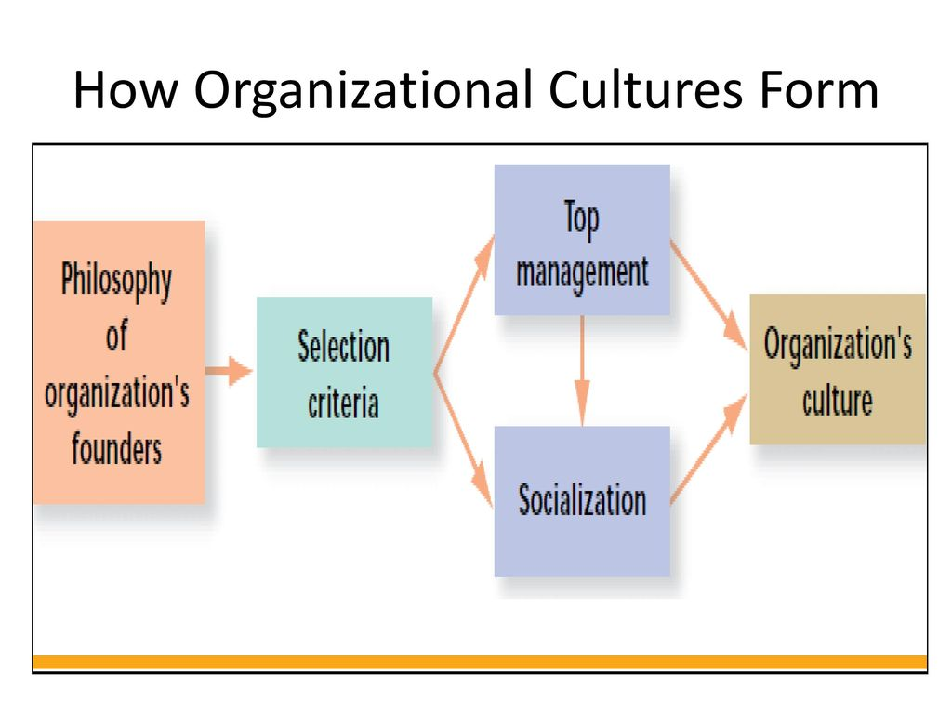
How a Culture Begins?

Slide 17
Philosophy Of organization‘s founders
Selection criteria- Top management - Socialization
Organization‘s culture

Slide 18
Keeping a Culture Alive
Selection
Top Management
Socialization

Slide 19
Can a culture change help with turnover problems?

Slide 20
Research by Goffee and Jones provides some interesting insights on different organizational cultures and guidance for prospective employees
MATCHING PEOPLE WITH ORGANIZATIONAL CULTURES
Networked culture (high on sociability, low on solidarity).
Mercenary culture (low on sociability, high on solidarity).
Fragmented culture (low on sociability, low on solidarity).
Communal culture (high on sociability, high on solidarity).

Slide 21
Impact of culture on change, diversity, and mergers and acquisitions
Culture as a Barrier to Change
Culture as a Barrier to Diversity
Culture as a Barrier to Mergers and Acquisitions

Slide 22
Strategies for Merging Cultures
Organizations can use several strategies when considering how to merge the cultures of two organization:
Assimilation (The entire new organization is determined to take on the culture of one of the merging organizations. This strategy works best when one of the organizations has a relatively weak culture. However, if a culture is simply imposed on an organization, it rarely works.)
Separation (The organizations remain separate, and keep their individual cultures. This strategy works best when the organizations have little overlap in the industries in which they operate.)
Integration (A new culture is formed by merging parts of each of the organizations. This strategy works best when aspects of each organization’s culture need to be improved.)

Slide 23
Lewin’s Three-Step Model
APPROACHES TO MANAGING CHANGE
unfreezing Change efforts to overcome the pressures of both individual resistance and group conformity.
moving Efforts to get employees involved in the change process.
refreezing Stabilizing a change intervention by balancing driving and restraining forces.

Slide 25
Kotter’s Eight-Step Plan for Implementing Change
Establish a sense of urgency by creating a compelling reason for why change is needed.
Form a coalition with enough power to lead the change.
Create a new vision to direct the change and strategies for achieving the vision.
Communicate the vision throughout the organization.
Empower others to act on the vision by removing barriers to change and encouraging risk-taking and creative problem solving.
Plan for, create, and reward short-term “wins” that move the organization toward the new vision.
Consolidate improvements, reassess changes, and make necessary adjustments in the new programs.
Reinforce the changes by demonstrating the relationship between new behaviours and organizational success.

Slide 27
QUESTION HOUR?

