Slide 1
Change an
Organization’s Culture

Slide 2
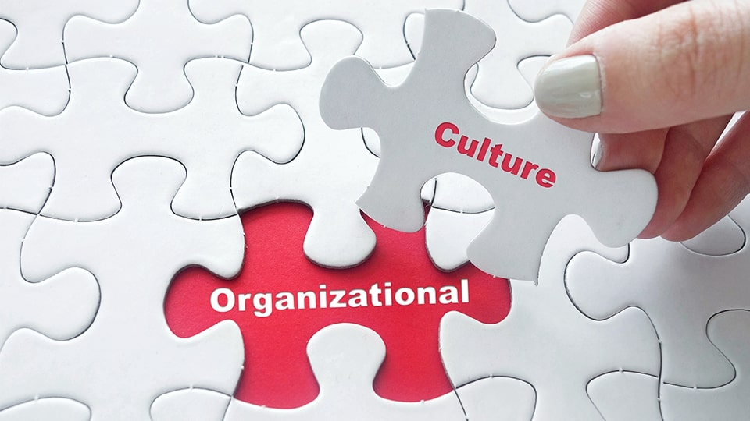

Slide 3
A dramatic crisis
Turnover in leadership
Young and small organization
Weak culture

Slide 4
Action Research
The process of action research, carried out by a change agent, consists of five steps:
Diagnosis
Analysis
Feedback
Action
Evaluation

Slide 5
Appreciative Inquiry
Discovery
Dreaming
Design
Destiny

Slide 6
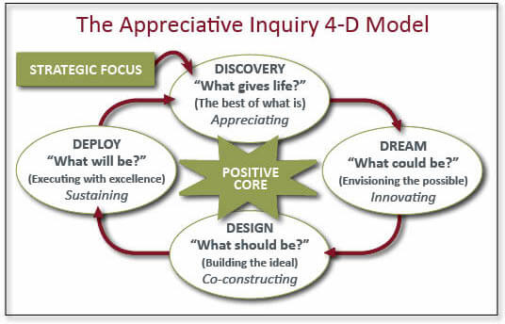

Slide 7
Resistance to Change
It provides a degree of stability and predictability to behavior.
Resistance to change can also be a source of functional conflict.
A change is proposed, and employees respond immediately by voicing complaints, engaging in work slowdowns, threatening to go on strike, or the like. The greater challenge is managing resistance that is implicit or deferred.
Implicit resistance efforts are more subtle—loss of loyalty to the organization, loss of motivation to work, increased errors or mistakes, increased absenteeism due to “sickness”— and hence more difficult to recognize.

Slide 8
Individual Resistance
Individual sources of resistance to change reside in basic human characteristics such as perceptions, personalities, and needs.
Habit
Security
Economic factors
Fear of the unknown
Selective information processing

Slide 9
Cynicism
Feeling uninformed about what was happening
Lack of communication and respect from one’s manager
Lack of communication and respect from one’s union representative
Lack of opportunity for meaningful participation in decision making

Slide 10
Organizational Resistance
Structural inertia
Limited focus of change
Group inertia
Threat to expertise
Threat to established power relationships
Threat to established resource allocations

Slide 11
Overcoming Resistance to Change
Kotter and Schlesinger have identified six tactics organizations use to deal with resistance to change
Education and communication
Participation and involvement
Facilitation and support
Negotiation and agreement
Manipulation and co-optation
Explicit and implicit coercion

Slide 12
The Politics of Change

Slide 13
Question Hour

