Slide 1
Decision Making in Organization

Slide 2
Is there a right way to make decisions?

Slide 3
A decision is the choice made from two or more alternatives
Problem is a discrepancy between some current state of affairs and some desired state, requiring consideration of alternative courses of action.
An opportunity occurs when something unplanned happens, giving rise to thoughts about new ways of proceeding.

Slide 4
The Rational Decision-Making Process
Rational decision-making model A six-step decision-making model that describes how individuals should behave in order
1. Define the problem
2. Identify the criteria
3. Allocate weights to the criteria
4. Develop alternatives
5. Evaluate the alternatives
6. Select the best alternative

Slide 5
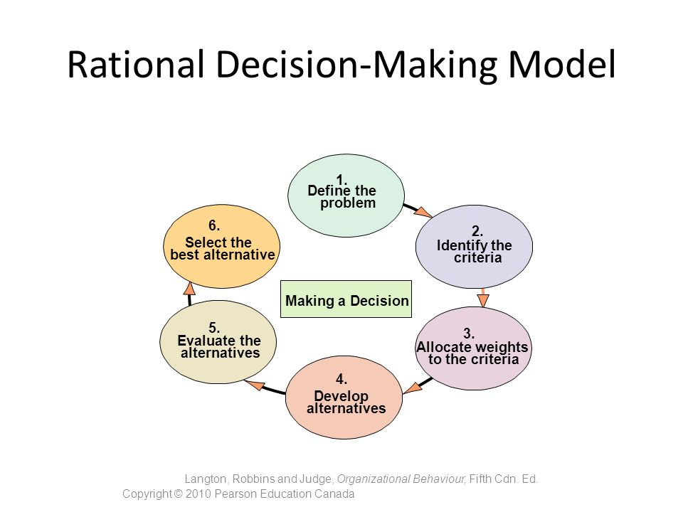

Slide 6
Assumptions of the Model
• Problem clarity. The problem is clear and unambiguous. The decision maker is assumed to have complete information regarding the decision situation.
• Known options. It is assumed the decision maker can identify all the relevant criteria and list all the workable alternatives. The decision maker is also aware of all possible implications of each alternative.
• Clear preferences. Rationality assumes that the criteria and alternatives can be ranked and weighted to reflect their importance.
• Constant preferences. It is assumed that the specific decision criteria are constant and that the weights assigned to them are stable over time.
• No time or cost constraints. The decision maker can obtain full information about criteria and alternatives because it is assumed that there are no time or cost constraints.
• Maximum payoff. The decision maker will choose the alternative that yields the highest perceived value.

Slide 7
How do people actually make decisions?
Most significant decisions are made by judgment, rather than by a defined prescriptive model.
Most of the decisions that get made reflect only the problems that decision makers see. Problems do not arrive with flashing neon lights to identify themselves. One person’s problem may even be another person’s acceptable status quo. So how do decision makers identify and select problems?

Slide 8
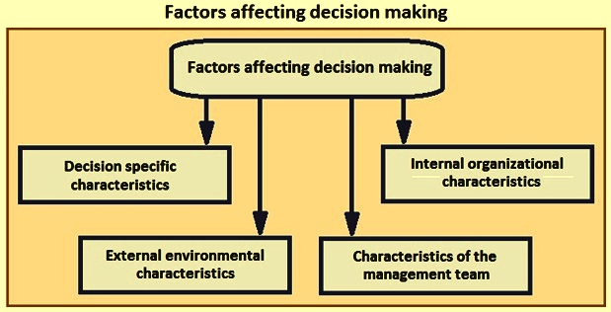

Slide 9
Problems that are visible tend to have a higher probability of being selected than ones that are important. Why? We can offer at least two reasons. First, it’s easier to recognize visible problems. They are more likely to catch a decision maker’s attention. This explains why politicians are more likely to talk about the “crime problem” than the “illiteracy problem.”

Slide 10
Do people really consider every alternative when making a decision?
Realistically speaking, people are limited by their ability to interpret, process, and act on information. This is called bounded rationality.
Satisfice
To provide a solution that is both satisfactory and sufficient.

Slide 11
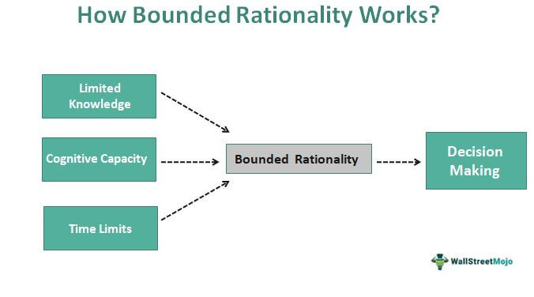

Slide 12
Is it okay to use intuition when making decisions?
Intuitive decision making
A subconscious process created out of a person’s many experiences.

Slide 13
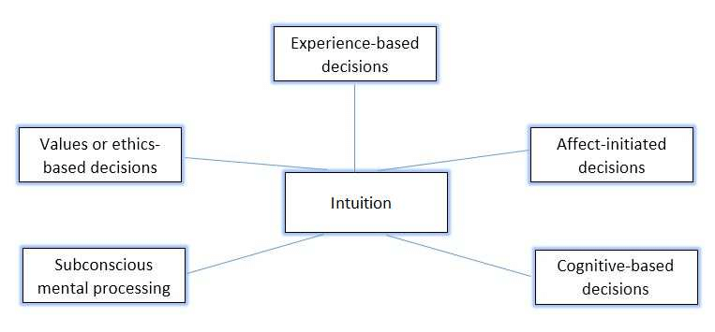

Slide 14
Based on our discussion above, you should consider the following when making decisions:
• Make sure that you define the problem as best you can.
• Be clear on the factors that you will use to make your decision.
• Be sure to collect enough alternatives so that you can clearly differentiate among them.

Slide 15
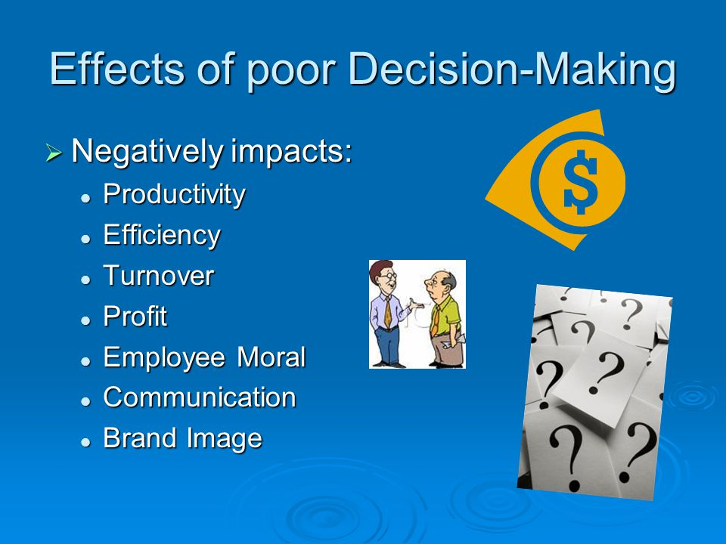
So why is it that we sometimes make bad decisions?

Slide 16
Judgment Shortcuts or heuristics
Framing
Statistical Regression to the Mean
Availability Heuristic
Representative Heuristic
Ignoring the Base Rate
Escalation of Commitment
Overconfidence Bias
Anchoring Bias

Slide 17
Reducing Biases and Errors in Decision Making
Focus on goals.
Look for information that disconfirms your beliefs.
Don’t create meaning
Increase your options

Slide 18
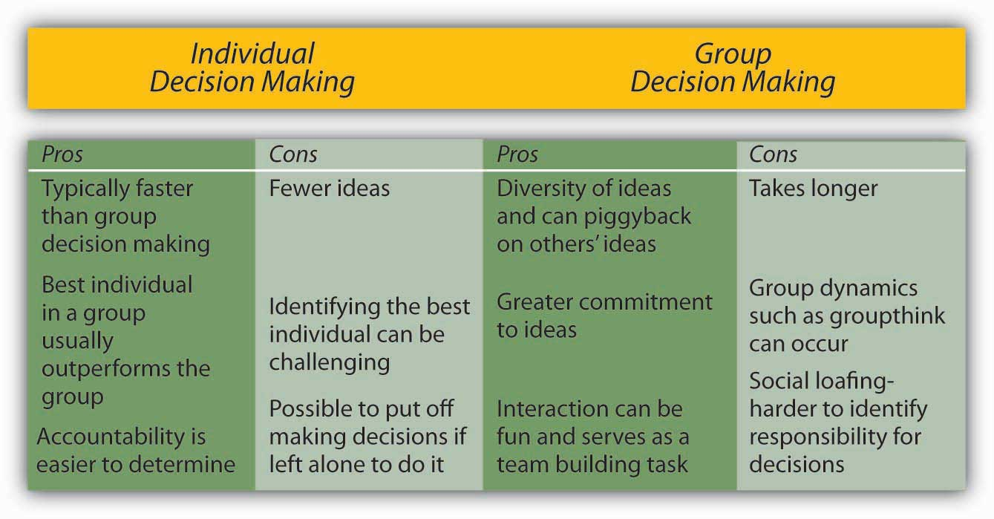
GROUP DECISION MAKING

Slide 19
Strengths of Group Decision Making
Weaknesses of Group Decision Making

Slide 20
Groupthink and Groupshift
Two by-products of group decision making have received a considerable amount of attention by organizational behaviour (OB) researchers: groupthink and groupshift.

Slide 21
Groupthink
A phenomenon in which group pressures for conformity prevent the group from critically appraising unusual, minority, or unpopular views.

Slide 22
We have all seen the symptoms of the groupthink phenomenon
Illusion of invulnerability. Group members become overconfident among themselves, allowing them to take extraordinary risks.
Assumption of morality. Group members believe highly in the moral rightness of the group’s objectives and do not feel the need to debate the ethics of their actions.
Rationalization. Group members rationalize any resistance to the assumptions they have made. No matter how strongly the evidence may contradict their basic assumptions, members behave so as to reinforce those assumptions continually.
Stereotyping outgroups. People outside the group who criticize decisions and actions are viewed as “enemies” who don’t know what they are talking about.
Minimized doubts. Group members who have doubts or hold differing points of view seek to avoid deviating from what appears to be group consensus by keeping silent about misgivings and even minimizing to themselves the importance of their doubts.

Slide 23
Continued….
• Illusion of unanimity. If someone does not speak, it’s assumed that he or she is in full agreement. In other words, abstention becomes viewed as a yes vote.
• Mindguards. One or more members of the team become self-appointed guardians to make sure that negative or inconsistent information does not reach team members.
• Peer pressure. Group members apply direct pressure on those who momentarily express doubts about any of the group’s shared views or who question the alternative favoured by the majority.

Slide 24
What can managers do to minimize groupthink?
• Encourage group leaders to play an impartial role. Leaders should actively seek input from all members and avoid expressing their own opinions, especially in the early stages of deliberation.
• Appoint one group member to play the role of devil’s advocate. This member’s role is to overtly challenge the majority position and offer divergent perspectives.
• Stimulate active discussion of diverse alternatives to encourage dissenting views and more objective evaluations.

Slide 25
Groupshift
A phenomenon in which the initial positions of individual group members become exaggerated because of the interactions of the group.

Slide 26
Group Decision-Making Techniques
Interacting Groups
Typical groups, where members interact with each other face to face.
Brainstorming
An idea-generation process that specifically encourages any and all alternatives while withholding any criticism of those alternatives.

Slide 27
Nominal Group Technique
A group decision-making method in which individual members meet face to face to pool their judgments in a systematic but independent fashion.
• Members meet as a group, but before any discussion takes place each member independently writes down his or her ideas about the problem.
• After this silent period, each member presents one idea to the group. Group members take turns presenting a single idea until all ideas have been presented and recorded. No discussion takes place until all ideas have been recorded.
• The group then discusses the ideas for clarity and evaluates them.
• Each group member silently and independently ranks the ideas. The idea with the highest overall ranking determines the final decision.

Slide 28
Electronic Meetings
A meeting in which members interact on computers, allowing for anonymity of comments and aggregation of votes.

Slide 29
THE INFLUENCE OF THE LEADER ON GROUP
DECISION MAKING
The five leadership styles the model proposes leaders can use in a given situation are Autocratic I (AI), Autocratic II (AII), Consultative I (CI), Consultative II (CII), and Group II (GII). Thus the group leader or manager has the following alternatives from which to choose when deciding how involved to be with decisions that affect a work group:
AI: You solve the problem or make a decision yourself using whatever facts you have at hand.
AII: You obtain the necessary information from employees and then decide on the solution to the problem yourself. You may or may not tell them about the nature of the situation you face. You seek only relevant facts from them, not their advice or counsel.
CI: You share the problem with relevant employees one-on-one, getting their ideas and suggestions. However, the final decision is yours alone.
CII: You share the problem with your employees as a group, collectively obtaining their ideas and suggestions. Then you make the decision, which may or may not reflect your employees’ influence.
GII: You share the problem with your employees as a group. Your goal is to help the group concur on a decision. Your ideas are not given any greater weight than those of others.

Slide 30
Question Hour

