Slide 1
Power and Politics in Organization

Slide 2
“Power corrupts, and absolute power corrupts absolutely,”
For Example, in game.
Within larger organizations, the information technology (IT) group often has considerable power, because everyone, right up to the CEO, is dependent on this group keeping computers and networks running.

Slide 3
Definition
Power refers to a capacity that A has to influence the behaviour of B, so that B acts in accordance with A’s wishes.
But one can have power and not impose it.
Probably the most important aspect of power is that it is a function of dependency.
For example, attending college or university on funds.

Slide 6
BASES OF POWER
Coercive Power
Reward Power
Legitimate Power
Expert Power
Referent Power
Information Power

Slide 7
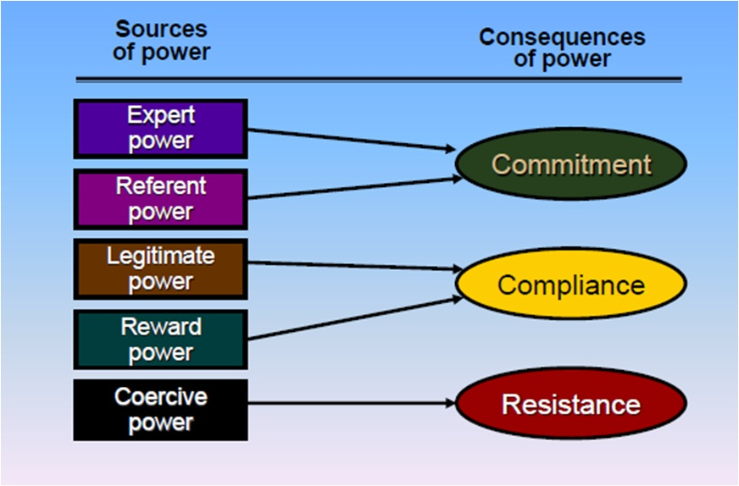
Evaluating the Bases of Power

Slide 10
DEPENDENCY: THE KEY TO POWER
What Creates Dependency?
Importance
Scarcity
Nonsubstitutability

Slide 12
INFLUENCE TACTICS (What tactics can be used to increase power?)
Rational persuasion
Inspirational appeals
Consultation
Ingratiation
Personal appeals
Exchange
Coalition tactics
Pressure
Legitimating tactics

Slide 13
EMPOWERMENT: GIVING POWER TO EMPLOYEES
Definition of Empowerment
The freedom and the ability of employees to make decisions and commitments.
One group of executives “believed that empowerment was about delegating decision making within a set of clear boundaries.” Empowerment would start at the top, specific goals and tasks would be assigned, responsibility would be delegated, and people would be held accountable for their results.
The other group believed that empowerment was “a process of risk taking and personal growth.” This type of empowerment starts at the bottom, with considering the employees’ needs, showing them what empowered behaviour looks like, building teams, encouraging risk-taking, and demonstrating trust in employees’ ability to perform.

Slide 14
Do workplaces empower people?
For employees to be empowered, however, and have an ownership mentality, four conditions need to be met, according to Professor Dan Ondrack at the Rotman School of Management:
The company must help employees gain the relevant skills.
Employees need to be supported in their decision making and not criticized when they try to do something extraordinary.
Employees need to be recognized for their efforts.

Slide 15
Effects of Empowerment
Sense of self-determination
Sense of meaning
Sense of competence
Sense of impact

Slide 17
Four US researchers investigated whether empowerment works similarly in different countries. Their findings showed that employees in India gave their supervisors low ratings when empowerment was high, while employees in the United States, Mexico, and Poland rated their supervisors favorably when empowerment was high.

Slide 18
A number of problems can arise when organizations decide they want to empower employees.
First, some managers do not want empowered employees, because this can take away some of their own base of power.
Second, some employees have little or no interest in being empowered, and therefore resist any attempts to be empowered. And finally, empowerment is not something that works well in every workplace throughout the world.

Slide 20
THE ABUSE OF POWER: HARASSMENT IN THE WORKPLACE
How are power and harassment related?

Slide 21
Question Hour

