Slide 1
Motivation in Organization

Slide 2
What is motivation?
The internal and external forces that lead an individual to work toward a goal.
Motivation can affect the intensity, direction, and persistence a person shows in working toward a goal.

Slide 4
Douglas McGregor
Theory X
The assumption that employees dislike work, will attempt to avoid it, and must be coerced, controlled, or threatened with punishment to achieve goals.
Theory Y
The assumption that employees like work, are creative, seek responsibility, and will exercise self-direction and self-control if they are committed to the objectives.

Slide 6
Criticisms?
What we know is that motivation is the result of the interaction of the individual and the situation.
The level of motivation varies both between individuals and within individuals at different times.
You may read a thriller at one sitting, yet find it difficult to concentrate on a textbook for more than 20 minutes. It’s not necessarily you—it’s the situation. So as we analyze the concept of motivation, keep in mind that the level of motivation varies both between individuals and within individuals at different times.

Slide 7
Intrinsic motivators
A person’s internal desire to do something, due to such things as interest, challenge, and personal satisfaction.
Extrinsic motivators
Motivation that comes from outside the person and includes such things as pay, bonuses, and other tangible rewards.
Are individuals mainly intrinsically or extrinsically motivated?
Theory X suggests that people are almost exclusively driven by extrinsic motivators. However, Theory Y suggests that people are more intrinsically motivated.

Slide 8
NEEDS THEORIES OF MOTIVATION
Needs theories describe the types of needs that must be met in order to motivate individuals. There are a variety of needs theories, including Maslow’s hierarchy
of needs, Alderfer’s ERG theory, McClelland’s theory of needs, and Herzberg’s motivation-hygiene theory (sometimes called the two-factor theory).

Slide 9
Maslow’s Hierarchy of Needs Theory
Physiological
Safety
Social
Esteem
Self-actualization

Slide 11
ERG Theory
Clayton Alderfer has reworked Maslow’s hierarchy of needs to align it more closely with the empirical research. His revised need hierarchy is called ERG theory (existence, relatedness, and Growth).
A revised-need hierarchy theory that emphasizes the core needs of existence, relatedness, and growth.
The ERG theory demonstrates that (1) more than one need may be working at the same time, and (2) if the gratification of a higher-level need is stifled, the desire to satisfy a lower-level need increases.

Slide 12
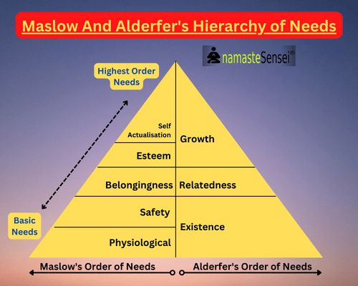

Slide 13
McClelland’s Theory of Needs
McClelland’s theory of needs was developed by David McClelland and his associates to help explain motivation. The theory focuses on three needs: achievement, power, and affiliation.
Need for achievement (nAch). The drive to excel, to achieve in relation to a set of standards, to strive to succeed.
Need for power (nPow). The need to make others behave in a way that they would not have behaved otherwise.
Need for affiliation (nAff). The desire for friendly and close interpersonal relationships.

Slide 14
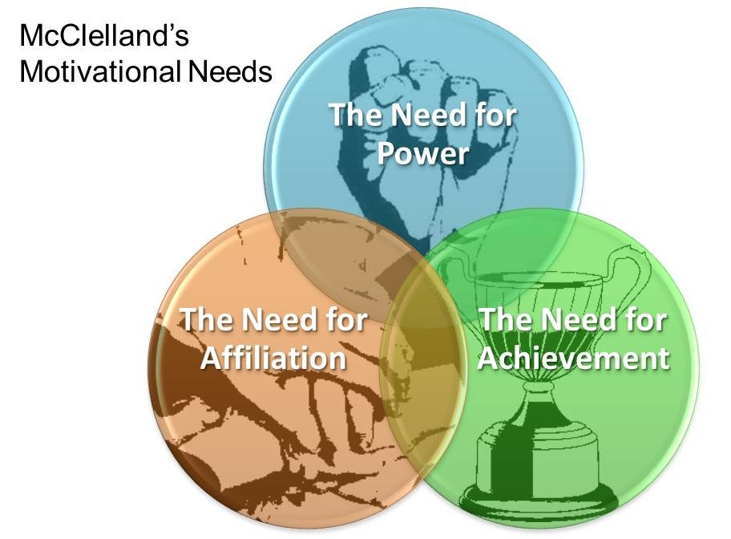

Slide 15
Motivation-Hygiene Theory
The motivation-hygiene theory was proposed by psychologist Frederick Herzberg. Herzberg investigated the question “What do people want from their jobs?” in an effort to determine what might lead to a person’s success or failure at work.
He found that intrinsic factors—such as achievement, recognition, the work itself, responsibility, advancement, and growth—seem to be related to job satisfaction. Herzberg also found that there were characteristics that led to job dissatisfaction. The factors that caused dissatisfaction were extrinsic—such as company policy and administration, supervision, interpersonal relations, and working conditions.
Herzberg proposes a dual continuum: the opposite of “Satisfaction” is “No Satisfaction,” and the opposite of “Dissatisfaction” is “No Dissatisfaction.”

Slide 16
Herzberg explained that the factors leading to job satisfaction were motivators that are separate and distinct from the hygiene factors that lead to job dissatisfaction. Thus managers who try to get rid of factors that create job dissatisfaction can create more pleasant workplaces, but not necessarily more motivated ones. Hygiene factors include company policy and administration, supervision, interpersonal relations, working conditions, and salary. When these factors are adequate, people will not be dissatisfied; however, neither will they be satisfied.
Motivating factors include achievement, recognition, the work itself, responsibility, and growth. These are the characteristics that people find intrinsically rewarding or motivating.

Slide 18
Summarizing Needs Theories
Theory | Maslow | Herzberg | Alderfer | McClelland
Is there a hierarchy of needs? | The theory argues that lower-order needs must be satisfied before one progresses to higher-order needs. | Hygiene factors must be met if a person is not to be dissatisfied. They will not lead to satisfaction, however. Motivators lead to satisfaction | More than one need can be important at the same time. If a higher-order need is not being met, the desire to satisfy a lower-level need increase | People vary in the types of needs they have. Their motivation and how well they perform in a work situation are related to whether they have a need for achievement, power, or affiliation.
What is the theory’s impact/ contribution? | The theory enjoys wide recognition among practising managers. Most managers are familiar with it. | The popularity of giving employees greater responsibility for planning and controlling their work can be attributed to his findings (see, for instance, the job characteristics model on page 134). It shows that more than one need may operate at the same time. | The theory is seen as a more valid version of the need hierarchy. It tells us that achievers will be motivated by jobs that offer personal responsibility, feedback, and moderate risks. | The theory tells us that high need achievers do not necessarily make good managers, since high achievers are more interested in how they do personally.
What empirical support/ criticisms exist? | Research does not generally validate the theory. In particular, there is little support for the hierarchical nature of needs. The theory is criticized for how data were collected and interpreted. | It is not really a theory of motivation: It assumes a link between satisfaction and productivity that was not measured or demonstrated. | It ignores situational variables. | It has mixed empirical support, but the theory is consistent with our knowledge of individual differences among people. Good empirical support exists on needs achievement in particular.

Slide 19
PROCESS THEORIES OF MOTIVATION
Process theories focus on the broader picture of how someone can set about motivating another individual. Process theories include expectancy theory and goal-setting theory.

Slide 20
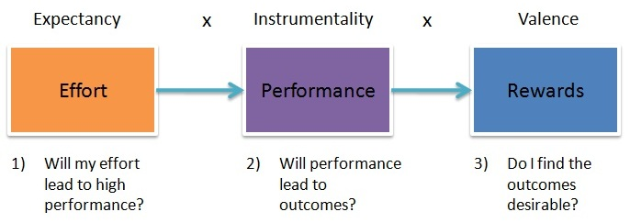
Expectancy Theory

Slide 21
The theory that individuals are motivated based upon their evaluation of whether their effort will lead to good performance, whether good performance will be followed by a given outcome, and whether that outcome is attractive to them.
From a practical perspective, expectancy theory says that an employee will be motivated to exert a high level of effort when he or she believes the following:
• That the effort will lead to good performance
• That good performance will lead to organizational rewards, such as a bonus, a salary increase, or a promotion
• That the rewards will satisfy his or her personal goals

Slide 22
Effort-Performance Relationship
The belief that effort is related to performance.
In general, an employee’s expectancy is influenced by the following:
Self-esteem
Previous success
Help from supervisors and subordinates
Information
Proper materials and equipment

Slide 23
Performance-Rewards Relationship
The performance-rewards relationship is commonly called instrumentality. It refers to the individual’s perception of whether performing at a particular level will lead to the attainment of a desired outcome.
Rewards–Personal Goals Relationship
The rewards–personal goals relationship is commonly called valence. It refers to the degree to which organizational rewards satisfy an individual’s personal goals or needs and the attractiveness of those potential rewards for the individual.
Steps to Increasing Motivation, Using Expectancy Theory

Slide 24
Goal-Setting Theory
You have heard the phrase a number of times: “Just do your best. That’s all anyone can ask.” But what does “do your best” mean? Do we ever know if we have achieved that vague goal? Might you have done better in your high school English class if your parents had said, “You should strive for 75 percent or higher on all your work in English” instead of “do your best”?
How Does Goal Setting Motivate?
Goals direct attention
Goals regulate effort
Goals increase persistence
Goals encourage the development of strategies and action plans
In order for goals to be effective, they should be “SMART.”
SMART stands for;
Specific
Measurable
Attainable
Results-oriented
Time-bound

Slide 26
Contingency Factors in Goal Setting
Feedback is one of the most important factors that influences the relationship between goals and performance. Recent research suggests that when individuals receive negative feedback, they lower their goals, and when they receive positive feedback, they raise their goals.
In addition to feedback, four other factors have been found to influence the goals-performance relationship. These are goal commitment, adequate self-efficacy, task characteristics, and national culture.
Self-efficacy may explain how feedback affects goal behaviour. Self-efficacy refers to an individual’s belief that he or she is capable of performing a task. The higher your self-efficacy, the more confidence you have in your ability to succeed in a task.

Slide 27
Question Hour

