Slide 1
Stress at Work

Slide 2
Are We Overstressed?

Slide 3


Slide 4
The Most Stressful Jobs
Among the criteria used in the rankings were overtime, quotas, deadlines, competitiveness, physical demands, environmental conditions, hazards encountered, initiative required, stamina required, win-lose situations, and working in the public eye.

Slide 5
What Is Stress?
Stress is usually defined in terms of a situation that creates excessive psychological or physiological demands on a person.
Stress is not necessarily bad in and of itself.
Work overload; role conflict; ineffective, hostile and incompetent bosses; lack of personal fit with a job; lack of recognition; lack of a clear job description or chain of command; fear, uncertainty, and doubt about career progress; and prejudice based on age, gender, ethnicity or religion.

Slide 6
Causes of Stress
Competition and change
Technological change
Increasingly diverse workforce
Downsizing
Employee empowerment and teamwork
Work/home conflict

Slide 7
Consequences of Stress
For instance, an individual who is experiencing a high level of stress may develop high blood pressure, ulcers, irritability, difficulty in making routine decisions, loss of appetite, accident proneness, and the like.
Physiological symptoms
Behavioural symptoms

Slide 8
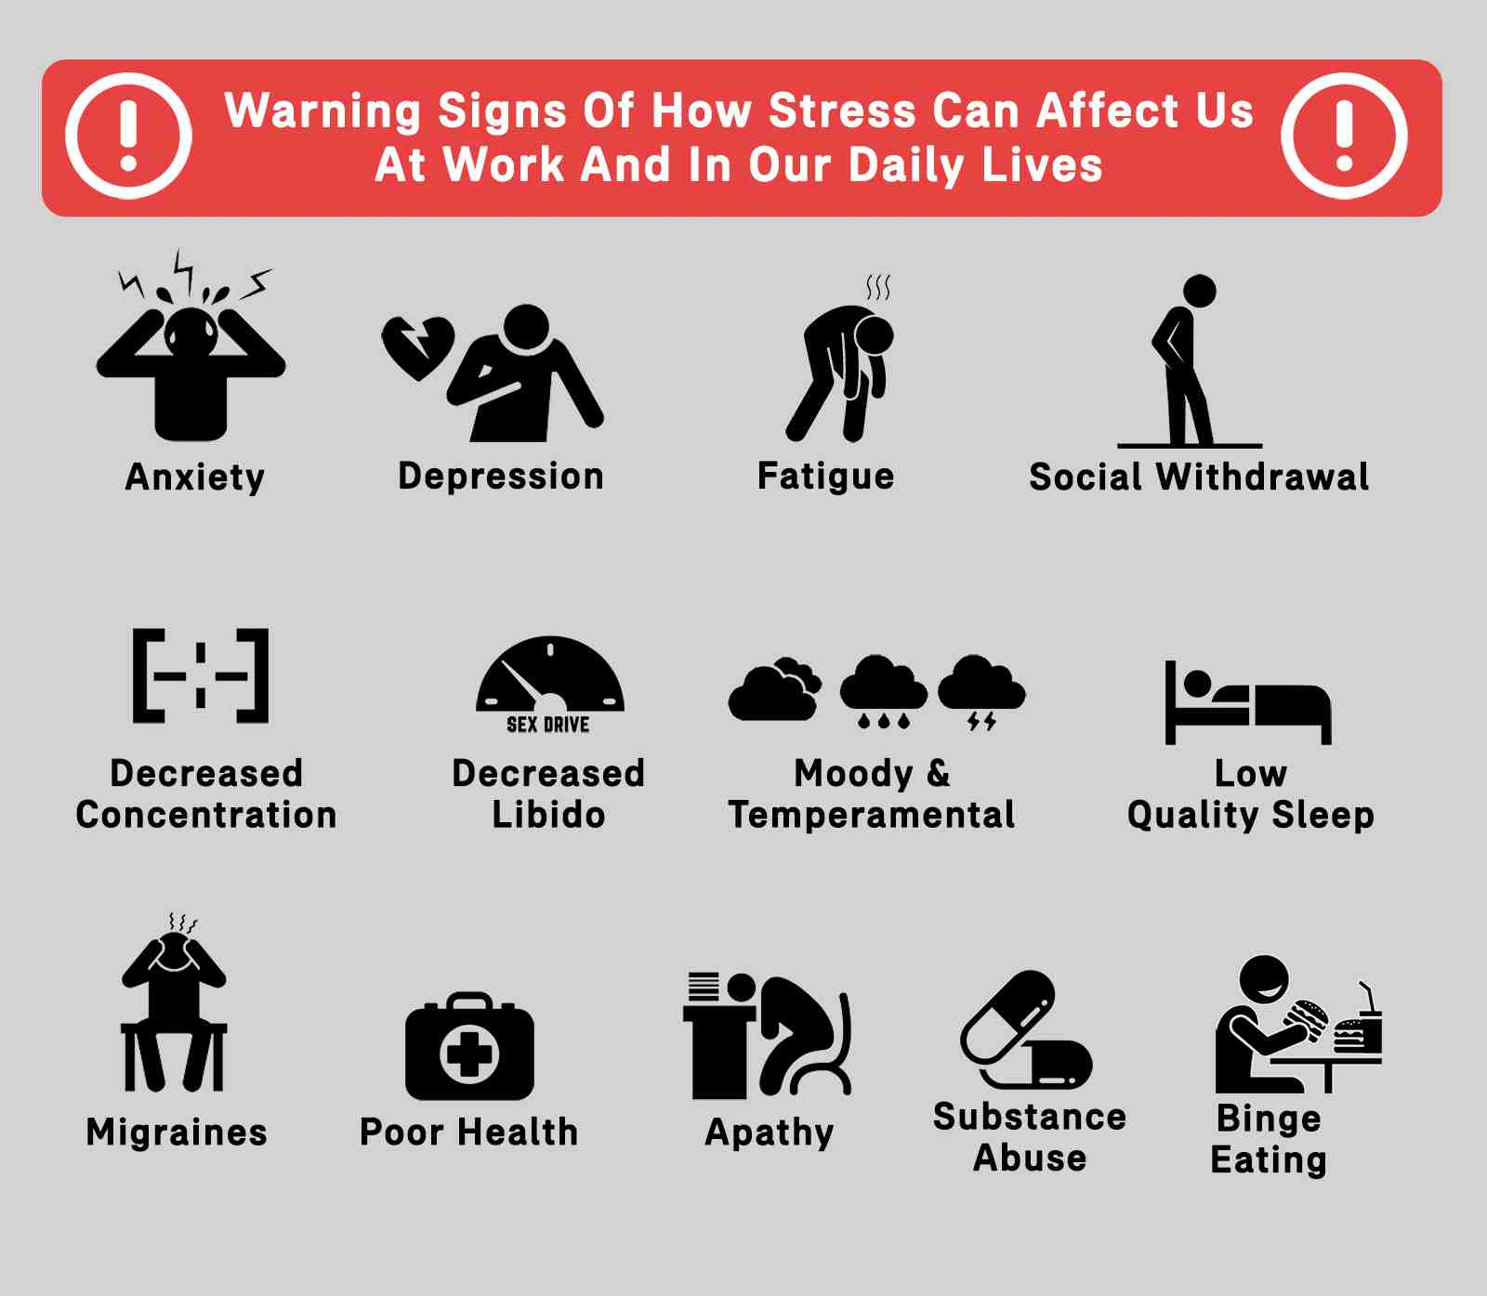

Slide 9
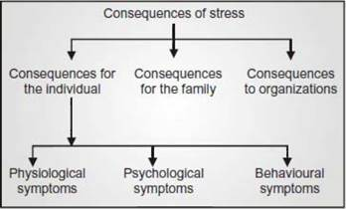

Slide 10
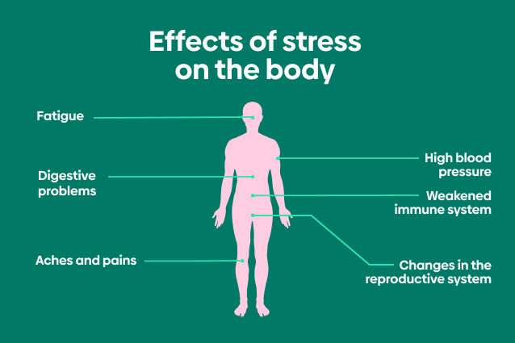

Slide 11
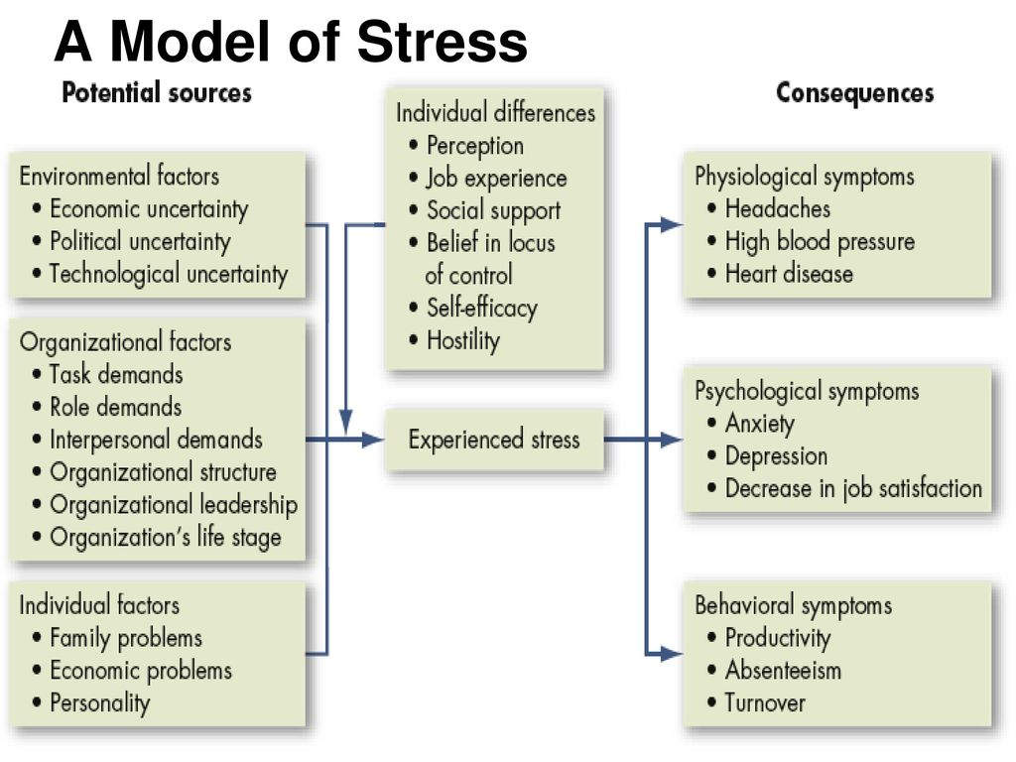
Model of Stress

Slide 12
Why Do Individuals Differ in Their Experience of Stress?
Perception
Job experience
Social support
Belief in locus of control
Hostility

Slide 13
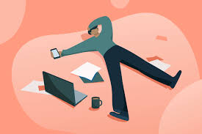
How Do We Manage Stress?

Slide 14
Individual Approaches
Time management
Physical activity
Relaxation techniques
Building social supports

Slide 15
Organizational Approaches
In general, strategies to reduce stress include improved processes for choosing employees, placement of employees in appropriate jobs, realistic goal setting, designing jobs with employee needs and skills in mind, increased employee involvement, improved organizational communication, and, as mentioned, establishment of corporate wellness programs.

Slide 16
Question Hour

