Slide 1
Leadership

Slide 4
Hurricane Katrina in September 2005

Slide 5
What is the difference between a manager and a leader?
Management | Leadership
Engages in day-to-day caretaker activities: Maintains and allocates resources system | Formulates long-term objectives for reforming the : Plans strategy and tactics
Exhibits supervisory behaviour: Acts to make others maintain standard job behaviour | Exhibits leading behaviour: Acts to bring about change in others congruent with long-term objective
Administers subsystems within organization | Innovates for the entire organization
Asks how and when to engage in standard practice | Asks what and why to change standard practice
Acts within established culture of the organization | Creates vision and meaning for the organization
Uses transactional influence: Induces compliance in manifest behaviour using rewards, sanctions, and formal authority | Uses transformational influence: Induces change in values, attitudes, and behaviour using personal examples and expertise
Relies on control strategies to get things done by subordinate | Uses empowering strategies to make followers internalize values

Slide 6
Are there specific traits, behaviours, and situations that affect how one leads?
The three general types of theories that emerged were-
(1) trait theories, which propose leaders have a particular set of traits that makes them different from nonleaders;
(2) behavioural theories, which propose that particular behaviours make for better leaders; and
(3) contingency theories, which propose the situation has an effect on leaders.
.

Slide 7
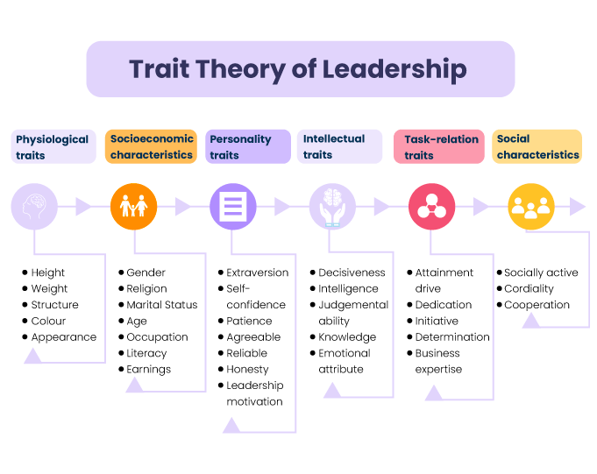
Trait Theory: Are Leaders Different from Others?

Slide 8
Theories that propose traits—personality, social, physical, or intellectual—differentiate leaders from nonleaders.
The media have long been believers in trait theories. They identify people such as Nelson Mandela, Richard Branson of the Virgin Group, and Steve Jobs of Apple as leaders, and then describe them in terms such as charismatic, enthusiastic, decisive, and courageous. The media are not alone. The findings of a recent survey of 200 CEOs, and what they cited as the most important leadership traits.

Slide 9
What CEOs Identify as Key Leadership Traits
Communication skills
Ability to motivate people
Honesty
Ability to listen
Team-building expertise
Analytical skills
Aggressiveness in business

Slide 10
Behavioural Theories: Do Leaders Behave in Particular Ways?
Theories that propose that specific behaviours differentiate leaders from nonleaders.
The three most best-known behavioural theories of leadership are the Ohio State University studies that were conducted starting in the late 1940s, the University of Michigan studies conducted at about the same time, and Blake and Mouton’s Leadership Grid, which reflects the behavioural definitions of both the Ohio and Michigan studies.

Slide 12
The Ohio State Studie
Initiating structure refers to the extent to which a leader is likely to define and structure his or her role and the roles of employees in order to attain goals; it includes behaviour that tries to organize work, work relationships, and goals. For instance, leaders using this style may develop specific output goals or deadlines for employees.
Consideration is defined as the extent to which a leader is likely to have job relationships characterized by mutual trust, respect for employees’ ideas, and regard for their feelings. A leader who is high in consideration shows concern for followers’ comfort, well-being, status, and satisfaction. For instance, leaders using this style may create more flexible hours, or flextime, to make it easier for employees to manage family issues during work hours.

Slide 13
The Michigan Studies
Researchers at the University of Michigan, whose work is referred to as “the Michigan studies,” also developed two dimensions of leadership behaviour that they labelled employee-oriented and production-oriented.
Employee-oriented leaders emphasize interpersonal relations. They take a personal interest in the needs of their subordinates and accept individual differences among members.
Production-oriented leaders, in contrast, tend to emphasize the technical or task aspects of the job. They are mainly concerned with making sure the group accomplishes its tasks, and the group members are simply a means to that end.

Slide 14
The Leadership Grid
Blake and Mouton developed a graphic portrayal of a two-dimensional view of leadership style. They proposed a Leadership Grid based on the styles of “concern for people” and “concern for production,” which essentially represent the Ohio State dimensions of consideration and initiating structure, or the Michigan dimensions of employee orientation and production orientation

Slide 15
Contingency Theories: Does the Situation Matter?
Theories that propose that leadership effectiveness depends on the situation.

Slide 16
Guidelines for Effective leadership
Build commitment to a core ideology
Build capable leadership at all levels
Involve and empower people at all levels
Keep lines of communication open
Use reward systems to support multiple objectives
Encourage and exemplify leadership by example
Maintain situation awareness
Embrace systems thinking

Slide 17
Question Hour

