Slide 1
CSE 1151 (Computer Programming) C Function
Section B

Slide 2
Function
A typical layout of a C file:
global declaration
directives
variables
functions
int main(parameters){
local declarations
statements
call functions
return_value
}
/* function definition section */
ret-type f1(parameters){
body of the function
return value;
)
ret-type f2(parameters){
function body
return value
}
Function is a block of codes that can be repeatedly used within the program for achieving a very specific job. Usually after performing the assigned job the function returns a single value as the result.
Syntax of a fucntion
ret-type: any type of data except array
parameter list: comma-separated list of param; may be empty
bodyof the function:
Declaration: a function must be declared before u define and use it.
int f(int i, int k, int j)
int f2(int, char, int*) // note the difference

Slide 3
Scope of Function
What is scope?
A function's code is private to that function.
Variables that are defined within a function are called local variables.
A local variable comes into existence when the function is entered and is destroyed upon exit. That is, local variables cannot hold their value between function calls (Except static variable).
You cannot define a function within a function.
void f1(int x, int y){ // local
int p, q; //local
statements;
}
void f2(int x, int y){
int p, q;
statements;
}

Slide 4
Function arguments
What is arguments?
It must declare variables that accept the values of the arguments. Known as formal parameters of the function local to the function.
is_odd() function has 1 parameter. It returns 1 if a is an odd integer; otherwise returns 0.
During calling this is_odd() you have to pass one value; it is called argument.
int is_odd(int a){
if(a%2)
return 1;
else
return 0;
}
Job:
Write a function that will accept two integers as argument, and return the larger number

Slide 5
Call by values and call by reference
Two ways of passing arguments to a function.
Call by value
a copy of the argument is passed to the formal parameter into the function
Call by reference
a copy of the address of the argument is passed into the function
Date types of argument and formal parameter must match

Slide 6
Example of call by reference

Slide 7
arc and arc -- argument to main function
‘main’ function can take two arguments from when the program is started
If you called this program name and your name were Tom, you would type name Tom to run the program. The output from the program would be Hello Tom
C:\>name.exe tom
C:\>Hello tom
What does main() return?
The main( ) function returns an integer to the calling process, which is generally the operating system.

Slide 8
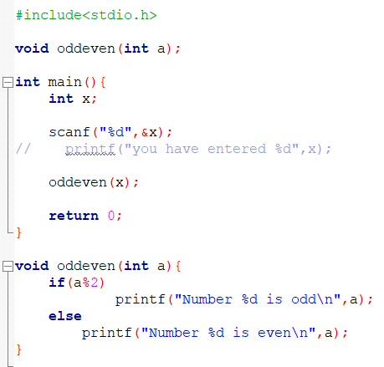
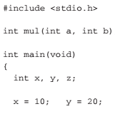
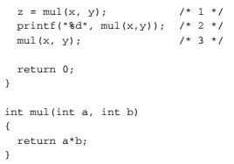
Returning from a function
Return type of the function and the data type of the variable to store the return value must match.
void type function does not return anything.

Slide 9
Recurvise function
/* non-recursive */
int factorial(int n) {
int t, answer;
answer = 1;
for(t=1; t<=n; t++)
answer=answer*(t);
return(answer);
}
/* recursive */
int factorial(int n) {
int answer;
if(n==1) return(1);
answer = factr(n-1)*n; /* recursive call */
return(answer);
}
A function is said to be recursive if a statement in the body of the function calls itself. Recursion is the process of defining something in terms of itself.
Example of a recursive function is factorial( )

Slide 10
Example: Recursive Fucntion
Sum of natural numbers
#include <stdio.h>
int sum(int n);
int main() {
int number, result;
printf("Enter a positive integer: ");
scanf("%d", &number);
result = sum(number);
printf("sum = %d", result);
return 0;
}
int sum(int n) {
if (n != 0)
// sum() function calls itself
return n + sum(n-1);
else
return n;
}

Slide 11
Example of Static variable in Fucntion

Slide 12
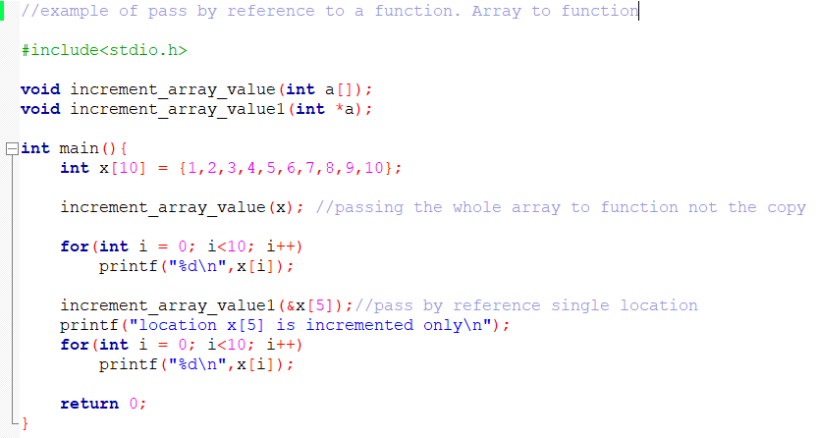
Passing array to a function

Slide 13
Returning multiple value
Use array. Pass the whole array to the function.
Use global variables which the array will work on.
void read_matrx(int row, int col, int m[][max_c]);

Slide 14
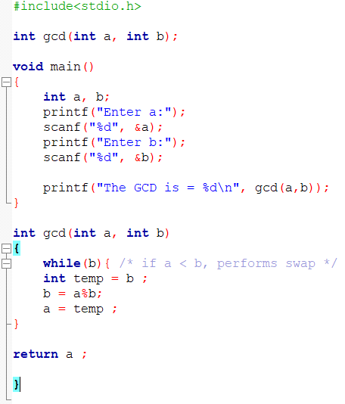
Example1: GCD
Job:
What if the b is greater than a?
Write a function to swap the value of a and b, then apply the gcd() function
Write a program to determine the gcd of 4 integers

