Slide 1
Pointers
M R Khandker

Slide 2
What is a Pointer?
Pointer: memory address of a variable
Address can be used to access/modify a variable from anywhere
Pointers can create dynamic data structures
data structures built up from blocks of memory allocated from the heap at run-time
Provides an alternative way to access information stored in arrays. Pointer techniques are especially valuable when you work with strings. There is an intimate link between arrays and pointers in C .

Slide 3
Physical and virtual memory
Physical memory: physical resources where data can be stored and accessed by your computer
cache
RAM
hard disk
removable storage
Virtual memory: abstraction by OS, addressable space accessible by your code

Slide 4
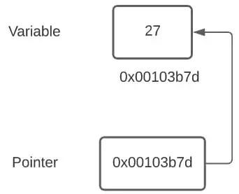
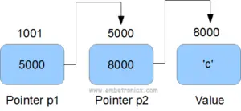
Pointer variable

Slide 5
Pointer initialization
int i,j;
int *p; /* a pointer to an integer */
p = &i; /* & is address reference. p is a variable where only an address of integer can be assigned */
*p = 5; // *p is the location pointed to by p. this is the value of the type it is pointed to
j = i;
int *q;
q = p; //valid but q = i is not valid
Pointer variable must be initialized before using it

Slide 6
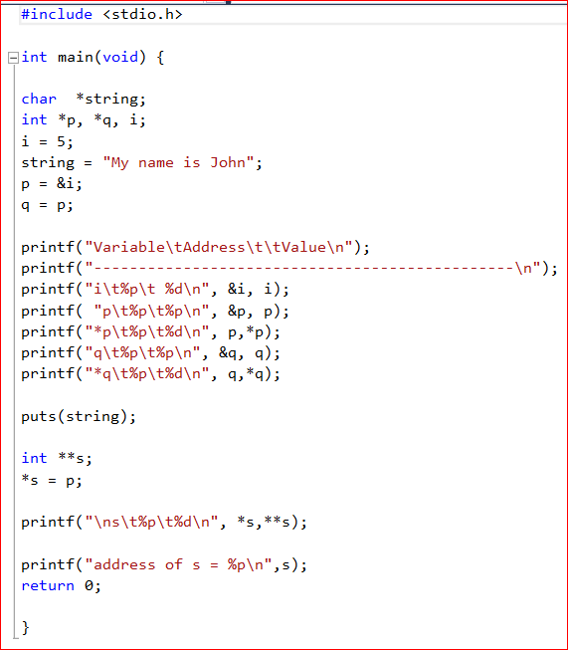
Example: pointer to integer,
pointer to character and
pointer to pointer integer

Slide 7
Memory allocation
A block of memory location can be allocated to a pointer before using it. It will not corrupt the memory accidentally, or crash the program due to shortage of memory space.
ptr = (cast-type*) malloc(byte-size)
ptr = (int*) malloc(100 * sizeof(int));

Slide 8
calloc() method
“calloc” or “contiguous allocation” method in C is used to dynamically allocate the specified number of blocks of memory of the specified type.
ptr = (cast-type*)calloc(n, element-size);
here, n is the no. of elements and element-size is the size of each element.
ptr = (float*) calloc(25, sizeof(float));

Slide 9
realloc() method
used to dynamically change the memory allocation of a previously allocated memory. In other words, if the memory previously allocated with the help of malloc or calloc is insufficient, realloc can be used to dynamically re-allocate memory.
re-allocation of memory maintains the already present value and new blocks will be initialized with the default garbage value.
ptr = realloc(ptr, newSize);

