Slide 1
C File I/O
M R Khandker

Slide 2
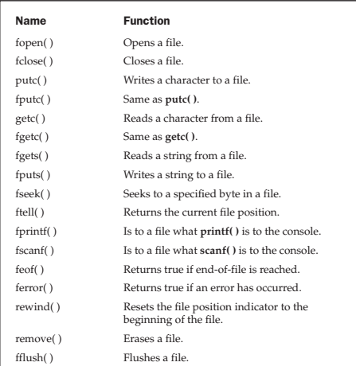
File System Basics
A file pointer is a pointer to a structure of type FILE. It points to information that defines various things about the file, including its name, status, and the current position of the file.
In order to read or write files, your program needs to use file pointers. To obtain a file pointer variable, use a statement like this
FILE *fp; //fp is a pointer to FILE type Then you can open a file pointer using fopen() function as:
fp = fopen("test", "w");
Here test is the name of the file to be opened, w is the mode of opening the file is write; i.e. you can only write to the file test now.

Slide 3
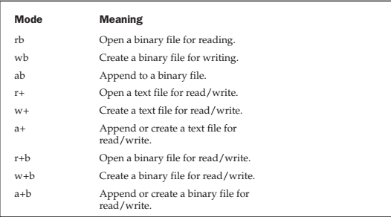
File opening modes

Slide 4
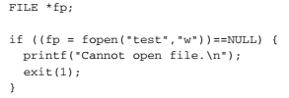
However, in order to avoid any error in file operation it is common to use following set of instructions:
If(fp==NULL){
printf(“cannot open file\n”);
exit (1);
}
The number of files that may be open at any one time is specified by FOPEN_MAX. This value will usually be at least 8, but you must check your compiler’s documentation for its exact value.

Slide 5
/* KTOD: A key to disk program. */
#include <stdio.h>
#include <stdlib.h>
int main()
{
FILE *fp;
char ch;
if((fp=fopen("test1.txt", "w"))==NULL) {
printf("Cannot open file.\n");
exit(1);
}
do {
ch = getchar();
putc(ch, fp);
} while (ch != '$');
fclose(fp);
return 0;
}

Slide 6
/* DTOS: A program that reads files and displays them on the screen. */
#include <stdio.h>
#include <stdlib.h>
int main()
{
FILE *fp;
char ch;
if((fp=fopen("test.txt", "r"))==NULL) {
printf("Cannot open file.\n");
exit(1);
}
ch = getc(fp); /* read one character */
while (ch!=EOF) { //check whether you reached end of the file or not
putchar(ch); /* print on screen */
ch = getc(fp);
}
fclose(fp);
return 0;
}

Slide 7
File copy
It is wise to open file in binary file which can be used for text file as well.
#include <stdio.h>
#include <stdlib.h>
int main()
{
FILE *in, *out;
char ch;
if((in=fopen("searching.exe", "rb"))==NULL) {
printf("Cannot open source file.\n");
exit(1);
}

Slide 8
if((out=fopen("write_file.exe", "wb")) == NULL) {
printf("Cannot open destination file.\n");
exit(1);
}
/* This code actually copies the file. */
while(!feof(in)) {
ch = getc(in);
if(!feof(in)) putc(ch, out);
}
fclose(in);
fclose(out);
return 0;
}

Slide 9
Your Job
Modify the programs so that you can supply file names from the keyboard at runtime.
Try other file operation, for example string reading/writing, structure reading/writing etc.

