Slide 1
Structure
M R Khandker

Slide 2
Structure Declaration
A structure is a collection of variables referenced under one name, providing a convenient means of keeping related information together. Each variable is called member of the structure.
Unlike array, structure can hold different data type under one name.
Declaration:
struct addr{ char name[30]; char street[40]; char city[20]; char state[3]; unsigned long int zip; };
addr is now the structure type, no variables has been created in the memory.
Following statements will create variables of type addr:
struct addr addr_info;
addr addr_info;

Slide 3
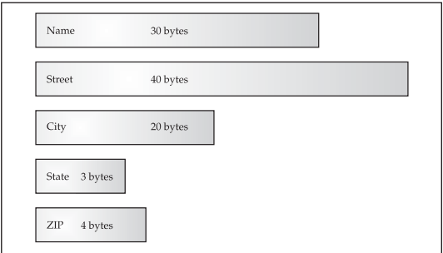
Structure in Memory
You can also use following statement to create structure variable:
struct addr { char name[30]; char street[40]; char city[20]; char state[3]; unsigned long int zip; } addr_info, binfo, cinfo; // 3 variables declared
The general form of a structure declaration is:
struct struct-type-name { type member-name; type member-name; type member-name; .. } structure-variables;

Slide 4
Accessing Structure Members
Using dot operator: structure-name.member-name
addr_info.zip = 12345; // zip is a member of add_info structure
Therefore, to print the ZIP code on the screen, write printf("%lu", addr_info.zip);
gets(addr_info.name); //passing member to a function
You can assign a structure to another identical structure
addr_info = binfo;// all member are assigned
addr_info.zip = binfo.zip;// only zip member is assigned

Slide 5
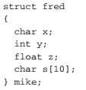
Passing Structure member to a function
Pass by value

Slide 6
Pass by reference:
Note that the & operator precedes the structure name, not the individual member name.

Slide 7
Passing entire structure to a function
#include <stdio.h> /* Define a structure type. */ struct struct_type { int a, b; char ch; } ; void f1(struct struct_type parm); // function declaration int main(void) { struct struct_type arg; arg.a = 1000; f1(arg); return 0; } void f1(struct struct_type parm) { printf("%d", parm.a); }
When a structure is used as an argument to a function, the entire structure is passed using the standard call-by-value method.
When using a structure as a parameter, remember that the type of the argument must match the type of the parameter.

Slide 8
Structure example
#include <stdio.h>
/* Define a structure type. */
struct struct_type {
int a, b;
char ch;
} ;
void f1(struct struct_type parm); // function declaration
void f2(int *x, int *y, char *c);//all members are call by value
int main(void){
struct struct_type arg;
arg.a = 1000;
arg.b = 10;
arg.ch = 'X';
f1(arg);
printf("a=%d\n",arg.a);
printf("b=%d\n",arg.b);
printf("c=%c\n",arg.ch);
//call by reference
f2(&arg.a,&arg.b,&arg.ch);
//print to verify that all original values are changed
printf("a=%d\n",arg.a);
printf("b=%d\n",arg.b);
printf("c=%c\n",arg.ch);
return 0;
}
void f1(struct struct_type parm){//whole structure call by value
parm.a++;
printf("a in function=%d\n", parm.a);
}
void f2(int *x, int *y, char *c){
*x+=1;
*y+=1;
*c = 'Y';
}

Slide 9
Array of structures
For example, to declare a 100-element array of structures of type addr, defined earlier, write struct addr addr_info[100];
To print the ZIP code of structure 3, write printf("%lu", addr_info[2].zip);

Slide 10
Declaring a Structure Pointer
struct addr *addr_pointer;
Structures can be nested – if ‘employee’ has been declared in the ‘workers’ structure
workers.employee.name = “mamun”;

Slide 11
Unions
A union is a memory location that is shared by two or more different types of variables.
Its general form is union union-type-name { type member-name; type member-name; type member-name; ... } union-variables ;
This declaration does not create any variables. To create a union variable

Slide 12
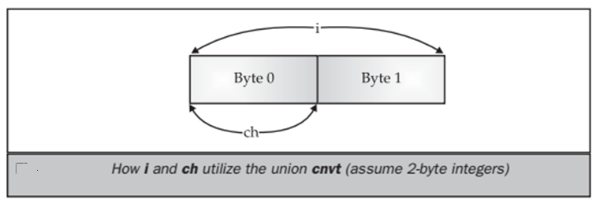
When a union variable is declared, the compiler automatically allocates enough storage to hold the largest member of the union. For example (assuming 2-byte integers), cnvt is 2 bytes long so that it can hold i, even though ch requires only 1 byte.

Slide 13
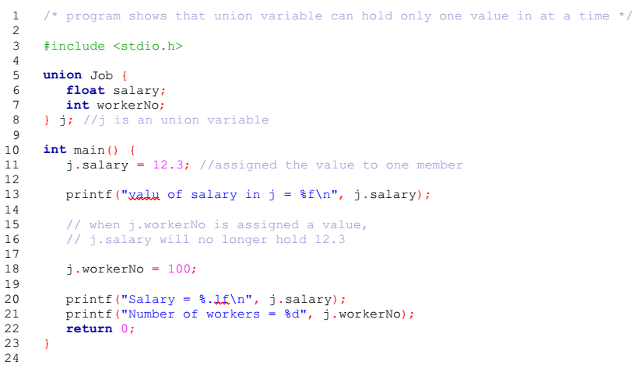
Example of union

Slide 14
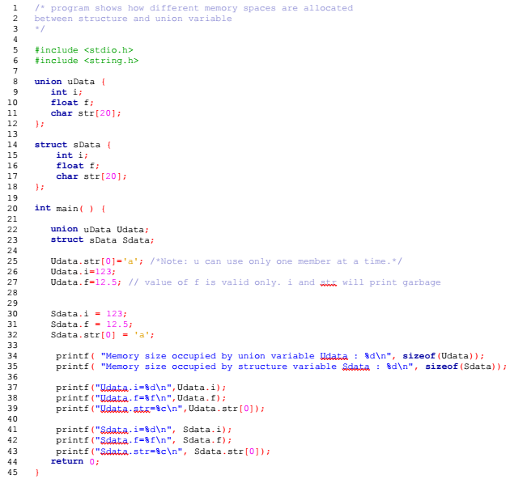
Union and Structure

