Slide 1
C++: Object oriented programming
M R Khandker

Slide 2
Motivation
When program becomes too large, it is very difficult for a single program to track down the flow of the programming control, and complete the job in a fairly reasonable time period. Then new approach of programming is felt necessary in which a single program can be split out into several relatively independent subtask and can be completed independently by other programmers.

Slide 3
Fundamental concepts
In structured programming code is organized in different functions and not integrated with data. Data is considered separately.
Object oriented programming data and the set of code that will work on it are integrated in a single entity which is called object. The program is organized considering these objects.
All objects belong to one or more classes. A class is a template or definition of an objects.

Slide 4
Concepts continued
Three basic properties:
Encapsulation
Polymorphism
one interface, multiple methods
Function overloading, operator overloading
Inheritance

Slide 5
Simple i/o operation
#include <iostream>
using namespace std; // a declarative region;
int main()
{
int i;
cout << "This is output.\n"; // this is a single line comment
// input a number using >>
cout << "Enter a number: ";
cin >> i;
// now, output a number using <<
cout << i << " squared is " << i*i << "\n";
return 0;
}

Slide 6
Class
class class-name { private data and functions public: public data and functions } object name list;
Object may also be declared later
class Room {
// By default, all items defined in a class are private.
double length;
double breadth;
double height;
public:
double calculateArea(){
return length * breadth;
}
double calculateVolume(){
return length * breadth * height;
}
} room1, room2;

Slide 7
Objects may also be declared as:
ClassName ObjectVariableName;
Room myRoom;
To access member variables and functions use (.) dot operator. For example,
myRoom.calculateArea();
A complete program

Slide 8
Public, Private and Protected variable
Access Control mechanism in OOP.
Class has 3 kinds of access-specifier:
Public: The public access specifier allows functions or data to be accessible to other parts of your program.
Private: By default, functions and data declared within a class are private to that class and may be accessed only by other members of the class.
Protected: Similar to private, but behaves differently when inheritance is involved.
Once an access specifier has been used, it remains in effect until either another access specifier is encountered or the end of the class declaration is reached
Example

Slide 9
Constructor and Destructor
The function having the same name as the class is the constructor. It’s purpose is to create an object with some initial value.
A class may have several constructor. It is possible to supply arguments to initialize the object variables during its creation.
Constructor does not have return type.
The complement of the constructor is the destructor.
Local objects are created when their block is entered, and destroyed when the block is left.
Global objects are destroyed when the program terminates. When an object is destroyed, its destructor (if it has one) is automatically called.

Slide 10
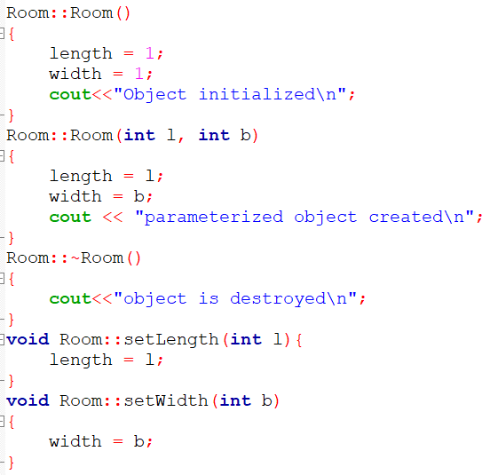
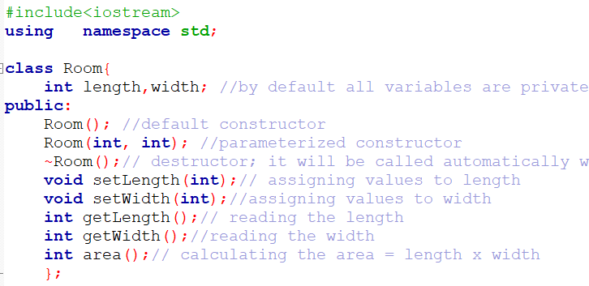
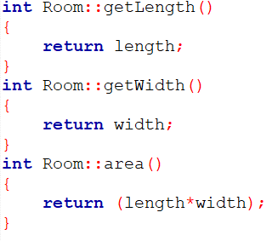

Slide 11
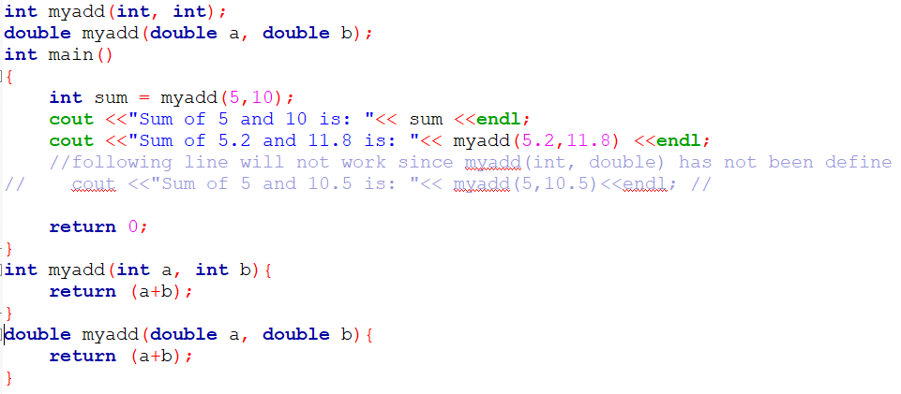
Function overloading
Function overloading is the process of using the same name for two or more functions.
must use either different types of parameters or a different number of parameters.

Slide 12
Operator overloading
Overloading a operator (say, +, -, +) means make them work differently in the context of current class.
The operator retains its original operation outside the object of the class.
For binary operator there will be one argument. For unary operator the arg-list will be empty.
A member operator function takes this general form:
ret-type class-name::operator#(arg-list) { // operations }

Slide 13
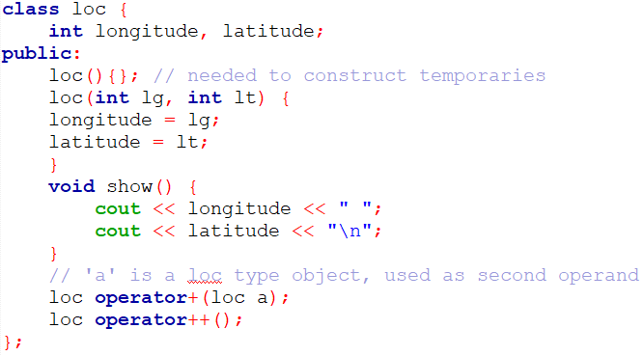
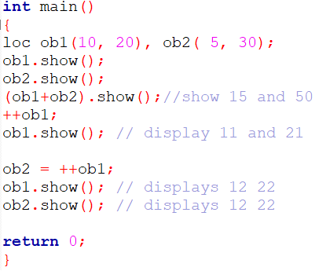
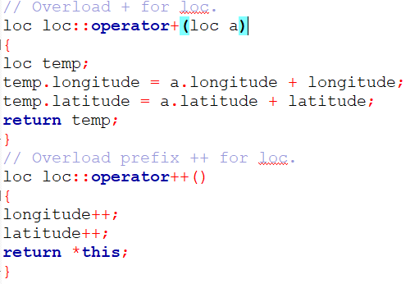

Slide 14
Inheritance
class derived-class: access base-class{
//body of the class
}
// building is class
Class building {
int rooms, floors, areas;
public:
void setRooms(int n);
int getRooms();
void setFloors(int n);
int getFloors();
void setAreas(int n);
int getAreas();
};
// house is a derived-class
class house: public building{
int bedrooms, bathrooms;
public:
void setBedRooms(int n);
int getBedRooms();
void setBathrooms(int n);
int getBathrooms();
};

Slide 15
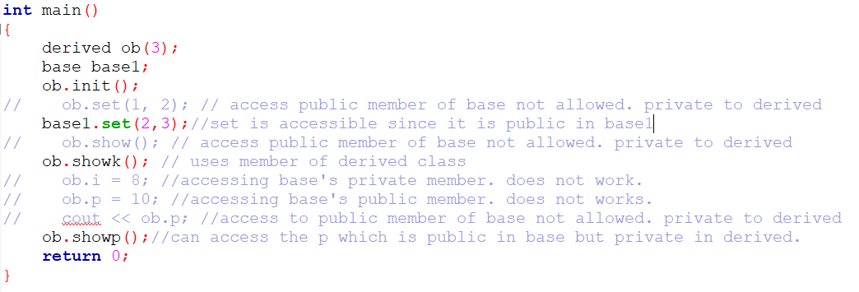
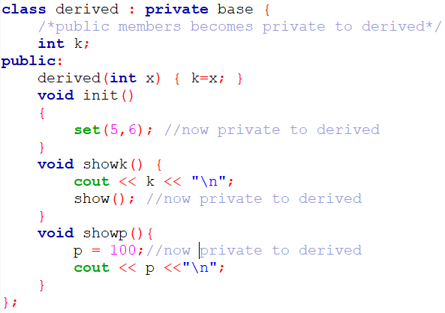
Inheritance: private
When a child class is derived as private from the base class, then all public, protected and private members becomes private to child class.

Slide 16
Calling parent constructor
If you want to call parent’s constructor from the child constructor, the syntax is:
child_class::child_constructor(..) : parent_constructor (..)
{
}
Example:
bedroom::bedroom(int a, int b, bool y):room(a,b)
{
attachedBath = y;
}
Example

Slide 17
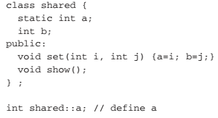
Static member
A variable which belong to the class, not to any particular object, then it is called static variable. In this case there is only one copy of variable created for all the objects. Any changes of value of the object is global to all objects.
static class member – members declared static will have one copy of it and shared to all objects.
A static member is declared inside a class but not defined. It is re-declared in global declaration area (outside of classed) an defined.

Slide 18
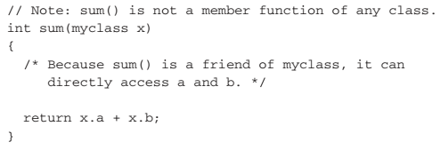
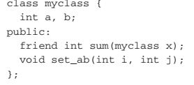
Friend function
It is possible to grant a nonmember function access to the private members of a class by using a friend. A friend function has access to all private and protected members of the class for which it is a friend.
Syntax:
A friend function is defined outside of any class without scope.

