Slide 1
Globalization International Trade
The increased integration of markets—goods and financial—the mobility of people with transnational travels for jobs and vacations, and the global reach of satellite channels, the Internet, and the telephone all have virtually transformed the world into a ‘global village’.
‘Globalization’, one of the most complex terms used in international business, has wide connotations. Interestingly, ‘globalization’ is a term not only used and heard frequently, but also as often misused and misinterpreted. Globalization is used to refer to the increasing influence exerted by economic, political, socio-cultural, and financial processes across the globe.

Slide 2
Globalization International Trade
Globalization not only offers numerous challenges to business enterprises but also opens up new opportunities. In the earlier era of restrictive trade and investment regimes with much lower degree of interconnectedness among countries, companies solely operating in their home markets were generally protected and isolated from the vagaries of upheavals in the international business environment.
Therefore, developing a thorough conceptual understanding of international business has become inevitable not only for the managers who operate in international markets, but also for those who operate only domestically.

Slide 3
Globalization International Trade
Globalization is the closer integration of the countries and peoples of the world, brought about by the enormous reduction in the costs of transportation and communications and the breaking down of artificial barriers to the flow of goods and services, capital, knowledge, and (to a lesser extent) people across the borders.
Globalization tends to erode national boundaries and integrate national economies, cultures, technologies, and governance, leading to complex relations of mutual interdependence.

Slide 4
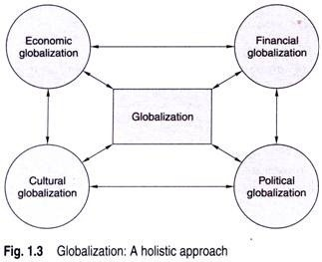
Holistic Approach of Globalization International Trade

Slide 5
Holistic Approach of Globalization International Trade
(i) Economic Globalization:
The term ‘globalization’ is widely used in business circles and economics to describe the increasing internationalization of markets for goods and services, the financial system, corporations and industries, technology, and competition.
In the globalized economy, distances and national boundaries have substantially diminished with the removal of obstacles to market access. Besides, there have been reductions in transaction costs and compression of time and distance in international transactions.

Slide 6
Holistic Approach of Globalization International Trade
(ii) Financial Globalization:
The liberalization of capital movements and deregulations, especially of financial services, led to a spurt in cross-border capital flows. The globalization of financial markets has triggered a rapid growth in investment portfolio and a large movement of short-term capital borrowers and investors interacting through an increasingly unified market.

Slide 7
Holistic Approach of Globalization International Trade
(iii) Cultural Globalization:
The convergence of cultures across the world may be termed as cultural globalization. India’s rich cultural heritage has a glorious history of globalization (Exhibit 1.3), which is evident even today by its profound impact on people and their lives. Globalization has led to the development of global pop culture.

Slide 8
Holistic Approach of Globalization International Trade
iv) Political Globalization:
The convergence of political systems and processes around the world is referred to as political globalization. International business is increasingly conducted across the juridical, socio-cultural, and physical borders of sovereign states. After World War II, there has been a proliferation of sovereign states. In 1914 there were 62 separate states, 74 in 1946, 149 in 1978, 193 in 1991, and 209 in 2007.

Slide 9
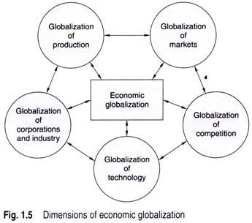
Dimensions of Economic Globalization International Trade

Slide 10
Dimensions of Economic Globalization International Trade
(i) Globalization of Production:
The increased mobility of the factors of production, especially the movement of capital, has changed countries’ traditional specialization roles significantly. Consequently, many firms in developing countries seek to strengthen their competitive advantage by specializing in differentiated products with an increasingly large technological content.

Slide 11
Dimensions of Economic Globalization International Trade
(ii) Globalization of Markets:
Marketing gurus in the last two decades have extensively argued over customized marketing strategies in the globalization of markets. Theodore Levitt, in his path- breaking paper ‘Globalization of Markets’, views the recent emergence of global markets on a previously unimagined scale of magnitude. Technology as the most powerful force has driven the world towards converging commonality.

Slide 12
Dimensions of Economic Globalization International Trade
(iii) Globalization of Competition
This refers to the intensification of competition among business enterprises on a global scale. Such globalization of competition has resulted in the emergence of new strategic transnational alliances among companies across the world. Increasingly, more firms need to compete with new players from around the globe in their own markets as well as foreign ones.

Slide 13
Dimensions of Economic Globalization International Trade
(iv) Globalization of Technology
The rapid pace of innovations with international networks and convergence of standards across countries has contributed to the globalization of technology. This rapid dissemination of technology internationally and the simultaneous shortening of the cycles of production has led to the globalization of technology.

Slide 14
Dimensions of Economic Globalization International Trade
(v) Globalization of Corporations and Industries
The worldwide economic liberalization led to the rapid growth in FDIs and the relocation of business enterprises heavily driven by the various forms of international strategic alliances and mergers and acquisitions across the world. As a result, there has been widespread rise in the fragmentation of production processes, whereby different stages of production for a given product are carried out in different countries.

Slide 15
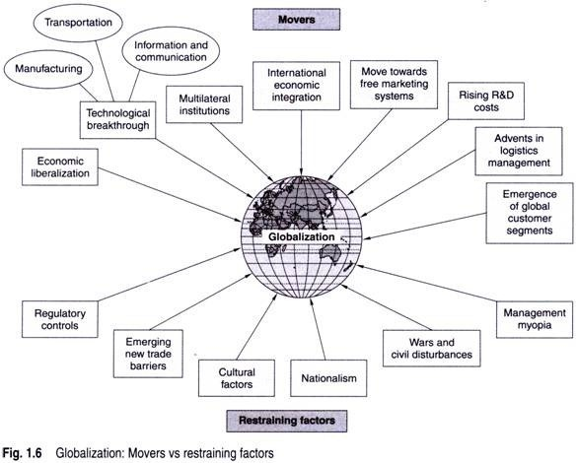
Factors Influencing Globalization International Trade

Slide 16
Factors Influencing Globalization International Trade
(i) Economic Liberalization
Economic liberalization, both in terms of regulations and tariff structure, has greatly contributed to the globalization of trade and investment. The emergence of the multilateral trade regime under the WTO has facilitated the reduction of tariffs and non-tariff trade barriers. In the coming years, the tariffs are expected to decline considerably further.

Slide 17
Factors Influencing Globalization International Trade
(ii) Technological Breakthroughs
The breakthroughs in science and technology have transformed the world virtually into a global village, especially manufacturing, transportation, and information and communication technologies.
(a) Manufacturing technology
Technological advancements transformed manufac­turing processes and made mass production possible, which led to the industrial revolution. The production efficiency resulted in cost-effective production of uniform goods on a large scale. In order to achieve the scale economies to sustain large-scale production,

Slide 18
Factors Influencing Globalization International Trade
(b) Transportation technology
The advents in all means of transports by roads, rail­ways, air, and sea have considerably increased the speed and brought down the costs incurred. Air travel has become not only speedier but cheaper. This has boosted the movement of people and goods across countries.
(c) Information and communication technology
The advent of information and communication technology and the fast developments in the means of transport have considerably undermined the significance of distance in country selection for expanding business. There has been a considerable reduction in international telecommunica­tion costs due to improved technology and increased competition.

Slide 19
Factors Influencing Globalization International Trade
(iii) Multilateral Institutions
A number of multilateral institutions under the UN framework, set up during the post-World War II era, have facilitated exchanges among countries and became prominent forces in present-day globalization.
(iv) International Economic Integrations
Consequent to World War II, a number of countries across the world collaborated to form economic groupings so as to promote trade and investment among the members.

Slide 20
Factors Influencing Globalization International Trade
(v) Move Towards Free Marketing Systems
The demise of centrally planned economies in Eastern Europe, the former USSR, and China has also contributed to the process of globalization as these countries gradually integrated themselves with the world economy.
(vi) Rising Research and Development Costs
The rapid growth in market competition and the ever-increasing insatiable consumer demand for newer and increasingly sophisticated goods and services compel businesses to invest huge amounts on research and development (R&D). In order to recover the costs of massive investments in R&D and achieve economic viability, it becomes necessary to globalize the business operations

Slide 21
Factors Influencing Globalization International Trade
(vii) Global Expansion of Business Operations
Growing market access and movement of capital across countries have facilitated the rapid expansion of business operations globally. Since the comparative advantages of countries strongly influence the location strategies of multinational corporations, companies tend to expand their businesses overseas with the growing economic liberalization. As a result, multinational corporations constitute the main vectors of economic globalization.

Slide 22
Factors Influencing Globalization International Trade
(viii) Advents in Logistics Management
Besides these, the greater availability of speedier and increasingly cost-effective means of transport, breakthroughs in logistics management such as multimodal transport technology, and third-party logistics management contributed to the faster and efficient movement of goods internationally.
(ix) Emergence of the Global Customer Segment
Customers around the world are fast exhibiting convergence of tastes and preferences in terms of their product likings and buying habits. Automobiles, fast-food outlets, music systems, and even fashion goods are becoming amazingly similar across countries.

Slide 23
Factors that are Used for Restraining Globalization International Trade
(i) Regulatory Controls
The restrictions imposed by national governments by way of regulatory measures in their trade, industrial, monetary, and fiscal policies restrain companies from global expansion.
(ii) Emerging Trade Barriers
The integration of national economies under the WTO framework has restrained countries from increasing tariffs and imposing explicit non-tariff trade barriers.

Slide 24
Factors that are Used for Restraining Globalization International Trade
(iv) Nationalism
The feeling of nationalism often aroused by local trade and industry, trade unions, political parties, and other nationalistic interest groups exerts considerable pressure against globalization
iii) Cultural Factors
Cultural factors can restrain the benefits of globalization. For instance, France’s collective nationalism favors home-grown agriculture and the US fear of terrorism has made foreign management of its ports difficult and restrained the entry of the Dubai Port World.

Slide 25
Factors that are Used for Restraining Globalization International Trade
(v) War and Civil Disturbances
The inability to maintain conducive business environment with sufficient freedom of operations restricts foreign companies from investing.
(vi) Management Myopia
A number of well-established business enterprises operating indigenously exhibit little interest in expanding their business overseas.

