Slide 1
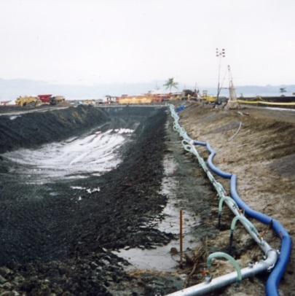
Mine Dewatering

Slide 2
Synopsis
Definition of mine dewatering
Open pit surface water control
Open pit dewatering techniques
Underground mine dewatering techniques
Groundwater investigation techniques

Slide 3
Definition of Mine Dewatering
Dewatering and groundwater control forms a vital part of many mining projects. Most open pit and underground mines will extend below groundwater level. Poorly controlled groundwater can impact the safety and efficiency of mine operations
Mine dewatering is the process of controlling and managing surface water and groundwater to allow mining in relatively dry conditions, to improve geotechnical stability and to improve the efficiency of mining methods

Slide 4
Groundwater Control Techniques
There are two main approaches to groundwater control:
Groundwater control by exclusion – using physical cut-off walls to exclude groundwater from the excavation
Groundwater control by pumping – using in-pit pumping or wells to lower groundwater levels

Slide 5
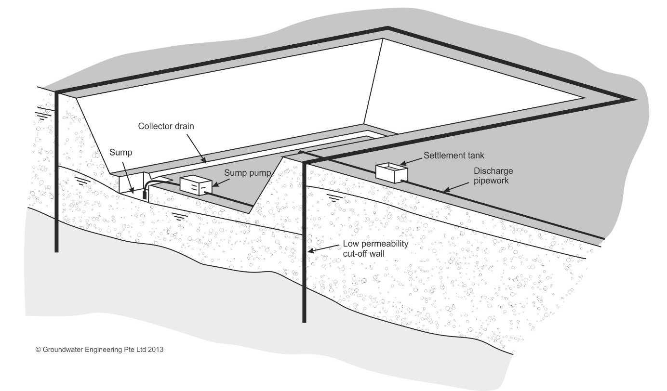
Groundwater Control by Exclusion
Physical cut-off walls are installed around a site to exclude groundwater from shallow alluvial or drift deposits, or to seal off preferential flow along permeable strata

Slide 6
Groundwater Exclusion Techniques
A range of methods can be used to form cut-off walls
Displacement barriers
Steel sheet-piles
Excavated barriers
Concrete diaphragm walls
Bored pile walls (secant pile walls and contiguous pile walls)
Bentonite slurry walls and trenches
Injected barriers
Permeation grouting
Rock grouting
Jet grouting
Mix-in-place methods
Artificial ground freezing

Slide 7
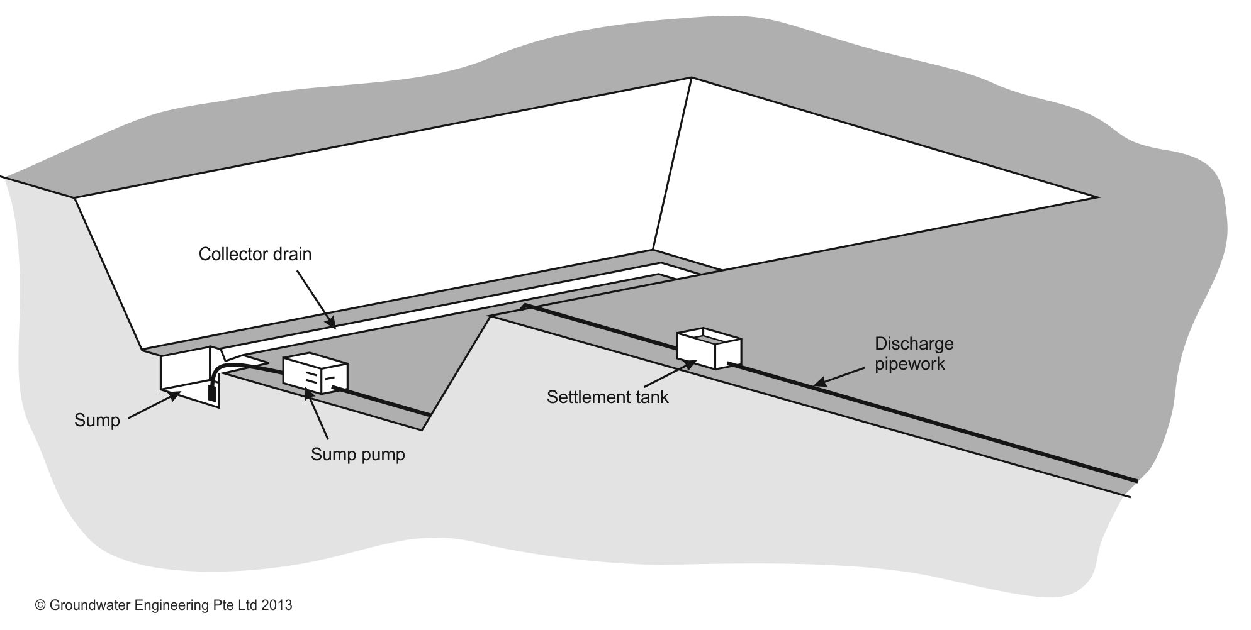
Groundwater Control by Pumping
Pumping from inside the pit, or from wells around the pit, is used to lower groundwater levels

Slide 8
Benefits of Mine Dewatering
Mine sites that implement a planned dewatering programme will typically see benefits of mine dewatering, including:
More efficient working conditions: better trafficking and diggability, reduced downtime due to pit flooding
Reduced blasting costs: lowering groundwater levels in advance of working will provide dry blast holes, reducing the need for more costly emulsion explosives

Slide 9
Benefits of Mine Dewatering
Mine sites that implement a planned dewatering programme will typically see benefits of mine dewatering, including:
Lower haulage costs: Dry ore and waste rock weigh less than wet material, so dewatering of rock provides a haulage cost saving
Improved slope stability and safety: lowering of groundwater levels and reduction in pore water pressures can allow steeper slope angles to be used, while maintaining or increasing geotechnical factors of safety

Slide 10
Open Pit Surface Water Control
Surface water must be controlled in open pits:
Sources of surface water
Rainfall and storm water
Snow melt
Mining operations (e.g. processing)
Seepage from pit walls
Detrimental effects of poorly-managed surface water
Risk of localised flooding
Softening of soil or rock exposed in pit walls
Loss of efficiency of mining, blasting and haulage operations

Slide 11
Open Pit Surface Water Control
Source control
Intercept run-off before it enters the pit
Use surface water drainage ditches and bunds around the perimeter of the pit to prevent surface water entering the pit from the surrounding land
Water collection
Collector drains, ditches and sumps used to divert water away from working areas
Sumps to temporarily store storm water while it is pumped away
In-pit pumping systems (keep it simple and robust!), sized to handle storm water
Water treatment
Solids removal (settlement lagoons)

Slide 12
Open Pit Groundwater Control
A range of groundwater control techniques can be used, depending on the geology and the type of mine:
In-pit pumping – used to pump from sump areas within the pit
Perimeter dewatering wells – used to intercept lateral groundwater flow into the pit and to lower groundwater levels in advance of mining
Pit slope depressurisation drains – inclined or horizontal drains used to provide permeable pathways to allow trapped or slowly draining groundwater behind pit slopes to bleed off into the pit

Slide 13
Open Pit Groundwater Control

Slide 14
In-Pit Pumping
Pumps located within the deeper parts of the pit
Submersible pumps or surface suction pumps may be used. In deeper pits booster pumps may be needed to lift the water from the pit. Pumps must have some solids handling capability
Flexible in use – additional pumps can easily be added or removed
Drains and ditches feed water to the sumps. The presence of these features may interfere with mining operations
Water produced from in-pit pumping may have a significant sediment content and may need treatment by settlement lagoons

Slide 15
Perimeter Dewatering Wells
Vertical wells are installed around the perimeter of the open pit and are pumped by electric submersible pumps
Wells need to be located to take account of structural geology and any compartmentalisation of aquifers
Once they have been developed, wells should produce clean water, hence minimising water treatment requirements
Water collection pipework and an electrical distribution system is laid along the line of wells. Power may be from generator supply
For deeper pits the costs per well may be high

Slide 16
Pit Slope Depressurisation Drains
Even when an open pit is dewatered by wells or in-pit pumping, high pore water pressures may remain in the pit slopes, reducing geotechnical stability
There may be a need for a programme of slope depressurisation to allow steeper pit slopes to be used
This may be achieved by small diameter angled or sub-horizontal drains drilled outwards through the pit slopes
The drains act as pressure relief wells and bleed water off by gravity. The water is collected in drains or ditches and fed to the in-pit pumps

Slide 17
Underground Mine Dewatering Techniques
In underground mines, the conventional approach is to allow groundwater to enter the workings, effectively using the mine itself as a drain
The water entering the mine is passed along roadways (by pumping or gravity) to a deeper part of the mine (sump) or shaft bottom, to be pumped out via shaft or decline
In deeper mines there may be a need for staged pumping to get the water out of the mine

Slide 18
Underground Mine Dewatering Techniques
In hard rock mines drain holes may be drilled out from workings
In order to minimise water treatment requirements it is important to reduce generation of ‘dirty water’ (that has run along the floor/walls) and segregate ‘clean water’ (that has come straight from drain holes)

Slide 19
Underground Mine Dewatering Techniques
Shaft sinking for underground mines presents certain challenges:
Great depth (which makes pumping more challenging)
Limited space and complex working sequence of shaft sinking and lining
May pass through multiple aquifers
Common to use groundwater exclusion
Cementitious grouting (cover grouting)
Artificial ground freezing
External pumped wells are not commonly used for mine shaft sinking apart from for shallow depths through granular soils
Even with exclusion methods there is a need to remove water from shaft bottom
May be too deep to pump in one lift
Water often bailed out in hoisting kibble

Slide 20
Groundwater Investigation Techniques
Groundwater investigations can play an important role in the design of mine dewatering systems. Groundwater investigation techniques include:
Hydrogeological desk studies
Desk top studies and research into existing information can be a very cost effective way to identify groundwater problems at an early stage. Numerical groundwater modelling can be used to assess likely flow rates, distance of influence and the potential for adverse environmental impacts
Installation of monitoring wells
Monitoring wells and specialist piezometers installed in advance of dewatering works can provide valuable information on hydrogeological conditions at a mine site
Groundwater monitoring systems
Groundwater monitoring systems can play an important role in mine dewatering projects to allow groundwater conditions to be monitored and to provide data for design purposes

Slide 21
Groundwater Investigation Techniques
Groundwater investigations can play an important role in the design of mine dewatering systems. Groundwater investigation techniques include:
Borehole permeability tests
A range of tests can be carried out in individual boreholes, including rising and falling head tests, constant head tests, Lugeon tests, Lefranc tests and packer tests. When carried out in accordance with relevant published standards and interpreted appropriately, such tests can provide some indication of permeability values and groundwater conditions
Pumping tests
Pumping tests are a reliable way of determining the mass permeability of soils and rocks, and of providing other information on groundwater conditions

Slide 22
Pumping Tests

Slide 23
Pumping Tests
A pumping test involves pumping from a test well at a controlled rate and monitoring the flow rate from the well and the drawdown in an array of observation wells at varying radial distances from the test well.
Analysis of data from a correctly executed pumping test can be one of the most reliable methods of determining the mass permeability of water-bearing soils and rocks. This is because the volume of soil or rock through which flow of water is induced by a pumping test is significantly greater than in the cases of small-scale tests in individual boreholes and observation wells.
Supported by other types of groundwater investigations and groundwater monitoring, pumping tests can provide valuable information for the planning and design of mine dewatering projects.

