Slide 1
Chapter 1
Introducing Economic Development

Slide 2
1.1 How the Other Half Live
When one is poor, she has no say in public, she feels inferior. She has no food, so there is famine in her house; no clothing, and no progress in her family.
—A poor woman from Uganda
For a poor person everything is terrible—illness, humiliation, shame. We are cripples; we are afraid of everything; we depend on everyone. No one needs us. We are like garbage that everyone wants to get rid of.
—A blind woman from Tiraspol, Moldova
Life in the area is so precarious that the youth and every able person have to migrate to the towns or join the army at the war front in order to escape the hazards of hunger escalating over here.
—Participant in a discussion group in rural Ethiopia

Slide 3
1.1 How the Other Half Live
When food was in abundance, relatives used to share it. These days of hunger, however not even relatives would help you by giving you some food. —Young man in Nichimishi, Zambia
We have to line up for hours before it is our turn to draw water. —Mbwadzulu Village (Mangochi), Malawi
[Poverty is] . . . low salaries and lack of jobs. And it’s also not having medicine, food, and clothes. --Discussion group, Brazil
Don’t ask me what poverty is because you have met it outside my house. Look at the house and count the number of holes. Look at the utensils and the clothes I am wearing. Look at everything and write what you see. What you see is poverty. —Poor man in Kenya
A universal theme reflected in these seven quotes is that poverty is more than lack of income – it is inherently multidimensional, as is economic development.

Slide 4
1.2 Economics and Development Studies
  The Nature of Development Economics
    Traditional economics
      An approach to economics that emphasizes utility, profit maximization, market efficiency, and determination of equilibrium.
    Political economy
      Political economy is concerned with the relationship between politics and economics, with a special emphasis on the role of power in economic decision making.

Slide 5
1.2 Economics and Development Studies
  The Nature of Development Economics
  Development economics has an even greater scope.
  The study of how economies are transformed from stagnation to growth and from low income to high-income status, and overcome problems of absolute poverty.

Slide 6
1.2 Economics and Development Studies
  Why Study Development Economics? Some Critical Questions
  What is the real meaning of development?
  What can be learned from the historical record of economic progress in the now developed world?
  What are economic institutions, and how do they shape problems of under development and prospects for successful development?

Slide 7
1.2 Economics and Development Studies
  Why Study Development Economics? Some Critical Questions
  How can the extremes between rich and poor be so very great?

Slide 8
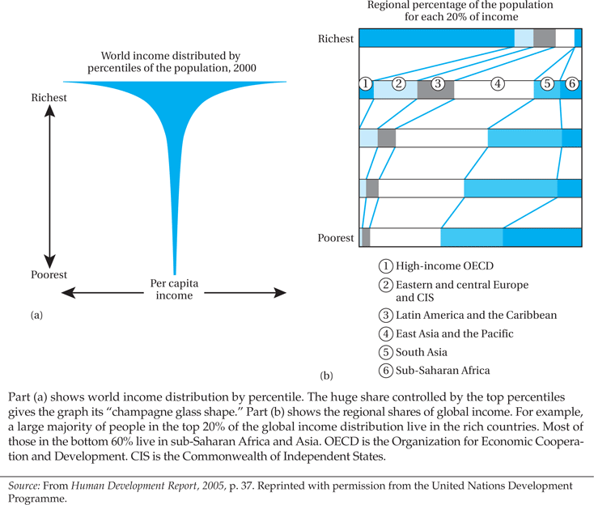
Figure 1.1 World Income Distribution

Slide 9
1.2 Economics and Development Studies
  Why Study Development Economics? Some Critical Questions
  What are the sources of national and international economic growth?
    Who benefits from such growth and why?
    Why do some countries make rapid progress toward development while many others remain poor?

Slide 10
1.2 Economics and Development Studies
  Why Study Development Economics? Some Critical Questions
  Which are the most influential theories of development, and are they compatible?
  How can improvements in the role and status of women have an especially beneficial impact on development prospects?
  What are the causes of extreme poverty, and what policies have been most effective for improving the lives of the poorest of the poor?

Slide 11
1.2 Economics and Development Studies
  Why Study Development Economics? Some Critical Questions
  What are the causes of extreme poverty, and what policies have been most effective for improving the lives of the poorest of the poor?
  Is rapid population growth threatening the economic progress of developing nations? Do large families make economic sense in an environment of widespread poverty and financial insecurity?

Slide 12
1.2 Economics and Development Studies
  Why Study Development Economics? Some Critical Questions
  Why is there so much unemployment and underemployment in the developing world, especially in the cities, and why do people continue to migrate to the cities from rural areas even when their chances of finding a conventional job are very slim?

Slide 13
1.2 Economics and Development Studies
  Why Study Development Economics? Some Critical Questions
  Wealthier societies are also healthier ones because they have more re sources for improving nutrition and health care. But does better health also help spur successful development?

Slide 14
1.2 Economics and Development Studies
  Why Study Development Economics? Some Critical Questions
  Do educational systems in developing countries really promote economic development, or are they simply a mechanism to enable certain select groups or classes of people to maintain positions of wealth, power, and influence?

Slide 15
1.2 Economics and Development Studies
  Why Study Development Economics? Some Critical Questions
    What do we mean by “environmentally sustainable development”?
    Are free markets and economic privatization the answer to development problems?
    Is expanded international trade desirable from the point of view of the development of poor nations?

Slide 16
1.2 Economics and Development Studies
  Why Study Development Economics? Some Critical Questions
    When and under what conditions, if any, should governments in developing countries adopt a policy of foreign-exchange control, raise tariffs, or set quotas on the importation of certain “nonessential” goods in order to promote their own industrialization?

Slide 17
1.2 Economics and Development Studies
  Why Study Development Economics? Some Critical Questions
    What is meant by globalization, and how is it affecting the developing countries?
    How did so many developing nations get into such serious foreign-debt problems?
    What is the impact of foreign economic aid from rich countries?

Slide 18
1.2 Economics and Development Studies
  Why Study Development Economics? Some Critical Questions
    Should multinational corporations be encouraged to invest in the economies of poor nations, and if so, under what conditions?
    What is the role of financial and fiscal policy in promoting development? Do large military expenditures stimulate or retard economic growth?

Slide 19
1.2 Economics and Development Studies
  Why Study Development Economics? Some Critical Questions
    What is microfinance, and what are its potential and limitations for reducing poverty and spurring grassroots development?
  The answers to these questions are often more complex than one might think

Slide 20
1.3 What Do We Mean by Development?
Traditional Economic Measures
  Gross National Income (GNI)
  Income per capita
  Utility of that income?
The New Economic View of Development
  Leads to improvement in wellbeing, more broadly understood
Amartya Sen’s “Capability” Approach
  Functioning's as an achievement
  Capabilities as freedoms enjoyed in terms of functionings
  Development and happiness
  Well being in terms of being well and having freedoms of choice
  “Beings and Doings”:

Slide 21
Some Key “Capabilities”
Some Important “Beings” and “Doings” in Capability to Function:
  Being able to live long
  Being well-nourished
  Being healthy
  Being literate
  Being well-clothed
  Being mobile
  Being able to take part in the life of the community
  Being happy – as a state of being - may be valued as a functioning

Slide 22
1.3 What Do We Mean by Development? (cont’d)
Three Core Values of Development
  Sustenance: The Ability to Meet Basic Needs
  Self-Esteem: To Be a Person
  Freedom from Servitude: To Be Able to Choose

Slide 23
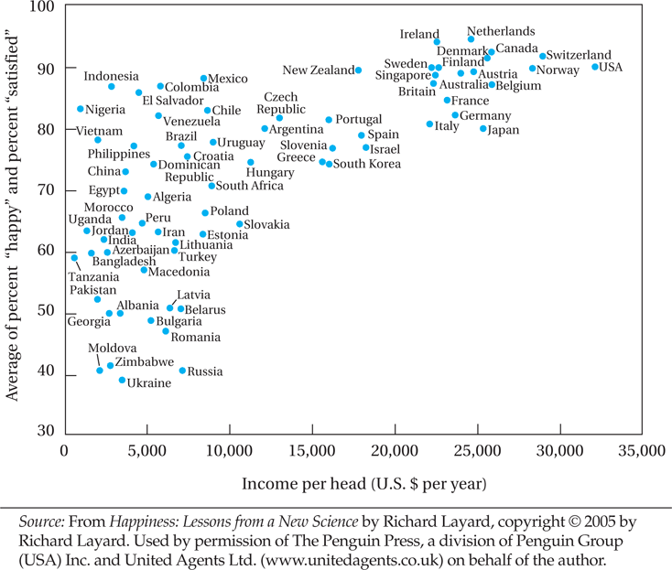
Figure 1.2 Income and Happiness: Comparing Countries

Slide 24
1.3 What Do We Mean by Development? (cont’d)
The Central Role of Women
  To make the biggest impact on development, societies must empower and invest in women
Three Objectives of Development
  (1) To increase the availability and widen the distribution of basic life-sustaining goods such as food, shelter, health, and protection

Slide 25
1.3 What Do We Mean by Development? (cont’d)
Three Objectives of Development
  (2) To raise levels of living, including, in addition to higher incomes, the provision of more jobs, better education, and greater attention to cultural and human values, all of which will serve not only to enhance material well being but also to generate greater individual and national self-esteem

Slide 26
1.3 What Do We Mean by Development? (cont’d)
The Three Objectives of Development
  (3) To expand the range of economic and social choices available to individuals and nations by freeing them from servitude and dependence not only in relation to other people and nation-states but also to the forces of ignorance and human misery

Slide 27
1.4 The Millennium Development Goals
Millennium Development goals (MDGs)
  Eight goals adopted by the United Nations in 2000
    Eradicate extreme poverty and hunger
    Achieve universal primary education
    Promote gender equality and empower women
    Reduce child mortality
    Improve maternal health
    Combat HIV/AIDS, malaria, and other diseases
    Ensure environmental sustainability
    Develop a global partnership for development

Slide 28
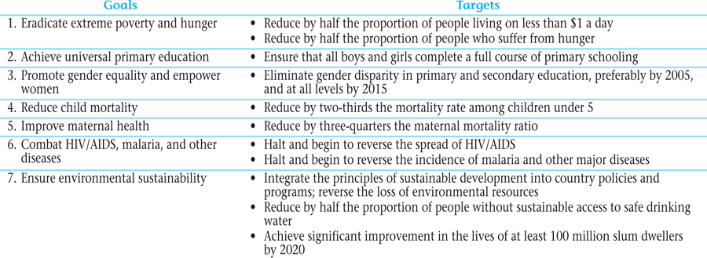
Table 1.1 Millennium Development Goals and Targets for 2015

Slide 29
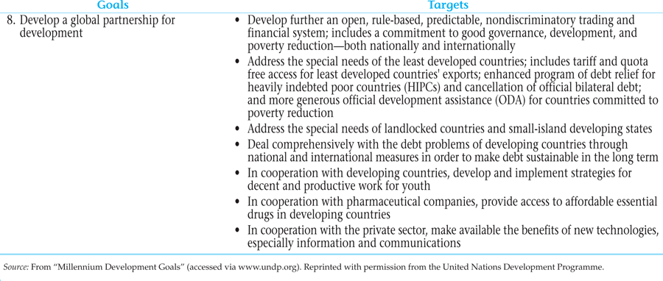
Table 1.1 Millennium Development Goals and Targets for 2015 (cont’d)

Slide 30
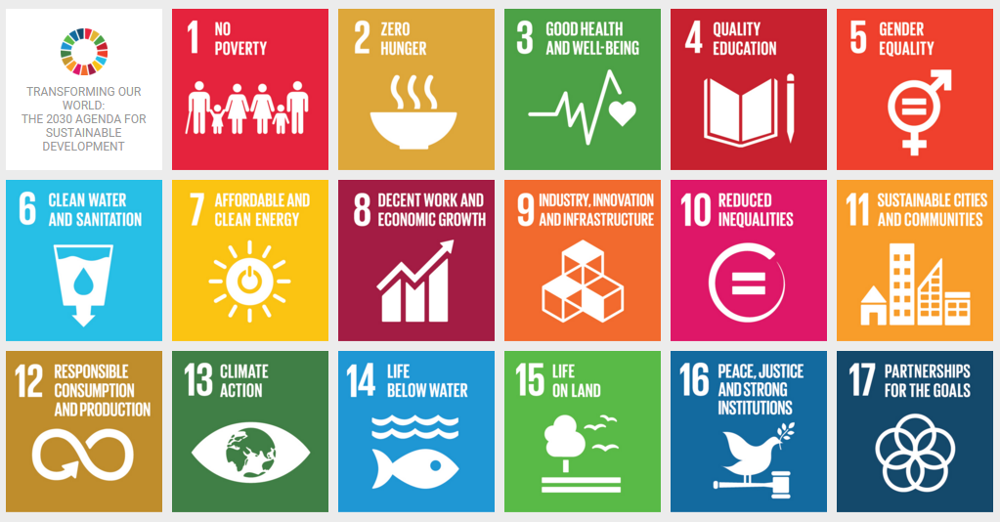
Sustainable Development Goals

Slide 31
1.5 Conclusions
The importance of Development Economics
Inclusion of non-economic variables in designing development strategies
Achieving the Sustainable Development Goals
“…One future-or none at all”

Slide 32
Concepts for Review
Absolute Poverty
Attitudes
Capabilities
Developing countries
Development
Development economics
Freedom
Functionings
Globalization
Gross domestic product
Gross national income (GNI)
Income per capita
Institutions
Less developed countries (LDCs)
Millennium Development Goals (MDGs)
More developed countries (MDCs)
Political economy

Slide 33
Concepts for Review (cont’d)
Self-esteem
Social system
Subsistence economy
Sustenance
Traditional economics
Values

