Slide 1
Theories of Economic Growth and Development

Slide 2
Theories of Economic Development
Implications of Harrod-Domar Model
The Neoclassical Growth Theory
Human Capital and Growth
International-dependence revolution
  Neoclassical dependence model
  False paradigm model

Slide 3

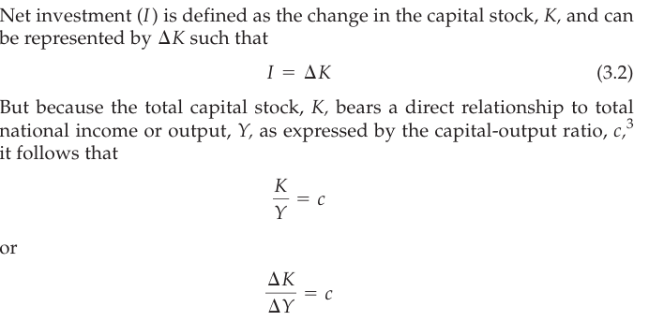

Harrod-Domar Growth Model
Net saving (S) is some proportion, s, of national income (Y) such that we have the simple equation
2.

Slide 4
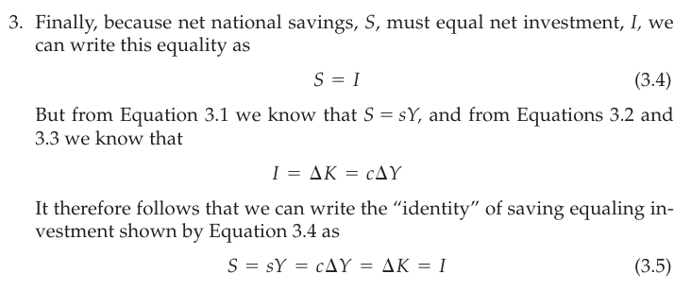
3.2 Harrod-Domar Growth Model

Slide 5
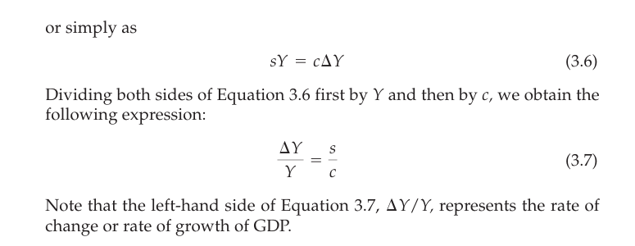
3.2 Harrod-Domar Growth Model

Slide 6
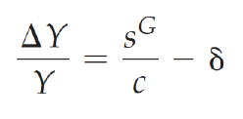
The Harrod-Domar Model – Incorporating Capital Depreciation
Equation 3.7 is also often expressed in terms of gross savings, in which case the growth rate is given by
  (3.7’)
  where δ is the rate of capital depreciation
But there is now growing evidence of “per capita income convergence,” weighting changes in per capita income by population size

Slide 7
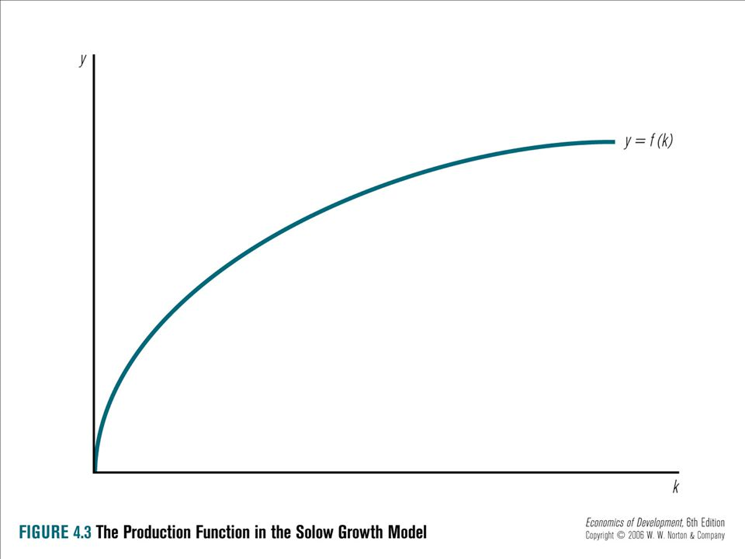
The Solow Growth Model

Slide 8
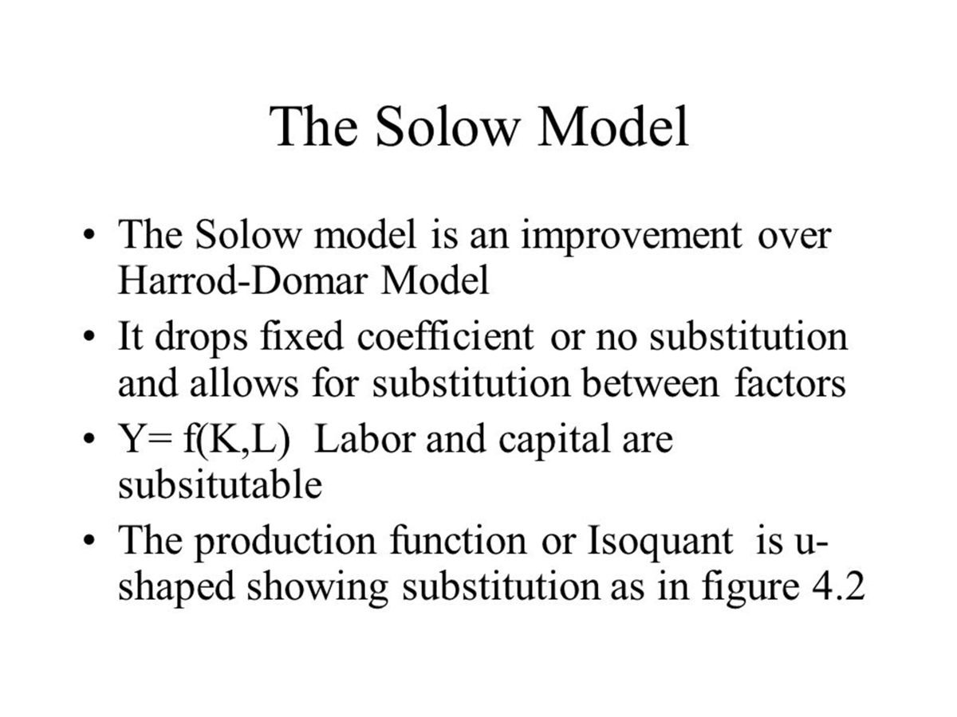
The Solow Growth Model

Slide 9
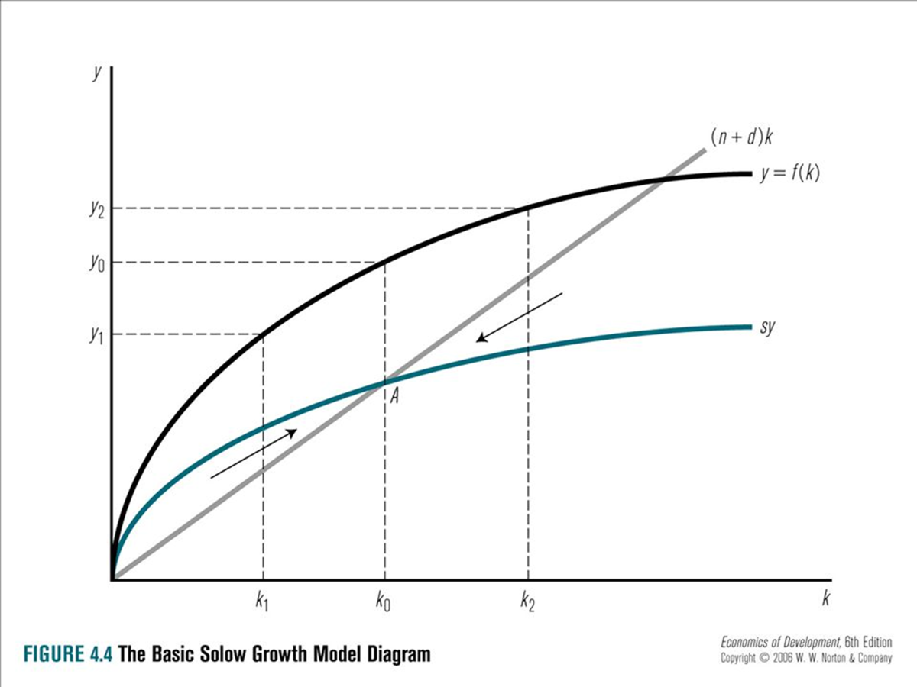
The Solow Growth Model

Slide 10
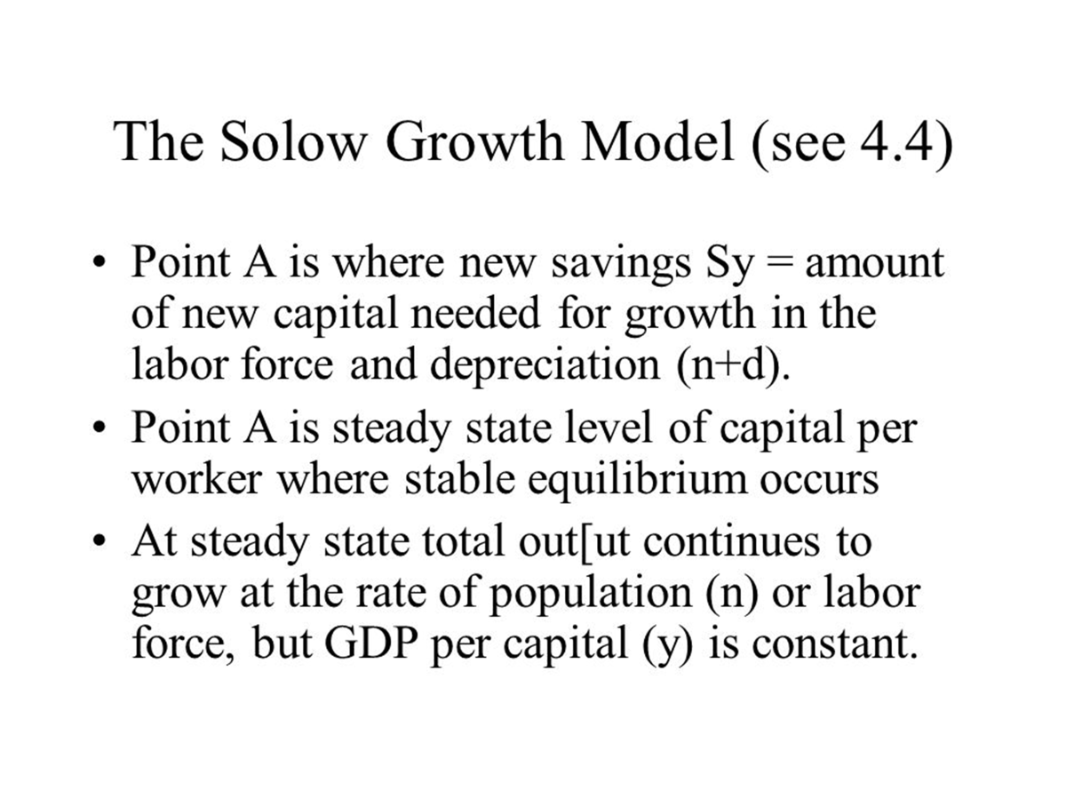

Slide 11
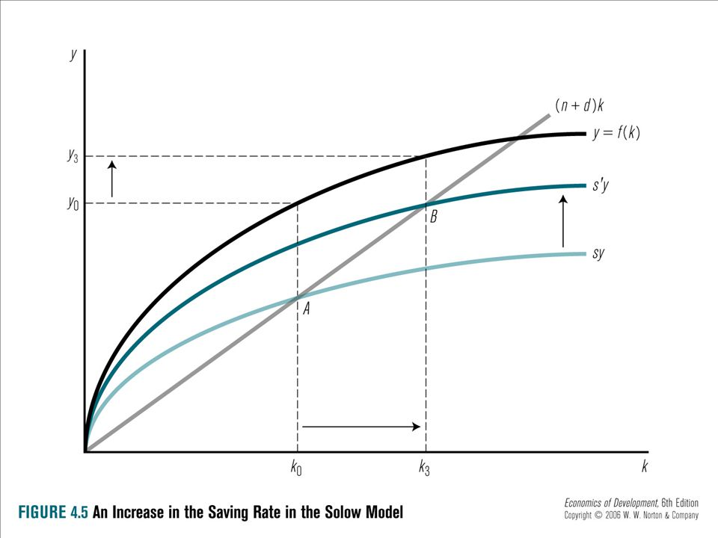

Slide 12
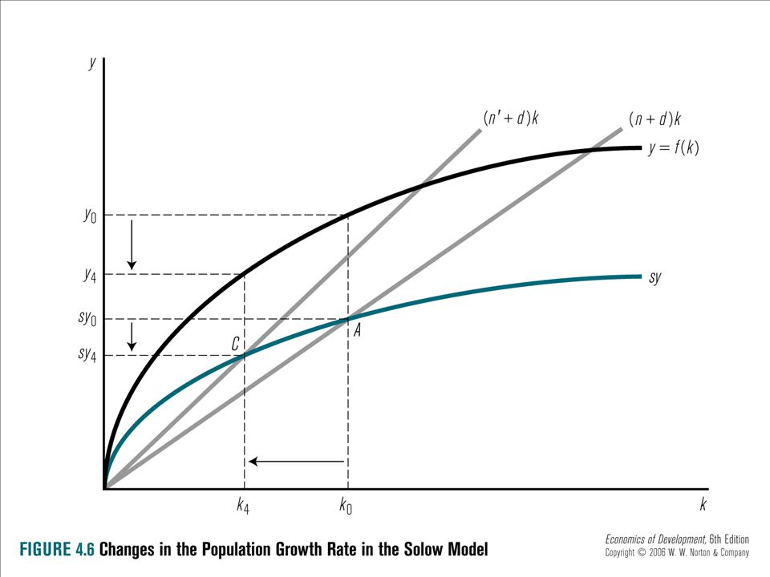

Slide 13
The Solow Neoclassical Growth Model

Slide 14
The Solow Neoclassical Growth Model

Slide 15
Appendix 3.2 The Solow Neoclassical Growth Model

Slide 16
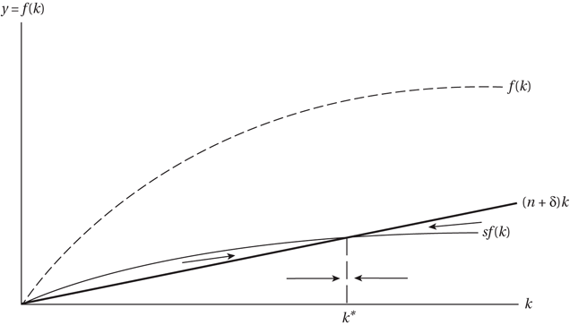
Figure A3.2.1 Equilibrium in the Solow Growth Model

Slide 17
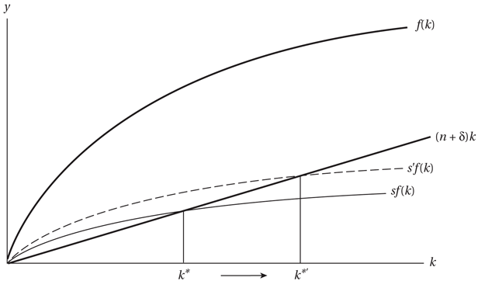
Figure A3.2.2 The Long-Run Effect of Changing the Saving Rate in the Solow Model

Slide 18

Human Capital and Growth
Assume for simplicity that population is constant and that there is no depreciation.
Augment the Solow model by introducing human capital.
Human capital, in contrast to labor, is deliberately accumulated and is not the simple outcome of population growth.

Slide 19
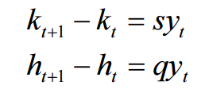

Human Capital and Growth
Allow individuals to save in two forms
  Physical capital
  Human capital.
Define

Slide 20
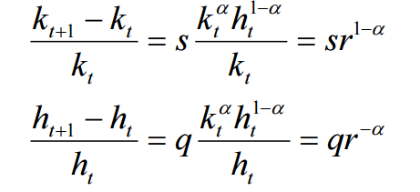
Human Capital and Growth
Let’s figure out the growth rate in k, h and y.

Slide 21
Human Capital and Growth
Let’s figure out the growth rate in k, h and y.
At steady-state, both h and k should be growing at the same rate.
Therefore we can write

Slide 22


Human Capital and Growth
We can now use this value of r to compute the long-run growth rate.
Use any of the preceding growth-rate equations to do this, because all variables must grow at the same rate in the long run.
For instance, the growth-rate equation for k tells us that
so that the long-run growth rate of all the variables, including per capita income, is given by the expression

Slide 23

Human Capital and Growth
The steady-state growth rate of variables h, k and y is
With CRS, the s and q parameters have growth-rate effects, and not just level effects.
In other words, the long-run growth rate is determined from within the model, by the
parameters of the model.
This is why we call such models endogenous growth theories.

Slide 24
Human Capital and Growth
The steady-state growth rate of variables h, k and y is
In the long-run, the ratio of h to k is known (q/s).
This means that if a country has a low level of k relative to its h, it will tend to grow faster in per capita terms, ceteris paribus.

Slide 25
Human Capital and Growth
The empirical testing

Slide 26
International-dependence revolution
Dependence
The reliance of developing countries on
developed-country economic policies to stimulate their own economic growth. Dependence can also mean that the developing countries adopt
developed-country education systems, technology, economic and political systems, attitudes, consumption patterns, dress, and so on.

Slide 27
International-dependence revolution
Dominance
In international affairs, a situation in which
the developed countries have much greater power than the less-developed countries in decisions affecting important international economic issues,
such as the prices of agricultural commodities and raw materials in world markets.

Slide 28
International-dependence revolution
Within this general approach are three major
streams of thought:
the neocolonial dependence model,
the false-paradigm model, and
the dualistic-development thesis

Slide 29
International-dependence revolution
The neocolonial dependence model
A model whose main proposition is that
underdevelopment exists in developing countries because of continuing exploitative economic, political, and cultural policies of former colonial
rulers toward less-developed countries

Slide 30
International-dependence revolution
The neocolonial dependence model
The dependency theory is originally Marxian in character for two reasons:
It is based on the concept of exploitation of the poorer LDCs by the capitalist developed country
It explains development and underdevelopment with reference to capitalist framework of the centre

Slide 31
International-dependence revolution
The neocolonial dependence model
  Legacy of colonialism
  Unequal power
  Core-periphery

Slide 32
International-dependence revolution
The False-Paradigm Model
The proposition that developing countries have failed to develop because their development strategies (usually given to them by Western economists) have been based on an incorrect model of
development—one that, for example, overstresses capital accumulation or market liberalisation without giving due consideration to needed social
and institutional change.

Slide 33
International-dependence revolution
The Dualistic-Development Thesis
Dualism is the existence and persistence of substantial and even increasing divergences between rich and poor nations and rich and poor peoples on various levels.

Slide 34
International-dependence revolution
The Dualistic-Development Thesis
The coexistence of two situations or phenomena
(one desirable and the other not) that are mutually exclusive to different groups of society—for example, extreme poverty and affluence, modern and traditional economic sectors, growth and stagnation, and higher education for a few amid large-scale
illiteracy

