Slide 1
Benefit-Cost Analysis

Slide 2
Applied Investment Appraisal
Conceptualizing an investment as:
a net benefit stream over time, or, “cash flow”;
giving up some consumption benefits today in anticipation of gaining more in the future.
A project as a cash-flow:
+
$
time
_

Slide 3
Although we use the term “cash flow”, the dollar values used might not be the same as the actual cash amounts.
In some instances, actual ‘market prices’ do not reflect the true value of the project’s input or output.
In other instances there may be no market price at all.
We use the term ‘shadow price’ or ‘accounting price’ when market prices are adjusted to reflect true values.

Slide 4
Three processes in any cash-flow analysis
identification
valuation
comparison

Slide 5
Conventions in Representing Cash Flows
Initial or ‘present’ period is always year ‘0’
Year 1 is one year from present year, and so on
All amounts accruing during a period are assumed to fall on last day of period

Slide 6
Graphical Representation of Cash Flow Convention
Figure 2.4
+
B₁ B₂
0
1
2
year
_

Slide 7
Comparing Costs and Benefits
We cannot compare dollar values that accrue at different points in time
To compare costs and benefits over time we use the concept
“discounting”
  The reason is that $1 today is worth more than $1 tomorrow
WHY?

Slide 8
Discounting a Net Benefit Stream
Year | 0 | 1 | 2 | 3
Project A | -100 | +50 | +40 | +30
Project B | -100 | +30 | +45 | +50
WHICH PROJECT ?

Slide 9
Deriving Discount Factors
Discounting is reverse of compounding
FV = PV(1 + i)^{n}
PV = FV x 1/ (1 + i)^{n}
1/ (1 + i)^{n} is the Discount Factor

Slide 10
Using Discount Factors
If i = 10% then year 1 DF = 1/(1+0.1)¹ = 0.909
PV of $50 in year 1 = $50 x 0.909 = $45.45
What about year 2 and beyond?
  PV of $40 in year 2 = $40 x 0.909 x 0.909
= $40 x 0.826 = $33.05
  PV = $30 in year 3 = $30 x 0.909³
= $30 x 0.751 = $22.53

Slide 11
Calculating Net Present Value
Net present value (NPV) is found by subtracting the discounted value of project costs from the discounted value of project benefits
Once each year’s amount is converted to a discounted present value
we simply sum up the values to find net present value (NPV)
NPV of Project A
= -100(1.0) + 50(0.909) + 40(0.826) + 30(0.751)
= -$100 + 45.45 + 33.05 + 22.53
= $1.03

Slide 12
Using the NPV Decision Rule for Accept
vs. Reject Decisions
If NPV ≥ 0, accept project
if NPV < 0, reject project

Slide 13
Comparing Net Present Values
Once each project’s NPV has been derived we can compare them by the value of their NPVs
NPV of A = -100 + 45.45 + 33.05 + 22.53
= $1.03
NPV of B = -100 + 27.27 + 37.17 + 37.55
= $1.99
As NPV(B) > NPV(A) choose B Will NPV(B) always be > NPV(A)?
Remember, we used a discount rate of 10% per annum.

Slide 14
Changing the Discount Rate
As the discount rate increases, so the discount factor decreases.
If i = 15% then year 1 DF = 1/(1+0.15)¹
= 0.87
Remember, when we used a discount rate of 10% per annum the DF was 0.909.
This implies that as the discount rate increases, so the NPV
decreases.
If we keep on increasing the discount rate, eventually the NPV becomes zero.
The discount rate at which the NPV = 0 is the “Internal Rate of Return” (IRR).

Slide 15
The NPV Curve and the IRR
Where the NPV curve intersects the horizontal axis gives the project IRR
Figure 2.5:
NPV curve
NPV
IRR
Discount rate

Slide 16
The IRR Decision Rule
Once we know the IRR of a project, we can compare this with the cost of borrowing funds to finance the project.
If the IRR= 15% and the cost of borrowing to finance the
project is, say, 10%, then the project is worthwhile.
If we denote the cost of financing the project as ‘r’, then the decision rule is:
  If IRR ≥ r, then accept the project
  If IRR < r, then reject the project

Slide 17
NPV vs. IRR Decision Rule
With straightforward accept vs. reject decisions, the NPV and IRR will always give identical decisions.
WHY?
If IRR ≥ r, then it follows that the NPV will be > 0 at discount rate ‘r’
If IRR < r, then it follows that the NPV will be < 0 at discount rate ‘r’

Slide 18
Graphical Representation of NPV and IRR Decision Rule
Figure 3.0
$425
$181
NPV
A
0
10%
20%
r %

Slide 19
Using NPV and IRR Decision Rule to Compare/Rank Projects
Example 3.7: IRR vs. NPV decision rule
 |  |  |  |  | IRR | NPV(10%)
 | 0 | 1 | 2 | 3
A | -1000 | 475 | 475 | 475 | 20% | $181
B | -500 | 256 | 256 | 256 | 25% | $137
If we have to choose between A and B which one is best?

Slide 20
Switching and Ranking Reversal
NPVs are equal at 15% discount rate
At values of r < 15%, A is preferred
At values of r > 15%, B is preferred
Therefore, it is safer to use NPV rule when comparing or
ranking projects.
Figure 3.1
NPV
$425
B
$181
$137
A
25%
0
10% 15%
20%
r %

Slide 21
Choosing Between Mutually Exclusive Projects
In example 3.8, you need to assume the cost of capital is:
4%, and then,
10%
IRR (A) > IRR (B)
At 4%, NPV(A) < NPV (B)
At 10%, NPV(A) > NPV (B)

Slide 22
Other Problems With IRR Rule
Multiple solutions (see figure 2.8)
No solution (See figure 2.9)
Further reason to prefer NPV decision rule. Figure 2.8 Multiple IRRs
NPV
25
100
400
r %

Slide 23
Figure 2.9 No IRR
NPV
r %

Slide 24
Problems With NPV Rule
Capital rationing
  Use Profitability Ratio (or Net Benefit Investment Ratio (See Table 3.3)
Indivisible or ‘lumpy’ projects
  Compare combinations to maximize NPV (See Table 3.4)
Projects with different lives
  Renew projects until they have common lives: LCM (See Table 3.5 and 3.6)
  Use Annual Equivalent method (See Example 3.12)

Slide 25
Using Discount Tables
No need to derive discount factors from formula - we use Discount Tables
You can generate your own set of Discount Tables in a spreadsheet
  Spreadsheets have built-in NPV and IRR formulae: Discount Tables become redundant

Slide 26
Using Annuity Tables
When there is a constant amount each period, we can use an annuity factor instead of applying a separate discount factor each period.
Annuity factors are especially useful for calculating the IRR when there is a constant amount each period (See examples 3.7 & 3.8).
To calculate Annual Equivalents you need to use annuity factors (See example 3.12).

Slide 27
Annual Equivalent Value
It is possible to convert any given amount, or any cash flow, into an
annuity.
This is how we calculate an Annual Equivalent, using Annuity Tables.
We illustrate the Annual Equivalent method using the data in table 3.6 and again using a 10 per cent discount rate.

Slide 28
Annual Equivalent Value
PV of Costs (A) = - $48,876 PV of Costs (B) = - $38,956
A has a 4-year life and B has a 3-year life. The annuity factor at 10 percent is: 3.17 for 4-years, and 2.49 for 3-years
AE (A) = $48,876/3.17 = $15,418
AE (B) = $38,956/2.49 = $15,645
AE cost (B)>(A), therefore, choose A.

Slide 29
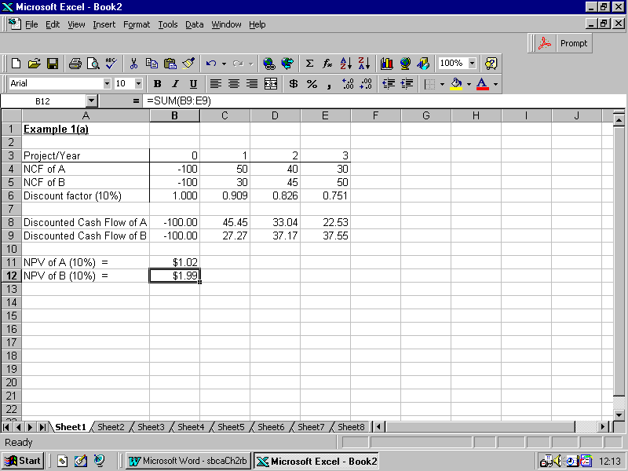
Using Spreadsheets: Figure 3.2

Slide 30
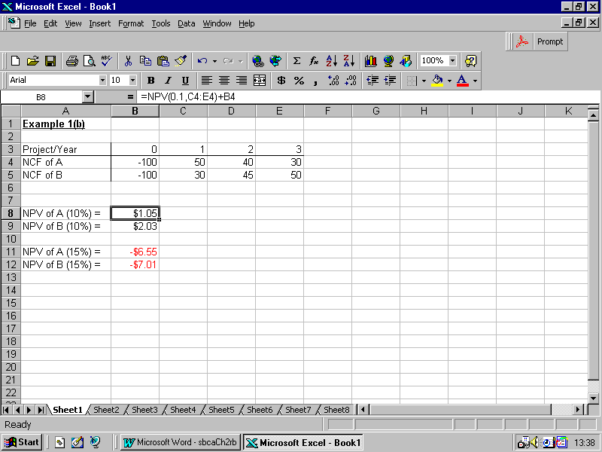
Using Spreadsheets: Figure 3.3

Slide 31
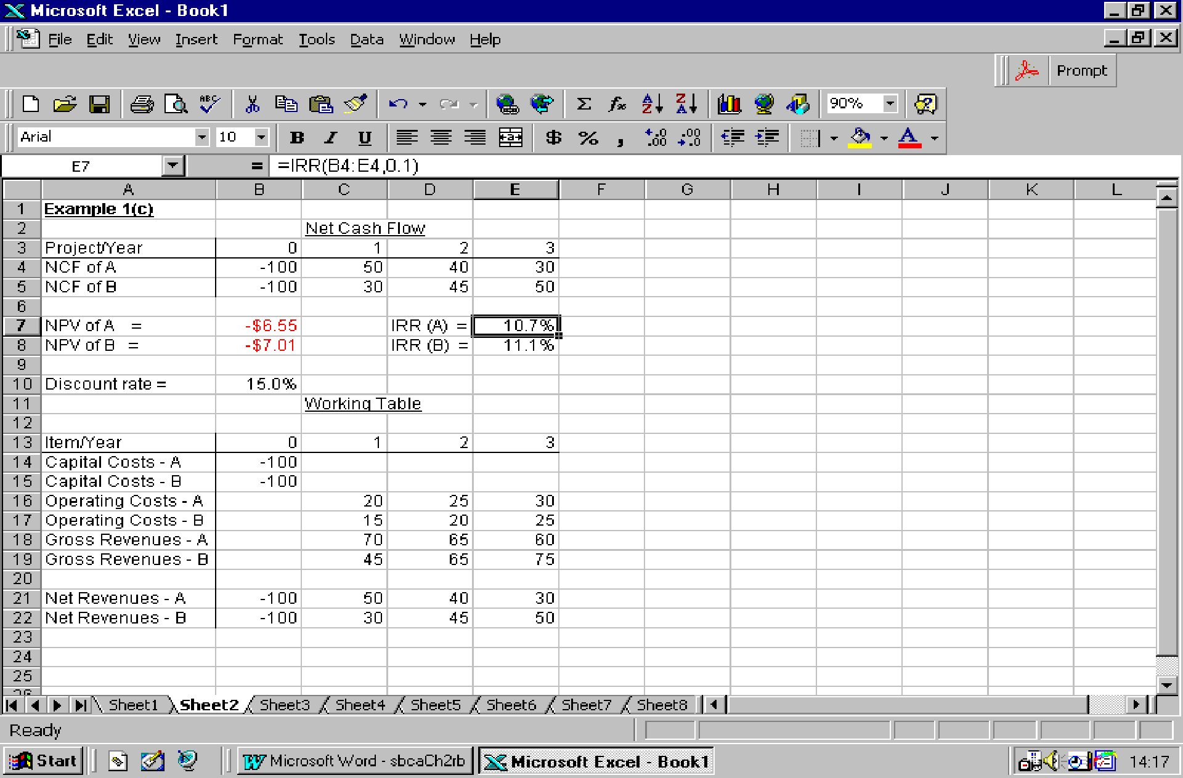
Using Spreadsheets: Figure 3.4

Slide 32
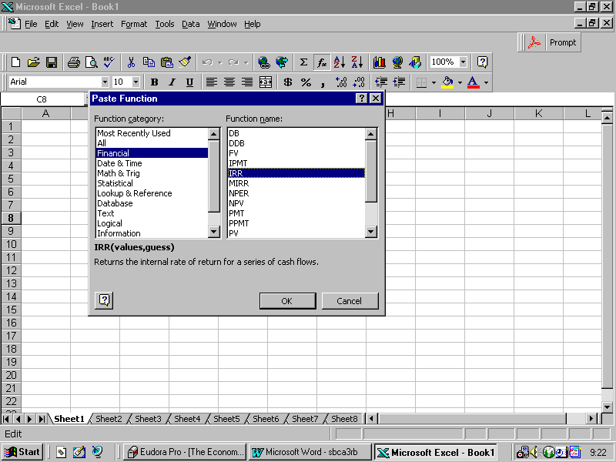
Using Spreadsheets: Figure 3.5

