Slide 1
Good Afternoon
This is our last class before Eid vaccation

Slide 2
Today’s Content
1. Channels of Communication
2. Verbal Communication ( Written and Oral communication)
3.Conditions of effectiveness of oral communication.

Slide 3
Meaning of Channels of Communication

Slide 4
Meaning of Channels of Communication
A medium through which a message is transmitted to its intended audience, such as print media or broadcast (electronic) media.
According to Dunham(1984) defines a channel as the physical medium for transmission of a message.
According to Barker(1981) believes that channels are the means by which messages are communicated.

Slide 5
Media of Communication

Slide 6
Verbal Communication
verbal communication refers to any exchange that uses words to communicate information. When messages or information is exchanged or communicated through words is called verbal communication. Verbal communication may be two types: written and oral communication. Verbal communication takes place through face-to-face conversations, group discussions, counseling, interview, radio, television, calls, memos, letters, reports, notes, email etc.

Slide 7
Written Communication
The Written Communication refers to the process of conveying a message through the written symbols. In other words, any message exchanged between two or more persons that make use of written words is called as written communication.

Slide 8
Written Communication
A. Written communication for management
B. Written communication for employees.

Slide 9
Oral Communication
Oral communication implies communication through mouth. It includes individuals conversing with each other, be it direct conversation or telephonic conversation. Speeches, presentations, discussions are all forms of oral communication. Oral communication is generally recommended when the communication matter is of temporary kind or where a direct interaction is required. Face to face communication (meetings, lectures, conferences, interviews, etc.) is significant so as to build a rapport and trust.

Slide 10
Channels of Oral Communication
1. Non-mechanical Channels:
Conversation
Interview
Group Discussion
Counseling
Formal Training Course
Special Prize Giving Ceremony
Inspection of Factory and Office

Slide 11
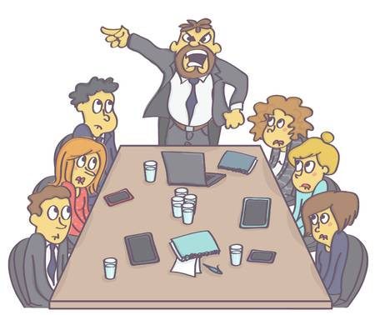
Channels of Oral Communication
2. Mechanical Channels
a. Telephone
b. Radio and Television
c. Microphone

Slide 12
Conditions of Oral Communication Effectiveness
1. Immediate Response
2. Oral Explanation
3. Secrecy
4. Illiterate Audience
5. Value of Time
6.Avoiding Sluggishness
7.Direct Relations

Slide 13
End of The Session

