Slide 1
Good Morning Everyone

Slide 2
Today’s Content
1.E-communication technology
2.Media for computer based communication
3.Non-verbal communication
4. Visual and Audible communication
5. Factors considered in selecting channels.

Slide 3
E-communication Technology
Electronic communication is a general term that embraces all kinds of computer-mediated communication in which individuals exchange messages with others, either individually or in groups.

Slide 4
Advantages and Disadvantages of E-com. Technology
Electronic communication is fast, cost-effective and convenient, but these attributes contain inherent disadvantages. The technology that enables people to keep in touch at all times also can invade privacy and cut into valuable relaxation time.
1. Mobility
2. Speed and Convenience
3.Distraction
4.Social Isolation
5. Cyber Crime
6.Privacy
7. Child Safety

Slide 5
Carriers of e-com. technology
1. Narrowband: Narrowband refers to data communication and telecommunications tools, technologies and services that utilize a narrower set or band of frequencies in the communication channel. These utilize the channel frequency that is considered flat or which will use a lesser number of frequency sets.
2.Voiceband:This refers to the transmission of (voice) information over a relatively narrow band of frequencies, called the voice spectrum (about 0–3,500 Hz), for which telephone networks have been designed. Your dialup 56-Kbps modem is an example of a voice band modem.
3.Broadband:Broadband technology is simply the name given to high-speed Internet access. Broadband replaced analogue modem. Broadband connection can be delivered in a number of different methods, ADSL, Cable & Satellite.
With a broadband router, you can connect two or more computers to share in Internet connection at home or office.

Slide 6
Media for computer based communication
E-Mail
V-Mail
Video Conferencing
Tele Conferencing
Tele Commuting
Mobile Phone
Facsimile (Fax)
Electronic Bulletin Boards.

Slide 7
Non verbal communication
Nonverbal communication is the process of sending and receiving messages without using words, either spoken or written. Also called manual language. Similar to the way that italicizing emphasizes written language, nonverbal behavior may emphasize parts of a verbal message.
The term nonverbal communication was introduced in 1956 by psychiatrist Jurgen Ruesch and author Weldon Kees in the book "Nonverbal Communication: Notes on the Visual Perception of Human Relations."

Slide 8
Visual Communication
Visual communication is the transmission of information and ideas using symbols and imagery. It is one of three main types of communication, along with verbal communication (speaking) and non-verbal communication (tone, body language, etc.). Visual communication is believed to be the type that people rely on most, and it includes signs, graphic designs, films, typography, and countless other examples.
1.Body Language or Kinesics
2.Proxemics or Spatial Relations
3.Clothing, Dress and Appearance
4.Use of Time or Chronemics
5. Communication Through Action

Slide 9
Audible Communication
When communication is done using Sound only, it is called audible communication. There are varieties of bounds around us that are used to communicate any message, information, news, idea or facts.
There are common techniques for audiovisual communication, which are as follows:
Use of Voice: Human voice has a major role in oral communication. Depend on the situation, our voice becomes hard, harsh, soft or moderate. Appropriate work helps up to control a situation, for example; when we are angry, we speak in a loud voice, it states about our emotion. When we are in a good mood, we use the soft voice and therefore our mental state is reflected clearly.

Slide 10
Audible communication
Siren: There is a different siren to convey the different message at different times. During Ramadan, Muslims are familiar with sirens at ‘Iftar’ and ‘Seheri’. When an ambulance is running towards the hospital, it uses one kind of siren to notify emergency. During the war, there is a siren to alert the people and to take safe shelter.
Calling Bell: It is used to call a person or to inform the desired person. The sound of calling bell indicates that the caller is asking someone to come or want somebody immediately.
Ringing Bell: It also signifies different meanings to a different section of people. For example: In a school, there is a use of bell to aware the teachers and students regarding time. Also in a rail station, there is a bell used by the stationmaster to permit the standing train to leave the station.

Slide 11
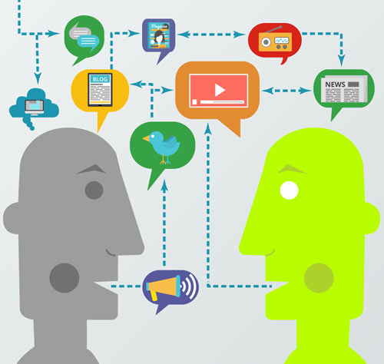
Factors considered in selecting channel
A communication channel is a type of media that is used to transfer a message from one person to another. In business specifically, communication channels are the way information flows in the organization within, and with other companies.

Slide 12
Factors considered in selecting channel
Communicator
Communicatee
Duplication
Immediacy
Channel Capacity
Expenditure
Feedback

Slide 13
End of the session

