Slide 1
Chapter 5 Poverty, Inequality, and Development

Slide 2
Distribution and Development: Critical Questions
How can we best measure inequality and poverty?
What is the extent of relative inequality in developing countries; how is this related to the extent of poverty?
Who are the poor, and what are their economic characteristics?
What determines the nature of economic growth—that is, who benefits from economic growth, and why?

Slide 3
Distribution and Development: Critical Questions
Are rapid economic growth and more equal income distribution compatible or conflicting objectives?: Is rapid growth achievable only at a cost of greater income inequality or can lessening income disparities contribute to higher growth rates?
Do the poor benefit from growth, and does this depend on the type of growth a developing country experiences? What might be done to help the poor benefit more?
What is so bad about extreme inequality?
What kinds of policies are required to reduce the magnitude and extent of absolute poverty?

Slide 4
Measuring Inequality
Measuring Inequality
Size distributions (quintiles, deciles)
Lorenz curves
Gini coefficients and aggregate measures of inequality
Functional distributions

Slide 5
Desirable Properties for Inequality Measures
Anonymity: measure should not depend on who has higher income; e.g. whether we believe the rich or poor to be good or bad people
Scale independence: inequality measures should not depend on size of the economy – want a measure of income dispersion
Population independence principle: an inequality measure should not be based on the number of income recipients
Transfer principle - all other incomes constant, if transfer income from a richer to a poorer person (not so much that the poorer person is now richer than the originally rich person), resulting new income distribution is more equal.
Gini coefficient satisfies all four properties; so does the coefficient of variation (CV), and some others

Slide 6
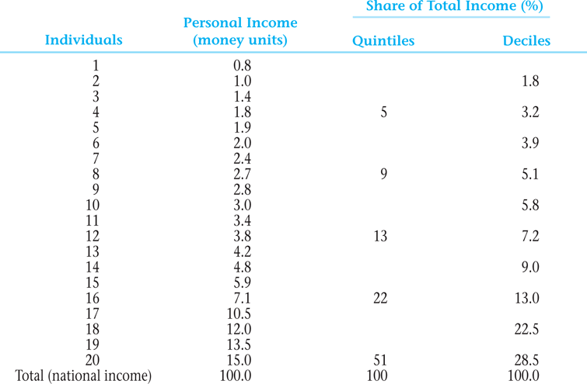
Table 5.1 Typical Size Distribution of Personal Income in a Developing Country by Income Shares—Quintiles and Deciles

Slide 7
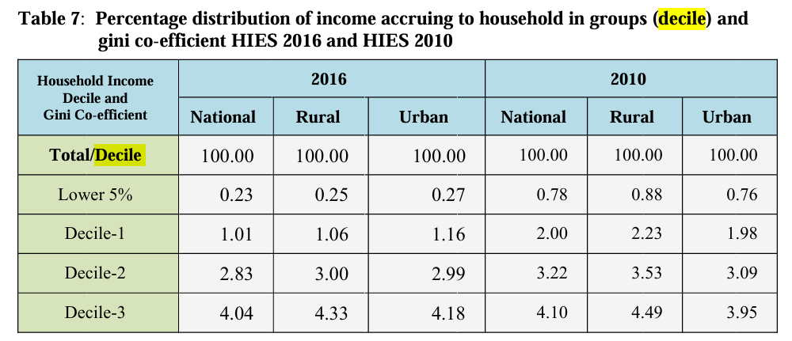
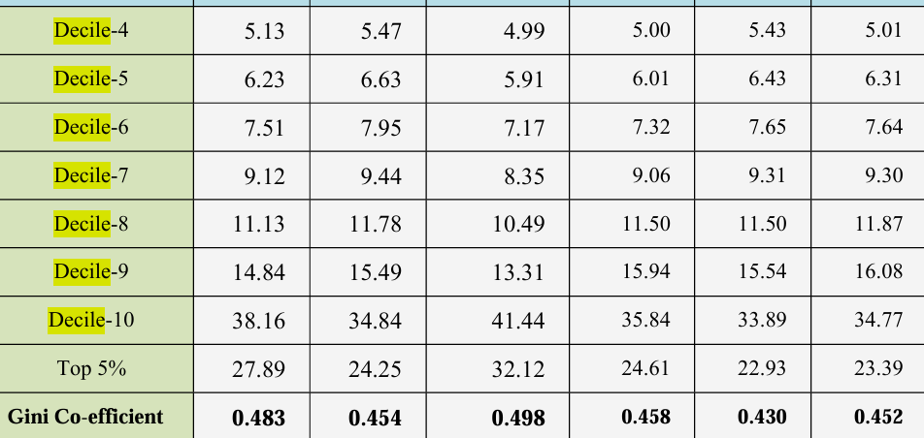

Slide 8
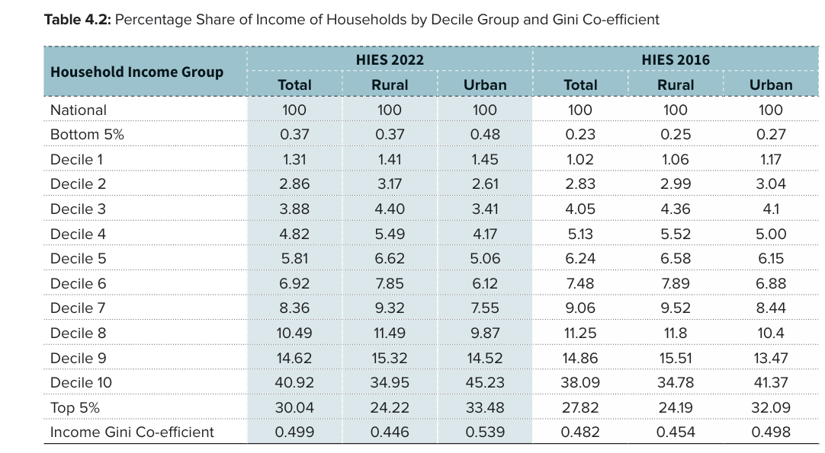

Slide 9
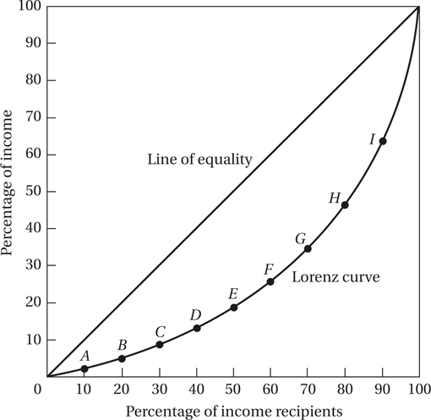
Figure 5.1 The Lorenz Curve
Notes:
n economics, the Lorenz curve is a graphical representation of the distribution of income or of wealth. It was developed by Max O. Lorenz in 1905 for representing inequality of the wealth distribution
Lorenz curves graph percentiles of the population against cumulative income or wealth of people at or below that percentile.

Slide 10
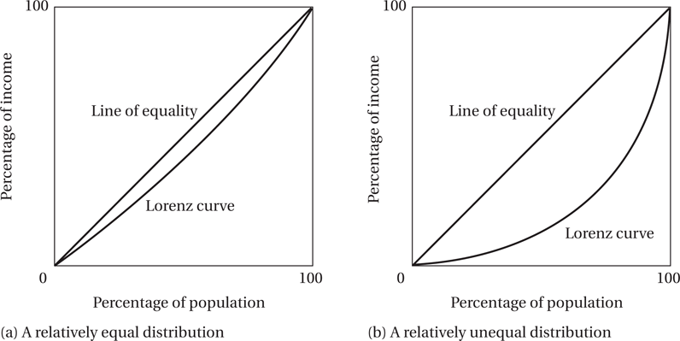
Figure 5.2 The Greater the Curvature of the Lorenz Line, the Greater the Relative Degree of Inequality

Slide 11
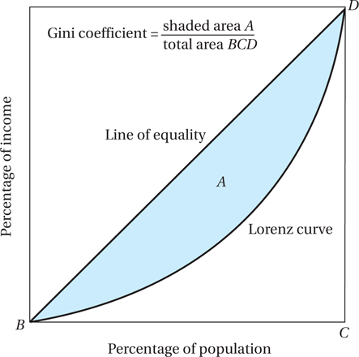
Figure 5.3 Estimating the Gini Coefficient

Slide 12
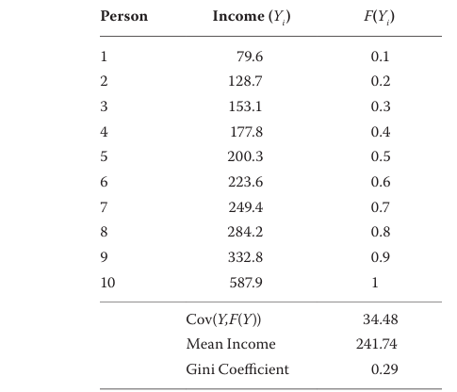

A Hypothetical Income Distribution
Notes:
Taylor, J. E., & Lybbert, T. J. (2020). Essentials of development economics. Univ of California Press.

Slide 13
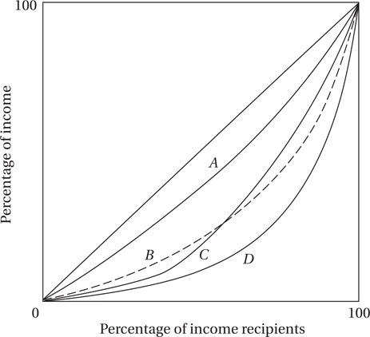
Figure 5.4 Four Possible Lorenz Curves

Slide 14
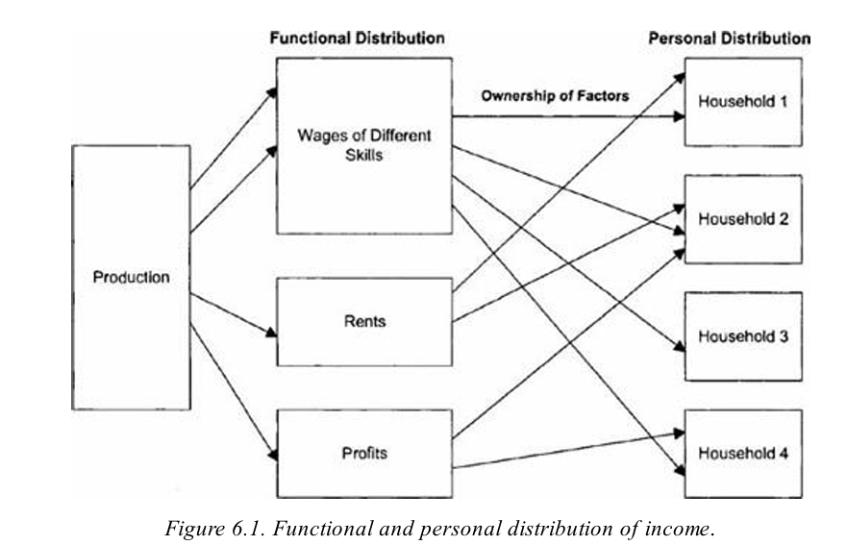
Notes:
Ray, D. (1998). Development economics. Princeton University Press.

Slide 15
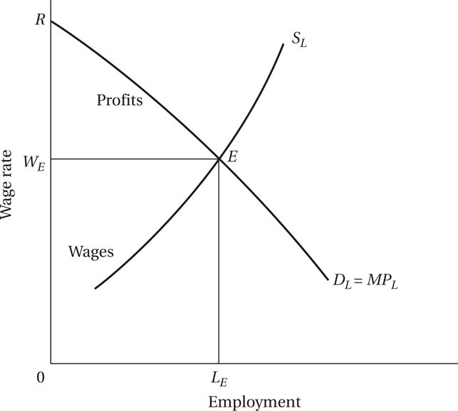
Figure 5.5 Functional Income Distribution in a Market Economy: An Illustration
Notes:
how are wages, rent, interest and profit determined

Slide 16
5.2 Measuring Absolute Poverty
Headcount Index: H/N
Where H is the number of persons who are poor and N is the total number of people in the economy
Total poverty gap:
Where Y_{p} is the absolute poverty line; and Y_{i} the income of the ith poor person

Slide 17
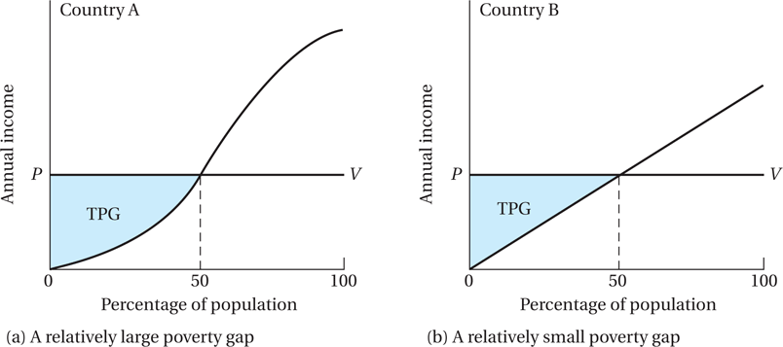
Figure 5.6 Measuring the Total Poverty Gap

Slide 18
5.2 Measuring Absolute Poverty
Average poverty gap (APG):
Where N is number of persons in the economy
TPG is total poverty gap
Note: normalized poverty gap, NPG = APG/Y_{p}

Slide 19
5.2 Measuring Absolute Poverty
Measuring Absolute Poverty
Average income shortfall (AIS):
Where H is number of poor persons
TPG is total poverty gap
Note: Normalized income shortfall, NIS = AIS/Y_{p}

Slide 20
5.2 Measuring Absolute Poverty
The Foster-Greer-Thorbecke (FGT) index:
N is the number of persons, H is the number of poor persons, and α ≥0 is a parameter
When α=0, we get the headcount index measure
When α=2, we get the “P₂” measure

Slide 21
5.2 Measuring Absolute Poverty
The Newly Introduced Multidimensional Poverty Index

Slide 22
Measuring Poverty: Income or Multidimensional?
Given that we are measuring poverty with income, we have good measures that, like P2, satisfies desirable properties
If must have a single indicator, income has advantages e.g. clarity, flexibility
But in general is measuring income sufficient?
Following Amartya Sen’s capability approach, it is apparent that, in general, poverty needs to be conceptualized – and so measured – in a multidimensional way
We will return to this with the new MPI

Slide 23
5.3 Poverty, Inequality, and Social Welfare
What’s So Bad about Extreme Inequality?
Dualistic Development and Shifting Lorenz Curves: Some Stylized Typologies
Traditional-sector enrichment (see Figure 5.7)
Modern-sector enrichment (see Figure 5.8)
Modern-sector enlargement (see Figure 5.9)

Slide 24
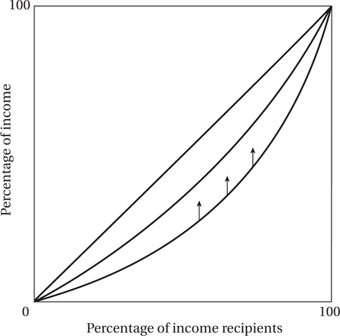
Figure 5.7 Improved Income Distribution under the Traditional-Sector Enrichment Growth Typology

Slide 25
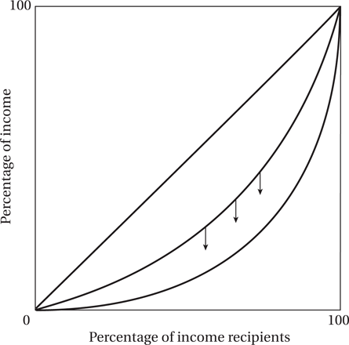
Figure 5.8 Worsened Income Distribution under the Modern-Sector Enrichment Growth Typology

Slide 26
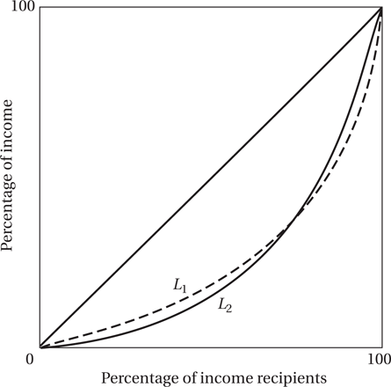
Figure 5.9 Crossing Lorenz Curves in the Modern-Sector Enlargement Growth Typology

Slide 27
5.3 Poverty, Inequality, and Social Welfare
Kuznets’ Inverted-U Hypothesis
The inverted-U is consistent with modern sector enlargement growth, but not traditional or modern sector enrichment growth

Slide 28
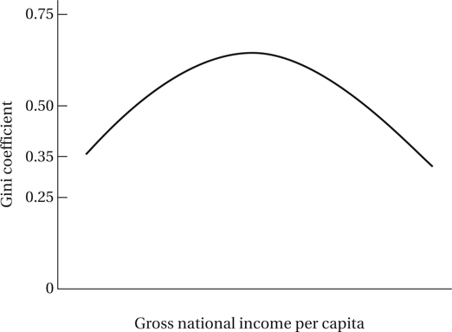
Figure 5.10 The “Inverted-U” Kuznets Curve

Slide 29
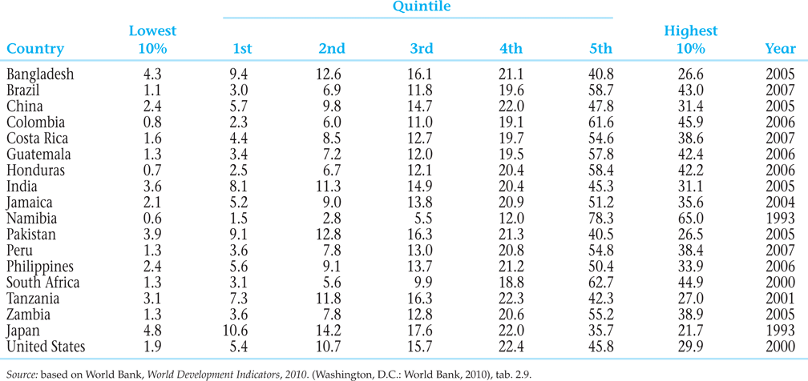
Table 5.2 Selected Income Distribution Estimates

Slide 30
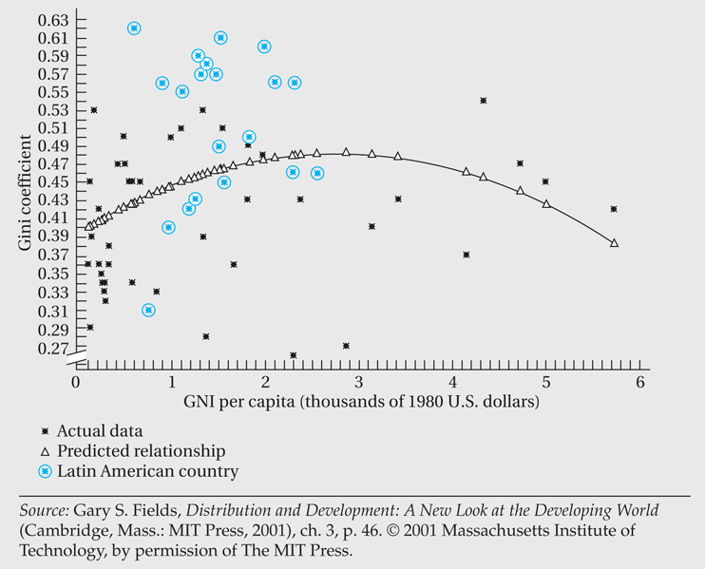
Figure 5.11 Kuznets Curve with Latin American Countries Identified

Slide 31
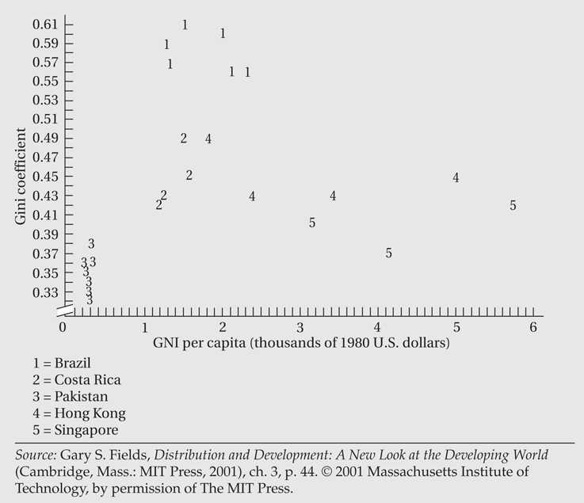
Figure 5.12 Plot of Inequality Data for Selected Countries

Slide 32
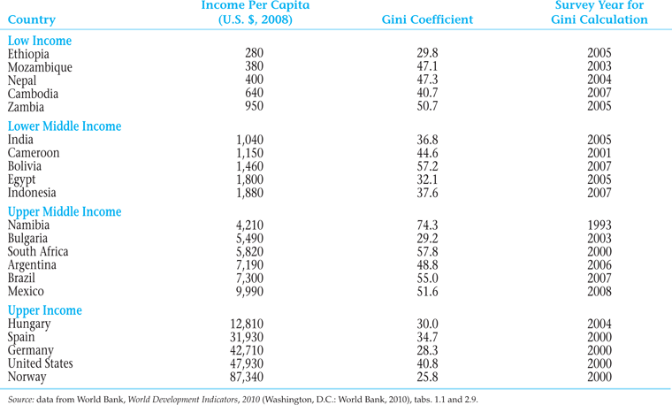
Table 5.3 Income and Inequality in Selected Countries

Slide 33
5.3 Poverty, Inequality, and Social Welfare
Growth and Inequality

Slide 34
5.4 Absolute Poverty: Extent and Magnitude
Progress on Extreme Poverty
Clear progress on $1.25-a-day headcount
Less clear progress on $2.00-per-day headcount (see Figure 5.14)
Incidence of extreme poverty is uneven
Relationship between Growth and Poverty
Association between growth and poverty reduction
When it is inclusive, growth reduces poverty
Lower extreme poverty may also lead to higher growth

Slide 35
5.4 Absolute Poverty: Extent and Magnitude
Poor health, nutrition, and education lowers economic productivity of people in poverty, leading directly and indirectly to slower growth
Higher income for the poor raises demand for locally produced goods
Often, the poor lack access to credit, which constrains entrepreneurship, children’s education, and fertility reduction
Social exclusion/injustice associated with poverty also leads to bad government policies that can reduce growth

Slide 36
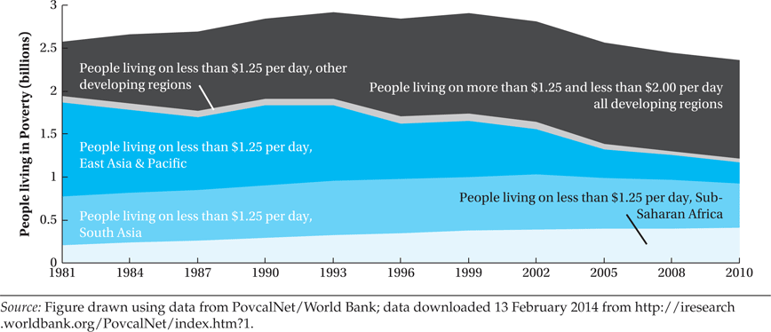
Figure 5.13 Global and Regional Poverty Trends, 1981–2010

Slide 37
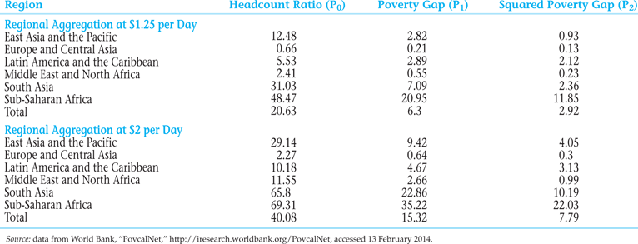
Table 5.4 Regional Poverty Incidence, 2010

Slide 38
The Multidimensional Poverty Index (MPI)
Identification of poverty status through a dual cutoff:
First, cutoff levels within each dimension (analogous to falling below a poverty line for example $1.25 per day for income poverty);
Second, cutoff in the number of dimensions in which a person must be deprived (below a line) to be deemed multidimensionally poor.
MPI focuses on deprivations in health, education, and standard of living; and each receives equal (that is one-third of the overall total) weight.

Slide 39
MPI Indicators
Health - two indicators with equal weight - whether any child has died in the family, and whether any adult or child in the family is malnourished –weighted equally (each counts as one-sixth toward the maximum deprivation in the MPI)
Education - two indicators with equal weight - whether no household member completed 5 years of schooling, and whether any school-aged child is out of school for grades 1 through 8 (each counts one-sixth toward the MPI).
Standard of Living, equal weight on 6 deprivations (each counts as 1/18 toward the maximum): lack of electricity; insufficiently safe drinking water; inadequate sanitation; inadequate flooring; unimproved cooking fuel; lack of more than one of 5 assets – telephone, radio, TV, bicycle, and motorbike.

Slide 40
Interaction of the deprivations?
Building the index from household measures up to the aggregate measure (rather than using already-aggregated statistics), MPI approach takes account of multiplied or interactive harm (complementarity) done when multiple deprivations are experienced by the same individual or family
The MPI approach assumes an individual’s lack of capability in one area can only to a degree be made up by other capabilities – capabilities are treated as substitutes up to a point but then as complements.

Slide 41
Computing the MPI
The MPI for the country (or region or group) is then computed
A convenient way to express the resulting value is H*A, i.e.,
The product of the headcount ratio H (the percent of people living in multidimensional poverty), and the average intensity of deprivation A (the percent of weighted indicators for which poor households are deprived on average).
The adjusted headcount ratio HA is readily calculated
HA satisfies some desirable properties. Important example -
Dimensional monotonicity: If a person already identified as poor becomes deprived in another indicator she is measured as even poorer - not the case using a simple headcount ratio.

Slide 42
Multidimensional poverty tells a different story than income poverty
The results showed that knowing income poverty is not enough if our concern is with multidimensional poverty.
Multidimensionally, Bangladesh is substantially less poor - but Pakistan substantially poorer - than would be predicted by income poverty
Ethiopia is far more multidimensionally poor, and Tanzania much less so, than predicted by income poverty.
Most Latin American countries e.g. Brazil rank worse on multidimensional poverty than on income poverty; but Colombia’s income and MPI poverty ranks are about same.

Slide 43
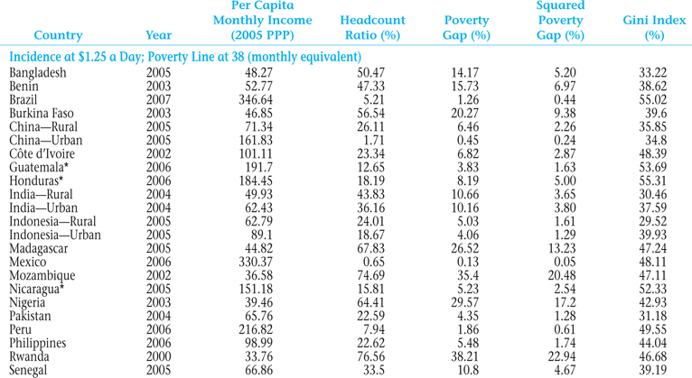
Table 5.5 Income Poverty Incidence in Selected Countries

Slide 44
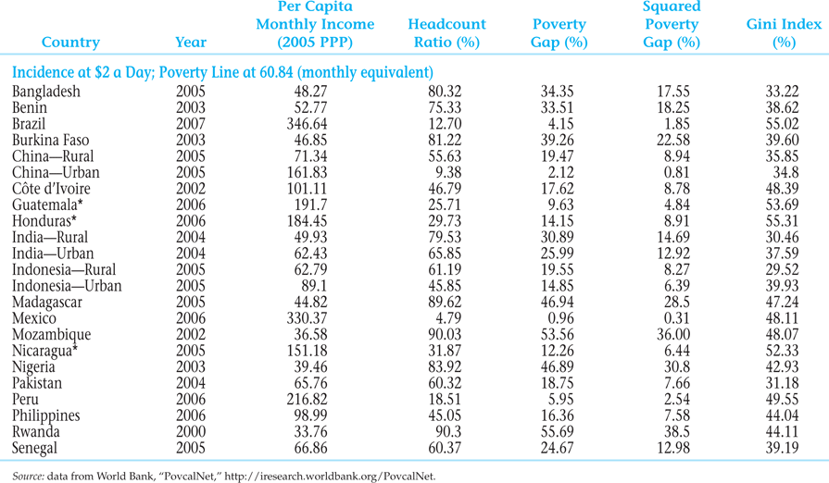
Table 5.5 Income Poverty Incidence in Selected Countries (continued)

Slide 45
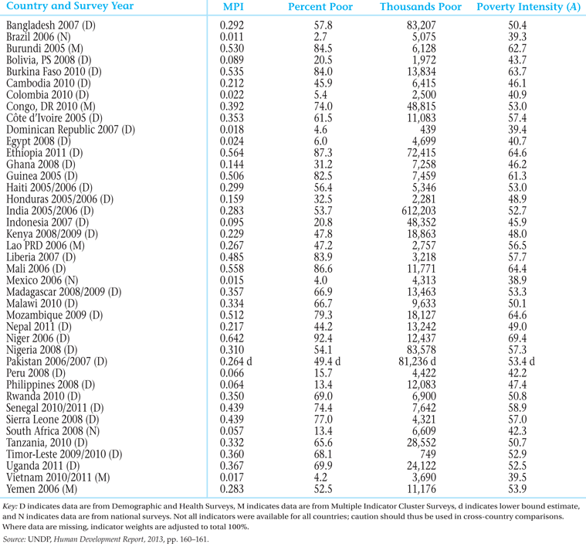
Table 5.6 Multidimensional Poverty Index, Data for 2007–2011

Slide 46
5.5 Economic Characteristics of High-Poverty Groups
Rural poverty
Women and poverty
Ethnic minorities, indigenous populations, and poverty

Slide 47
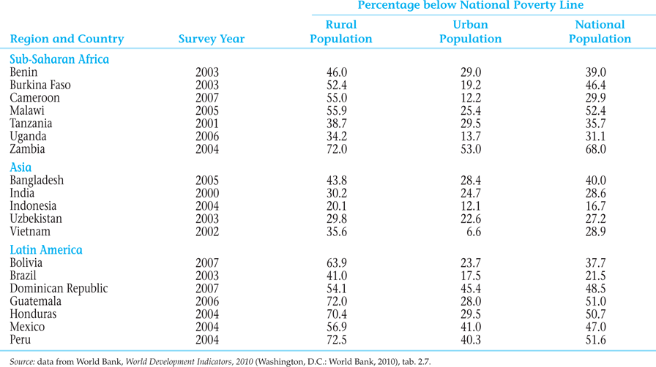
Table 5.7 Poverty: Rural versus Urban

Slide 48
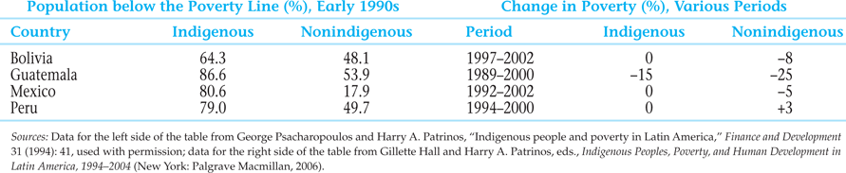
Table 5.8 Indigenous Poverty in Latin America

Slide 49
Workfare
Workfare, such as a Food for Work Program, represents a better policy than welfare when these criteria are met:
The program does not reduce incentives for the poor to acquire human capital and other assets
There are greater net benefits of the program’s work output
It is harder to screen the poor without a workfare requirement
Poor workers have lower opportunity cost of time (so the economy loses little output when they work in the program)

Slide 50
Workfare
Non-poor workers have higher opportunity cost of time (so they are unlikely to participate to get the benefits)
The fraction of the population living in poverty is smaller (so the extra costs of a universal welfare scheme would be high)
There is less social stigma of visible workfare participation, so the poor do not suffer humiliation or be deterred from needed work (otherwise, a discreet welfare transfer may be preferable)

Slide 51
5.6 Policy Options on Income Inequality and Poverty: Some Basic Considerations
Areas of Intervention:
Altering the functional distribution
Mitigating the size distribution
Moderating (reducing) the size distribution at upper levels
Moderating (increasing) the size distribution at lower levels

Slide 52
5.6 Policy Options on Income Inequality and Poverty: Some Basic Considerations
Policy options
Changing relative factor prices
Progressive redistribution of asset ownership
Progressive taxation
Transfer payments and public provision of goods and services

Slide 53
5.7 Summary and Conclusions: The Need for a Package of Policies
Policies to correct factor price distortions
Policies to change the distribution of assets, power, and access to education and associated employment opportunities
Policies of progressive taxation and directed transfer payments
Policies designed to build capabilities and human and social capital of the poor

