Slide 1
Education and Health in Economic Development

Slide 2
8.1 The Central Roles of Education and Health
Health and education are important objectives of development, as reflected in Amartya Sen’s capability approach, and in the core values of economic development
Health and education are also important components of growth and development – inputs in the aggregate production function

Slide 3
Education and Health as Joint Investments for Development
These are investments in the same individual
Greater health capital may improve the returns to investments in education
Health is a factor in school attendance
Healthier students learn more effectively
A longer life raises the rate of return to education
Healthier people have lower depreciation of education capital
Greater education capital may improve the returns to investments in health
Public health programs need knowledge learned in school
Basic hygiene and sanitation may be taught in school
Education needed in training of health personnel

Slide 4
Improving Health and Education: Increasing Incomes Is Not Sufficient
Increases in income often do not lead to substantial increases in investment in children’s education and health
But better educated mothers tend to have healthier children at any income level
Significant market failures in education and health require policy action

Slide 5
Investing in Education and Health: The Human Capital Approach
Initial investments in health or education lead to a stream of higher future income
The present discounted value of this stream of future income is compared to the costs of the investment
Private returns to education are high, and may be higher than social returns, especially at higher educational levels

Slide 6
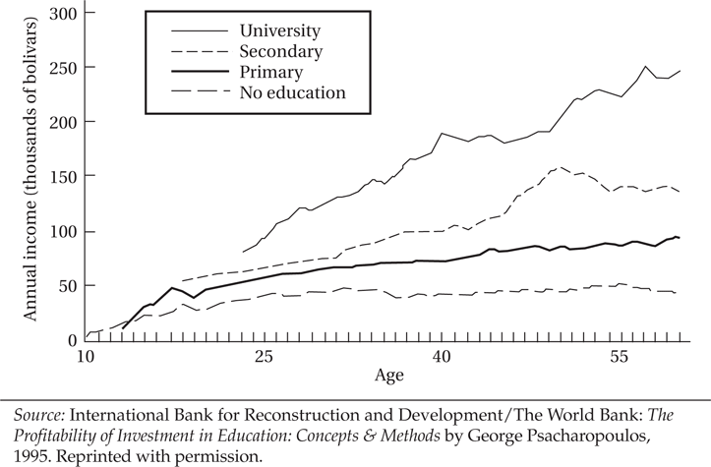
Figure 8.1 Age-Earnings Profiles by Level of Education: Venezuela

Slide 7
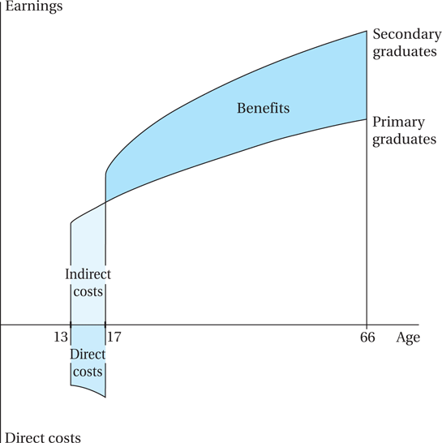
Financial Trade-Offs in the Decision to Continue in School

Slide 8
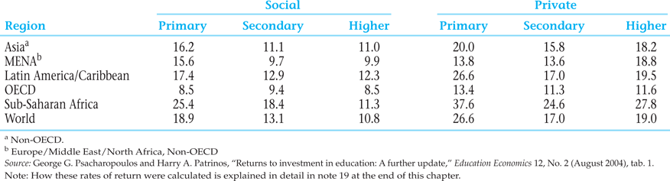
Table 8.1 Returns to Investment in Education by Level, Regional Averages (%)

Slide 9
8.3 Child Labor
Child labor is a widespread phenomenon
The problem may be modeled using the “multiple equilibria” approach
Government intervention may be called for to move to a ‘better’ equilibrium
Sometimes this shift can be self-enforcing, so active intervention is only needed at first

Slide 10
Assumptions of the Child Labor Multiple Equilibria Model
Luxury Axiom: A household with sufficiently high income would not send its children to work
Substitution Axiom: Adult and child labor are substitutes (perfect substitutes in this model), in which the quantity of output by a child is a given fraction of that of an adult: Q^{C} = γQ^{A}, 0 < γ < 1.

Slide 11
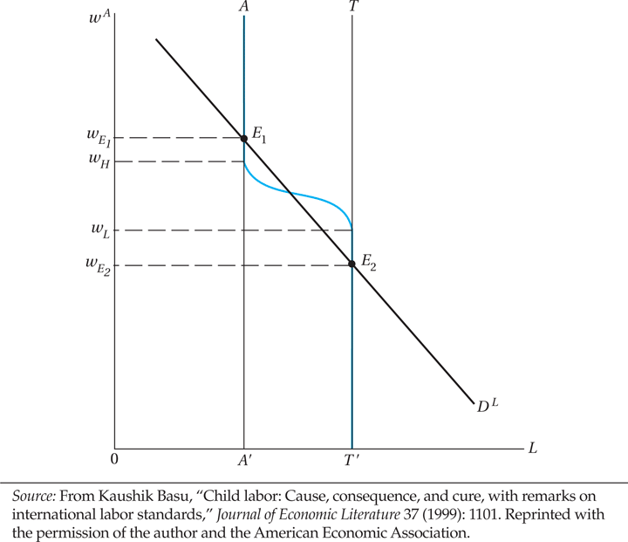
Figure 8.3 Child Labor as a Bad Equilibrium

Slide 12
Other approaches to child labor policy
The Chapter 8 Case Study: Get more children into school (as in Millennium Development Goals), e.g. new village schools; and enrollment incentives for parents such as in Progresa/ Oportunidades
Consider child labor an expression of poverty, so emphasize ending poverty generally (a traditional World Bank approach, now modified)
If child labor is inevitable in the short run, regulate it to prevent abuse and provide support services for working children (UNICEF approach)
Ban child labor; or if impossible, ban child labor in its most abusive forms (ILO strategy; “Worst Forms of Child Labor Convention”)
Activist approach: trade sanctions. Concerns: could backfire when children shift to informal sector; and if modern sector growth slows

Slide 13
8.4 The Gender Gap: Discrimination in Education and Health
Young females receive less education than young males in nearly every low and lower-middle income developing country
Closing the educational gender gap is important because:
The social rate of return on women’s education is higher than that of men in developing countries
Education for women increases productivity, lowers fertility
Educated mothers have a multiplier impact on future generations
Education can break the vicious cycle of poverty and inadequate schooling for women
Good news: Millennium Development Goals on parity being approached, progress in every developing region

Slide 14
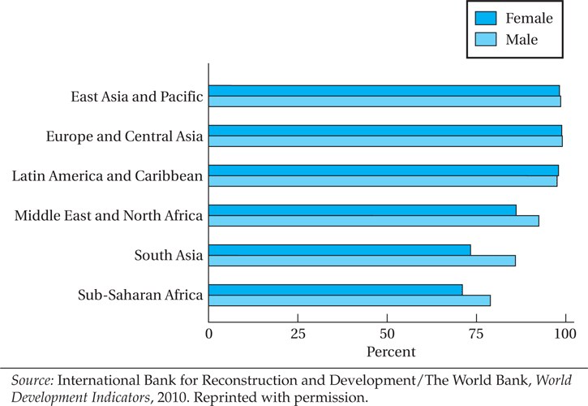
Figure 8.4 Youth Literacy Rate, 2008

Slide 15
8.4 The Gender Gap: Discrimination in Education and Health (cont’d)
Consequences of gender bias in health and education
Economic incentives and their cultural setting
“Missing Women” mystery in Asia

Slide 16
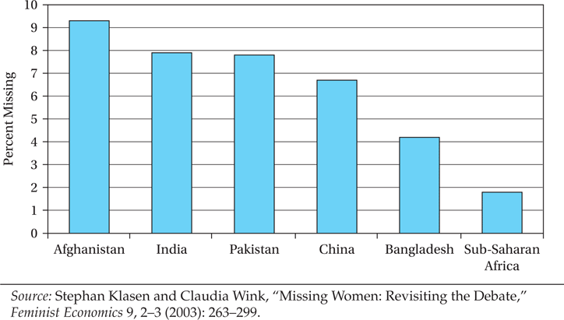
Figure 8.5 Estimated Percent of Women “Missing”

Slide 17
The “Missing Women” Crisis
Research has concluded that in Asia at least 100 million women or more are “missing”
If gender ratios were closer to normal levels based on biology, in comparison to other regions such as Europe, North America, or Latin America (or for that matter sub-Saharan Africa), that is the minimum number of additional women who would be alive in Asia alone
Some women are also missing in Africa, but a much smaller proportion
Reasons include inferior medical care for girls, and gender selective abortion or female infanticide

Slide 18
8.5 Educational Systems and Development
Educational supply and demand: the relationship between employment opportunities and educational demands
Social versus private benefits and costs
Distribution of education
Education, inequality, and poverty
Education, Internal Migration, and the Brain Drain

Slide 19
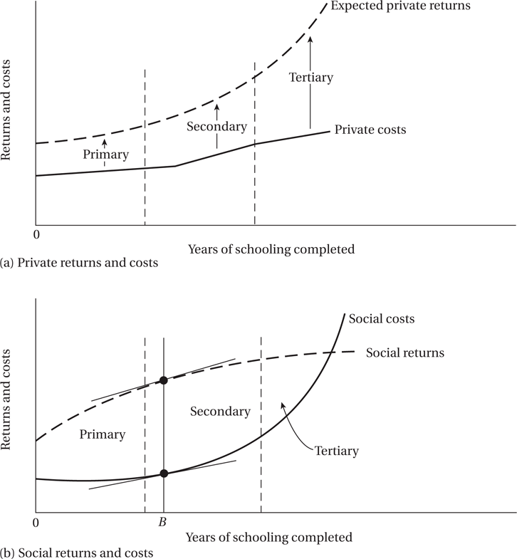
Figure 8.6 Private versus Social Benefits and Costs of Education: An Illustration

Slide 20
8.5 Educational Systems and Development (cont’d)
Distribution of Education
Lorenz curves for the distribution of education
Education, Inequality, and Poverty

Slide 21
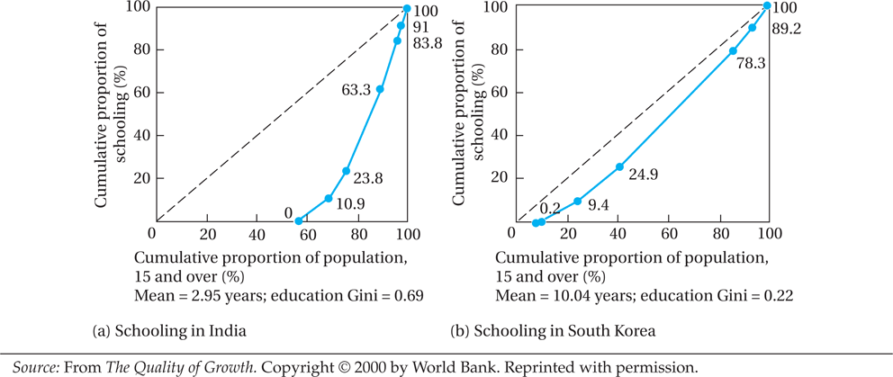
Figure 8.7 Lorenz Curves for Education in India and South Korea

Slide 22
Does education promote growth?
Key channels
1. Human Capital Formation
Education increases the skills, knowledge, and productivity of workers. A more skilled workforce can produce more output with the same amount of inputs, driving higher levels of GDP.
2. Innovation and Technological Progress
Higher education and research contribute to innovation. Educated individuals are more likely to invent new technologies, improve production methods, or adopt innovations, all of which fuel economic growth.

Slide 23
Does education promote growth?
Key channels
3. Improved Health and Social Outcomes
Education tends to improve health outcomes and lower fertility rates. Healthier, smaller populations can invest more per capita in human and physical capital, enhancing growth potential.
4. Institutional Quality and Governance
Educated citizens are better at demanding transparency, accountability, and the rule of law, which supports stable institutions — a crucial foundation for sustainable growth.

Slide 24
Does education promote growth?
Key channels
5. Greater Adaptability and Resilience
An educated workforce can more easily adapt to economic shocks and changing labor markets, making growth more resilient overtime.
6. Externalities and Spillovers
Education doesn't just benefit the individual — there are positive externalities. A more educated population raises the overall productivity of society by facilitating knowledge diffusion and collaboration.

Slide 25
Does education promote growth?
Empirical evidence
Countries with higher levels of educational attainment grow faster, although the quality of education matters as much as or even more than the quantity (i.e., years of schooling)

Slide 26
Does education stimulate rural–urban migration?
1. Better Employment Opportunities
Education raises people's skills and aspirations. In many developing economies, cities offer more jobs — especially skilled jobs — compared to rural areas. Educated individuals are more likely to migrate to cities where they can find employment that matches their qualifications.
2. Higher Returns to Education in Urban Areas
Wages for educated workers are typically higher in urban labor markets because of greater industrialization, services, and knowledge-based sectors. People migrate to capture these higher returns.

Slide 27
Does education stimulate rural–urban migration?
3. Access to Further Education and Professional Growth
Urban areas often have better access to universities, professional training, and career development opportunities. Those seeking to continue their education or specialize may move to cities.
4. Increased Awareness and Information
Education improves access to information — about job markets, living standards, and migration opportunities. People with more education are better equipped to navigate the challenges of migration.

Slide 28
Does education stimulate rural–urban migration?
5. Changing Social Preferences
Education can shift cultural values and lifestyles, making rural life seem less attractive relative to urban living, especially for younger generations.

Slide 29
Does education stimulate rural–urban migration?
Downsides
However, this migration can also create issues like:
Urban overcrowding and slums if city infrastructure cannot keep up.
Rural "brain drain," where the countryside loses its most capable individuals, potentially weakening rural economies.

Slide 30
Does the education of women tend to reduce their fertility?
1. Delayed Marriage and Childbearing
Educated women often marry later and delay starting families, which naturally shortens the period during which they can have children.
2. Greater Career and Economic Opportunities
With more education, women have access to better job opportunities and higher wages. As the opportunity cost of childbearing (i.e., time away from work and income) rises, women tend to have fewer children.

Slide 31
Does the education of women tend to reduce their fertility?
3. Increased Use of Contraception and Family Planning
Education improves knowledge about reproductive health and access to contraception. Educated women are more likely to use family planning methods effectively.
4. Changing Preferences and Aspirations
Education can shift women's preferences toward smaller family sizes, greater investment in each child (quality over quantity), and greater emphasis on personal development.

Slide 32
Does the education of women tend to reduce their fertility?
5. Improved Child Health and Survival Rates
Educated women usually have healthier children. When child mortality falls (often because mothers are better educated), parents tend to have fewer children because they are more confident their children will survive.
6. Empowerment and Decision-Making Power
Education empowers women to have greater say in family decisions, including decisions about the number and spacing of children.

Slide 33
Does the education of women tend to reduce their fertility?
More education leads to lower fertility rates.
This effect is particularly strong with secondary and higher education, but even basic literacy and primary education make a difference.

