Slide 1
Chapter 8
Agricultural Transformation and Rural Development

Slide 2
The Imperative of Agricultural Progress and Rural Development
The heavy emphasis in the past on rapid industrialization may have been misplaced
Agricultural development is now seen as an important part of any development strategy
Three complementary elements of an agriculture – and employment-based strategy
  Accelerated output growth
  Rising domestic demand for agricultural output
  Non-agricultural labor-intensive rural development activities that are supported by the farming community

Slide 3
Agricultural Growth: Past Progress and Current Challenges
Although agriculture employs the majority of the developing country labor force, it accounts for a much lower share of total output
Agricultural production is rising but unevenly

Slide 4
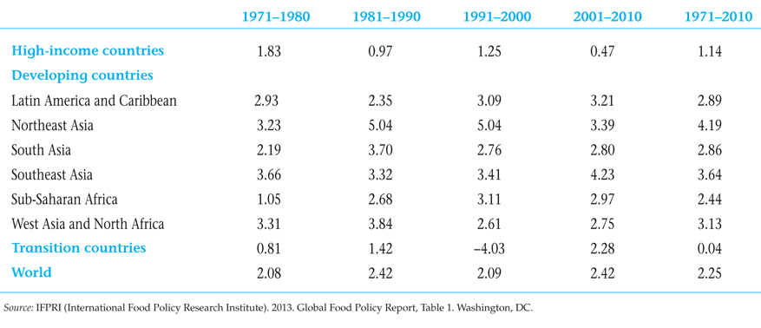
Table 9.1 Average Annual Growth Rates of Agriculture, by Region (%)

Slide 5
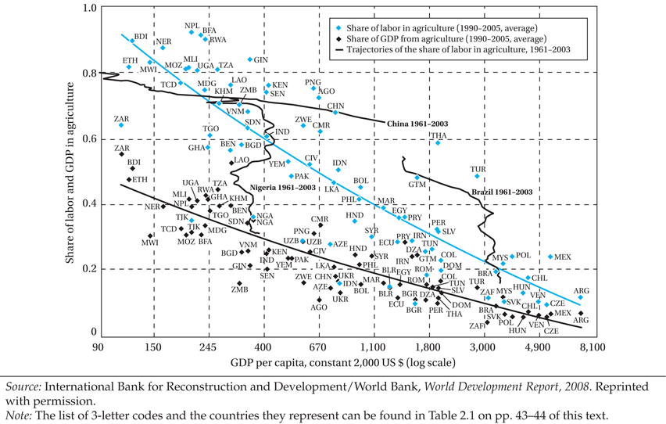
As Countries Develop, the Shares of GDP and Labor in Agriculture Tend to Decline, but with Many Idiosyncrasies

Slide 6
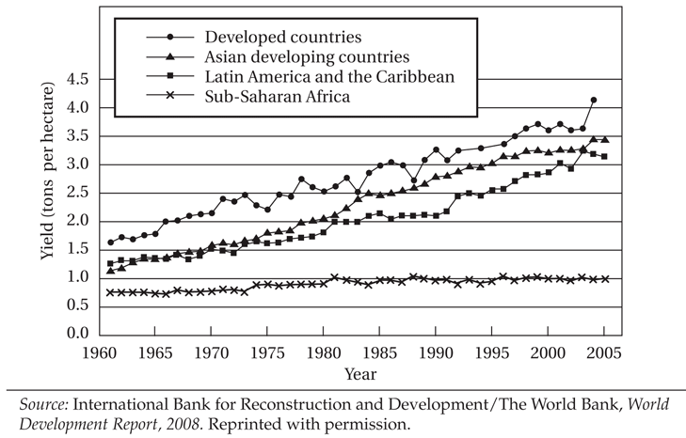
Cereal Yields by World Region, 1960-2005

Slide 7
9.2 Agricultural Growth: Past Progress and Current Challenges (cont’d)
Malnutrition and famine inspire calls for a new green revolution focused on Africa.
Food price spike of 2007-2008 partly due to short term factors but long-term factors may herald return to persistently higher food prices in the years ahead.
New upward spike of prices by early 2011
The presence of market failures - and poverty alleviation goals – create need for constructive government role in agriculture

Slide 8
Roles for Government in Agricultural Development
Environmental externalities
Agricultural research and extension services
Helping create markets where they are missing
Addressing monopoly power in input supply
Economies of scale in marketing
Informational asymmetries in product quality
Providing institutions and infrastructure
Addressing poverty traps

Slide 9
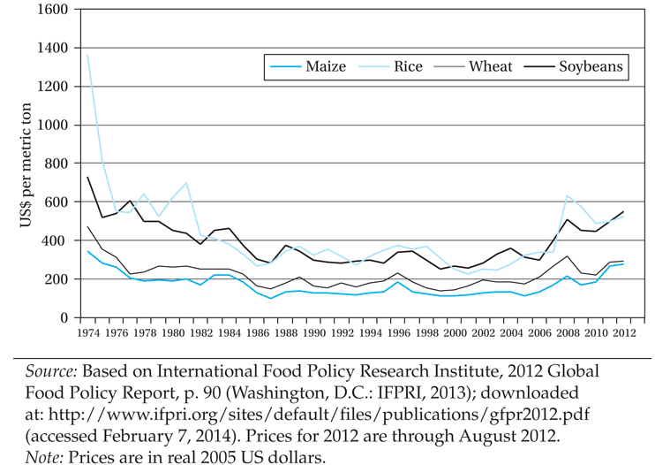
World Prices for Agricultural Commodities, 1974–2012

Slide 10
The Structure of Agrarian Systems in the Developing World
Three systems of agriculture
Agriculture based countries, often subsistence, but agriculture makes up large part of growth
Transforming countries, most of world’s rural people, large proportion of poverty incidence found there, low contribution of agriculture to growth
Urbanized countries, half or even more of the poor found in urban areas
The trend is from agriculture-based, to transforming, to urbanized economies as illustrated with the cases of India, China, Indonesia, and Brazil in Fig. 9.4

Slide 11
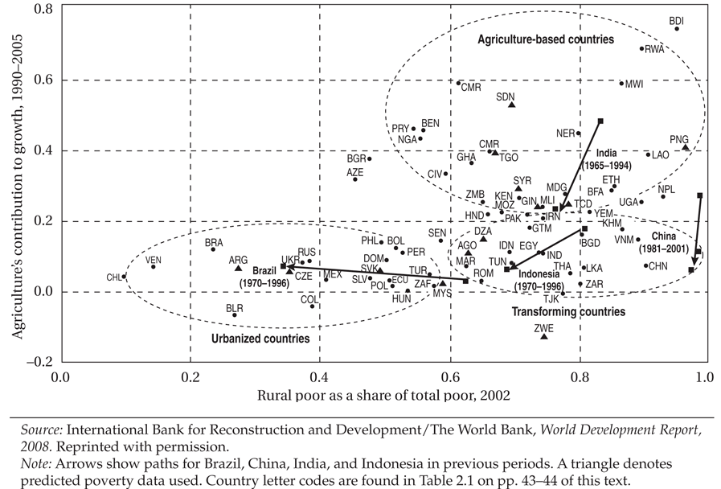
Agriculture’s Contribution to Growth and the Rural Share in Poverty in Three Types of Countries

Slide 12
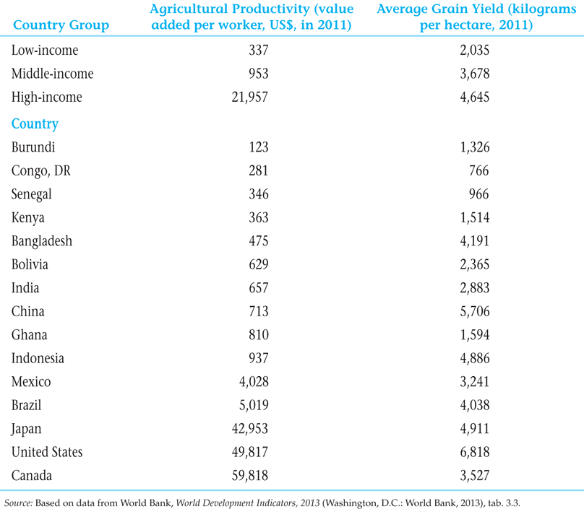
Labor and Land Productivity in Developed and Developing Countries

Slide 13
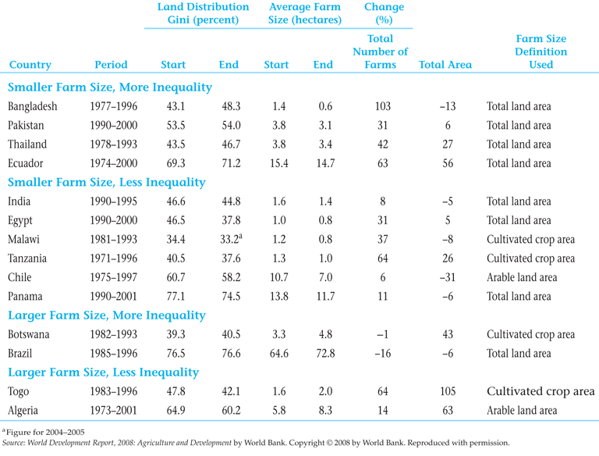
Changes in Farm Size and Land Distribution

Slide 14
The Structure of Agrarian Systems in the Developing World (cont’d)
Transforming Economies: Problems of Fragmentation and Subdivision of Peasant Land in Asia
  Impact of colonial rule in strengthening land tenure systems of private property rights and the consequent rise of moneylenders
  Contemporary landlordism in India and Pakistan involves absentee landlordism and persistence of sharecroppers and tenant farmers
  Rapid population growth resulted in more fragmentation and peasant impoverishment

Slide 15
The Structure of Agrarian Systems in the Developing World (cont’d)
Agrarian Patterns in Latin America: Progress and Remaining Poverty Challenges
  Apart from latifundios (large holdings) and minifundios (small farms) much production occurs on family farms and medium sized farms.
  Latifundios (traditional ones, especially) are relatively inefficient; landlords/owners are sometimes less focused on the business of farming; and large farms typically entail higher transaction costs
  Overall the agricultural sector seems to be doing well in many Latin American countries. Two prominent examples: Chile (diversification), and Brazil (biofuels)
  Extreme rural inequalities still persist.

Slide 16
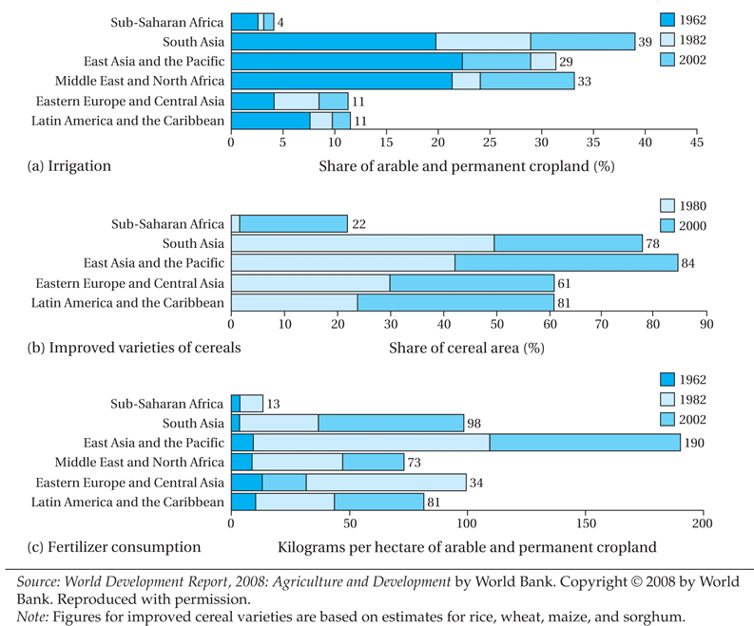
Expansion of Modern Inputs in the World’s Developing Regions

Slide 17
The Important Role of Women
Women provide 60% to 80% of agricultural labor in Africa and Asia, and 40% in Latin America
Women work longer hours than men
Government assistance programs tend to reach men, not women

Slide 18
The Microeconomics of Farmer Behavior and Agricultural Development
The Transition from Traditional Subsistence to Specialized Commercial Farming: Three stages in the evolution of agricultural production.
Traditional(peasant) farm
  Low productivity, subsistence-level traditional farm.
  Still prevalent in Africa
Diversified or mixed family agriculture
  A small part is grown for consumption and a significant part for sale to the commercial sector.
  Prevalent in much of Asia
Modern Farm
  High productivity, specialized agriculture geared to the commercial market.
  Developed and highly urbanized developing countries

Slide 19
The Microeconomics of Farmer Behavior and Agricultural Development
Subsistence farming: risk aversion, uncertainty, and survival
  Traditional neoclassical model of profit maximization with certainty is not adequate
  Price, weather, and other uncertainty, along with limited access to credit and insurance (and even savings vehicles), largely explains the extent of risk-averse behaviors observed
  Risk-averse subsistence farmers often (not irrationally) can prefer technologies that combine low mean-per-hectare with low variance to alternative high yielding but higher risk technologies
  Efforts to minimize risk and remove commercial and institutional obstacles to small farmer innovation are necessary

Slide 20
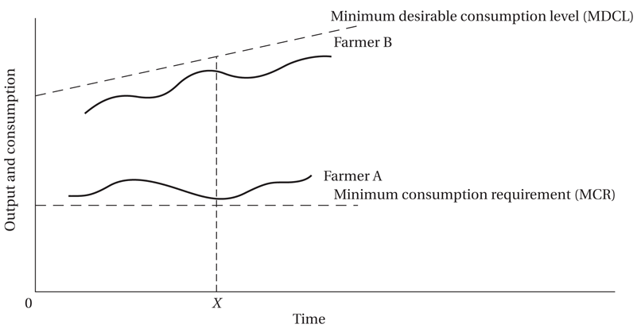
Small-Farmer Attitudes toward Risk: Why It Is Sometimes Rational to Resist Innovation and Change

Slide 21
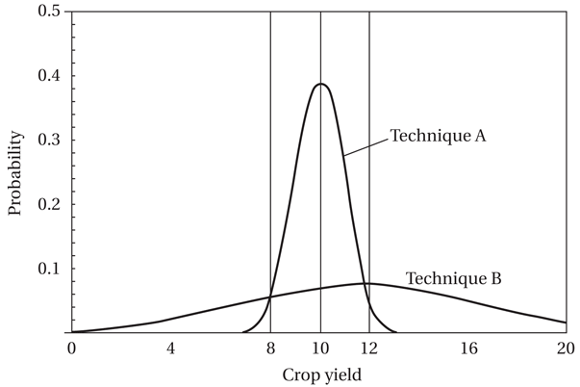
Crop Yield Probability Densities of Two Different Farming Techniques

Slide 22
The Microeconomics of Farmer Behavior and Agricultural Development (cont’d)
Issues in sharecropping: a long debate
  Intrinsically Inefficient due to poor incentives (Marshall)
  Monitoring approach (Cheung)
  Compromise between two types of risk (Stiglitz, others)
  Screening argument (if high ability then take pure rental)
  Empirical evidence for inefficiency from Ali Shaban (comparing same farmer, controlling for soil)
  Giving sharecroppers a larger share of the produce and security of tenure on land can increase efficiency
Issues in interlocking factor markets

Slide 23
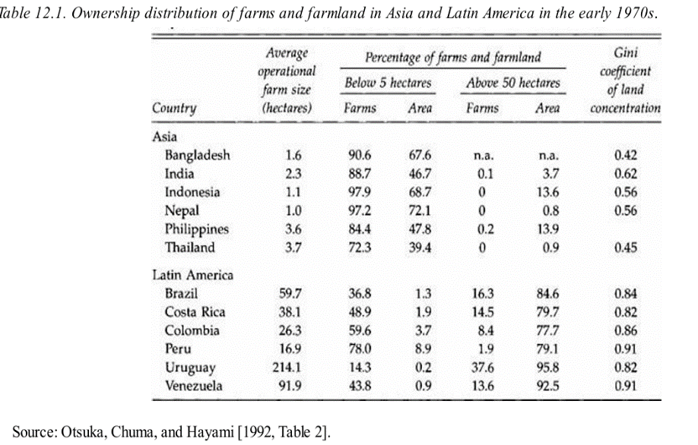
Ownership and Tenancy

Slide 24
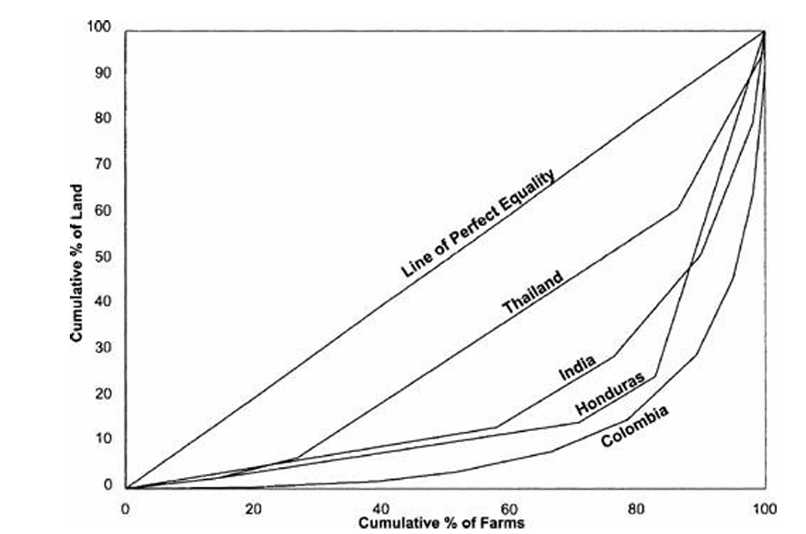
Ownership and Tenancy

Slide 25
The Agricultural Production Function
We assume two inputs, labor and land, produce an output, such as grain.
Instead of showing output as a function of capital per worker, agricultural output is shown as a function of labor per unit of land.
Because any increase in labor must be combined with the existing stock of land (or perhaps new land of decreasing quality), the production function exhibits diminishing returns.

Slide 26
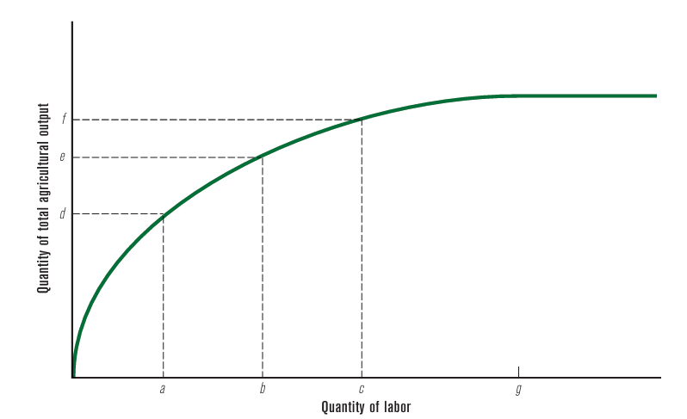
The Agricultural Production Function
A rise in the labour force from a to b leads to an increase in output from d to e
An equal increase in labour from b to c leads to a smaller increase in output.
At point g, however, further increases in the amount of labor used lead to no rise in output at all.

Slide 27
The Agricultural Production Function
Beyond point g, the marginal product of labor (MPL) is zero or negative, so additional labor causes no increase or reduction in output.
This could happen if all arable land were fully used and so many workers were available already that adding new ones would not result in more grain being produced.

Slide 28
Contracts and Incentives
Fixed-Rent Tenancy
The tenant pays a fixed amount of money to the landlord and gets the right to farm the land in return. The tenant retains 100% of output produced.
The landlord is relieved of all risk: the fixed rent is to be paid whether the production does well or not.
It is, therefore, necessary that the tenant is willing to take the risks of bad crops or crop failures.
Since rich tenants engage in this form of tenancy, they have enough wealth to face such risks.
There is indirect evidence that Latin American tenancies are held by large farmers. Contrast this with Asia, where the bulk of tenancy is in the form of sharecropping

Slide 29
Contracts and Incentives
Sharecropping
Sharecropping comes in many flavors, but all of them involve the sharing of the tenant’s output in some preassigned proportion between the landlord and the tenant.
The proportions vary from country to country and across regions within a country, although a 50–50 division is commonly observed.
The importance of sharecropping is particularly realized when the tenants are small and risk-averse
In other words, part of the fluctuation or risk can be shared with the landlord.

Slide 30
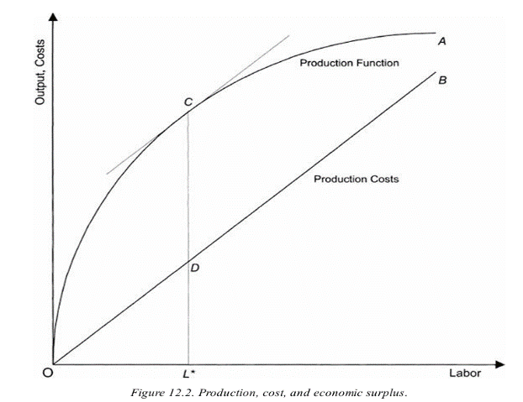
Contracts and Incentives
Maximization of Economic Surplus
Assume that the tenant has just one variable input of production—labor.
Labor supply to the rented plot has a cost. This cost is depicted by the line OB.
This depiction makes it very clear just how much economic surplus is produced by the tenancy arrangement

Slide 31
Contracts and Incentives
Maximization of Economic Surplus
The surplus will vary, of course, with the amount of labor being applied.
We are interested in the labor input level that yields the maximum possible economic surplus.
This is the point where the vertical difference between the curves OA and OB is at a maximum.
The surplus is given by the segment CD

Slide 32
Contracts and Incentives
Maximization of Economic Surplus
More output per se is not necessarily better, because the cost of producing that higher output is higher as well.
Economic surplus is thus maximized at some intermediate point, as shown in Figure 12.2.

Slide 33
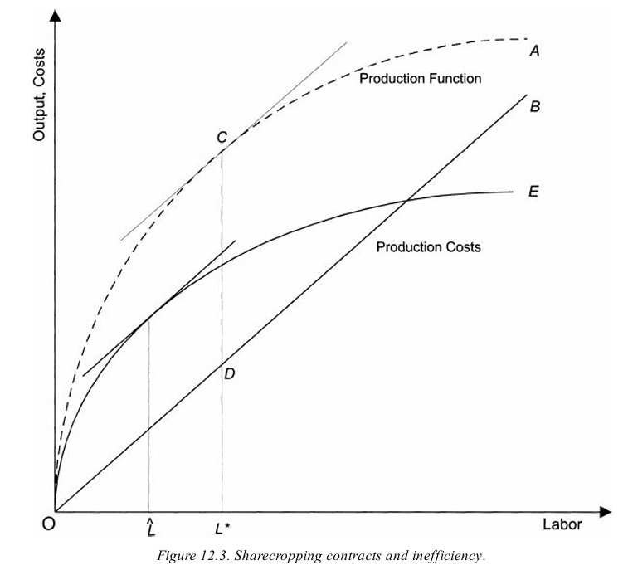
Contracts and Incentives
Sharecropping and inefficiency

Slide 34
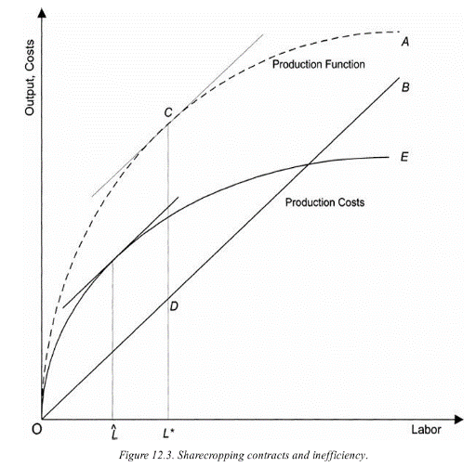
Contracts and Incentives
Sharecropping and inefficiency
Under sharecropping, the tenant cedes a share of the output to the landlord.
Because the tenant receives only some fraction of the output, the effective return to the tenant is the line OE.
OE is simply the OA multiplied by a fraction ( the tenant’s output share)
The tenant wants to maximize the difference between OE and OB
Notes:
Cede—sid= give up

Slide 35
Contracts and Incentives
The tenant wants to maximize the difference between OE and OB.
Is this the same as maximizing economic surplus as defined earlier? The answer is no.
Because OE is not just shifted-down but a flattening of OA.
Thus when the tenant maximizes his effective return (net of cost), he generally does so at a labor input that is smaller than L*.
Marginal return is smaller than the actual value of marginal product.
The tenant will thus desist from applying more labor
Sharecropping and inefficiency
Notes:
Desist –stop doing something

Slide 36
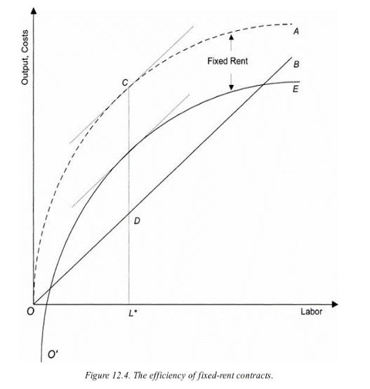
Contracts and Incentives
The effects of a fixed rent contract
The tenant’s return can be depicted in this case simply by a parallel downward shift of the production function that is obtained by subtracting the fixed rent at every point.
The result is the line O′E, which is just the old production function OA minus whatever the fixed rent is.
The difference between this effective return and the tenant’s cost, OB, is what the tenant seeks to maximize through his choice of labor input.

Slide 37
Contracts and Incentives
The effects of a fixed rent contract
The key observation is that this exercise is essentially identical to the maximization of economic surplus.
The imposition of a fixed rent has no effect at all on tenant incentives at the margin, although, of course, if the fixed rent is too high he may not accept the tenancy in the first place.
The difference between O’E and OB, and OA and OB is maximized at the same level of labor input L*

Slide 38
Core Requirements of a Strategy of Agricultural and Rural Development
Improving Small-Scale Agriculture
  Technology and innovation
  Institutional and pricing policies: Providing necessary economic incentives
  Adapting to new opportunities and new constraints
Conditions for Rural Development
  Land reform
  Supportive polices
  Integrated development objectives

