Slide 1
STRIP MINE PLANNING AND DESIGNING
Younus Ahmed Khan, PhD
Professor, Dept. of Geology and Mining
University of Rajshahi

Slide 2
1. PLANNING PROCEDURE AND RESERVE ESTIMATION
Planning a surface mine using the strip (open cast) mining method requires consideration of many variables with complex interrelationships
Following a collection of general deposit and project-related information, a development and extraction plan is conceived. Project economics is determined, and an economic analysis is performed to determine project viability.
The planning and development process can take up to 10 years and require millions of dollars of expenditure exclusive of that for actual mine preparation and equipment purchase.

Slide 3
Reserve Estimation and Stripping Ratio
SAMPLING METHODS. In most cases, a combination of rotary and diamond core drilling methods is used to obtain sample data from the deposit. Rotary drilling is used to determine overburden depth and coal thickness. A rotary rig is used to drill through the coal seam(s). Then a geophysical probe is lowered into the hole and a log of the hole is produced. Combinations of parameters such as gamma logs and density logs are used

Slide 4
Calculation Methods
Tons/Acre Method—The tons-per-acre approach is commonly employed where there is little seam variability or where a rapid approximation of reserves, overburden, and stripping ratio is required.
The method involves calculating the tons of coal/acre-ft (tonnes/hectare-meter) and then multiplying this figure by the average thickness of the coal to determine the tons/acre (tonnes/hectare) of coal. The area of reserves in acres is then multiplied by the tons/acre (tonnes/hectare) of coal to arrive at the reserve. Two reserve figures are generally presented: (1) the in-place reserve and (2) the recoverable reserve, which includes allowances for mining and for preparation plant recoveries.
Similarly, overburden/acre is calculated using the average overburden height, and the reserve area is multiplied by this figure to arrive at total overburden.
The average stripping ratio (i.e., bank cubic yards of overburden/ton of coal, or cubic meters/tonne) is calculated by dividing total volume of overburden by total weight of coal, usually on a recoverable basis.

Slide 5
Iso-Line Method—The iso-line method involves construction of lines of equal values for overburden thickness and coal thickness in an effort to present a model of these parameters representing the deposit.
The iso-overburden map is generated from the surface topography map and a topographic map of the top of the coal seam.
Computer Models—Many operators utilize computer software to perform the previously described reserve calculations and to generate the associated graphics utilizing flat-bed plotters. A typical software system will have the following capabilities:

Slide 6
1. Drillhole data loading and editing with data including drillhole identification, location, lithology on a from-to basis, rock type, seam codes, coal seam analysis, etc.
2. Drillhole data listing and abstracts.
3. Drillhole data quality summaries by seam, list, and area with averages for specified parameters.
4. Polygonal reserves with reserves by hole and seam with maps generated showing polygonal shapes.
5. Topography loading by drillhole or by digitizing contour maps.
6. Vertical cross sections, to scale, showing overburden, coal, and other input data.
7. Plan maps showing drillhole locations, crop lines, property lines, etc.
8. Interpolation of data to produce a gridded model of overburden thickness, coal thickness, top and bottom coal elevations, etc.
9. Seam reserves based on gridded data for any area or series of areas with ability to limit reserves based on numerous parameters or combinations of parameters (e.g., minimum coal thickness, maximum overburden thickness, maximum percent
sulfur, etc.)
10. Mining cut data generated on a cut-by-cut basis to allow simulation of alternative mine plans and comparison of coal and overburden amounts, coal quality, etc.
Such software is available from numerous companies.

Slide 7
Economic Stripping Ratio—The economics of stripping increasing amounts of overburden is a factor controllable by mine management. The basic premise involves setting a minimum acceptable profit/ton of coal recovered and then adjusting the amount of stripping to satisfy that profit constraint. Such an approach results in a maximum allowable stripping ratio and places a boundary on the area that can be mined economically.

Slide 8
Mining and Barrier Losses—Mining losses are those associated with the extraction process. These losses include the following:
1. Top of coal: losses at upper coal contact with overburden as a result of cleaning coal after stripping.
2. Bottom of coal: losses at lower coal contact with bottom as a result of loader losses; both top and bottom losses, as a percentage, are a function of seam thickness.
3. Rib: losses at side of seam adjacent to spoil as a result of spoil piled on coal rib during stripping or slides of spoil on coal; function of pit width.
4. Other: includes fly rock (blasting) and transportation losses (dust and spillage).

Slide 9
2. STRIPPING AND PIT DEVELOPMENT
Alternative Stripping Methods
Three alternative stripping procedures are described.
AREA/DRAGLINE METHOD. The area/dragline method involves opening an initial box cut, removing the coal exposed in the box cut, and then placing the overburden from the next longitudinal cut into the mined-out, box-cut area.
The procedure is then repeated on a cut-by-cut basis. The method is generally employed in flat to moderately dipping coal seams with relatively constant overburden depths.
MODIFIED OPEN PIT/SHOVEL-TRUCK METHOD. Modified open pit or terrace mining is generally used in thick-seam properties with low stripping ratios. In these applications, seams are generally flat-lying, gently dipping, or rolling.
BLOCK AREA/DOZER-SCRAPER METHOD. The block area method, which utilized construction-type equipment, was first conceived in the mid- 1970s as an alternative to the area/dragline method. This method takes advantage of the dozer’s ability to move material over short distances at low costs and the scraper’s ability to elevate material over steep grades for short distances at reasonable costs.

Slide 10
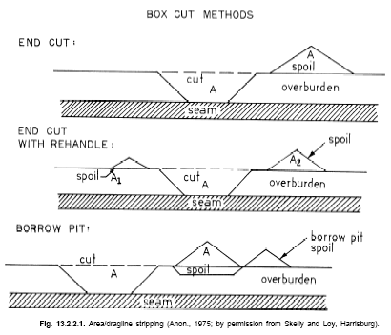

Slide 11
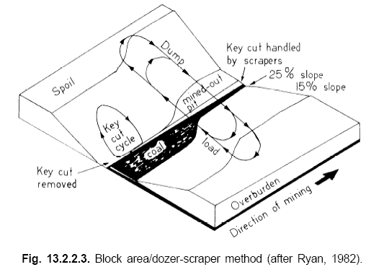

Slide 12
Dragline Pit Design
PIT LENGTH. The average length of pit (in the central United States) is approximately 5500 ft (1.67 km), and although specific data are not available for the western part of the country, lengths are similar.
PIT WIDTH. Pit width in large midwestern mines ranges from 95 to 105 ft (29 to 32 m) and averages 120 ft (37 m) in western mines. In deep cover, widths range to 180 ft (55 m).
PIT ORIENTATION. Selection of pit orientation and sequencing is critical to the mine plan, because it will determine equipment selection, operating costs relative to production life, coal quality relative to production life, and so forth.
HAUL ROAD LAYOUT. The average strip mine haul distance in the central United States is approximately 5 miles (8 km) one way. Strip mine roads are usually spaced on 1500- to 1800-ft (450- to 540-m) centers through the spoil to facilitate one-way hauls if possible. In deeper overburden, fewer haul roads through the spoil may be used as a result of significant spoil volume losses.

Slide 13
PIT DEVELOPMENT
CLEARING AND GRUBBING. This involves clearing the property of trees and shrubs and then removing the stumps and roots to insure a homogeneous topsoil. Grubbing is often done with rake-like grubbing attachments on agricultural tractors or dozers.
TOPSOIL REMOVAL. Regulations dictate that the topsoil be removed and ultimately replaced upon graded spoils. Topsoil can either be stockpiled at the side of the pit area for later redistribution or hauled immediately to the graded area for redistribution.
In the latter case, the topsoil can either be hauled around the pit or across the pit on spoil bridges.
Topsoil thicknesses are usually determined by auger drilling, and the regulations dictate that a minimum of 6 in. (150 mm) of material be removed. In cases where multiple soil horizons (i.e., A, B, and C) exist, these layers must be removed separately

Slide 14
MINE DRAINAGE AND EROSION AND SEDIMENT CONTROL
For many years, it has been good operating practice to divert surface water from active pit areas to eliminate in-pit water problems. Diversion ditch systems were utilized to deflect the water and direct it into natural drainages. Under current regulations, this practice has been expanded to include the following:
1. Surface drainage from disturbed areas must pass through a sediment pond.
2. Effluent from the ponds must meet limitations of pH, iron, manganese, total suspended solids, etc.
3. Sedimentation ponds must be constructed to standards on capacity, detention time, dewatering, location, slopes, etc.; these standards, particularly the capacity standards, have been contested by industry.
4. Discharge compliance must meet 10-year, 24-hour precipitation events.
5. Treatment is required, if necessary to meet effluent standards.

Slide 15
REGRADING. Regrading or striking-off the spoil is usually accomplished with large-horsepower dozers, and final grading is done with large graders. Regulations provide a number of general guidelines including:
1. Restoration to approximate original contour.
2. Elimination of highwalls.
3. Restoration of natural drainages to the extent possible.
4. Construction of final slopes not exceeding original slopes.
5. Productivity equal or greater than premining productivity.
In addition, the regrading must be done within 180 days or with regrading kept within four spoil ridges of the active pit
TOPSOIL REPLACEMENT OR REDISTRIBUTION
REVEGETATION.

Slide 16
3. CAST BLASTING OF DEEP OVERBURDEN

