Slide 1
Advanced physiology of exercise and metabolism
Professor Dr. Md Rezaul Karim-2
Department of Biochemistry and Molecular Biology
University of Rajshahi

Slide 2
Heat production in the muscle
Muscle contractions produce heat as a byproduct of metabolism, specifically through ATP hydrolysis. The energy released when ATP breaks down during muscle contraction is not fully captured for mechanical work, and the remaining energy manifests as heat. Skeletal muscle, due to its abundance in the body, is a major contributor to overall body heat production.

Slide 3
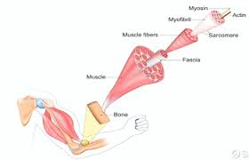
Heat production----
ATP Hydrolysis:
Muscle contraction relies on the breakdown of ATP (adenosine triphosphate) into
ADP (adenosine diphosphate) and inorganic phosphate (Pi). This process releases energy, and some of this energy is converted into heat.
Heat as a Byproduct:
Not all the energy released from ATP hydrolysis is used to generate mechanical work. A portion of the energy is dissipated as heat.
Skeletal Muscle Dominance:
Skeletal muscles, which are responsible for voluntary movement, are the largest muscle type in the body. Their extensive presence makes them a significant contributor to heat production, especially during exercise or shivering.
Shivering:
In response to low body temperatures, the body initiates shivering, a rapid and involuntary contraction of skeletal muscles. This process generates a significant amount of heat to help maintain body temperature.
Other Contributing Factors:
While muscle contractions are a primary source of heat, other metabolic processes within the body also contribute to overall heat production, such as those related to the liver, brain, heart, and other tissues.

Slide 4
Effect of exercise and training on the muscular system
Exercise and training have profound effects on the muscular system, leading to both short-term and long-term physiological changes. These include increased muscle strength, endurance, and size, along with improved blood supply, oxygen utilization, and overall muscle function. In addition to the physiological changes, exercise also has positive effects on bone health, including increased bone density and reduced risk of osteoporosis. Furthermore, regular physical activity contributes to overall well-being, reducing the risk of chronic diseases and improving mental health.
Short-term effects:
Muscle fatigue and soreness:
Exercise can cause temporary muscle fatigue and soreness, which are typically experienced after intense physical activity.
Increased blood supply:
Exercise increases blood flow to muscles, delivering more oxygen and nutrients to support muscle activity.
Increased oxygen utilization:
Muscles become more efficient at using oxygen, improving their ability to perform sustained activity.

Slide 5

Effect of exercise----
Long-term effects:
Muscle hypertrophy:
Resistance training can lead to an increase in muscle fiber size, resulting in larger and stronger muscles.
Increased strength and endurance:
Regular exercise, especially strength training can improve both muscle strength and the ability to sustain activity for longer periods.
Improved flexibility:
Exercise, particularly stretching, can increase joint range of motion and flexibility.
Enhanced muscle coordination and efficiency:
Training can improve the coordination and efficiency of muscles, allowing for more precise and powerful movements.

Slide 6
Effect of exercise----
Increased mitochondrial density:
Endurance training can increase the number of mitochondria in muscle cells, which are responsible for energy production, improving the muscle's ability to produce ATP (adenosine triphosphate) for energy.
Improved blood supply and capillary density:
Exercise increases the number and size of capillaries in muscle tissue, which further improves blood flow and oxygen delivery.
Enhanced neuromuscular connections:
Regular exercise can improve the communication between the nervous system and muscles, leading to increased motor neuron firing rates and improved muscle activation.
Reduced muscle damage:
With consistent training, muscles become better at repairing damage and reducing inflammation, leading to less soreness and faster recovery.
Improved muscle metabolism:
Exercise can improve muscle metabolism, making it more efficient at utilizing different energy sources, like carbohydrates and fats.

Slide 7

Effect of exercise----
Specific training types and their effects:
Resistance training: Primarily leads to muscle hypertrophy (the growth of muscle fibers, leading to an increase in muscle size) and increased strength.
Endurance training: A type of physical activity that aims to improve cardiovascular health and build stamina, primarily leads to increased mitochondrial density, improved cardiovascular function, and enhanced oxygen utilization.
Stretching: Primarily leads to improved flexibility and joint range of motion.
Interval training: Combines periods of high-intensity exercise with periods of rest or low-intensity exercise, leading to improvements in both strength and endurance.
Resistance training
Endurance training

Slide 8
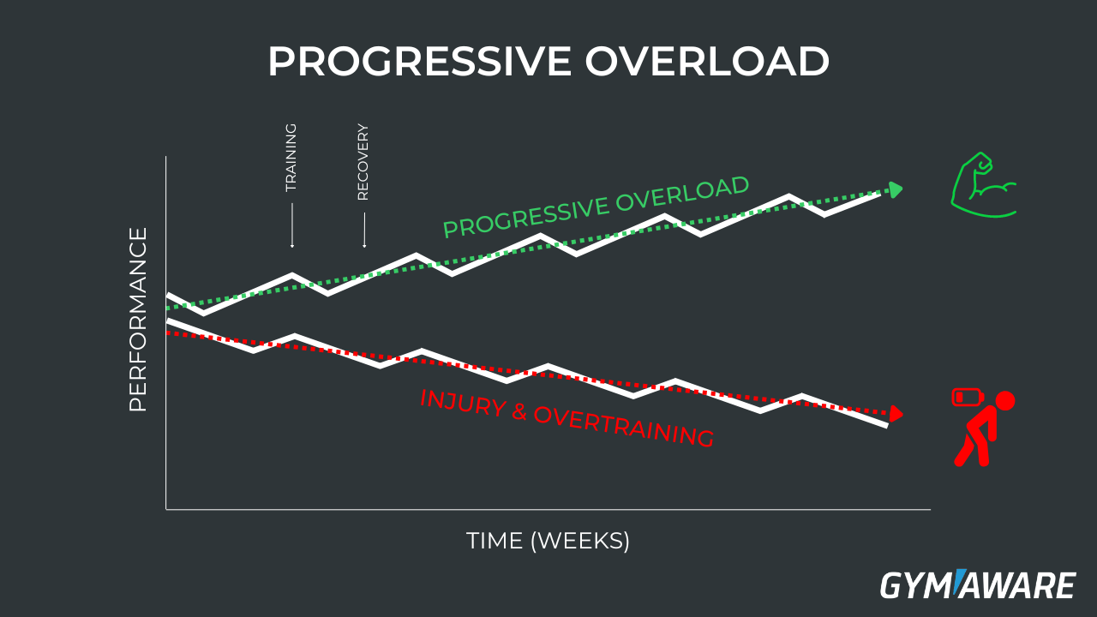
Overloading and overtraining
Overload and overtraining are related training concepts. Overload is a deliberate increase in training intensity or volume to stimulate adaptation and improve fitness, while overtraining is when the body is stressed beyond its capacity to recover, leading to performance decrements and potential injury. Overload is a necessary part of training, but when taken to extremes without adequate rest, it can lead to overtraining.
Overload:
Definition: Overload is the principle of increasing the demands placed on the body during exercise to promote improvement.
Purpose: It's a strategic way to challenge the body, forcing it to adapt and become stronger, faster, or more efficient.
Examples: Increasing weight lifted, adding more repetitions, shortening rest periods, or increasing the frequency or duration of workouts.
Key Principle: Overload should be progressive, meaning the demands are gradually increased over time to allow for adaptation and prevent injury.

Slide 9
Overloading and overtraining
Overtraining:
Definition: Overtraining is a state of excessive training stress that the body cannot recover from, leading to performance decline and potential health problems.
Symptoms: Symptoms can include fatigue, persistent muscle soreness, decreased motivation, increased resting heart rate, sleep disturbances, and increased susceptibility to illness.
Causes: Overtraining can result from excessive training volume, intensity, or frequency, insufficient rest and recovery, inadequate nutrition, and poor sleep.
Impact: Overtraining can negatively impact athletic performance, potentially leading to injuries and prolonged periods of rest and recovery.
Key Differences:
Intent: Overload is a planned and controlled increase in training stress, while overtraining is an unintended state of excessive stress.
Adaptation: Overload leads to positive adaptations, while overtraining leads to negative consequences.
Recovery: Overload allows for sufficient recovery and adaptation, while overtraining indicates a lack of recovery.

Slide 10
Fatigue and Staleness: Symptoms and Causes
Fatigue and staleness are related but distinct concepts, particularly in the context of athletic training. Fatigue is a general feeling of tiredness or lack of energy, while staleness, also known as overtraining syndrome, is a more severe, chronic condition characterized by both physical and psychological symptoms that can significantly impact performance.
Fatigue:
Definition: Fatigue is a common experience of tiredness or reduced energy levels. It can be a normal response to exertion, stress, or lack of sleep.
Causes: Fatigue can stem from various factors including insufficient sleep, poor nutrition, overexertion, stress, or underlying medical conditions.
Symptoms: Symptoms can include tiredness, decreased energy, difficulty concentrating, and reduced motivation.
Resolution: Fatigue is usually temporary and can be resolved with adequate rest, proper nutrition, and stress management.

Slide 11
Fatigue and Staleness: Symptoms and Causes
Staleness:
Definition: Staleness is a more serious, chronic condition that can develop from prolonged overtraining or insufficient recovery, leading to a decline in performance and well-being.
Causes: Staleness is often associated with an imbalance between training and recovery, where the body is not given enough time to repair and rebuild after intense physical or mental stress.
Symptoms: Symptoms include decreased performance, increased fatigue, muscle soreness, mood disturbances, and decreased motivation.
Resolution: Staleness requires a more proactive approach to recovery, including reduced training intensity and duration, increased rest, and potentially professional intervention.
Key Differences:
Severity: Fatigue is a temporary condition, while staleness is a more chronic and severe state.
Motivation: Stale athletes may still retain their physical energy and try to push through the fatigue, while burned-out athletes may lose motivation and desire to train.
Resolution: Fatigue can be resolved with rest, but staleness requires a more comprehensive approach to recovery that may involve reducing training load and seeking professional guidance.
In essence, fatigue is a common experience that can often be resolved with rest, while staleness is a more serious condition that requires careful attention and intervention to address the underlying imbalance between training and recovery.

Slide 12
Theories associated with fatigue
Several theories attempt to explain fatigue, broadly categorized into those focusing on physical mechanisms, cognitive processes, and motivational control. These theories consider factors like energy depletion, muscle damage, cognitive effort, and the individual's motivation and control strategies in managing task demands.
Here's a breakdown of key theories:
1. Physical Theories of Fatigue
Biomechanical Model: This model suggests fatigue arises from inefficiencies in movement, leading to increased energy expenditure, metabolic buildup, and potentially, core body temperature increase.
Energy Depletion Theory: This theory proposes that fatigue is a result of the depletion of energy stores, such as ATP, within muscle cells.
Muscle Damage Theory: This theory suggests that fatigue can stem from micro-damage to muscle fibers during exercise, leading to reduced force production and increased pain.
Central Governor Theory: This theory proposes that fatigue is regulated by the brain, which anticipates and limits muscle activity to prevent excessive damage.
Neurophysiological Theory (Change in Chronaxy): This theory, focusing on skeletal muscle, suggests fatigue is linked to changes in the excitability of nerve fibers supplying the muscles.

Slide 13
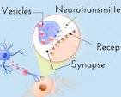
Theories associated with fatigue
2. Cognitive Theories of Fatigue
Central Fatigue Theory: This theory emphasizes the role of the brain in fatigue, suggesting that changes in neurotransmitter levels or neuronal activity in the brain can contribute to feelings of tiredness.
Cognitive Load Theory: This theory, particularly relevant to mental fatigue, suggests that excessive cognitive load (demands on working memory and attention) can lead to fatigue, impaired performance, and reduced learning.
Motivational Control Theory: This theory proposes that fatigue is a problem of managing cognitive control to maintain performance, rather than simply a lack of energy.
Compensatory Control Model: This model suggests that individuals may compensate for fatigue by increasing effort or adjusting their approach to a task, but these strategies can also contribute to fatigue.
Resource Depletion Model: This model suggests that individuals have limited cognitive resources, and fatigue occurs when these resources are depleted by prolonged or demanding tasks.
3. Motivational and Emotional Theories:
Emotional Exhaustion: This theory, often associated with burnout, suggests that emotional exhaustion is a consequence of prolonged exposure to work-related stressors, leading to feelings of cynicism, detachment, and reduced personal accomplishment.
Affective Component of Burnout: This theory highlights the role of negative emotions, such as cynicism, in contributing to burnout and fatigue.
Integrative Model of Fatigue: This model suggests that fatigue is influenced by a complex interplay of physiological, psychological, and motivational factors.

Slide 14
Theories associated with fatigue
4. Theories of Fatigue in Materials (Metal Fatigue):
Crack Initiation Theories: These theories, like the Manson-Coffin local strain approach, aim to predict when cracks will start to form in a material under cyclic loading.
Crack Growth Theories: These theories, often based on linear elastic fracture mechanics, focus on how cracks propagate through a material under stress.
Unified Theory of Metal Fatigue: This theory seeks to combine crack initiation and growth models into a single framework that explains fatigue failure at microscopic, macroscopic, and structural levels.
Random Fatigue: This theory considers the effects of random fluctuations in stress on fatigue life.
5. Other Relevant Theories:
Theory of Human Fatigue: This theory suggests that fatigue is a function of both workload and time, with a hyperbolic relationship between the two.
Healing in Fatigue: This theory explores the recovery process in materials, where rest periods can lead to some repair of damage, potentially extending fatigue life.
These theories provide a framework for understanding the multifaceted nature of fatigue and its causes, highlighting the interplay of physical, cognitive, and motivational factors. They also offer insights into how fatigue can affect different systems and contexts, from physical performance to mental work and material behavior.

Slide 15
Mechanisms and frequency of overtraining and overtraining syndrome
Overtraining (OT) occurs when training stress, both physical and non-physical, overwhelms an individual's ability to recover, leading to a decline in performance. Overtraining syndrome (OTS) is a more severe, chronic condition resulting from prolonged overtraining, characterized by persistent performance decrements despite rest, along with physiological and psychological symptoms. The frequency of OTS varies with studies showing between 30% and 60% of athletes experiencing some signs of overtraining.
Mechanisms of Overtraining and Overtraining Syndrome:
Intramuscular Mechanisms: Exhaustive exercise can lead to muscle damage, glycogen depletion, and disruptions in excitation-contraction coupling. Increased oxidative stress and inflammation are also implicated in skeletal muscle dysfunction associated with OTS.
Neuroendocrine Changes: Overtraining can disrupt the balance of hormones like cortisol and testosterone, potentially affecting mood, sleep, and immune function.
Central Nervous System Involvement: OTS can manifest as central fatigue, altered mood, and impaired cognitive function, suggesting a role for the brain in the syndrome.
Immunological Dysregulation: OTS may involve changes in immune cell function and heightened susceptibility to illness.

Slide 16
Mechanisms and frequency of overtraining and overtraining syndrome
Frequency of Overtraining and Overtraining Syndrome:
Overtraining (OT): This is a relatively common phenomenon during periods of intense training.
Overtraining Syndrome (OTS): A smaller percentage of athletes progress to OTS, which is a more serious and persistent condition.
Prevalence: Studies suggest that 30% to 60% of athletes may experience some signs of overtraining.
Individual Variation: The specific mechanisms and symptoms of OTS can vary between athletes and depend on the type of training and individual factors.
Progression from Training Fatigue to OTS:
Training fatigue can be a normal part of the training process, and with adequate recovery, performance can improve (functional overreaching). However, excessive training without sufficient recovery can lead to nonfunctional overreaching (NFOR) and eventually overtraining (OT), which can progress to overtraining syndrome (OTS) if not addressed.
Important Considerations:
Individualized Approach: Overtraining is not a one-size-fits-all condition, and athletes may respond differently to training loads.
Diagnosis of Exclusion: OTS is often a diagnosis of exclusion, meaning other potential causes of performance decline need to be ruled out.
Prevention is Key: Proper training periodization, adequate rest and recovery, proper nutrition, and monitoring of training load are crucial for preventing overtraining and OTS.

