Slide 1
Women in sports
Professor Dr. Md. Rezaul Karim-2
Department of Biochemistry and Molecular Biology
University of Rajshahi

Slide 2
male and female in structure and physiological limitations
Males generally have greater muscle mass, bone strength, and larger heart size, leading to higher absolute strength and power, while females tend to have a higher body fat percentage, smaller lung volumes, and lower hemoglobin levels, impacting oxygen delivery. Physiologically, males have a broader skeletal structure with wider shoulders and longer limbs, whereas females possess a wider pelvis. These structural and physiological differences create varying limitations and advantages, with females often exhibiting faster recovery and better endurance properties despite lower absolute power.
Male Structure & Physiology
Skeletal and Muscular System: Males typically have larger, stronger skeletons and greater muscle mass and strength, particularly in the upper body.
Cardiovascular System: Males generally have larger hearts and higher red blood cell counts, contributing to greater oxygen-carrying capacity.
Respiratory System: Males have larger lung volumes and a more predominantly diaphramatic breathing pattern.
Metabolism: Males exert greater absolute power during exercise.

Slide 3
male and female in structure and physiological limitations
Female Structure & Physiology
Skeletal and Muscular System: Females have a wider pelvis and a higher body fat percentage, which can impact skeletal and muscular function and overall strength.
Cardiovascular System: Females have smaller hearts, smaller lung volumes, and lower hemoglobin levels, which leads to lower oxygen delivery during high-intensity exercise.
Respiratory System: Females utilize ribcage muscles more, possibly to adapt to hormonal and anatomical changes during pregnancy, resulting in more pronounced thoracic breathing.
Metabolism: While having lower absolute power, females can exhibit better metabolic properties and faster recovery from exercise.
Physiological Limitations and Advantages
Males: Higher muscle mass and larger hearts allow for greater absolute strength and aerobic capacity.
Females: Lower absolute power output due to smaller muscle mass and cardiovascular limitations. However, this can be offset by better metabolic properties and greater muscle fatigue resistance during endurance exercises.

Slide 4
Hazards of women in sports
Women in sports face significant hazards including increased risks for musculoskeletal injuries like stress fractures and ACL tears, hormonal and metabolic issues such as the female athlete triad (eating disorders, amenorrhea, and osteoporosis), and serious psychological and social challenges including sexual abuse, discrimination, body image pressure, and mental health strain.
Musculoskeletal and Physical Hazards
Musculoskeletal and Physical Hazards
Increased Injury Risk: Female athletes are at a higher risk for certain injuries, such as stress fractures and anterior cruciate ligament (ACL) tears, which are common in lower extremities.
Joint Hypermobility: Females may have higher rates of joint hypermobility, which increases the risk of injury, although it can also enhance performance.
Overuse Injuries: Repetitive strain from sports can lead to conditions like shoulder injuries (rotator cuff strains, instability) particularly in overhead sports.

Slide 5
Hazards of women in sports
Hormonal and Metabolic Hazards
Female Athlete Triad: This condition involves three interrelated issues:
Disordered Eating: Inadequate energy intake to meet the demands of training.
Menstrual Disorders: Energy deficiency can disrupt hormonal function, leading to irregular or absent periods (amenorrhea).
Osteoporosis: Reduced bone mineral density due to hormonal imbalances, increasing the risk of stress fractures.
Relative Energy Deficiency in Sport (RED-S): Similar to the female athlete triad, this broader concept highlights how low energy availability impacts hormone balance and increases injury risk.

Slide 6
Hazards of women in sports
Psychological and Social Hazards
Sexual Abuse: A significant percentage of female athletes, particularly at the professional level, have experienced sexual abuse in sports, a rate higher than for male athletes.
Discrimination and Inequality: Women may face discrimination in sports, with their activities devalued and limited by societal biases.
Mental Health Strain: High-level sports can create significant psychological stressors, leading to mental health concerns and impacting athlete well-being.
Body Image Pressures: Awareness of body image and appearance can contribute to low self-esteem and embarrassment for female athletes.
Lack of Role Models: Fewer visible female role models in some age groups can impact confidence and participation.
Unwanted Scrutiny: Female athletes can experience uncomfortable stares and psychological pressure due to the opposite sex's attention, even if their clothing is appropriate for sports.

Slide 7
Sports Amenorrhea
Sports amenorrhea is the absence of a woman's menstrual periods, which can occur in female athletes due to the combination of high exercise intensity, low energy availability, and psychological stress. It is a form of functional hypothalamic amenorrhea and is considered a warning sign for potential health risks, including poor bone density and disordered eating behaviors, and is a component of the female athlete triad.
Causes
Sports amenorrhea is multifactorial, stemming from a disruption in the hypothalamic-pituitary-ovarian (HPO) axis. Key factors include:
High training load: Intense and prolonged exercise can act as a stressor on the body.
Low energy availability: When the energy an athlete consumes through nutrition doesn't meet the energy expended through exercise, it can suppress hormone production.
Psychological stress: Stress from training, competition, and even the pressure to maintain a low body weight can contribute to amenorrhea.
.

Slide 8
Sports Amenorrhea
Consequences
The absence of menstruation is not a normal or healthy adaptation to exercise and can signal other underlying health issues:
Low bone mineral density: This increases the risk of stress fractures and osteoporosis.
Disordered eating: The drive for thinness and high strength-to-weight ratio in some sports can lead to restrictive eating habits and eating disorders.
Impaired growth and development: This is particularly concerning in adolescent athletes, during a critical time for bone accrual.
Management
Addressing sports amenorrhea requires an interdisciplinary approach:
Energy balance: A sports dietitian can help ensure adequate calorie and nutrient intake to support normal bodily functions.
Training modification: Adjusting the volume and intensity of training can help reduce excessive stress.
Psychological support: A therapist can assist with stress management, body image concerns, and disordered eating behaviors.
Medical evaluation: A physician can monitor bone density, treat any associated bone loss, and conduct standard investigations

Slide 9
Injury to female reproductive tract
Injury to the female reproductive tract can cause vaginal bleeding, genital pain, bruising, swelling, and problems with urination. Causes vary from childbirth and sexual activity to accidental trauma, sexual assault, and female genital mutilation. Treatment depends on the severity and type of injury, ranging from rest and painkillers for minor injuries to surgery for severe bleeding or internal organ damage. Seek medical attention immediately for any significant trauma to assess the injury and receive appropriate treatment.
Symptoms
Symptoms can include: Genital pain or extreme groin pain, vaginal bleeding, bruising and swelling, redness, pain with or difficulty urinating, abdominal pain, faintness or vomiting, an embedded object, a foul-smelling discharge, fever,
Causes
Injuries can result from:
Childbirth: Tears sustained during labor and delivery.
Accidental trauma: Straddle injuries (e.g., from falls), auto accidents, or other blunt trauma.
Sexual activity: First sexual contact or using objects during sex can be risk factors.

Slide 10
Injury to female reproductive tract
Sexual assault: Direct trauma to the genital area.
Female Genital Mutilation (FGM): This is a form of deliberate trauma to the vulva.
Animal bites: Can also cause vulvar trauma.
Diagnosis
A healthcare provider will typically diagnose the injury through: A detailed discussion about the symptoms and how the trauma occurred. A thorough physical examination , which may include a pelvic exam.
Additional tests such as an ultrasound or X-ray to check for internal organ damage or an embedded object.
Treatment
Treatment varies depending on the severity of the injury: Mild injuries may only require rest, painkillers, and cold compresses for swelling.
More severe injuries with heavy bleeding or internal organ damage may need surgery.
Wound care: Cleaning the wound with mild soap and warm water and keeping the area dry.
When to Seek Care: Contact a doctor or seek medical care immediately if you experience symptoms like severe pain, significant bleeding, or trouble urinating. Early diagnosis and treatment are crucial for preventing complications and promoting healing.

Slide 11
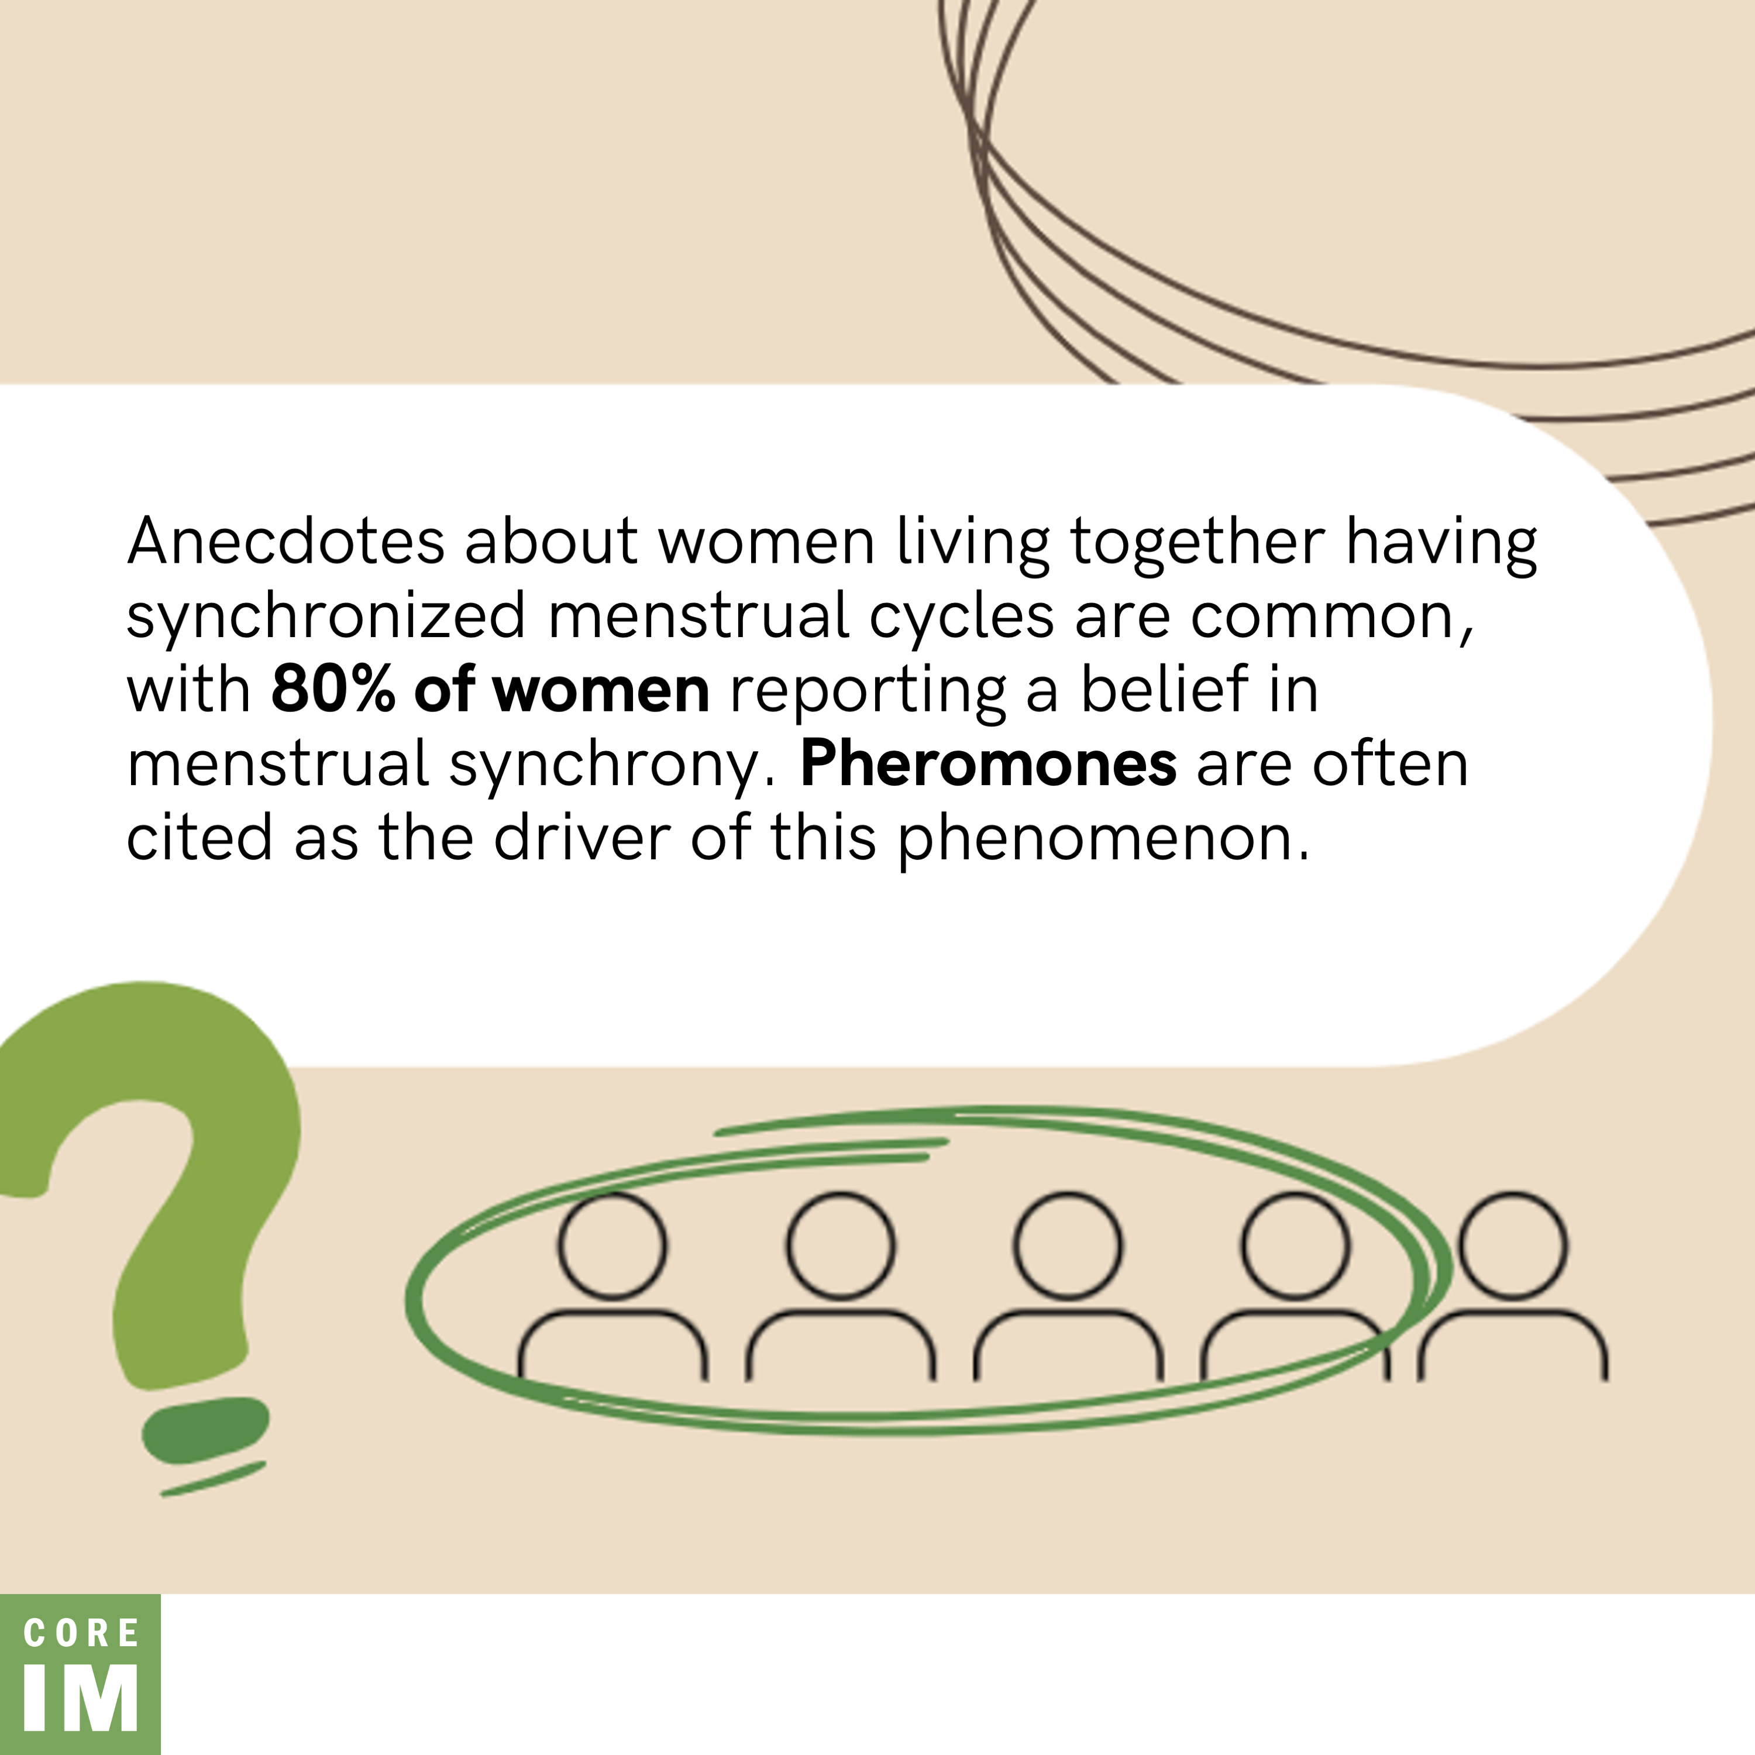
Menstrual Synchrony
Menstrual synchrony, also known as the McClintock effect, is the phenomenon where women living in close proximity experience their menstrual cycles aligning more closely in time. Though it was first described by Martha McClintock in 1971, modern research and larger studies have cast doubt on its validity, with many suggesting the effect could be due to chance, statistical anomalies in small sample sizes, or other factors rather than a true biological phenomenon.

Slide 12
Exercise and pregnancy
Exercise is beneficial and generally safe during pregnancy, providing energy, improving well-being, easing common discomforts like back pain, and preparing the body for labor and birth. Aim for at least 150 minutes of moderate-intensity aerobic activity per week, which can be broken into smaller sessions. Recommended activities include walking, swimming, and prenatal yoga. Avoid exercises with a risk of falling or abdominal trauma, and always consult a healthcare provider before starting or continuing an exercise program.
Benefits of Exercise During Pregnancy
Improved Overall Health: Boosts your sense of well-being and increases energy levels.
Easier Adaptation to Pregnancy: Helps your body adjust to the physical changes of pregnancy, including weight gain.
Reduced Discomforts: Can alleviate common pregnancy symptoms like back pain, constipation, and swelling in the legs and feet.
Preparation for Labor: Builds strength in the back, abdomen, and pelvic floor, and can help with managing stress and sleep.
Reduced Risk of Complications: Lowers the risk of complications such as gestational diabetes and preeclampsia.

Slide 13
Exercise and pregnancy
Recommendations for Exercise
Aim for 150 minutes of moderate-intensity aerobic activity per week. Moderate intensity means you can talk, but can't sing
during exercise. Warm up before exercising and cool down afterwards.
Stay hydrated and don't exhaust yourself.
Listen to your body and slow down if needed.
Safe Exercises
Walking: A great way to get your heart rate up.
Swimming: Eases pressure on your back and is a good full-body workout.
Prenatal Yoga: Can improve flexibility and help you practice relaxation and breathing techniques.
Pelvic Floor Exercises (Kegels): Strengthen the muscles that support your pelvic organs.

Slide 14
Exercise and pregnancy
Exercises to Avoid
Activities with a high risk of falling or contact trauma, such as contact sports (basketball, soccer), horseback riding, and downhill skiing.
Hot Yoga or Hot Pilates: Can lead to overheating and dehydration.
Scuba Diving .
Exercising at High Altitudes (over 6,000 feet).
Any exercises that make you breathless or cause discomfort.
When to Consult a Doctor or Midwife
It's essential to talk to your doctor or midwife before starting or continuing an exercise program. They can advise you on appropriate exercises based on your health and pregnancy. Stop exercising and seek medical advice if you experience any warning signs, such as vaginal bleeding, dizziness, or pain.

Slide 15
Eating disorders in athlets
What are Eating Disorders?
Serious mental health illnesses characterized by severe disturbances in eating behaviors.
Involve an unhealthy preoccupation with body weight or shape.
Can have serious physical consequences.
Eating disorders (EDs) in athletes cause significant physiological and metabolic imbalances, primarily driven by a state of low energy availability (LEA), where energy intake fails to meet the body's energy expenditure. This deficit disrupts numerous bodily systems, including the cardiovascular, endocrine, and musculoskeletal systems, with distinct consequences for male and female athletes.

Slide 16
Common Eating Disorders in Athletes
Anorexia Nervosa: Characterized by weight loss, restriction of food, intense fear of gaining weight, and distorted body image.
Bulimia Nervosa: Involves episodes of binge eating followed by compensatory behaviors like self-induced vomiting, excessive exercise, or laxative misuse.
Binge Eating Disorder (BED): Recurrent episodes of eating large quantities of food, often accompanied by a sense of loss of control.
Other Specified Feeding or Eating Disorders (OSFED): Clinical eating disorders that do not meet the full criteria for anorexia or bulimia, but still have significant consequences.
Relative Energy Deficiency in Sport (RED-S): Formerly known as the "Female Athlete Triad," this broader term describes health and performance issues caused by low energy availability in both male and female athletes.

Slide 17
Why are Athletes Vulnerable?
Performance Pressure: Belief that a lower body weight will lead to better performance.
Aesthetic Sports: Focus on leanness or a specific body shape (e.g., gymnastics, diving, ballet).
Weight-Category Sports: Need to "make weight" for competition (e.g., wrestling, martial arts).
Endurance Sports: Emphasis on low body weight to improve speed or endurance (e.g., long-distance running).
Personality Traits: Athletes tend toward perfectionism, a desire for control, and high achievement, which are also associated with eating disorders.

Slide 18
Recognizing the Signs
Physical Warning Signs:
Significant or frequent weight fluctuations.
Chronic fatigue or decreased energy.
Frequent injuries, including stress fractures.
Changes in menstrual cycle (amenorrhea) in female athletes.
Gastrointestinal problems (bloating, constipation).
Feeling cold constantly.
Dental problems from vomiting.
Behavioral Warning Signs:
Obsessive preoccupation with weight, body composition, and calories.
Selective eating or avoiding team meals.
Ritualistic eating patterns.
Compulsive or excessive exercise beyond training requirements.
Persistent use of laxatives or diuretics.

Slide 19
Recognizing the Signs
Psychological Warning Signs:
Mood swings, irritability, or increased anxiety and depression.
Social withdrawal from teammates.
Negative self-talk and poor body image.
Inability to take rest days without guilt.
Impact on Performance and Health:
Reduced strength, speed, and endurance.
Poor concentration and focus.
Increased risk of injury and longer recovery time.
Bone density loss, increasing fracture risk.
Cardiac complications, including low heart rate and blood pressure.
Dehydration and electrolyte imbalances, which can be fatal.
Gastrointestinal distress and organ damage.

Slide 20
Prevention Strategies
For Athletes:
Focus on performance and health, not on weight or body image.
Seek guidance from a sports dietitian for healthy nutrition.
Communicate with coaches and support staff about concerns.
For Coaches and Parents:
Emphasize nutrition for fuel and performance, not for weight control.
Avoid weighing athletes or making comments about their weight.
Encourage athletes to listen to their bodies and take rest days.
Foster an environment of open communication and trust.
For Organizations:
Provide education on eating disorders for all athletes and staff.
Implement screening procedures during pre-participation physicals.

Slide 21
Treatment and Recovery
Multidisciplinary Team Approach:
Medical Evaluation: To address physical health issues.
Nutritional Counseling: To develop a balanced eating plan.
Psychotherapy: Such as Cognitive Behavioral Therapy (CBT), to address the underlying psychological issues.
Temporary Break from Sport: It is often necessary for athletes to take a step back to focus fully on recovery.
Support System: Coaches, parents, teammates, and trainers all play a role in supporting the athlete's recovery.
Conclusion
Eating disorders are serious and prevalent in the athletic community, but they are treatable by increasing awareness and promoting a culture of health and support, we can help athletes achieve their full potential while protecting their long-term well-being.
Prioritizing the athlete's overall health is the best way to help them play the "long game" and return to the sport they love.

