Slide 1
The Economics of Sustainable Development
Chapter 06

Slide 2
Chapter Outline
After reading this chapter, you will be familiar with the following:
  • the link between biophysical limits and economics of sustainable development;
  • sustainable development as defined by the Brundtland Commission report;
  • the problem of defining sustainable economic development;
  • sustainability and the nature of the relationship between human and nature capital;
  • trade-offs between intergenerational efficiency and equity;
  • the Hartwick-Solow approach to sustainability;
  • the ecological economic approach to sustainability;
  • the safe minimum standard (SMS) approach to sustainability;
  • sustainable national income account.

Slide 3
Introduction
Sustainable development links economy and environment
Focus on long-term resource use
Concern for future generations
A response to environmental degradation

Slide 4
What is Sustainable Development?
Meets present needs
Does not compromise future generations
Balances growth, environment, equity
    Balances:
    Economic growth
    Environmental protection
    Social equity
Emphasize the intergenerational responsibility concept.

Slide 5
What is Sustainable Development?
The World Commission on Environment and Development (WCED), famously known as the Brundtland Commission, defined sustainable development in its 1987 report Our Common Future as:
"Development that meets the needs of the present without compromising the ability of future generations to meet their own needs."

Slide 6
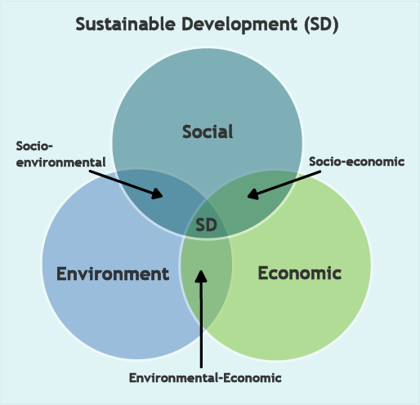
What is Sustainable Development?

Slide 7
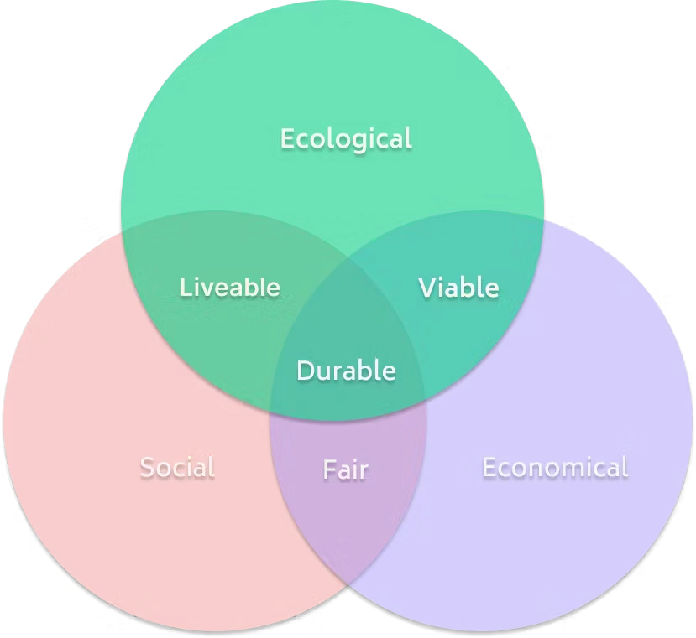
What is Sustainable Development?

Slide 8
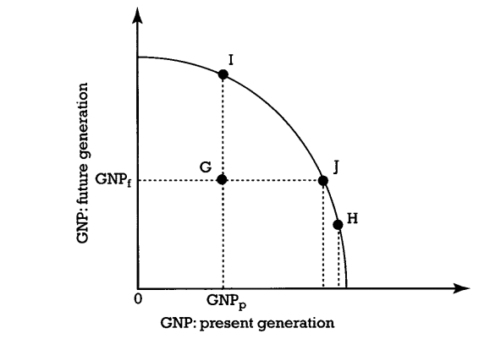
Trade-offs between intergenerational efficiency and equity

Slide 9
Key Sustainability Questions
Issues
Often vague and hard to measure
Different interpretations across disciplines
Questions
Can growth continue indefinitely?
Are natural resources replaceable?

Slide 10
Hartwick-Solow Approach
Based on neoclassical economics
Focus on capital substitution
Rule:
  Invest resource rents into man-made capital
Notes:
This approach assumes natural resources can be replaced by human-made capital.

Slide 11
Hartwick Rule
Maintain constant consumption over time
Use profits from resource depletion for investment
Ensures intergenerational equity
Notes:
Key idea: future generations should not be worse off.

Slide 12
Limitations of Hartwick-Solow Approach
Assumes perfect substitutability
Ignores ecological limits
Overlooks irreversible environmental damage
Notes:
This approach is often criticized by ecological economists.

Slide 13
Ecological Economics Approach
Economy is part of ecosystem
Natural capital is not fully replaceable
Focus on:
  Carrying capacity
  Sustainability limits
Notes:
This approach emphasizes the physical limits imposed by nature.
Protection of the Sundarbans reflects the ecological approach, as it cannot be replaced by man-made capital.

Slide 14
Key Features of Ecological Approach
Strong sustainability
Preserve natural capital
Respect ecological thresholds
Maintain biodiversity
Notes:
Natural resources are seen as essential, not optional.

Slide 15
Safe Minimum Standard (SMS) Approach
Prevent irreversible environmental damage
Maintain minimum resource levels
Act under uncertainty
Notes:
Better to be cautious when environmental damage is uncertain but potentially severe.

Slide 16
Safe Minimum Standard (SMS) Principle
Avoid critical environmental loss
Exceptions only if:
  Costs are extremely high
Notes:
This is a precautionary approach to sustainability.

Slide 17
Sustainable National Income
Traditional GDP is misleading
Does not include:
  Resource depletion
  Environmental damage
Notes:
GDP may increase even when environment deteriorates.

Slide 18


Green Accounting
Adjust GDP for:
  Environmental costs
  Resource depletion
Called “Green GDP”
Notes:
Provides a more realistic measure of welfare.
Notes:
DHC is the depreciation allowance of human capital; DNC is the depreciation of natural capital. EDE represents the environmentally defensive expenditures.

Slide 19
Trade-offs in Sustainability
Efficiency vs equity
Present vs future consumption
Growth vs environment
Notes:
Policy decisions often involve difficult trade-offs.

Slide 20
Intergenerational Equity
Fair distribution across generations
Ethical responsibility
Long-term planning required
Notes:
Sustainability is as much ethical as economic.

Slide 21
Policy Implications
Environmental regulation
Investment in renewable resources
Sustainable resource management
Global cooperation
Notes:
Policies must integrate economics and ecology.

Slide 22
Real-World Relevance
Climate change
Resource depletion
Biodiversity loss
Sustainable development goals (SDGs)
Notes:
These issues make sustainability a global priority.

Slide 23
Summary
Multiple approaches to sustainability
No single solution
Balance between economy and environment
Importance of long-term thinking
Notes:
Highlight differences between neoclassical and ecological views.

Slide 24
Conclusion
Sustainability is essential for future survival
Requires economic + ecological integration
Policy and ethical commitment needed
Notes:
End with a strong message about responsibility and action.

Slide 25
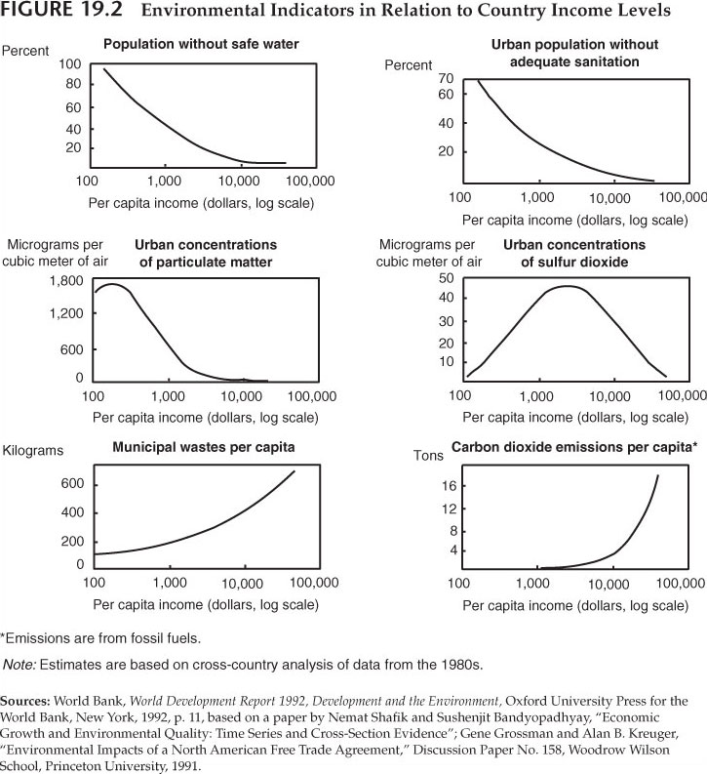
Economy and Environment

Slide 26
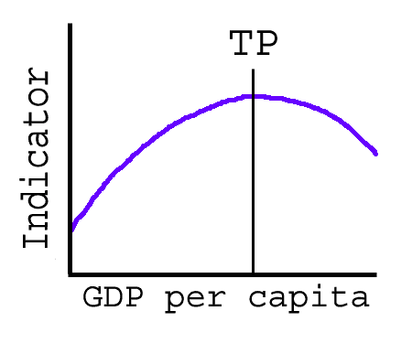
Environment Kuznets Curve (EKC)

Slide 27
EKC
In the 1990s several studies found evidence suggesting, in the early stages of economic growth (with average income rising from a low level) environmental degradation increases,
At some stage in economic growth (at some income level) pollution ceases to increase and subsequently decreases.
Graphically, this relationship shows an inverted U-shaped curve when degradation per capita (y axis) is plotted against GDP per capita (x axis).

Slide 28
Pollution Haven Hypothesis
Based on the view that “ developing countries may be acting as pollution havens, places where firms can move and operate without the strict environmental controls of the developed country”

Slide 29
Pollution Haven Hypothesis: Two Parts
Stringent Environment Standards in industrialized countries are causing some firms especially ‘pollution intensive’ ones to flee to countries with less stringent standards.
Developing countries have tried with some success to attract pollution intensive firms with the promise of lower pollution control standards in the hope of bolstering their rate of economic growth
(Field & Field, 2009)

Slide 30
Pollution Haven Hypothesis
Empirical Evidence
The evidence supporting PHH is mixed.
Some studies find that environmental regulations influence trade patterns and investment decisions, particularly in sectors like chemicals, metals, and paper.
Others argue that factors like labor costs, market access, and infrastructure play a more significant role.

