Slide 1
Hello Everyone Good Afternoon
Hope you all are fine

Slide 2
Hey folks what’s up
Hope you all are doing good

Slide 3
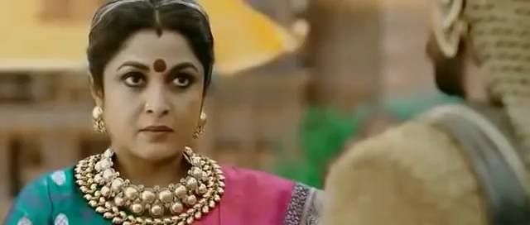
Formal Communication

Slide 4
Today’s Content
1.Meaning of formal and informal communication
2.Features of formal and informal communication
3.Types of informal communication
4.Rumors through informal communication
5.Comparison between formal and informal communication.

Slide 5
Formal Communication
When some established systems, procedures, rules , regulations, or any other prescribed ways and means are followed in transmitting a message , the process is called formal communication.
According to Bartoal and Martin, “Formal communication refers to vertical and horizontal communication that flows path specified by the official hierarchical organizational structure and related task requirements.”
According to Bovee and his associates, “Formal communication is the flow of information that is dictated by the organization’s official structure.”

Slide 6

Informal Communication

Slide 7
Informal Communication
Communication which does not follow any official or prescribed rules and procedures is called informal communication. The informal communications are based on the personal or informal relations such as friends, peers, family, club members, etc. and thus is free from the organizational conventional rules and other formalities. In the business context, the informal communication is called as a “grapevine” as it is difficult to define the beginning and end of the communication.

Slide 8
Types of Informal Communication
There are four types of Informal Communication (Grapevine) network that show how the communication is facilitated. These are:
Single Strand Chain
Gossip Chain
Probability Chain
Cluster Chain

Slide 9
Features of Formal Communication
1. Prescribed channel
2. Documentation of formal elements
3. Communication flow
4.Direction of communication
5. Jurisdiction.

Slide 10
Features of Informal Communication
1. Bigger Impact
2. Pervasive
3. Flexibility
4. Speed
5.Distortion
6. Oral Mode
7. Many Receivers
8. Unusual Ability
9.Unsaid Information
10.Contradictory Information

Slide 11
Rumors through informal communication
How rumors spread through informal communication stated below:
1.Lack of Understanding
2. Absence of set rules
3. Fabrication
4. Inattention
5. Cheap Admiration
6. No Control

Slide 12
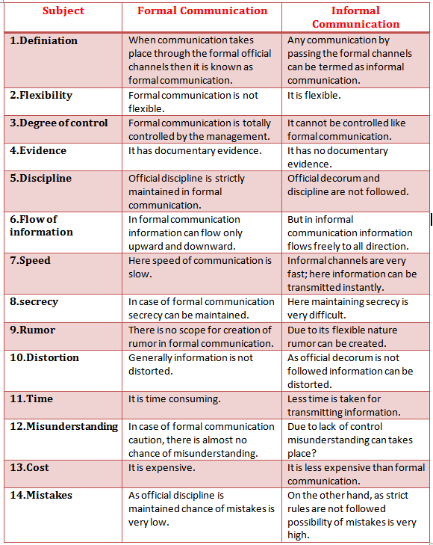
Comparison between formal and informal communication

Slide 13

End of the session

