Slide 1
9th class
Good Morning Everyone

Slide 2
Today’s Content
1. Meaning of business letter
2.Essential conditions of ideal business letter
3.Functions of a business letter
4.Planning a business letter.

Slide 3
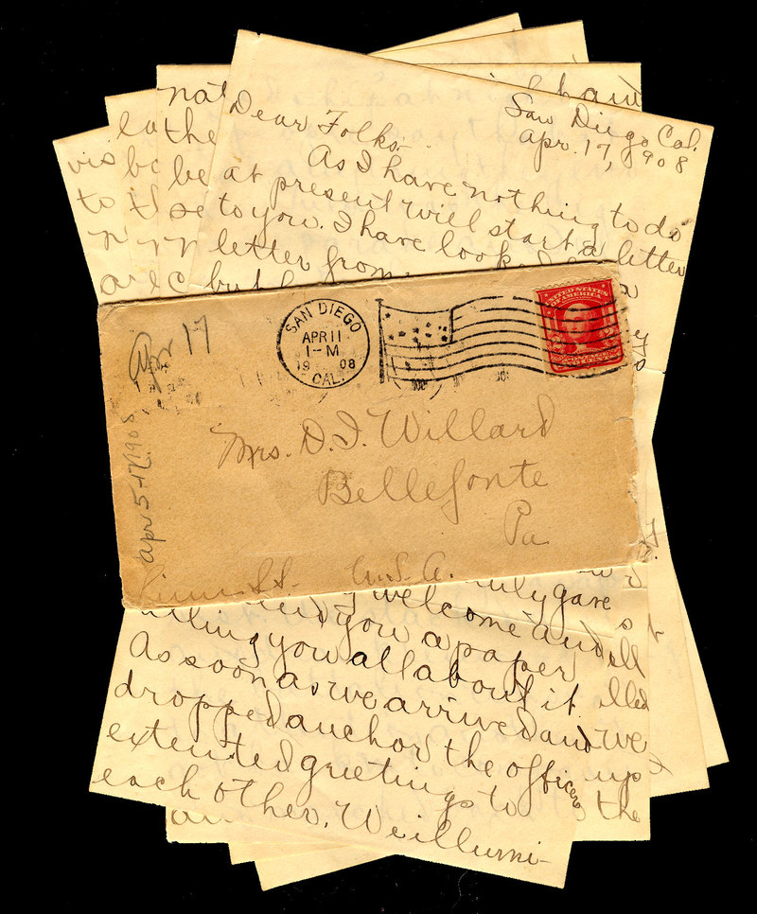
Letter
A written message from one person to another, usually put in an envelope and sent by post.

Slide 4
Types of Letter
1. Business Letter
2. Employee Letter
3. Informational Letter
4.Job Application Letter
5.Interview Letter
6.Job Offer Letter
7.Recommendation Letter
8.Resignation Letter
9.Thank You, Appreciation and Congratulations Letter.

Slide 5
Business Letter
According to W.J Weston “ Any written thing directed to conduct business is called a business letter.”

Slide 6
Essential Conditions of ideal business letter
1. Definite Structure 13. Coherence
2. Planning 14. Appropriate timing
3, Simplicity 15. Inducing
4. Conciseness 16. Tact
5. Relevance 17. The positive and pleasant approach
6. Completeness 18. Sincerity
7. Specific Purpose
8. Clearness
9. Free from error
10. Attractive format
11. Courtesy
12. You attitude

Slide 7
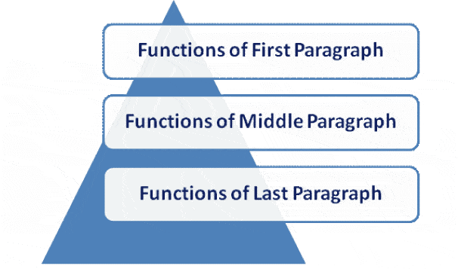
Functions of a business letter

Slide 8
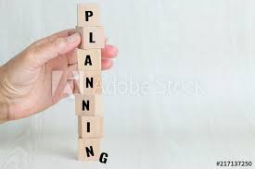
Planning a business letter
Steps of Planning
Determine the main purpose
Identify the secondary purpose
Gather relevant information
Evaluate the readers position
Determine the approach.

Slide 9
End of the Session

