Slide 1
Good Afternoon
Class no 10….

Slide 2
Public Speaking and Oral Presentation

Slide 3
Today’s Content
1. Meaning of public speaking
2. Difference between public speaking and oral communication.
3. Delivery methods.

Slide 4
Public Speaking
Basically, it's a presentation that's given live before an audience. Public speeches can cover a wide variety of different topics. The goal of the speech may be to educate, entertain, or influence the listeners. Often, visual aids in the form of an electronic slideshow are used to supplement the speech and make it more interesting to the listeners.

Slide 5
Importance of Public Speaking
Over the years, public speaking has played a major role in education, government, and business. Words have the power to inform, persuade, educate, and even entertain. And the spoken word can be even more powerful than the written word in the hands of the right speaker.
Whether you're a small business owner, a student, or just someone who's passionate about something—you'll benefit if you improve your public speaking skills, both personally and professionally. Some benefits to public speaking include:
Improves confidence
Better research skills
Stronger deductive skills
Ability to advocate for causes
And more

Slide 6
How to Become Better at Public Speaking
The truth is that public speaking is a skill. It can be learned. While some people may have more natural speaking ability than others, or a more pleasing voice, or are more charismatic—anyone who can speak can learn to be a better public speaker than they are right now. It just takes some know-how and some effort.
To help you become better at public speaking, we'll take a look at these four areas:
Writing the speech
Overcoming a fear of speaking
Practicing the speech
Giving the speech

Slide 7
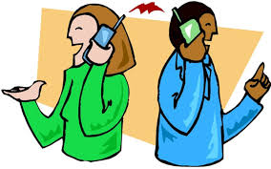
Difference Between Public Speaking and Oral Communication

Slide 8
Delivery Methods
Memorizing
Reading
Extemporaneous Speaking
Impromptu Speaking

Slide 9
End of Today’s Session

