Slide 1
Good Afternoon
Business Communication 122

Slide 2
Today’s Content
1. Delivery Methods ( During and after the presentation).
2. Types of visual aids
3. Practicing Oral Presentation
4.Guidelines for improving good voice qualities.

Slide 3
Delivery Methods
During Presentation……….
The following techniques can be used during your presentation:
1.Do not rush the opening
2. Begin with a pause
3. Begin from memory
4. Maintain eye contact
5. Control voice
6. Avoid annoying speech habits
7. Put the breaks on.
And many more…..

Slide 4
Delivery Methods
After Presentation……..( Q & A session)
The following are useful after your presentation:
Distribute handouts
Encourage questions
Repeat questions
Ask for clarification
Answer the questions
Admit your unknowing
Handle politely
And many more……….

Slide 5
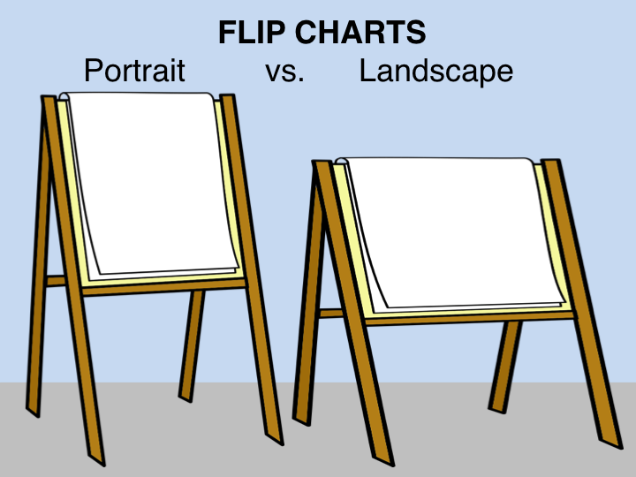
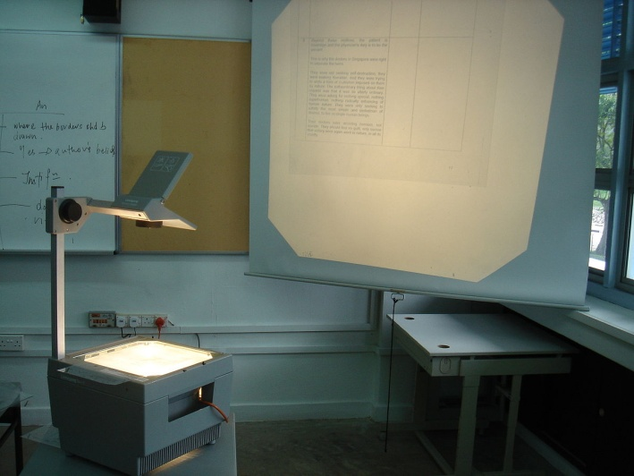
Types of Visual Aids

Slide 6
Practicing oral presentation
1. Phonation
2. Articulation
3. Pronunciation

Slide 7
Guidelines for improving Good voice quality
1. Breath properly and Relax
2. Listen to yourself
3.Use voice exercises
4. Record phone conversations
5. Eat and drink well

Slide 8
End of the session

