Slide 1
Principles of Marketing
Class No. 2

Slide 2
Marketing
A story of Nike………….

Slide 3
About Philip Kotler ????

Slide 4
What is Marketing
*The history of the marketing is found in the beginning of the civilization.
* Marketing as a topic appeared at the first half of the 20th century with reference to the process of distribution and the determination of price through the demand and supply paved the way for studies in marketing. That’s why economics is known as the mother of Marketing.

Slide 5
What is Marketing

Slide 6
What is Marketing
Identify and Meet the Needs of Consumer
Customer Needs
Met Needs Unmet Needs

Slide 7
Marketing By Mr. Kotler

Slide 8
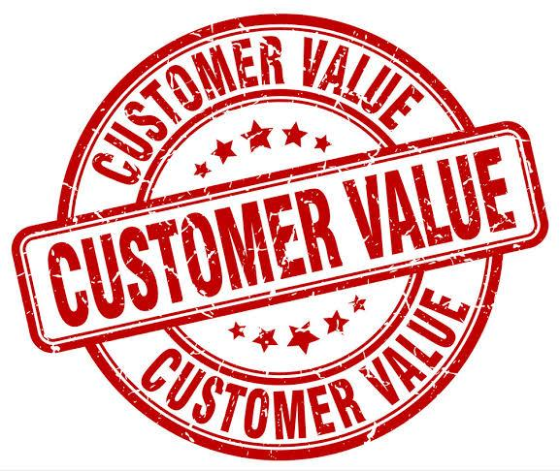
Customer Value
Customer value is the ratio between customers perceived benefits (economic, functional, psychological) and the resources(monetary, time, effort, psychological) used to obtain these benefits.

Slide 9
American Marketing Association(AMA)
Marketing is the activity, set of institutions, and processes for creating, communicating, delivering, and exchanging offerings, that have value for customers, clients, partners and society at large.

Slide 10
End of the Session

