Slide 1
Phytochemistry
Ashik Mosaddik

Slide 14
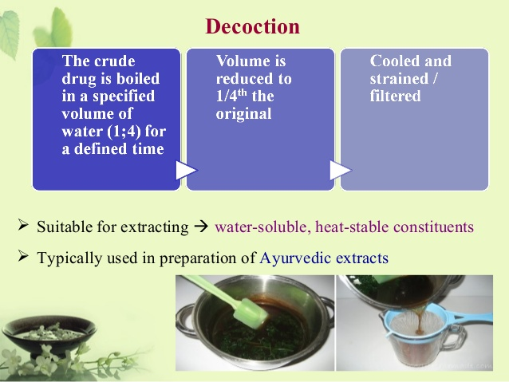

Slide 23
