Slide 1
Principles Of Marketing
4th slide

Slide 2
Today’s Content
Designing customer driven marketing strategy.
( Market segmentation, targeting, differentiation and positioning).
Marketing mix.

Slide 3
Designing customer driven marketing strategy

Slide 4
Market Segmentation
Dividing a market into distinct groups with distinct needs, characteristics or behavior who might require separate products or marketing mixes.

Slide 6
Geographic segmentation
Geographic segmentation is a common strategy when you serve customers in a particular area, or when your broad target audience has different preferences based on where they are located. It involves grouping potential customers by country, state, region, city or even neighborhood.

Slide 7
Demographic Segmentation
Demographic segmentation is defined as a market segmentation method based on variables such as age, gender, income etc. ... In marketing, it defines people that form a specific market for a product or a service based on demographics.

Slide 8
Psychographic Segmentation
Psychographic segmentation is a method used to group prospective, current or previous customers by their shared personality traits, beliefs, values, attitudes, interests, and lifestyles and other factors. These characteristics may be observable or not.

Slide 9
Psychographic Segmentation

Slide 10
Demographics vs Psychographics

Slide 11
Behavioral Segmentation

Slide 12
Targeting
Once the firm has decided its market segments then it has to decide how many segments to be selected for targeting purpose. Market targeting is a process of capturing the target market to cultivate profit.

Slide 13
Differentiation
Differentiation is a marketing strategy that businesses employ to make their products unique and stand out from competitors. It is the typical strategy for industries for which multiple competitors produce identical or very similar products.

Slide 14
Differentiation
The key objective of differentiation is to make a product more attractive in comparison with other directly competing products. Successful product differentiation strategy creates a competitive advantage for the producer because customers perceive these products as unique or superior. Recognizable examples of differentiation are attractive packaging or new promotional stories behind the products. Producers often decide to differentiate by introducing innovative features, which might be more difficult to recognize for customers.

Slide 15
Differentiation

Slide 16
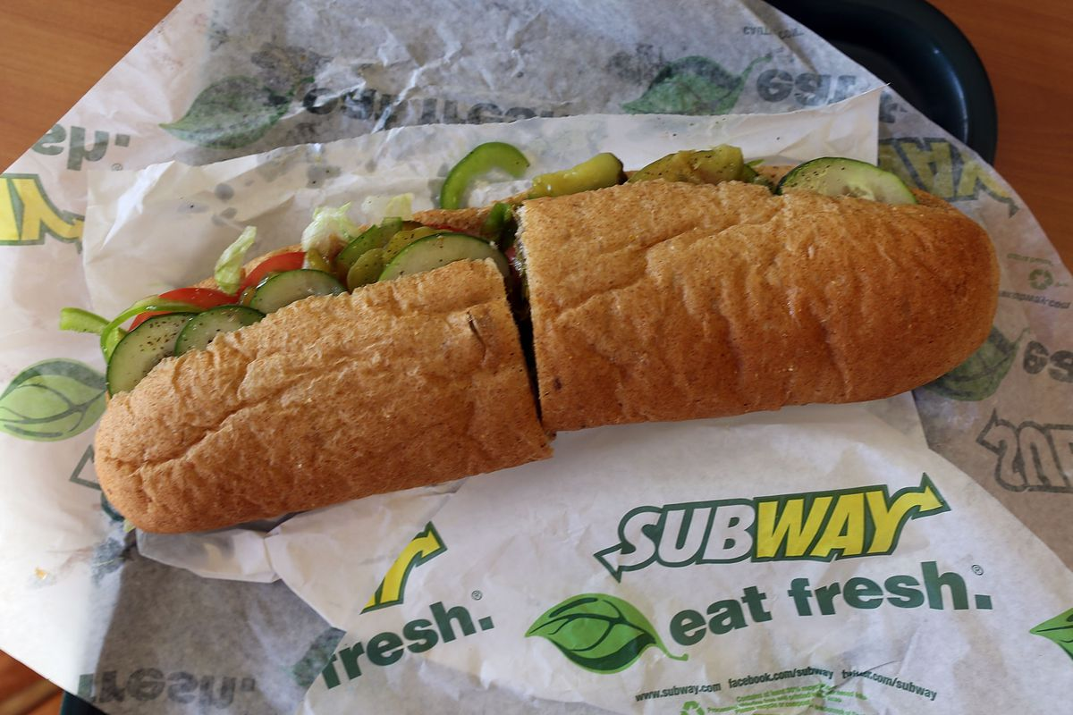
Positioning
Arranging for a product to occupy a clear, distinctive and desirable place relative to competing products in the minds of target consumers.

