Slide 1
Design approaches in rock mechanics
Younus Ahmed Khan

Slide 2
Problem solving
(i) a brief but concise statement as to what is being sought;
(ii) a listing of pertinent known data;
(iii) a sketch of the “structure” for analysis showing in particular the applied loads and reactions;
(iv) the equations and assumptions used; and
(v) an outline of the major calculational steps taken in obtaining the desired results. Some of these steps may be combined as circumstances allow
Background information
Rock mechanics literatures
Mechanical properties of rock
Review of state of stress, deformation history, strain and elasticity

Slide 3
Shafts & their design
Younus Ahmed Khan

Slide 4
Shafts
Shafts are vital access ways for underground mines. They provide passageways for personnel, materials, and ventilation air.
Vertical shafts are common, but inclines are also used.
Shafts must be engineered for a long, stable design life; they must be safe at all points along the shaft route.
Where the rock mass is strong and the in situ stress is low, an unlined shaft may be acceptable, for example, a ventilation shaft, but usually some provision is needed for preventing loose rock from cascading down the shaft. Even small rock fragments can do great harm after falling from considerable height.

Slide 5
Protection during shaft sinking
Rock bolts, steel strapping, wire mesh, screen of some type, lacing, and lagging are commonly used to prevent minor falls of rock in shafts and are usually installed during shaft sinking.
A relatively thin concrete liner serves the same purpose and also provides a smooth surface that reduces air friction loss in ventilation shafts.
If the safety factor of the unlined, unsupported shaft wall is acceptable shaft framing would be enough for protection

Slide 6
Shaft framing
Materials for Shaft framing may be wood or steel, although steel is the most commonly used material today.
Shaft framing partitions the shaft space into compartments for hoisting personnel and material, and for utilities (electrical power, compressed air, drill water, and pump water) as well as for ladders that allow passage of personnel.
Spacing of shaft framing is variable but generally of the order of feet or meters.
Ends of shaft framing are usually placed in notches excavated in the shaft walls (bearing sets), but may also rest on bearing plates (ledges) bolted to the walls

Slide 7
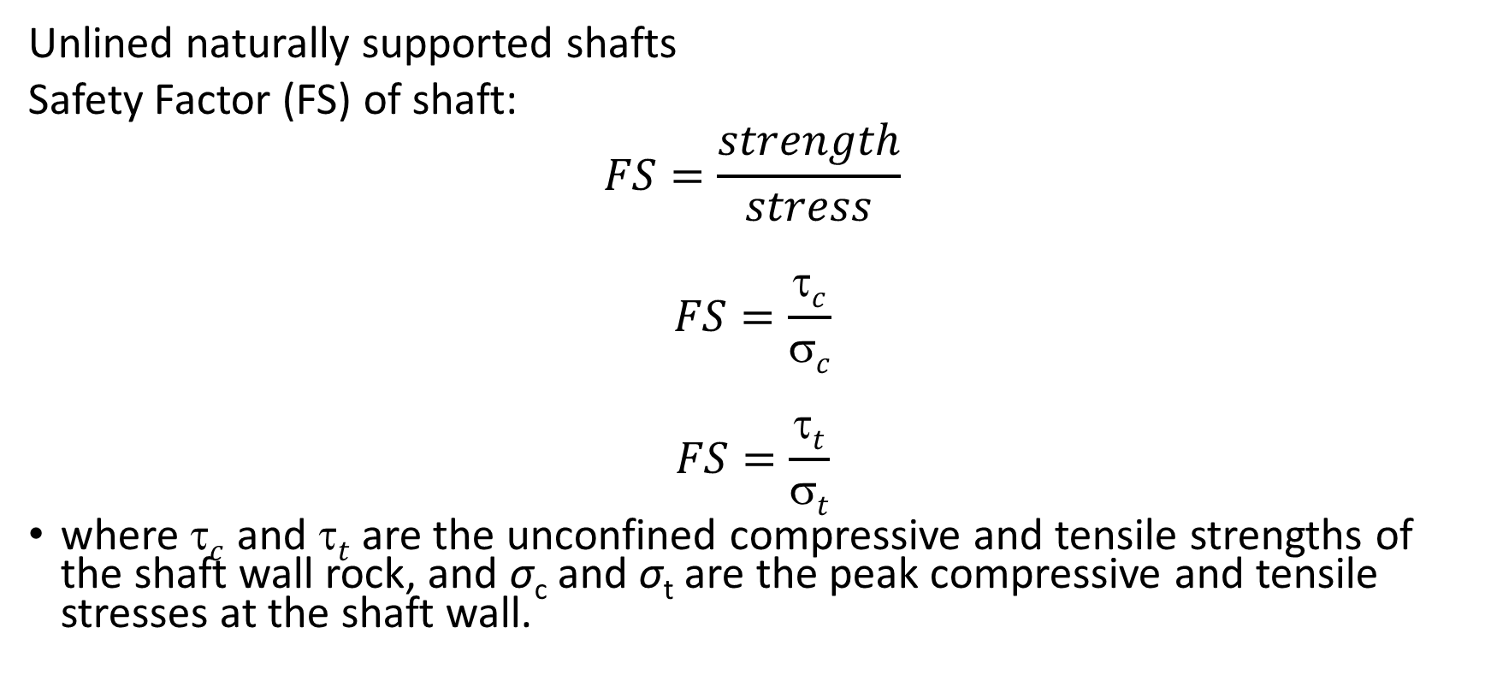
Shaft design
Unlined naturally supported shafts
Safety Factor (FS) of shaft:
$$FS=\frac{strength}{stress}$$
$$FS=\frac{τc}{σc}$$
$$FS=\frac{τt}{σt}$$
where $c$ and $t$ are the unconfined compressive and tensile strengths of the shaft wall rock, and σ_{c} and σ_{t} are the peak compressive and tensile stresses at the shaft wall.

Slide 8
Shaft design
Safety factors of 2 to 4 in compression and 4 to 8 in tension have been suggested (Obert et al., 1960).
Rock mass response to induced stress
Determining the requisite strength and stress requires thoughtful attention to details of rock mass strength and stress and how they may be influenced by shaft route geology. Within the elastic range of stress, shaft wall displacements remain small. These conditions may not always be met.
For examples,
An important exception occurs when a shaft route penetrates bedded salt that behaves much like a highly viscous fluid.
Shales may also exhibit a significant time-dependent component of displacement and lead to “squeezing” ground.
Densely jointed rock masses may tend to flow because of joint alteration mineralogy and inelasticity.
The presence of acid mine waters, saline solutions, and liquid and gaseous hydrocarbons may further complicate a rock mass response to stresses induced by shaft excavation.

Slide 9
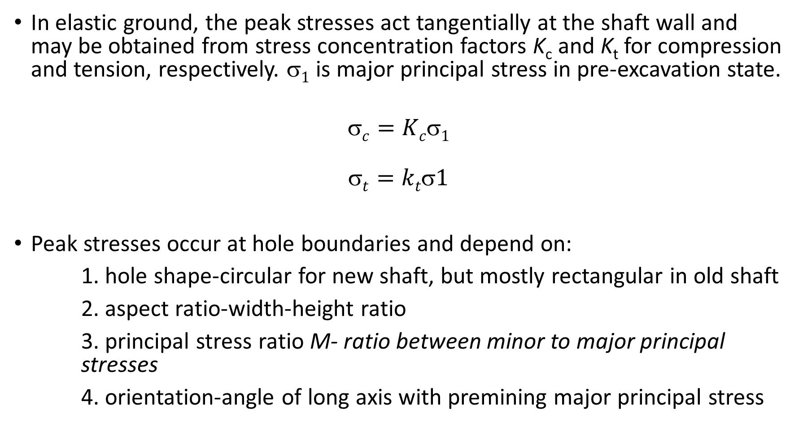
Shaft wall stress concentration
In elastic ground, the peak stresses act tangentially at the shaft wall and may be obtained from stress concentration factors K_{c} and K_{t} for compression and tension, respectively. $1$ is major principal stress in pre-excavation state.
$$c=Kc1$$
$$t=kt1$$
Peak stresses occur at hole boundaries and depend on:
1. hole shape-circular for new shaft, but mostly rectangular in old shaft
2. aspect ratio-width-height ratio
3. principal stress ratio M- ratio between minor to major principal stresses
4. orientation-angle of long axis with premining major principal stress

Slide 10
Unlined circular Shaft
In linearly elastic, homogeneous, isotropic rock, the circumferential (tangential) normal stress at the shaft wall is
σ_{t} = (σ₁ + σ₃) − 2(σ₁ − σ₃) cos(2θ)
where σ₁ and σ₃ are the major and minor applied (preshaft) principal stresses and θ is the angle from the direction of σ₁ to the point of action of σ_{t}
Circumferential stress concentration K at the shaft wall is then
K = (1 + M) − 2(1 − M) cos(2θ)
where M is the ratio of preshaft minor to major principal stress and θ is a counterclockwise angle from σ₁ to the point of stres concentration at the shaft wall

Slide 11
Unlined circular Shaft
This is similar in each quadrant, so only the first quadrant needs to be examined. Maximum and minimum values of K occur at 0◦ and 90◦ in this quadrant and have values
K_{max} = (3 − M) and K_{min} = (−1 + 3M).

Slide 12
Unlined circular Shaft-
Preshaft stress concentration at circular hole

Slide 13
Unlined circular Shaft-
Preshaft stress concentration at circular hole
The peak compressive stress concentration K_{c} always occurs parallel to the direction of σ₁ at ±90◦ and ranges from 2.0 to 3.0, as a practical matter.
When M > 1/3, the minimum stress concentration factor is compression and only safety with respect to compressive stress failure is of concern.
However, when tension is present (M < 1/3), the peak tensile stress concentration factor K_{t} occurs perpendicular to σ₁ at 0◦ (and 180◦) and ranges from−1 to nil, as a practical matter.
Figure shows the location and orientation of these peak compressive and tensile stress concentrations

Slide 14
Unlined circular Shaft-
Preshaft stress concentration at circular hole: Consider a hypothetical case of a vertical, circular shaft sunk in a preshaft stress field attributable to gravity alone.
The vertical preshaft stress is then unit weight of rock times depth (Sv = γH); the horizontal stress in any direction is some fraction of the vertical stress. Assume compass coordinates, so x = east, y = north and z = up, then in the x- and y-directions, the horizontal stresses SH and Sh are some fraction of the vertical stress, that is,
SH =Sh =Ko Sv.
In plan view, SH =Sh =S1 = S3, M =1 (hydrostatic case)

Slide 15
Unlined circular Shaft-
The shaft wall is in a uniform state of compression. The compressive stress concentration factor K_{c} = 2,
hence, FS=FS_{h}=C_{o}/2K_{o}S_{v} in plan view (horizontal cross section).
In vertical section, a vertical compressive stress acts at the shaft wall that is equal to the preshaft vertical stress.
Thus, in vertical section, σ_{v} = S₁ and σ₃ = 0,
but there is no stress concentration of the vertical stress.
In this view, the unlined shaft wall safety factor is simply FS=FS_{v} = C_{o}/S_{v}.
In a gravity-only initial stress field; FS_{v} is often less than FS_{h} and therefore governs the design, but both safety factors should always be computed.

Slide 16
Worked out problems
Example 1: A vertical, unlined circular shaft is sunk in a preexcavation stress field caused by gravity alone. Estimate the peak stresses in horizontal and vertical sections as functions of depth. Note: The ratio of horizontal to vertical stress is 1/3
Solution: Peak stress may be obtained from stress concentrations and reference stresses. There are no tensile stresses. In plan view, the stress concentration factor is 2 and in section is 1.
However, the reference stress in plan view is the horizontal preexcavation stress, while in section, it is the vertical pre-excavation stress. Thus, the peak compression in plan view is
σc = 2Sh
= 2KoSv
= (2)(1/3)γ h
σc = (2/3)(γ /144)h
where stress σc is in psi, specific weight γ is in pcf, and depth h is in ft. The peak stress in psi in this case is about 2/3 times the depth in ft.

Slide 17
Worked out problems
In vertical section, the preexcavation and postexcavation stresses are equal, so the poststress compression at the shaft wall σv = γ h or about 1 psi per foot of depth.

Slide 18
Workedout problems
Example 3.2 A vertical, unlined circular shaft is sunk in a preexcavation stress field caused by gravity alone. Estimate the peak stress concentrations in horizontal and vertical sections as functions of depth.
Solution: In a gravity stress field, the vertical preexcavation normal stress is unit weight of rock times depth,
so Sv = γ h where γ is unit weight of rock and h is depth from the surface. Compression is considered positive. The unit weight is not given, so an estimate is necessary for a numerical calculation.
Horizontal normal stresses, Sh and SH, say, in the east and north directions (compass coordinates, z is positive up) are equal in a gravity stress field and are some fraction of the vertical stress.
Thus, SH = Sh = KoSv
where Ko is some decimal fraction. An estimate of Ko can be obtained by considering the gravity field to be applied to an elastic rock mass under complete lateral restraint. This assumption implies zero lateral strains. In consideration of Hooke’s law
Eεh = 0 = Sh − νSH − νSv
0 = (1 − ν)Sh − νSv
A reasonable value for Poisson’s ratio is 0.25, so that Ko = 1/3.

Slide 19
A formula for stress concentration about a circular hole can be obtained from the expression for the tangential stress. Thus, at the shaft wall of radius a

